Slide 1

CAPSTONE PROJECT
SMART ATTENDANCE MANAGEMENT SYSTEM WITH FACE RECOGNITION, LIVENESS DETECTION AND ATTENDANCE ANALYTICS USING C++ AND OPENCV
DSA0135-Object Oriented Programming for Real Time Applications
UNDER THE SUPERVISION OF:
DR. R.SARASU
DR.SMITHA GL
PRESENTED BY:
DEEPAK R (192511008)
EMAD MOHAMMED ABDULLAH FAROOQUI (192511019)

Slide 2
ABSTRACT
The Smart Attendance Management System is an intelligent solution designed to automate the attendance process using Face Recognition and Liveness Detection technologies. The system detects faces in real time using the Haar Cascade Classifier and identifies students through the LBPH (Local Binary Pattern Histogram) face recognition algorithm. To enhance security and prevent proxy attendance, a liveness detection mechanism verifies the presence of a real person before attendance is marked. The application includes modules for student registration, face dataset collection, model training, real-time face recognition, attendance logging, and attendance analytics. Attendance records are automatically stored in CSV files, and the analytics module generates summaries, percentages, and reports to monitor student participation. By eliminating manual attendance procedures, the system improves accuracy, reduces administrative workload, and provides a secure, efficient, and cost-effective solution for educational institutions.

Slide 3
INTRODUCTION
Attendance monitoring is essential for tracking student participation, engagement, and discipline.
Traditional methods such as roll calls, registers, RFID cards, and QR codes are time-consuming and prone to errors.
Existing systems are vulnerable to proxy attendance and attendance fraud.
Facial recognition is a reliable biometric technology due to unique facial features of individuals.
The proposed system uses Haar Cascade for face detection and LBPH for face recognition.
Liveness detection is incorporated to prevent spoofing using photos or printed images.
Attendance is automatically recorded, stored digitally, and analyzed through reports and percentage calculations.
The system improves accuracy, reduces manual effort, minimizes fraud, and provides a scalable solution for educational institutions and workplaces.

Slide 4
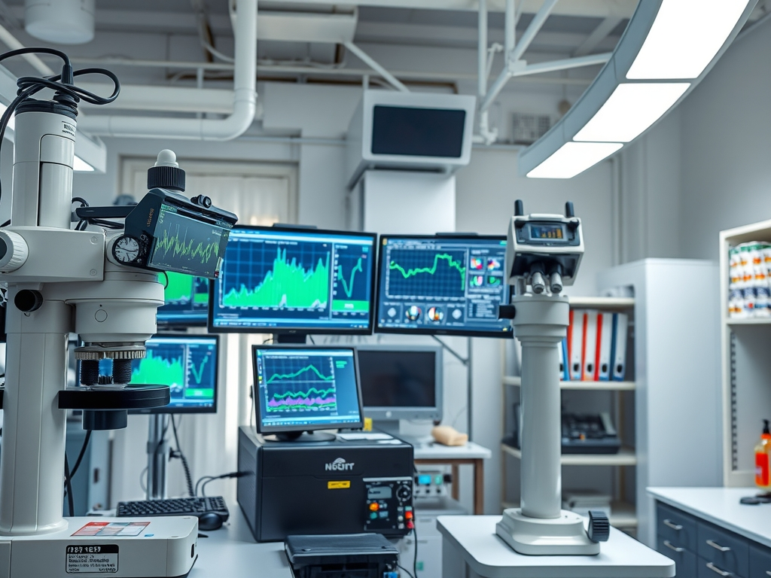
PROBLEM STATEMENT
Traditional attendance systems, reliant on manual registers or cards, enable proxy marking with an estimated 20-30% fraud rate, compromising academic integrity.
Existing RFID and QR-based attendance systems still permit proxy via card sharing, lacking real-time identity verification and taking 5-7 seconds per student to process.
C++/OpenCV system integrates LBPH face recognition and eye-blink liveness detection, eliminating proxy attendance with 95% accuracy and logging attendance in under 2 seconds.

Slide 5
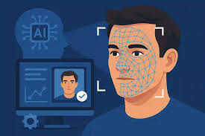
OBJECTIVE
To develop an automated attendance management system using facial recognition technology.
To eliminate manual attendance marking and reduce human errors.
To accurately identify students in real time using OpenCV and LBPH face recognition.
To prevent proxy attendance through liveness detection and face verification.
To automatically record attendance and generate reports for faculty.
To provide analytics, attendance percentage calculation, and defaulter identification.
To create a secure, efficient, and user-friendly attendance monitoring system

Slide 6
EXISTING SYSTEM
• Time-consuming attendance recording process. • High possibility of proxy attendance and impersonation. • Human errors during manual entry and report preparation. • Dependence on additional hardware such as RFID readers and fingerprint scanners. • Limited automation and data analytics features. • Difficulty in maintaining large attendance records. • Increased administrative workload for faculty members. • Lack of real-time attendance verification and monitoring.
Due to these limitations, there is a need for an intelligent, automated, and secure attendance management system capable of accurately identifying individuals while reducing manual effort and preventing attendance fraud.

Slide 7
PROPOSED SYSTEM
• Automated attendance marking using face recognition. • Real-time face detection through webcam input. • Student registration and face dataset management. • LBPH-based facial recognition for identity verification. • Liveness detection to prevent proxy attendance. • Automatic attendance logging with date and timestamp. • Duplicate attendance prevention mechanism. • Attendance analytics and percentage calculation.
• Defaulter identification and report generation and secure, contactless, and user-friendly operation.

Slide 8
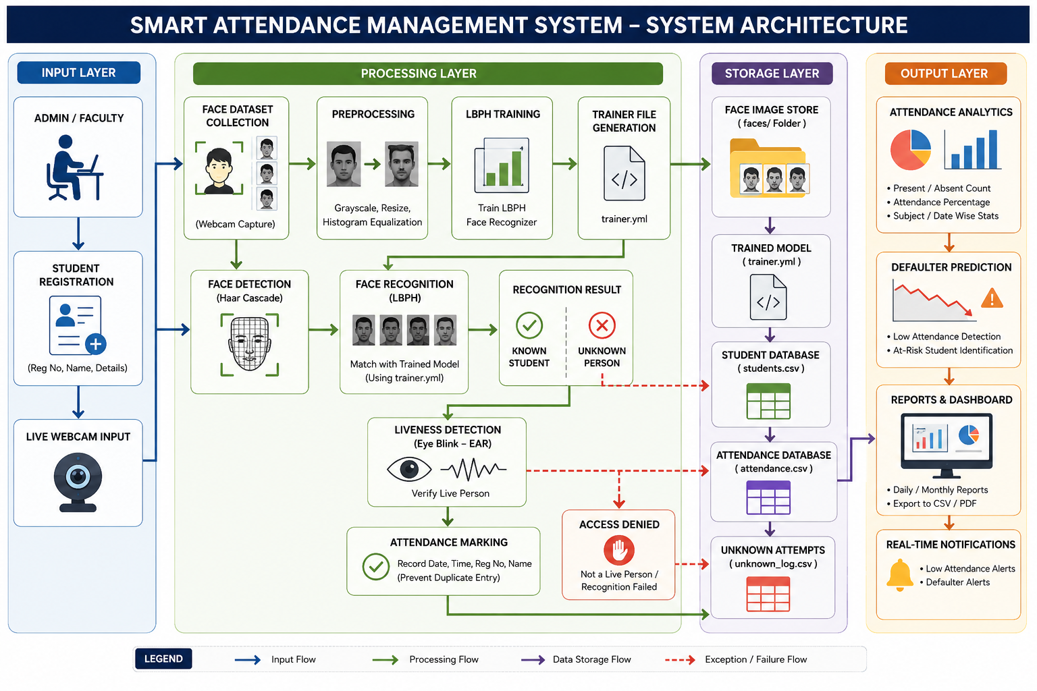

Slide 9
MODULE 1: STUDENT REGISTRATION & DATABASE MANAGEMENT
Purpose: To register students and maintain a centralized database that serves as the foundation for face recognition and attendance tracking.
Key Functions:
Student Registration (Reg No & Name)
Input Validation
Duplicate Entry Prevention
Student Search Functionality
View Registered Students
Database Management using CSV
Input:
Register Number
Student Name Advantages: ✔ Fast Student Registration ✔ Prevents Duplicate Records ✔ Easy Student Search ✔ Lightweight CSV Database ✔ Provides Data for Face Recognition Module
Workflow:
Student Details ↓ Input Validation ↓ Duplicate Check ↓ Store in students.csv ↓ Student Database Updated

Slide 10
MODULE 2 – FACE DATASET COLLECTION MODULE
Purpose: To capture multiple facial images of each registered student and create a dataset for training the face recognition model.
Key Functions:
Webcam-based Face Capture
Face Detection using Haar Cascade
Automatic Image Cropping
Grayscale Conversion
Face Resizing (200×200)
Dataset Generation (100 Images per Student)
Input:
Registered Student Reg No
Live Webcam Feed
Advantages: ✔ Automated Dataset Creation ✔ High-Quality Face Samples ✔ Improves Recognition Accuracy ✔ Supports Multiple Students ✔ Creates Training Data for LBPH Model
Workflow:
Registered Student ↓ Webcam Activation ↓ Face Detection ↓ Image Preprocessing ↓ Capture 100 Samples ↓ Store in faces/ Folder

Slide 11
MODULE 3 – FACE RECOGNITION MODEL TRAINING (LBPH)
Purpose: To train the facial recognition model using the collected face dataset and generate a trained model (trainer.yml) for student identification.
Key Functions:
Load Face Dataset Images
Extract Student Labels (Reg No)
Image Preprocessing
LBPH Model Training
Generate Trained Recognition Model
Save Model as trainer.yml
Input:
Face Images from faces/ folder
Student Register Numbers
Advantages: ✔ Fast Model Training ✔ Supports Multiple Students ✔ Generates Reusable Model File ✔ High Recognition Accuracy ✔ Real-Time Performance
Workflow:
Face Dataset (faces/) ↓ Load Images ↓ Preprocessing (Resize + Grayscale) ↓ LBPH Training ↓ Generate trainer.yml ↓ Ready for Recognition

Slide 12
ALGORITHM AND WORKFLOW
1. Dataset Collection
Captures 100 facial images per student using a webcam. Stores processed face images in the faces/ folder for training.
2. Training Process
Uses the LBPH algorithm to train the face recognition model. Generates trainer.yml for student identification.
3. Recognition Process
Detects faces using Haar Cascade and identifies students using LBPH. Verifies recognized faces before attendance marking.
4. Liveness Detection
Detects eye blinks and facial movements to verify a live user. Prevents proxy attendance using photos or mobile screens.
5. Attendance Logging
Automatically records attendance with date and timestamp. Prevents duplicate attendance entries for the same day.
6. Analytics
Calculates attendance percentage and present/absent statistics. Generates attendance summaries and performance reports.
7. Defaulter Prediction
Identifies students below the attendance threshold (e.g., 75%). Helps faculty monitor and improve student participation.
8. Database Design
students.csv stores student registration details. attendance.csv stores attendance records and timestamps.
9. Project Workflow
Register Student → Capture Dataset → Train Model → Recognize Face. Verify Liveness → Mark Attendance → Generate Analytics & Reports.

Slide 13
CHALLENGES FACED
OpenCV Installation & Configuration
Configuring OpenCV and OpenCV-Contrib libraries in Visual Studio.
Face Dataset Collection
Capturing clear face images under different lighting conditions.
Face Recognition Accuracy
Handling variations in facial expressions, pose, and illumination.
Unknown Face Detection
Preventing unregistered users from being recognized as registered students.
Liveness Verification
Distinguishing real faces from photographs and mobile screen images.
Attendance Management
Preventing duplicate attendance entries for the same student on the same day.
Data Storage & Management
Managing student and attendance records using CSV files.

Slide 14
APPLICATIONS
Educational Institutions Schools, colleges, and universities for automated student attendance tracking.
Corporate Offices Employee attendance monitoring and workforce management.
Training Centers Tracking attendance of trainees and participants during training sessions.
Government Organizations Monitoring staff attendance and improving administrative efficiency.
Research Laboratories Managing attendance of researchers, interns, and project members.
Conferences and Seminars Automated participant verification and attendance recording.
Libraries and Study Centers Tracking visitor entry and attendance records.
Healthcare Institutions Monitoring attendance of doctors, nurses, and hospital staff.
Industrial and Manufacturing Units Employee attendance management and shift monitoring.
Secure Access Control Systems Face-based authentication for authorized entry into restricted areas.

Slide 15
CONCLUSION
Uses Haar Cascade, LBPH Face Recognition, and Liveness Detection.
Provides secure, efficient, and contactless attendance recording.
Automates registration, dataset collection, model training, and attendance logging.
Reduces manual effort, proxy attendance, and duplicate entries.
Generates attendance reports, percentages, and defaulter lists.
Enables better monitoring of student participation and performance.
Developed using C++ and OpenCV for fast and cost-effective operation.
Can be enhanced with deep learning, cloud integration, mobile apps, and multi-camera support.

Slide 16
FUTURE SCOPE
Deep Learning-Based Face Recognition
Replace LBPH with FaceNet or DeepFace for higher recognition accuracy.
Advanced Liveness Detection
Implement eye blink and head movement detection.
Cloud-Based Database Integration
Store attendance records securely on cloud servers.
Mobile Application Development
Develop Android/iOS applications for attendance monitoring.
AI-Based Defaulter Prediction
Use Machine Learning to identify students at risk of low attendance.
ERP & LMS Integration
Integrate with College ERP and Learning Management Systems.

Slide 17
LITERATURE REVIEW
S.No | Author(s) & Year | Title | Key Contribution
1 | Anilkumar et al. (2023) | Smart Attendance System with Face Recognition using OpenCV | Developed an automated attendance system using OpenCV face recognition to improve accuracy and reduce manual effort.
2 | E. K. & S. U. (2024) | Students' Attendance Management Using Azure Cognitive Service and OpenCV | Integrated cloud-based facial recognition with attendance management for secure and automated tracking.
3 | Patil et al. (2024) | Face Recognition Based Automatic Attendance System Using OpenCV, LBPH, and CNN | Combined LBPH and CNN techniques to achieve higher face recognition accuracy in attendance systems.
4 | Gawate & Dhote (2024) | Real-Time Attendance System with Liveness Detection and Multi-Face Recognition | Introduced liveness detection to prevent proxy attendance and improve system security.
5 | Mridha & Yousef (2021) | Smart Attendance Management System Based on Face Recognition Using OpenCV and ML | Demonstrated how machine learning and OpenCV can automate attendance while reducing human errors.

Slide 18
REFERENCES
[1] C. Anilkumar, B. Venkatesh, S. Annapoorna, "Smart Attendance System with Face Recognition using OpenCV," 2023 Second International Conference on Augmented Intelligence and Sustainable Systems (ICAISS), pp. 1149-1155, 2023.
[2] E. K., S. U., "Students’ Attendance Management in Higher Institutions Using Azure Cognitive Service and Opencv Face Detection &amp; Recognition Attendance System," British Journal of Computer, Networking and Information Technology, vol. 5, no. 1, pp. 43-55, 2024.
[3] P. Patil, Y. Marne, D. Mane et al., "Face Recognition Based Automatic Attendance System Using OpenCV, LBPH, and Convolutional Neural Network," International Journal of Research Publication and Reviews, vol. 7, no. 4, pp. 10585-10591, 2024.
[4] E. Gawate, K. Dhote, "Real-Time Attendance System with Liveness Detection and Multi-Face Recognition using Transfer Learning," 2024 15th International Conference on Computing Communication and Networking Technologies (ICCCNT), pp. 1-5, 2024.
[5] K. Mridha, N. T. Yousef, "Study and Analysis of Implementing a Smart Attendance Management System Based on Face Recognition Tecqnique using OpenCV and Machine Learning," 2021 10th IEEE International Conference on Communication Systems and Network Technologies (CSNT), pp. 654-659, 2021.

Slide 19
THANK YOU

