Slide 1

Design and Development of a Wi-Fi 6 (802.11ax) Wireless Local Area Network Architecture
Presented By:
Emad Farooqui (192511019)
Deepak R (192511008)
Mohammed Rayhaan Khan (192511006)
Guided By:
Dr. Sivagami

Slide 2


Table of Content
Project Abstract
Introduction
Module 1: Wi-fi 6 System Design
Module 2: Configuration and Optimization
Module 3: Testing and Troubleshooting
Work Flow
Future Scope and Extensions
Conclusion
References

Slide 3
Project Abstract
The project is titled “Design and Development of a Wi-Fi 6 (802.11ax) Wireless Local Area Network (WLAN) Architecture.”
It focuses on designing, simulating, and analyzing a next-generation wireless network using Cisco Packet Tracer.
Wi-Fi 6 (IEEE 802.11ax) introduces advanced technologies like OFDMA, MU-MIMO, and Target Wake Time (TWT) for improved performance.
The main goal is to build a scalable, high-performance WLAN that reduces latency and increases throughput, signal coverage, and reliability.
Implementation includes configuring wireless routers, access points, and client devices in a simulated setup to analyze real-world performance.
Network parameters such as signal strength, bandwidth usage, and latency are tested under varying user loads.Optimization techniques (like channel management and bandwidth tuning) are used to minimize interference and enhance connection stability.
The results show that Wi-Fi 6 outperforms older Wi-Fi versions, especially in multi-user scenarios, proving its value for smart homes, enterprises, and IoT applications.

Slide 4

Introduction
OFDMA Technology
MU-MIMO Enhancement
Orthogonal Frequency Division Multiple Access allows simultaneous device communication, reducing latency.
Multi-User MIMO serves multiple devices simultaneously with improved spectral efficiency.
Target Wake Time (TWT)
Power-efficient scheduling allows devices to sleep longer, extending battery life significantly.
Key Challenge: Previous Wi-Fi standards struggled in high-density environments with interference and congestion. Wi-Fi 6 solves these through advanced spectrum management and efficiency protocols.

Slide 5
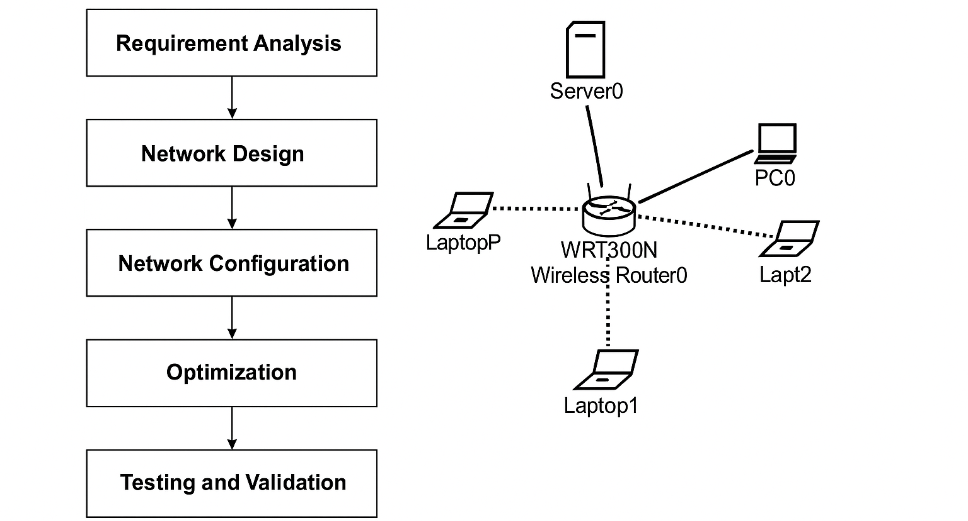
Work flow

Slide 6
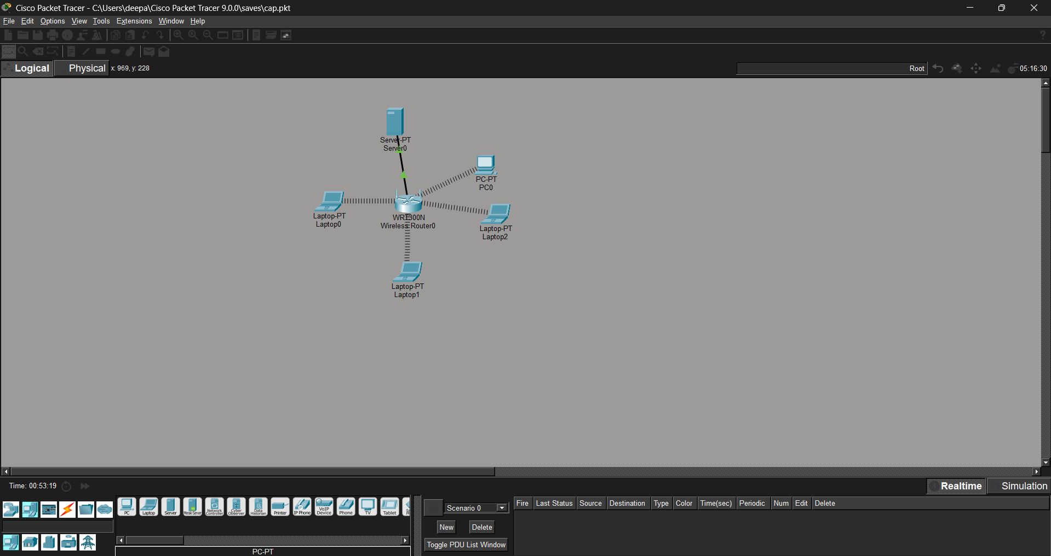
Module 1: Wi-Fi 6 System Design
Network Architecture
Configuration Framework
Wi-Fi 6 access points with advanced antennas
SSID broadcast and segmentation
Client devices with compatible wireless NICs
DHCP pools for dynamic IP assignment
Backend servers and managed switches
WPA3 security with encryption
Centralized network management system
QoS policies for bandwidth management
Outcome: Fully functional, simulation-ready WLAN architecture meeting enterprise standards.

Slide 7
Module 2: Configuration and Optimization
Device Association Optimization
Implement load balancing and band steering to distribute clients evenly across available access points.
Power Settings Adjustment
Optimize transmit power levels to balance coverage range with energy efficiency and interference mitigation.
Performance Verification
Monitor throughput improvements, latency reduction, and stable client connections across the network.

Slide 8
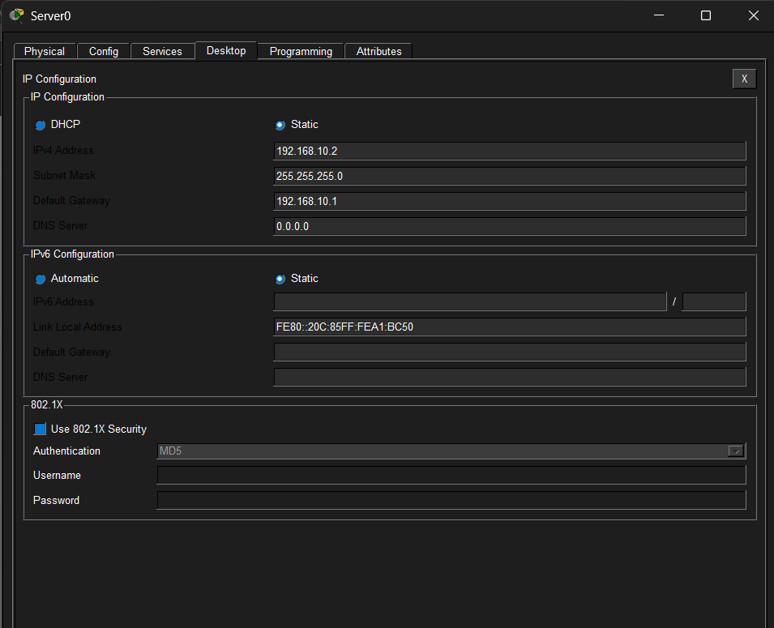
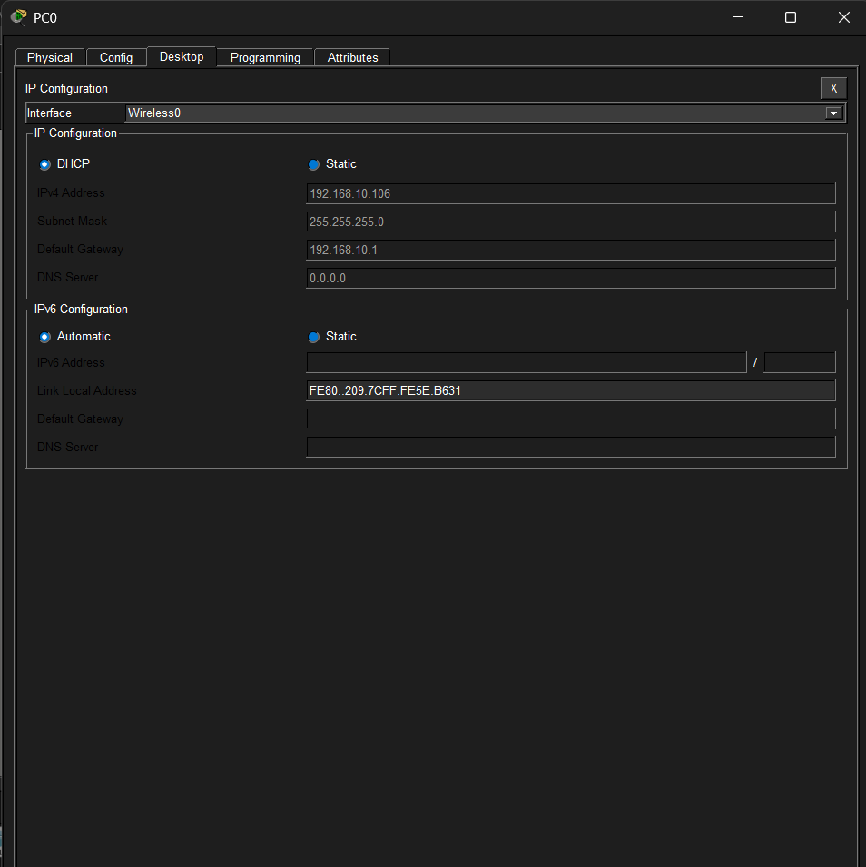
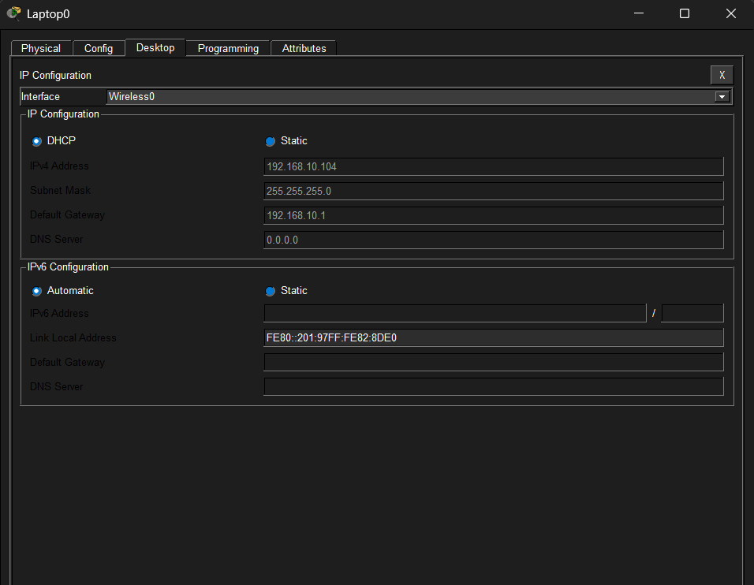
Module 2: Configuration and Optimization

Slide 9
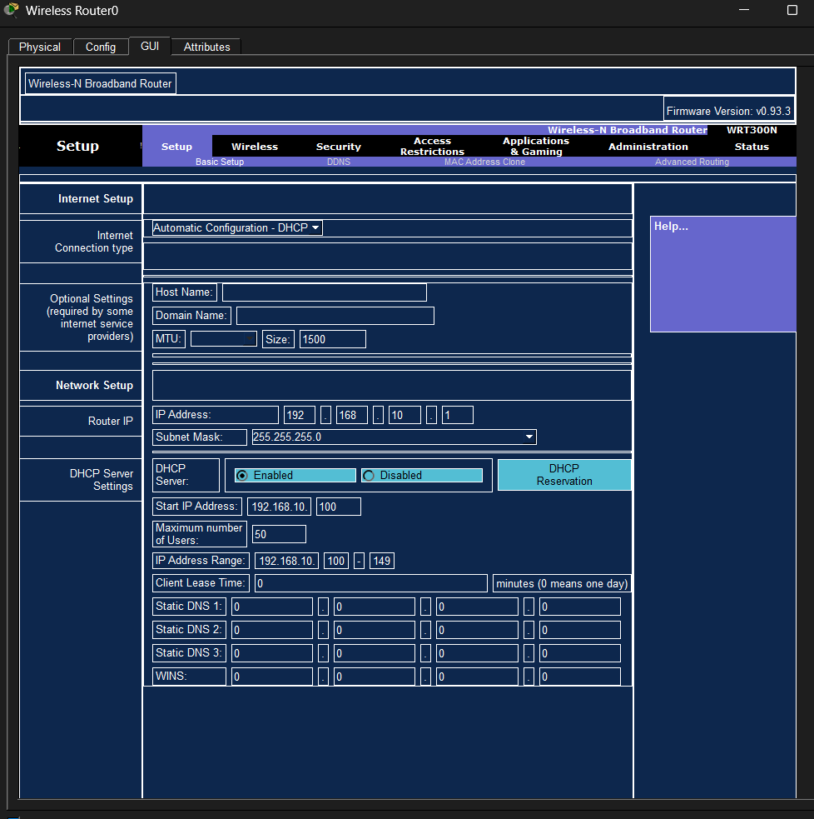
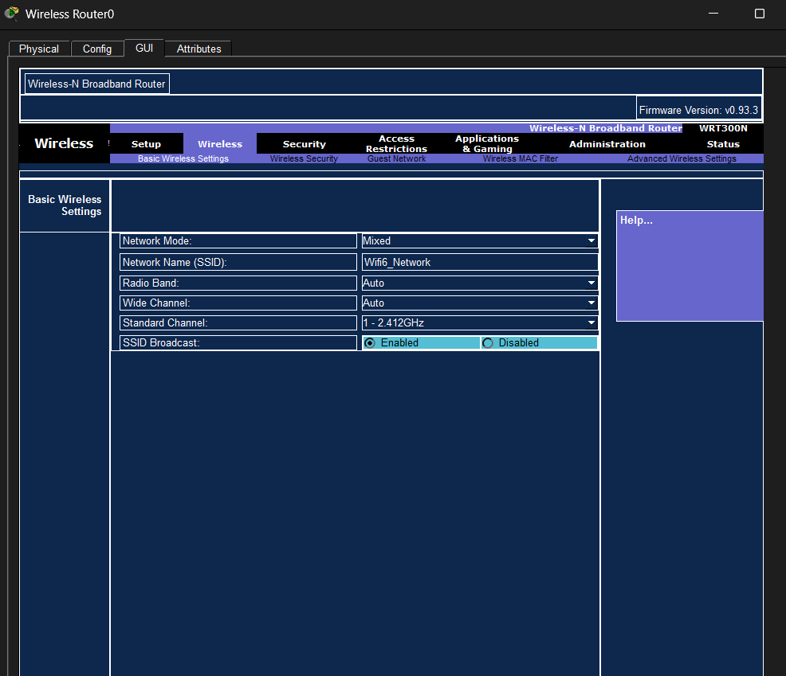
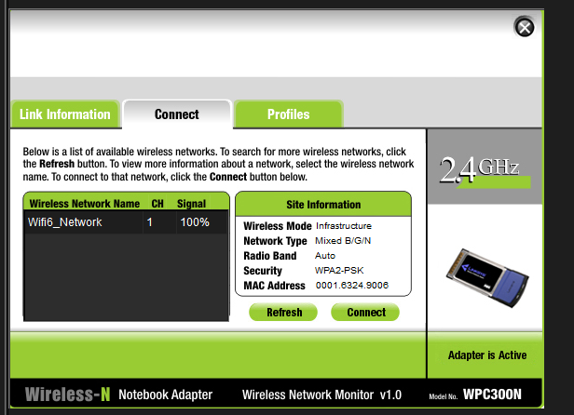
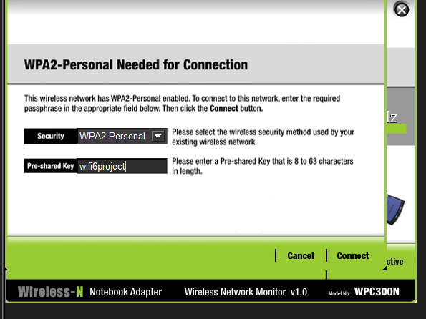
Module 2: Configuration and Optimization

Slide 10
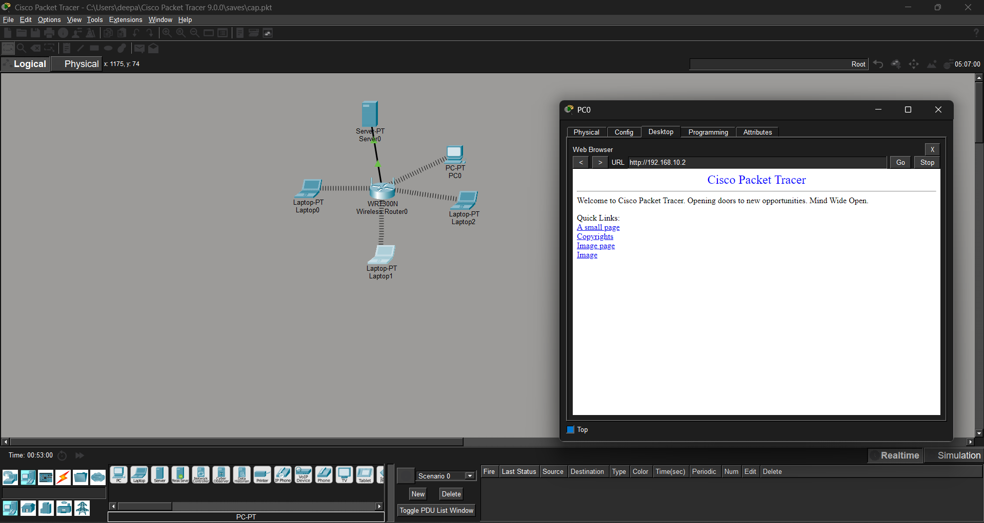
Module 3: Testing and Troubleshooting
Testing Methodology
Performance Metrics
Comprehensive evaluation using:
Measured improvements:
Ping tests for latency measurement
Throughput increase: 40-50%
File transfer simulations
Latency reduction: 60-70%
Continuous traffic generation
Packet loss: <0.5%
Packet loss analysis
Stability index: >99%
Result: Validated fault-tolerant architecture with superior performance over legacy standards.

Slide 11
Conclusion
1
Wi-Fi 6 represents a quantum leap in wireless technology
OFDMA, MU-MIMO, and TWT fundamentally transform network efficiency and device coordination.
2
Simulation-based validation proves real-world applicability
Cisco Packet Tracer successfully demonstrates performance gains before hardware investment.
3
Strategic optimization unlocks maximum potential
Careful configuration and testing ensure networks meet enterprise-grade reliability standards.

Slide 12
Future Scope and Extensions
IoT and Smart Home Integration
Extend architecture to support thousands of IoT devices with optimized power consumption.
AI-Based Adaptive Bandwidth
Implement machine learning algorithms for dynamic spectrum allocation and traffic prediction.
Wi-Fi 6E and Wi-Fi 7 Hardware
Transition from simulation to real-world testing with next-generation devices and 6 GHz band support.
Enterprise-Scale Deployment
Scale simulation to large campus networks supporting thousands of simultaneous connections.

Slide 13
References
Cisco Systems. (2022). Cisco Packet Tracer – Networking Simulation Tool. Cisco Networking Academy. https://www.netacad.com/
IEEE Standards Association. (2021). IEEE 802.11ax™: High Efficiency WLAN Standard. IEEE.
Gast, M. (2021). 802.11ax (Wi-Fi 6): A Survival Guide. O'Reilly Media.
Aruba Networks. (2022). Understanding Wi-Fi 6 and Its Benefits. Hewlett Packard Enterprise.
Tanenbaum, A. S., & Wetherall, D. J. (2021). Computer Networks (6th ed.). Pearson Education.
NetSpot. (2023). Wi-Fi Performance Analysis and Heatmap Tools. https://www.netspotapp.com/

Slide 14
Thank You

