Slide 1

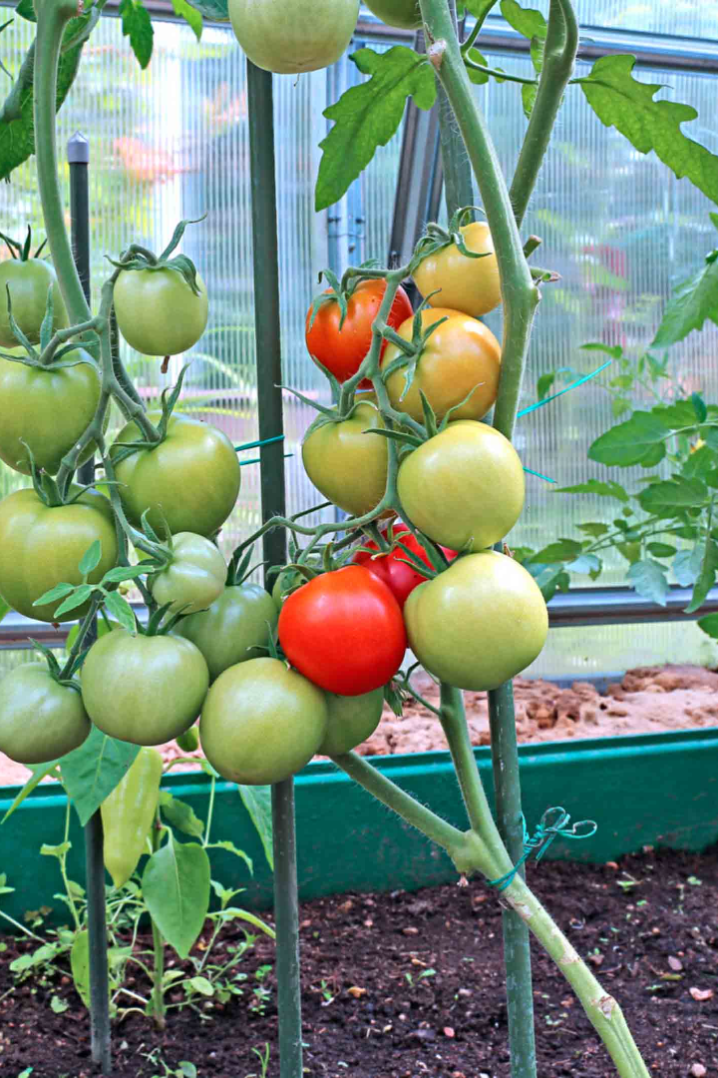
IoT-Enhanced Tomato Plant Cultivation with Machine Learning

Slide 2

Introduction to IoT and Machine Learning in Agriculture
Develop an IoT and Machine Learning-driven solution to optimize tomato cultivation by efficiently managing irrigation, precise nutrient delivery, proactive pest control, and sustainable practices, thereby overcoming inefficient resource usage and environmental degradation while enhancing crop yield and data-driven decision-making.

Slide 3
PROBLEM STATEMENT
In conventional tomato cultivation, inefficient irrigation, imprecise nutrient management, pest-related crop losses, and resource-intensive practices hinder the pursuit of sustainable agriculture. Additionally, the absence of data-driven insights limits informed decision-making in the context of tomato farming.

Slide 4
SOLUTION
Our project aims to address these challenges by developing an integrated system that leverages IoT and Machine Learning to optimize irrigation, enhance nutrient management, enable real-time pest detection and control, promote sustainable farming practices, and provide data-driven decision support for tomato cultivation.

Slide 5

Benefits of IoT-Enhanced Tomato Plant Cultivation
1
Enhanced Crop Yield
2
Resource Efficiency and Environmental Sustainability
3
Data-Driven Precision Agriculture
By optimizing irrigation and nutrient delivery while proactively managing pests, this project improves tomato plant health and productivity.
The smart utilization of resources, including water and nutrients, reduces waste and the environmental impact of agriculture.
Transforms traditional farming into a data-driven, precision agriculture approach. Real-time monitoring, decision support, and scalability enable growers to make informed choices

Slide 6
Overview of the System
Sensors
Data Collection
Data Analysis
Deployed in the soil, plants, and surrounding environment to capture critical data on soil moisture, and nutrients.
Continuous and automated collection of sensor data, which is transmitted wirelessly to a app.
Add water and nutrients if sensed low and machine learning algorithm is used to identify pest found in the plant.

Slide 7
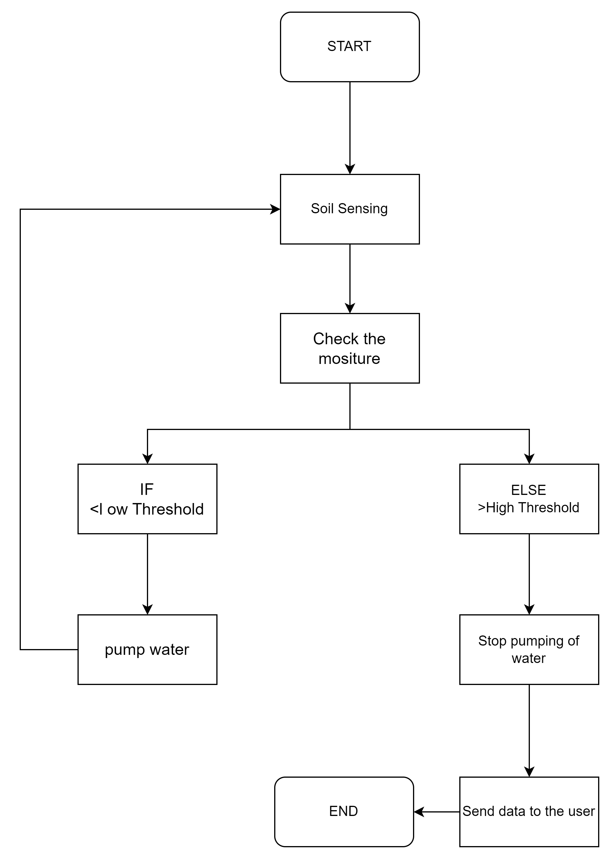
FLOWCHART OF SOIL MOSITURE

