Slide 1
CIRCUITS
Ppt on​

Slide 2


Agenda
A
Introduction
Primary goals
Areas of growth
Timeline
Summary

Slide 3
Introduction
At Contoso, we empower organizations to foster collaborative thinking to further drive workplace innovation. By closing the loop and leveraging agile frameworks, we help business grow organically and foster a consumer-first mindset.

Slide 4
Primary goals
Annual revenue growth

Slide 5
Quarterly performance

Slide 6
Areas of growth
 | B2B | Supply chain | ROI | E-commerce
Q1 | 4.5 | 2.3 | 1.7 | 5.0
Q2 | 3.2 | 5.1 | 4.4 | 3.0
Q3 | 2.1 | 1.7 | 2.5 | 2.8
Q4 | 4.5 | 2.2 | 1.7 | 7.0

Slide 7
Business opportunities are like buses. There's always another one coming.
“
”
Richard Branson

Slide 8
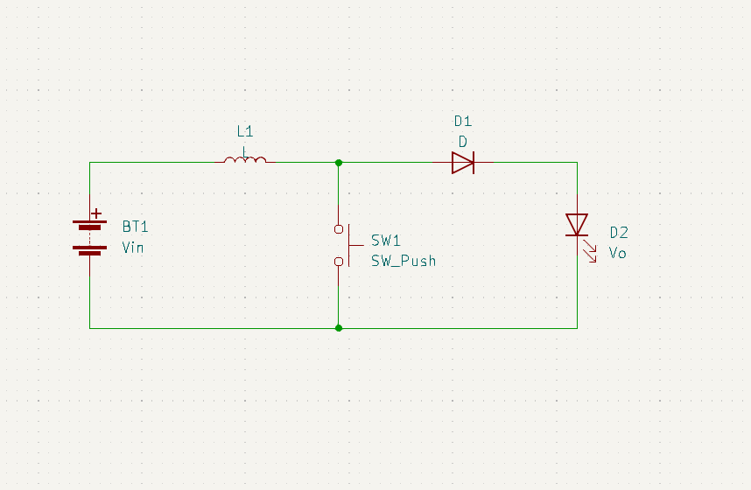
Boost Converter :
A boost converter (step-up converter) is a DC to DC power converter that steps up voltage (while stepping down current) from its input (supply) to its output (load).
Voltage Source
Inductor
1N4001 Diode
Switching Device
Capacitor
Load

Slide 9
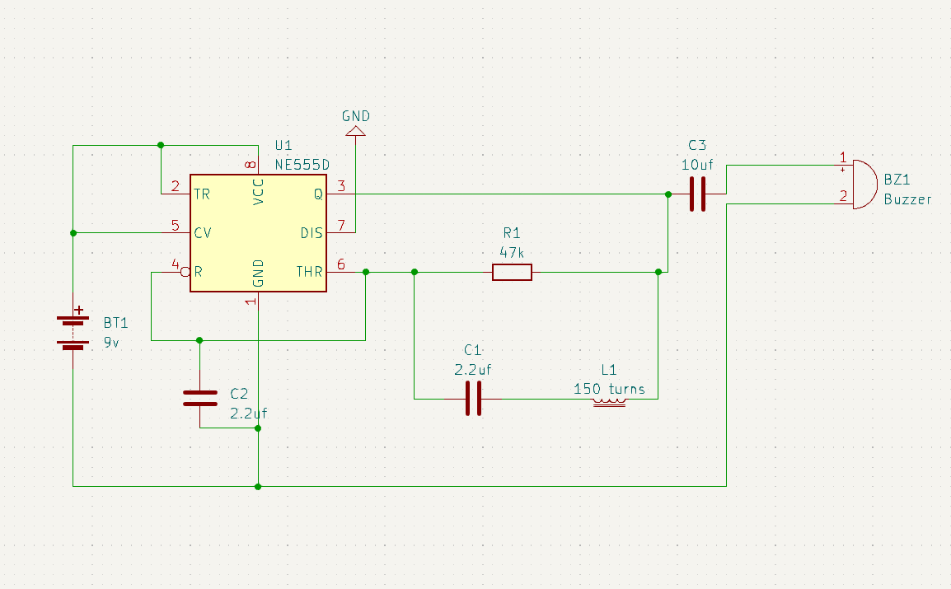
Metal Detector :
The 555 IC timer here acts as a square wave generator and it generate pulses with frequencies audible to human.
NE555D timer
Metal Coil
9V battery
Capacitor
Resistor
Buzzer

Slide 10
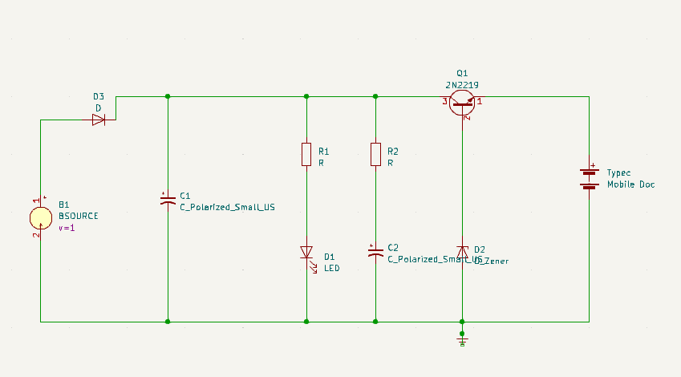
Mobile Charger :
A mobile battery charger circuit is a device that can automatically recharge a mobile phone's battery when the power in it gets low.
2N2219 Transistor
Polarised Capacitor
Source voltage
Zenner Diode
LED indicater
Resistors

Slide 11
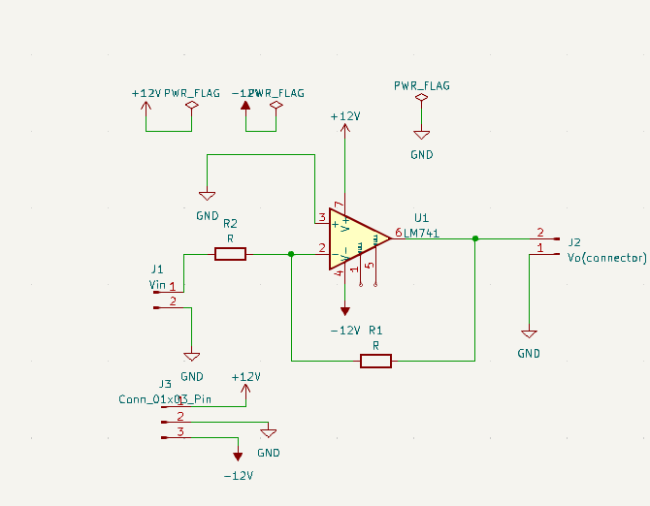
Inverted Op Amp :
The inverting operational amplifier is basically a constant or fixed-gain amplifier producing a negative output voltage as its gain is always negative.
LM741 amplifier: LM741 is used as an amplifier, where the gain is set by an external resistive network.
Polarised Capacitor
Power Flag
I/O pins
12V Power
Resistors

Slide 12
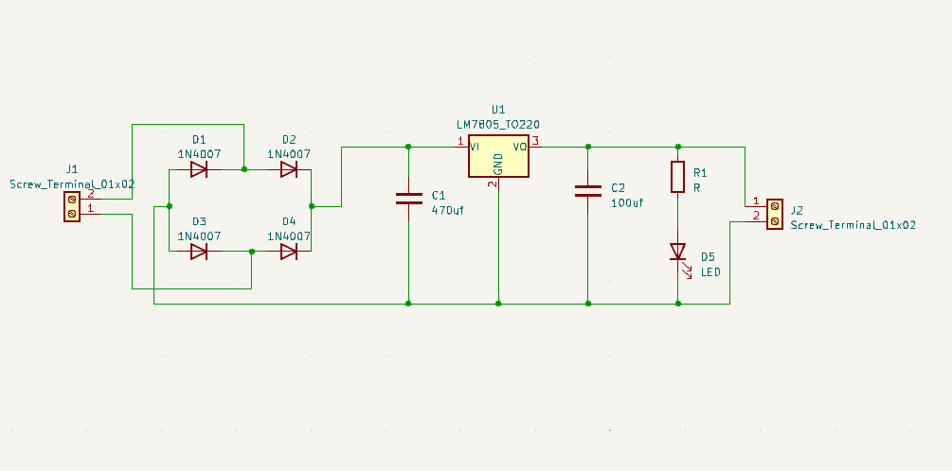
DC to DC Converter :
A DC-to-DC converter is an electronic circuit that converts a source of direct current (DC) from one voltage level to another. It is a type of electrical power converter. Power levels range from very low to very high.
1x2 terminals
LM7805 voltage regulator
Capacitors
LEDs
Resistors

Slide 13








Meet our extended team
Takuma Hayashi​
Mirjam Nilsson​
Flora Berggren​
Rajesh Santoshi​
President
Chief Executive Officer
Chief Operations Officer
VP Marketing
Graham Barnes
Rowan Murphy
Elizabeth Moore
Robin Kline
VP Product
SEO Strategist
Product Designer
Content Developer

Slide 14
Plan for product launch
Deploy strategic networks with compelling e-business needs
Planning
Synergize scalable e-commerce
Marketing
Disseminate standardized metrics
Design
Coordinate e-business applications
Foster holistically superior methodologies
Launch
Strategy

Slide 15
Timeline
Deploy strategic networks with compelling e-business needs
Sep 20XX
Synergize scalable e-commerce
Nov 20XX
Disseminate standardized metrics
Jan 20XX
Coordinate e-business applications
Mar 20XX
Foster holistically superior methodologies
May 20XX

Slide 16
Areas of focus
F
B2B market scenarios
Develop winning strategies to keep ahead of the competition
Capitalize on low-hanging fruit to identify a ballpark value
Visualize customer directed convergence
Cloud-based opportunities
Iterative approaches to corporate strategy
Establish a management framework from the inside

Slide 17
How we get there
ROI
Niche markets
Supply chains
Envision multimedia-based expertise and cross-media growth strategies
Visualize quality intellectual capital
Engage worldwide methodologies with web-enabled technologies
Pursue scalable customer service through sustainable strategies
Engage top-line web services with cutting-edge deliverables
Cultivate one-to-one customer service with robust ideas
Maximize timely deliverables for real-time schemas

Slide 18
Summary
At Contoso, we believe in giving 110%. By using our next-generation data architecture, we help organizations virtually manage agile workflows. We thrive because of our market knowledge and great team behind our product. As our CEO says, "Efficiencies will come from proactively transforming how we do business."

Slide 19
Thank you
Mirjam Nilsson​
mirjam@contoso.com
www.contoso.com

