Slide 1
ARRAY

Slide 2
Array
An array is defined as the collection of similar type of data items stored at contiguous memory locations.
Arrays are the derived data type in C programming language which can store the primitive type of data such as int, char, double, float, etc.
It also has the capability to store the collection of derived data types, such as pointers, structure, etc.
The array is the simplest data structure where each data element can be randomly accessed by using its index number.
Fixed Size: Whatever size, we define at the time of declaration of the array, we can't exceed the limit. So, it doesn't grow the size dynamically like LinkedList which we will learn later.

Slide 3
Declaration of C Array
data_type array_name[array_size];
Now, let us see the example to declare the array.
int marks[5];

Slide 4
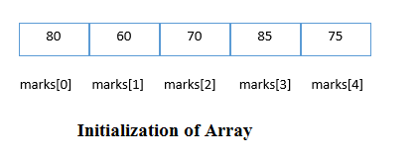
INITIALIZATION OF ARRAY
Initialization of C Array
marks[0]=80;//initialization of array
marks[1]=60;
marks[2]=70;
marks[3]=85;
marks[4]=75;

Slide 5
C array example
#include<stdio.h>
int main(){
int i=0;
int marks[5];//declaration of array
marks[0]=80;//initialization of array
marks[1]=60;
marks[2]=70;
marks[3]=85;
marks[4]=75;
//traversal of array
for(i=0;i<5;i++){
printf("%d \n",marks[i]);
}//end of for loop
return 0;
}

Slide 6
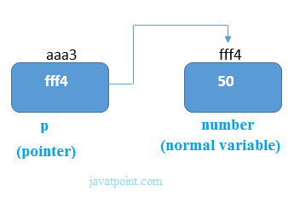
POINTERS
A pointer variable can store only the address of a variable.
This variable can be of type int, char, array, function, or any other pointer.
The size of the pointer depends on the architecture. However, in 32-bit architecture the size of a pointer is 2 byte.

Slide 7
DECLARING POINTER VARIABLES
The pointer declared using * (asterisk symbol). It is also known as indirection pointer used to dereference a pointer.
data_type *ptr_name
int *a;//pointer to int
char *c;//pointer to char

Slide 8
POINTER EXAMPLE
#include<stdio.h>
int main(){
int number=50;
int *p;
p=&number;//stores the address of number variable
printf("Address of p variable is %x \n",p);printf("Value of p variable is %d \n",*p);
return 0;
}
OUTPUT
Address of number variable is fff4
Address of p variable is fff4
Value of p variable is 50

Slide 9
POINTER TO ARRAY
int arr[10];
int *p[10]=&arr; // Variable p of type pointer is pointing to the address of an integer array arr.
POINTER TO A FUNCTION
void show (int);
void(*p)(int) = &display; // Pointer p is pointing to the address of a function
POINTER TO STRUCTURE
struct st {
int i;
float f;
}ref;
struct st *p = &ref;

Slide 10
Command Line Arguments
The arguments passed from command line are called command line arguments. These arguments are handled by main() function.
To support command line argument, we need to change the structure of main() function as given below.
syntax:- int main(int argc, char *argv[] )
Here, argc counts the number of arguments. It counts the file name as the first argument. T
he argv[] contains the total number of arguments

Slide 11
STRUCTURE
A structure is a user-defined data type that can store related information(even of different data type) together.
Declarations
struct structure_name
{
data_type member1;
data_type member2;
.
.
data_type memeberN;
};

Slide 12
INITIALIZATION
struct structure_name
{
data_type member1;
data_type member2;
.
.
data_type memeberN;
}struct_var = {constant1,constant2,constant3,...}; OR
struct struct_name struct_var = {constant1,constant2,constant3,...};

Slide 13
WHY USE STRUCTURE?
n C, there are cases where we need to store multiple attributes of an entity. It is not necessary that an entity has all the information of one type only. It can have different attributes of different data types. For example, an entity Student may have its name (string), roll number (int), marks (float). To store such type of information regarding an entity student, we have the following approaches:
Construct individual arrays for storing names, roll numbers, and marks.
Use a special data structure to store the collection of different data types.

Slide 14
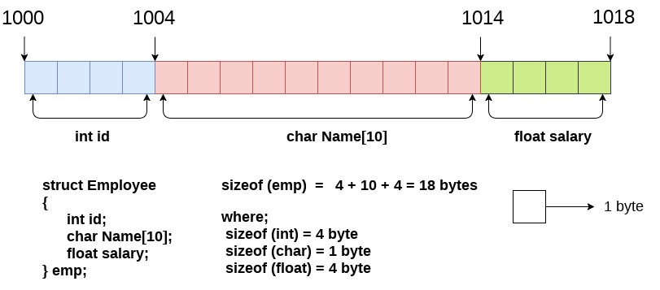
ACCESSING THE MEMBERS OF A STRUCTURE
    struct employee
    { int id;
    char name[20];
    float salary;
    }emy ={01,”rahul”,45000};
    scanf(“%d”,&emy.id);
    scanf(“%s”,&emy.name);
    scanf(“%f”,&emy.salary);

