Slide 1

Exploring Basics
Presented By :- Deepak Kumar Beniya

Slide 2
Agenda
Introduction to Computer Software
Generation of Programming Language
Introduction to C Programming Language
Introduction to Linux
Practical

Slide 3
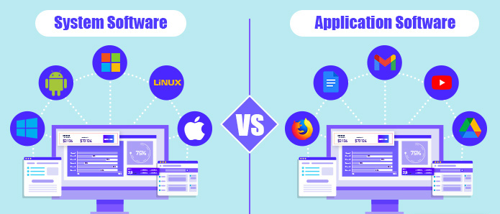
Introduction to Computer Software
Computer hardware alone cannot perform any particular function without software
Software makes the hardware to function
It acts as an interface between the user and the computer
The two primary software categories are system software and application software:
System Software
Operating System
Utility Software
Application Software
MS-office
AutoCAD

Slide 4
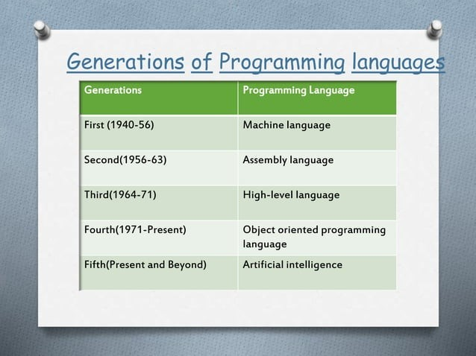
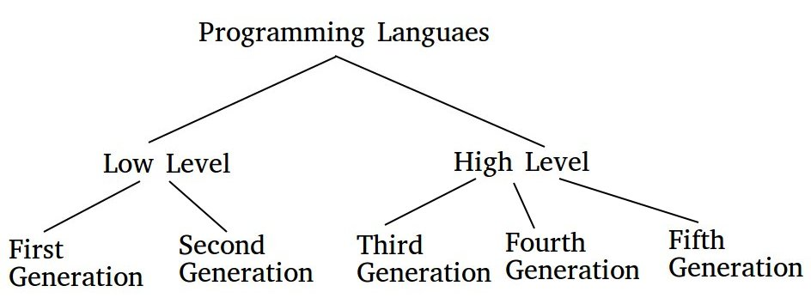
Generation of Programming Language
Machine Language:- It consists of instructions that are in the binary 0 and 1. A000,0010.
Assembly Language(2GL):-In this language instructions are given in English like word MOV,ADD,SUB etc. Ex:-COBAL,BASIC,ALGOL.
High-Level Language(3GL):-It provides statements that are closer to the way humans solve problems than assembly language.
Ex:- COBAL,PASCAL,FORTRAN,C,C++.
Very High-level Language(4GL):-The fourth-generation language is also called a non – procedural language/ 4GL. It enables users to access the database. Examples: SQL, Foxpro, Focus, etc.
Fifth Generation Language:- It is based on the concept of artificial intelligence. It uses the concept that rather than solving a problem algorithmically, an application can be built to solve it based on some constraints. Examples: PROLOG, LISP, etc.

Slide 5
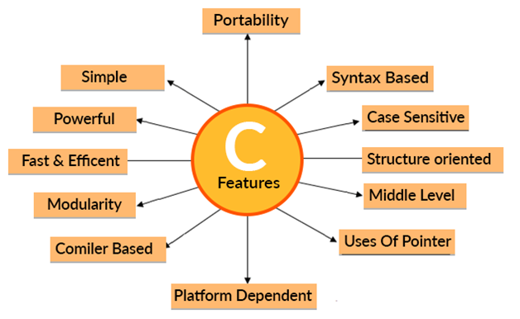
Introduction to C Programming Language
ALGOL in 1960s for the development of structured programming concepts.
BCPL in 1967 by Martin Richards was basically a type-less language which facilitated direct access of memory.
B in 1970 by Ken Thompson was used to develop the first version of UNIX.
C was Developed by Dennis Ritchie in 1972 that took concepts from ALGOL,BCPL and B language.
C is a procedural programming language initially developed by Dennis Ritchie in the year 1972 at Bell Laboratories of AT&T Labs.
It was mainly developed as a system programming language to write the UNIX operating system.
The main features of the C language include:
General Purpose and Portable
Low-level Memory Access
Fast Speed
Clean Syntax

Slide 6
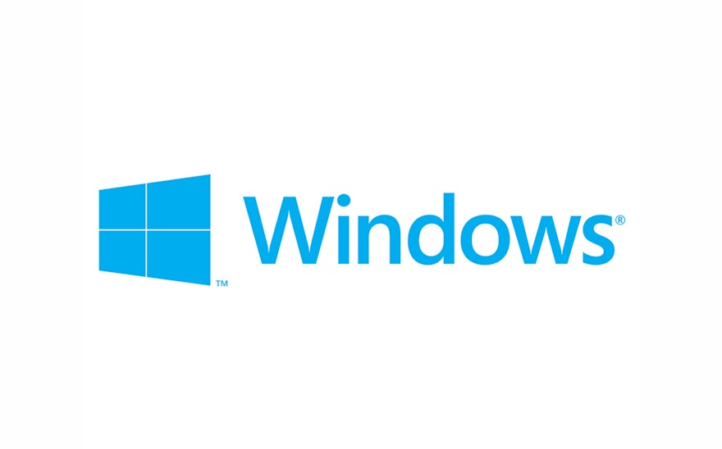

Introduction to C Programming Language
Why Should We Learn C?
Many later languages have borrowed syntax/features directly or indirectly from the C language. Like syntax of Java, PHP, JavaScript, and many other languages are mainly based on the C language. C++ is nearly a superset of C language (Only a few programs may compile in C, but not in C++).
So, if a person learns C programming first, it will help him to learn any modern programming language as well. As learning C help to understand a lot of the underlying architecture of the operating system. Like pointers, working with memory locations, etc.
S.NO | Linux | Windows
1. | Linux is a open source operating system. | While windows are the not the open source operating system.
2. | Linux is free of cost. | While it is costly.
3. | It’s file name case-sensitive. | While it’s file name is case-insensitive.
4. | In Linux, monolithic kernel is used. | While in this, micro kernel is used.
5. | Linux is more efficient in comparison of windows. | While windows are less efficient.
6. | Linux provides more security than windows. | While it provides less security than linux.

Slide 7

Introduction to Linux
Linux is a community of open-source Unix like operating systems that are based on the Linux Kernel.
It was initially released by Linus Torvalds on September 17, 1991.
It is a free and open-source operating system and the source code can be modified and distributed to anyone commercially or noncommercially under the GNU General Public License.
Linux Basic Commands
mkdir
cd
cp
vim
ls
mv
pwd
rm

Slide 8
Practical
Step 1:- vi helloworld.c
Step 2:- press “i” to insert
Step 4:- gcc helloworld.c – o helloworld
Step 5:- ./helloworld
// Simple C program to display "Hello World"
// Header file for input output functions
#include <stdio.h>
// main function -
// where the execution of program begins
int main()
{
// prints hello world
printf("Hello World");
return 0;
}
Step 3:- esc(key) , :wq!(save and exit update)

Slide 9


