Slide 1



CORTEX-M4 INTERNAL
Presented by :
Deepak Kumar Beniya PHY202302EF25

Slide 2
CONTENTS
1.FEATURES OF STM32
2.DEBUGING
3.OPERATIONAL MODE
4. MEMORY MAPPED
5.PIPELINE ARCHITECTURE
7. BUS MATRIX
8.T-BIT
9. RESET SEQUENCE

Slide 3
FEATURES OF STM32
FEATURES:-
512 KB OF FLASH MEMORY.
128 KB OF SRAM.
MAXIMUM CPU FREQUENCY 180 MHZ
APPLICATION:-
MEDICAL EQUIPMENT.
ALARM SYSTEM
PRINTERS AND SCANNER

Slide 4
DEBUGGING
Steps:
1.File -> New ->Stm32 project
2.Go to board selector
3.Select Nucleo-F446RE -> Finish -> Next
4.Give the project name
5.Select the target project type : STM32Cube or Empty
6.Finish

Slide 5
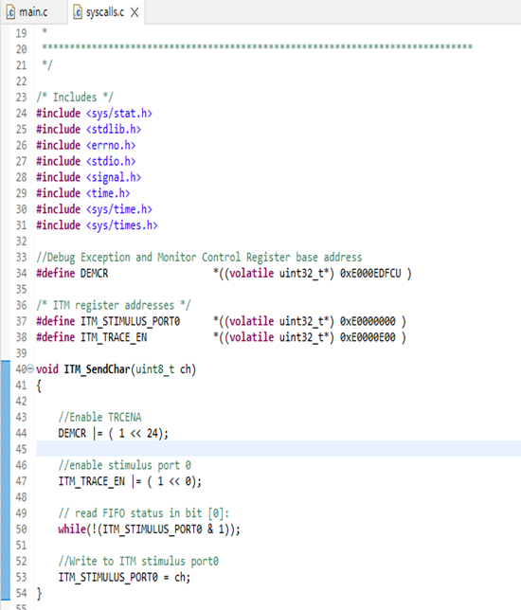
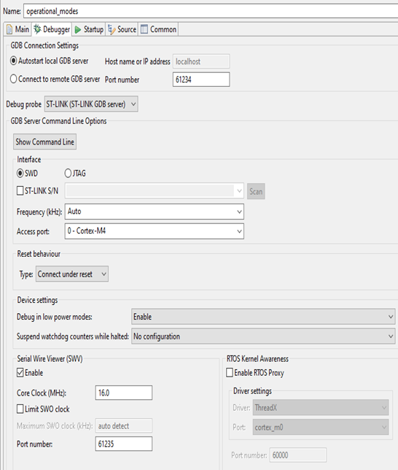
DEBUGGING

Slide 6
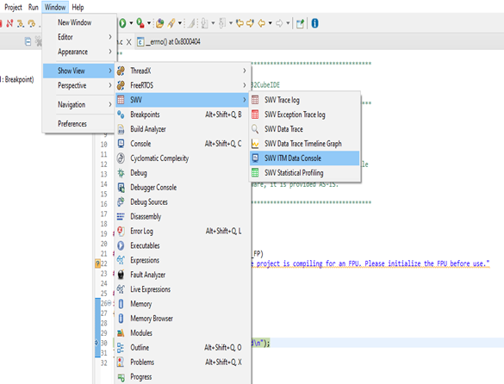
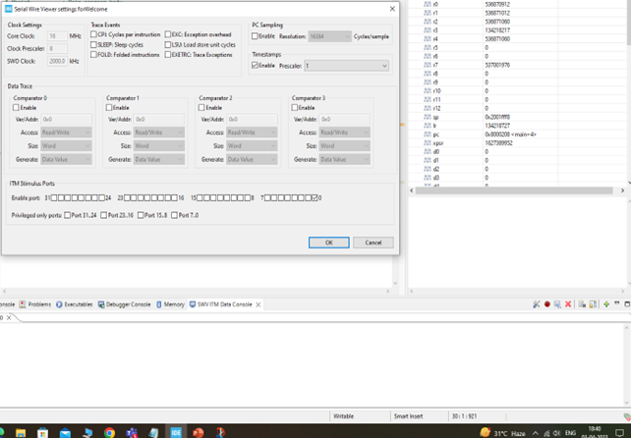
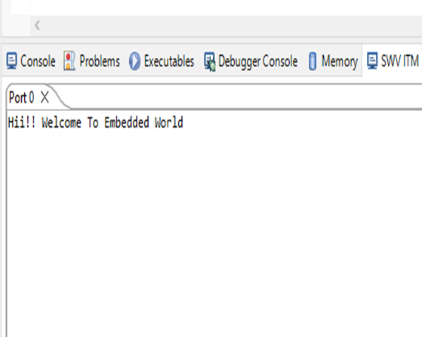
DEBUGGING
Here we have SWD (serial wire debugging) and SWV (serial wire viewer) in STM32CUBE IDE and to display the “printf” statements we can use the following steps below.

Slide 7
OPERATIONAL MODE
1.THREAD MODE:-ALL YOUR APPLICATION CODE WILL EXACUTE UNDER THREAD MODE OF THE PROCESSOR.
THIS IS ALSO CALLED USER MODE.
2.HANDLER MODE:-ALL EXCEPITION HANDLER OR INTERUPT WILL RUN UNDER HANDLER MODE
PROCESSOR ALWAYS RUN IN THREAD MODE.

Slide 8
PRIVILAGE LEVELS
Unprivileged Mode:
If coded is running with non privileged mode, then the code doesn't have access to some of resistor of the processor.
Privilege Mode:
which is does not have any restriction to access registers.
By default, it will run in privileged mode.
When the processor is in thread mode it is possible to move the processor into non-privileged access mode.
Once you move out of the privileged to non privileged mode being in thread mode then it is not possible to privilege mode .

Slide 9
MEMORY MAP
DIVIDED INTO TWO TYPES:-
1.NON MEMORY MAPED :-
THIS CAN BE ACCESSED WITH ASEMBLY CODE .
THIS REGISTOR DONOT HAVE ANY ADDRESSES ASSOCIATED WITH THEM.
2.MEMORY MAPED :-
IT CAN BE ACCESSEDE USING C LANGUAGE.
THIS REGISTOR HAVE SOME SPECIFIC ADDRESSES ASSOCIATED WITH THEM.

Slide 10
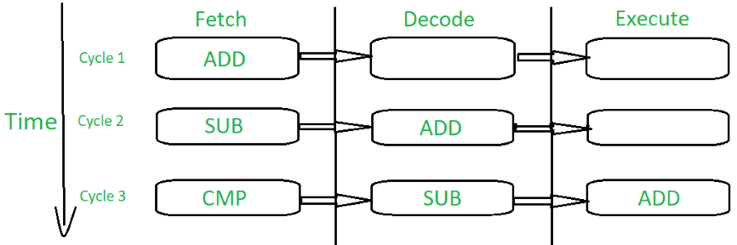
PIPELINE ARCITECTURE
HERE THE PIPELINE IS OF 3-STAGE
1.FETCH
2.DECODE
3.EXECUTE

Slide 11
BUS Matrix
Generally, the bus matrix used for communication between and the peripherals(slaves) and CPU and DMA(masters).It of 3 types.
I - Bus(Instruction bus)
It carries instructions among the main memory system, processor, and I/O devices
D - Bus(Data bus)
It carries data among the main memory system, processor, and I/O devices.
S - Bus(System bus)

Slide 12
AHB ,APB
AHB(180MHz) mainly used for the high-speed communication and it is the main bus interface.
AHB is further divided into APB1(45MHz) and APB2(90MHz)
APB are specific to the PPB (MPU/FPU ,NVIC,ETM,SW) access
Peripherals that do not require high speed connected to APB.

Slide 13
T-BIT
IT REFFERS TO THUMB STATE.
CORTEX M4 ONLY SUPPORTS THUMB STATE.
IF T-BIT=1(THUMB STATE)
IF T-BIT=0(ARM STATE)
IN THUMB STATELSB OF PC=1

Slide 14
RESET SEQUENCE
After reset, PC is loaded with the address 0x00000000
Processor reads the value from the address location 0x00000000(MSP=PC)
Then it reads the reset handler address which is 0x00000004
Set the vector table entries with the exceptions ISR address
Branches to the main in the C library
Then from RESET handler you can call your main function of the application.

Slide 15

Thank You

