Slide 1

Microcontroller:

Slide 2
Agenda
Introduction
Microcontroller
IDE
STM32F446RE
Memory
Operational Modes
SRAM Partition
GPIO
Timers
ADC
UART
I2C
SPI

Slide 3
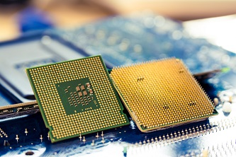
Microcontroller
A microcontroller unit (MCU) is a type of integrated circuit (IC) that combines a processor core, memory, and various input/output (I/O) peripherals on a single chip.
It is designed to perform specific tasks and is commonly used in embedded systems where compact size, low power consumption, and real-time processing capabilities are essential.
Processor Core: The central processing unit (CPU) is responsible for executing instructions and performing calculations. It can be based on various architectures such as ARM, AVR, PIC, etc.
Ex:-
8 bit :- 8051(Philips,Motorola,ATMEL)
16 bit :- PIC(Microchip)
32 bit :-ARM(TI,Samsung,Freescale)

Slide 4





IDE
"IDE" stands for Integrated Development Environment. It is a software application that provides comprehensive tools and features for software development.
An IDE typically includes a source code editor, a compiler or interpreter, build automation tools, and debugging capabilities, all integrated into a single user interface.
This integrated approach helps developers write, edit, compile, and debug their code efficiently in one central environment.
Some popular examples of IDEs in Embedded Systems are
KEIL(Philips)
CUBEIDE(ST)
Eclipse
IAR Workbench
MP Lab(Microchip)

Slide 5
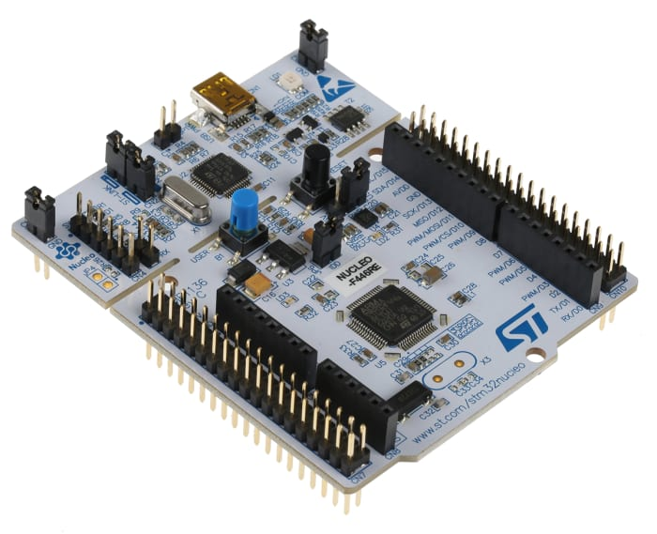
STM32F446RE
Microcontroller: The Nucleo STM32F446RE features an STM32F446RE microcontroller, which is based on the ARM Cortex-M4 core running at a maximum frequency of 180 MHz. This provides high-performance processing capabilities.
Memory: The board includes 512 KB of flash memory for storing program code and 128 KB of SRAM for data storage. The flash memory can be easily reprogrammed for firmware updates. ST-Link/V2-1 debugger .
4 I2C
50 GPIO PINS
4 USARTS
2 CAN
Camera interface
3 12-bit ADC
Operating voltage 1.8 to 3.6 V
2 QuadSPI

Slide 6
Memory
Memory Map
Memory Mapped
Non Memory Mapped
Memory-Mapped Peripherals:
Memory-mapped peripherals are a type of peripheral that is accessed through memory addresses.
These peripherals are assigned specific memory addresses within the microcontroller's address space.
Non-Memory-Mapped Peripherals:
Non-memory-mapped peripherals, on the other hand, are accessed through dedicated input/output (I/O) registers rather than memory addresses.
These regeister are reffered as as processor register or register.Ex:-

Slide 7
Operational Modes
Modes
THREAD MODE
HANDLER MODE
Privileged Level (Default)
Unprivileged Level
Privileged Level (Default)
Unprivileged Level
THREAD MODE:
This is the default mode of operation for the Cortex-M processor.
In Thread mode, the processor executes user code or tasks in a sequential manner.
It provides a simple and efficient execution environment for most application code.
Thread mode supports features such as privileged and unprivileged execution, exception handling, and interrupt handling.

Slide 8
Operational Modes
HANDLER MODE:
Handler mode is an exception mode in the Cortex-M processor.
It is used to handle various types of exceptions and interrupts that can occur during the execution of the code.
When an exception or interrupt occurs, the processor switches from Thread mode to Handler mode to execute the corresponding interrupt service routine (ISR) or exception handler.
Privileged Level (PL):
In this level, the processor has full access to all resources and instructions.
It can execute privileged instructions, access all memory regions (including protected and system-level regions), and configure and control system-level features.
Unprivileged Level (UL):
In the Unprivileged Level, the processor has restricted access to certain resources and instructions.
It cannot execute privileged instructions or directly access certain memory regions, such as the protected or system-level regions.

Slide 9
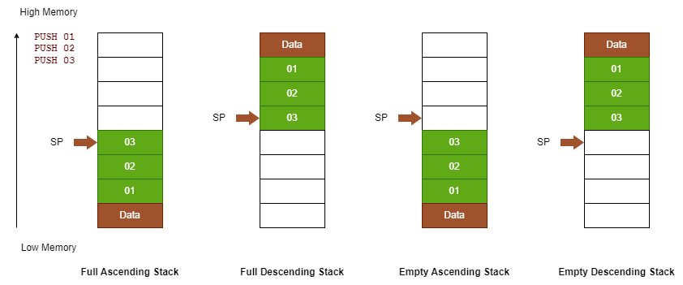
SRAM Partition
Full Ascending stack
Full Descending Stack(ARM cortex MX)
Empty Ascending Stack
Empty Descending Stack

Slide 10
GPIO
GPIO stands for General Purpose Input/Output.
It is a common feature found in microcontrollers and other digital integrated circuits.
GPIO allows the microcontroller to interact with the external world by providing a flexible interface for both input and output operations.
(RCC_AHB1ENR):- RCC AHB1 peripheral clock enable register. GPIOA,B,C,D
(GPIOx_MODER) :- GPIO port mode register
00: Input (reset state)
01: General purpose output mode
10: Alternate function mode
11: Analog mode
(GPIOx_IDR):- GPIO port input data register
(GPIOx_ODR):- GPIO port output data register

Slide 11
Timers
Timers
Basic
General Purpose
Advanced
Timers are essential components found in microcontrollers that provide accurate timing and synchronization capabilities.
They are used to measure time intervals, generate precise delays, or trigger events at specific time intervals.
Counting: Timers consist of a counter that increments or decrements at a specified frequency or clock source.
Prescaler: The prescaler divides the clock source frequency, allowing for adjustable time resolution.
Basic Timers 16 bit -(TIM 6 & TIM 7)
General Purpose 32 bit-(TIM 2 to TIM 5) 16 bit –(TIM9 to TIM14)
Advanced Timers 16 bit-(TIM1 & TIM8)

Slide 12
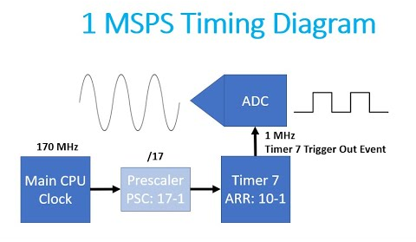
ADC
ADC stands for Analog-to-Digital Converter.
It is an essential component found in microcontrollers that allows the conversion of analog signals into digital data.
The ADC enables microcontrollers to interface with the analog world, such as reading values from sensors, measuring voltage levels, or sampling analog waveforms.
Sampling: The ADC samples the analog input signal at regular intervals.
Resolution: ADCs have a specified resolution that determines the number of discrete values the ADC can represent.

Slide 13
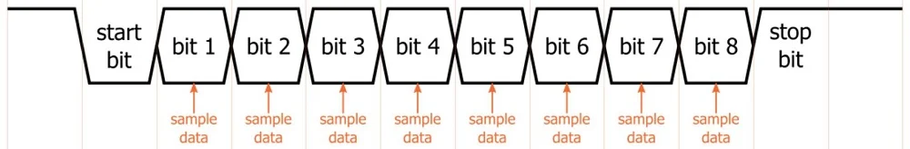
UART
UART stands for Universal Asynchronous Receiver/Transmitter.
It is a commonly used communication protocol that allows the serial transmission of data between devices.
UART is widely used for communication between microcontrollers, sensors, peripheral devices, and computers.
UART supports full-duplex communication, allowing simultaneous transmission and reception. This means that data can be sent and received independently in both directions.

Slide 14
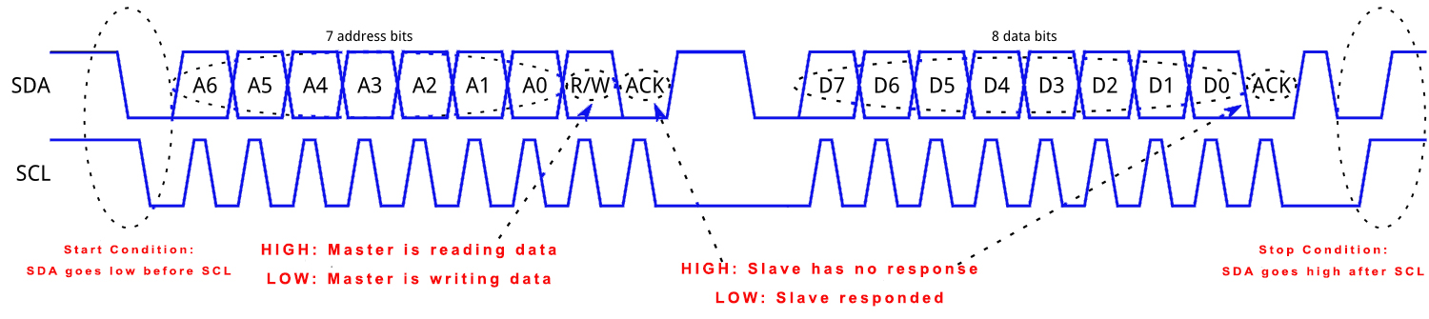
I2C
I2C, which stands for Inter-Integrated Circuit, is a widely used serial communication protocol that enables communication between multiple devices on the same bus.
Master and Slave Devices: In an I2C network, one device acts as the master, which initiates and controls communication, while other devices act as slaves that respond to the master's requests. The master device controls the timing and addresses the slaves for read or write operations.
Interfacing with real-time clocks (RTCs), EEPROMs, or other memory devices.

Slide 15
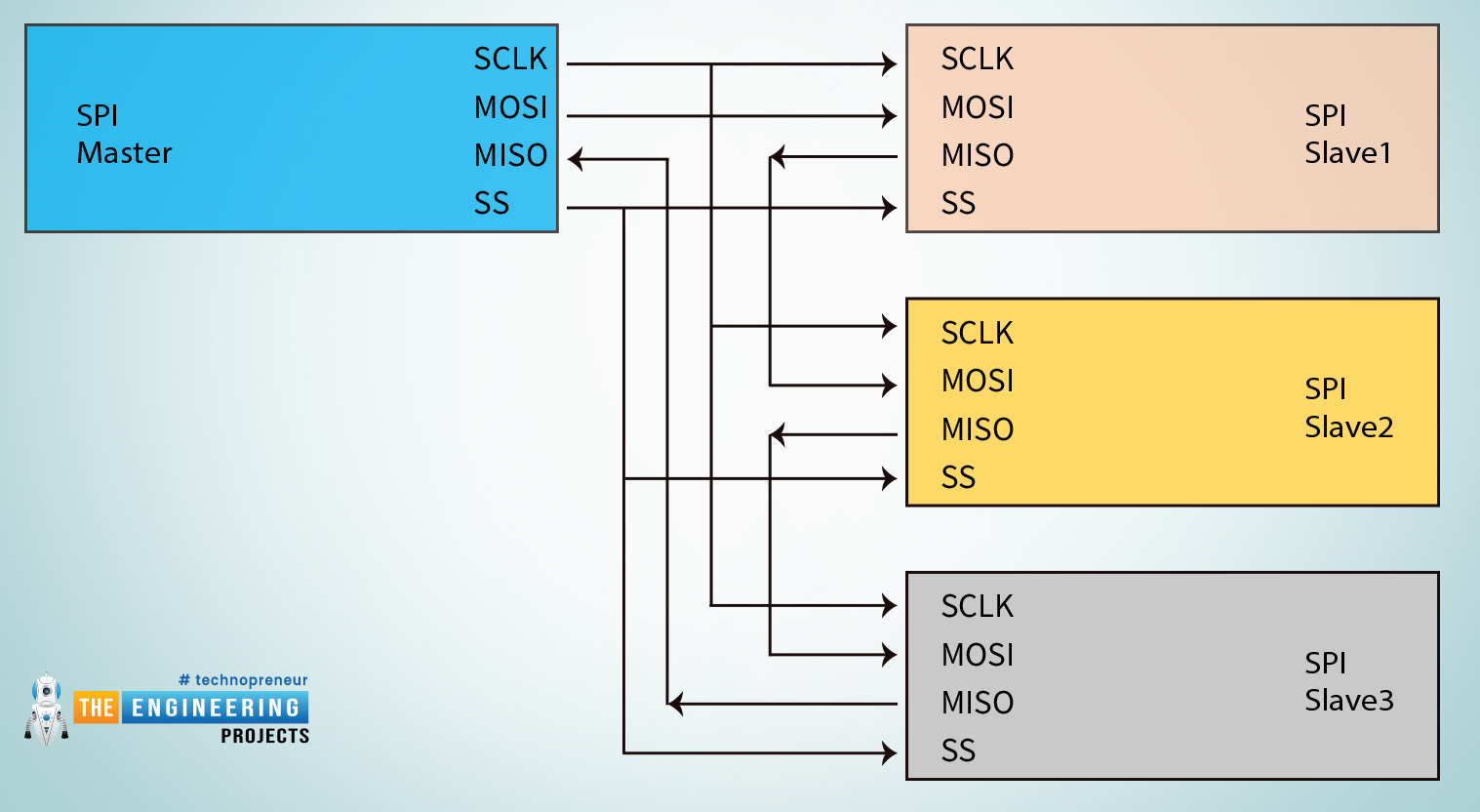
SPI
SPI, which stands for Serial Peripheral Interface, is a synchronous serial communication protocol commonly used for communication between microcontrollers and peripheral devices. SPI supports full-duplex communication
MOSI (Master Out Slave In): The master device sends data to the slave devices on this line.
MISO (Master In Slave Out): The slave devices send data to the master device on this line. allowing simultaneous data transmission and reception.
SS/CS (Slave Select/Chip Select): Each slave device has a dedicated SS/CS line. The master device selects the specific slave device with which it wants to communicate by asserting the corresponding SS/CS line.
Ex:-LCD displays, flash memory, or digital-to-analog converters (DACs).

Slide 16


