Slide 1
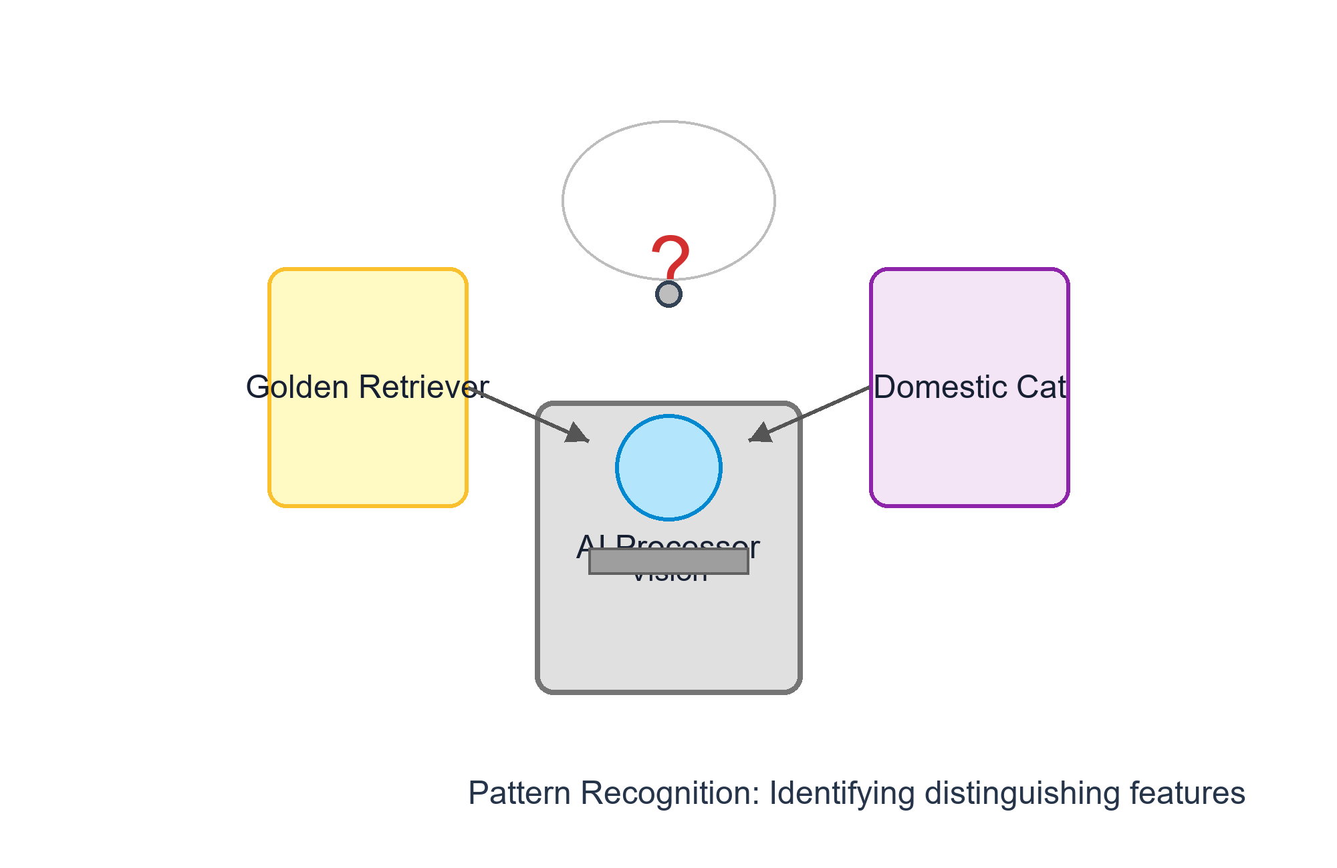
The Robot Teacher's Dilemma
How do we teach a machine to see the world?
How do we teach a machine to see the world?
• Imagine a robot tasked with recognizing dogs: it has never seen one before and needs a way to identify them.
• The robot learns by looking at thousands of photos and creating 'rules' (e.g., 'If it has floppy ears and a tail, it is a dog').
• The challenge: If the robot creates too few rules, it misses many dogs; if it creates too many, it might think every furry animal is a dog.
01 / 20
Notes:
Start with a story. We aren't just talking about code; we are talking about the process of learning. The robot is our proxy for a Machine Learning model.

Slide 2
What is Machine Learning?
Learning from patterns, not instructions
• Traditional Programming: A human writes a strict recipe (If X, then Y). Machine Learning: The computer finds the recipe itself from data.
• Pattern Recognition: ML algorithms analyze vast amounts of data to find mathematical relationships and make guesses about new, unseen information.
• The Ultimate Goal - Generalization: The ability of a model to perform accurately on new data it has never encountered during its training phase.
02 / 20
Notes:
Contrast explicit programming with ML. Emphasize that 'Generalization' is the gold standard of a successful model.

Slide 3
The Map of Our Journey
Navigating the complexities of model error
01
The Basics: Defining Bias and Variance in simple terms.
02
The Problem: Understanding Underfitting and Overfitting.
03
The Struggle: Navigating the Bias-Variance Tradeoff.
04
The Solution: Practical strategies to fix and optimize your models.
03 / 20
Notes:
Set the stage. We will move from conceptual definitions to the 'problem' and finally to the 'solution'.

Slide 4
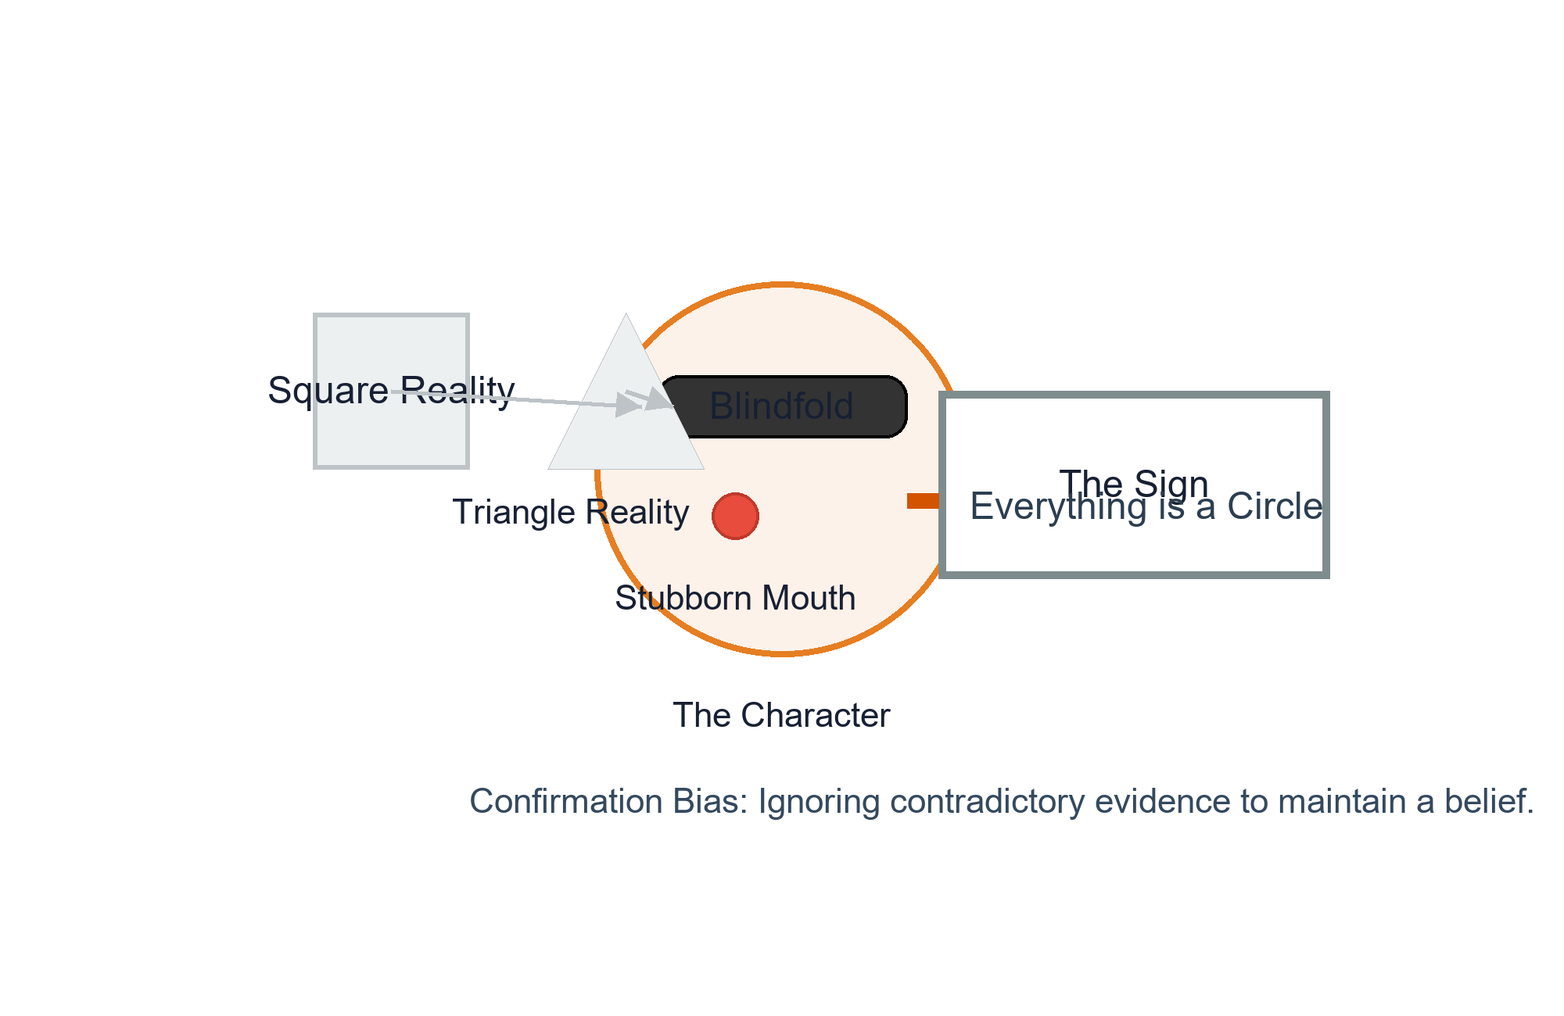
Meet 'Bias': The Stubborn Thinker
When simplicity becomes a limitation
• Definition: Bias is the error introduced by approximating a real-life problem (which is complex) with a much simpler model.
• The Mindset: High Bias is like a person with a preconceived notion who says, 'I already know the answer, I don't need more detail.'
• The Result: The model ignores the nuances of the data, leading to consistently wrong predictions because the 'rules' are too rigid.
04 / 20
Notes:
Personify Bias as 'stubborn'. Explain that high bias happens when we assume a relationship is a straight line when it's actually a complex curve.

Slide 5
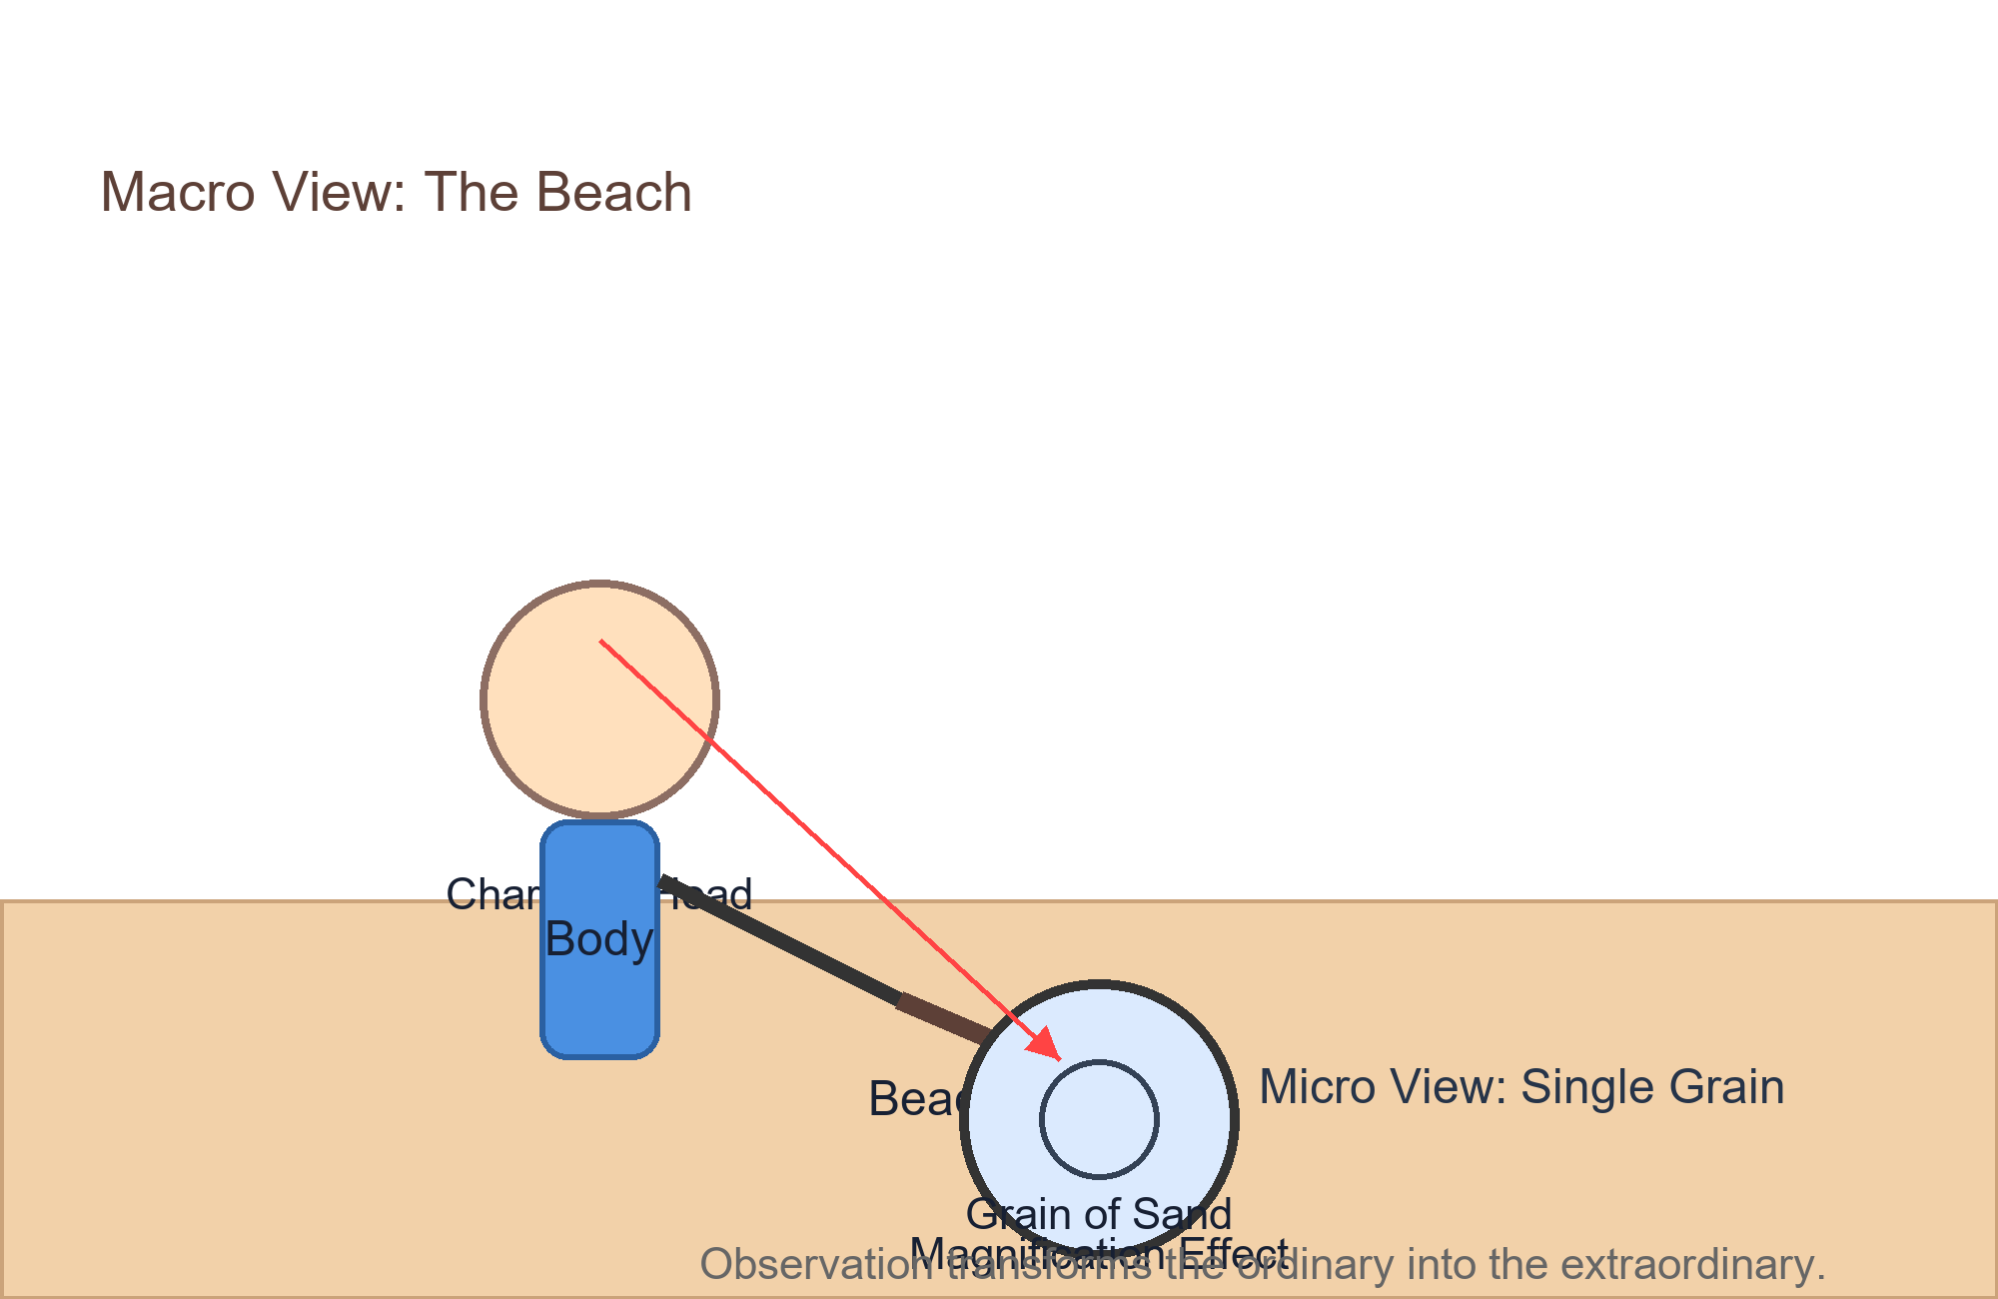
Meet 'Variance': The Over-Thinker
When detail becomes a distraction
• Definition: Variance is the error introduced when a model is overly sensitive to small fluctuations (noise) in the training set.
• The Mindset: High Variance is like an over-thinker who believes 'Every single dot is a special rule that must be followed!'
• The Result: The model performs perfectly on the data it has seen but fails miserably on new data because it learned the 'noise' instead of the 'pattern'.
05 / 20
Notes:
Contrast Variance with Bias. While Bias is too simple, Variance is too complex. It's the difference between a general rule and a memorized list.

Slide 6
The Bullseye Analogy
Visualizing the four states of model error
01
02
03
Low Bias / Low Variance: The Ideal. Hits the center consistently; the model is accurate and stable.
High Bias / Low Variance: Consistent but Wrong. Hits the same spot every time, but that spot is far from the bullseye.
Low Bias / High Variance: Accurate but Unstable. The average is near the center, but the individual shots are scattered everywhere.
06 / 20
Notes:
This is the most important visual in ML. Explain that Bias is about 'offset' (distance from center) and Variance is about 'spread' (scatter).

Slide 7
Underfitting: The 'Too Simple' Problem
The consequence of High Bias
Problem
Solution
• What happens: The model is too simple to capture the underlying trend of the data (e.g., using a linear model for non-linear data).
• Analogy: It is like trying to draw a complex, curvy mountain range using only a straight ruler.
• The Outcome: Poor performance on the training data AND poor performance on new data. It simply hasn't learned enough.
07 / 20
Notes:
Connect the 'Stubborn Thinker' (Bias) to Underfitting. The model is 'under-learning'.

Slide 8
Overfitting: The 'Memorization' Problem
The consequence of High Variance
Problem
Solution
• What happens: The model learns the training data too well, including the random errors and outliers (the 'noise').
• Analogy: Like a student who memorizes a math textbook word-for-word but cannot solve a new problem because they don't understand the logic.
• The Outcome: Near-perfect performance on training data, but a total crash when faced with new, real-world data.
08 / 20
Notes:
Connect the 'Over-Thinker' (Variance) to Overfitting. The model is 'over-learning' the wrong things.

Slide 9
The Goldilocks Zone
Finding the optimal model complexity
Perspective 1
Perspective 2
• Underfit: Too simple. Misses the trend entirely. (High Bias)
• Overfit: Too complex. Follows the noise too closely. (High Variance)
• Just Right: The Optimal Model. Captures the essential pattern while ignoring the random noise. This is where generalization happens.
09 / 20
Notes:
Use the Goldilocks metaphor. We want the model that is just complex enough to be accurate, but simple enough to be flexible.

Slide 10
The Bias-Variance Tradeoff
The balancing act of Machine Learning
The Inverse Relationsh
The Tug-of-War: If you
The Goal: Minimize the
Illustrative visual scale — not measured data
10 / 20
Notes:
Explain that we can't usually have zero bias and zero variance. We have to find the 'sweet spot' on the U-shaped error curve.

Slide 11
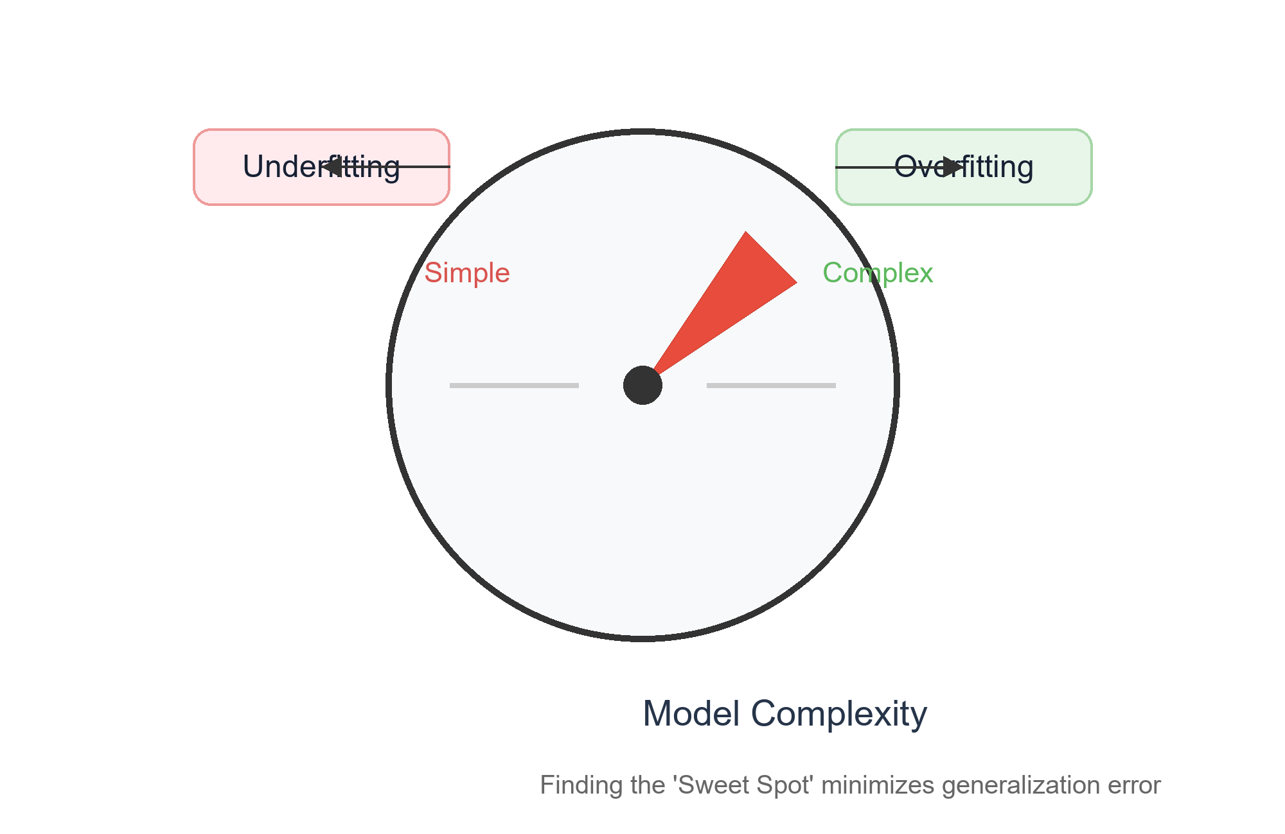
Model Complexity: The Volume Knob
What actually controls the balance?
• Low Complexity: Linear models (like Linear Regression) or models with very few input features. These tend toward High Bias.
• High Complexity: Deep Neural Networks, Decision Trees with unlimited depth, or models with hundreds of features. These tend toward High Variance.
• Tuning: Data scientists 'turn the knob' by adding/removing features or changing the algorithm to find the optimal complexity.
11 / 20
Notes:
Use the knob metaphor. Complexity isn't inherently bad; it's about having the right amount for the specific problem.

Slide 12
Example 1: Predicting House Prices
Applying bias and variance to regression
Perspective 1
Perspective 2
• Underfit (High Bias): Predicting price based ONLY on square footage. It ignores location and age, making it too simple to be accurate.
• Overfit (High Variance): Predicting price based on the color of the mailbox, the day the owner was born, and the number of clouds in the sky on Tuesday.
• Balanced: Using a combination of size, neighborhood quality, number of rooms, and recent local sales data.
12 / 20
Notes:
This shows how 'features' contribute to complexity. Too few = bias; too many irrelevant ones = variance.

Slide 13
Example 2: Recognizing a Cat
Applying bias and variance to classification
01
02
03
High Bias: The model decides 'Anything with four legs and fur is a cat.' It will incorrectly label dogs and bears as cats.
High Variance: The model decides 'A cat must have exactly 3 whiskers on the left and a small scratch on the left ear.' It will fail to recognize any other cat.
Balanced: The model learns that cats have pointed ears, specific whisker patterns, and a certain face shape.
13 / 20
Notes:
Relate this back to the robot from the first slide. Show how the 'rules' change based on the bias/variance level.

Slide 14
How to Fight High Bias (Underfitting)
Adding power to a weak model
• Increase Feature Depth: Give the robot more clues (e.g., instead of just 'size', add 'location' and 'condition').
• Upgrade the Model: Switch from a simple linear model to a more complex one, like a Polynomial Regression or a Neural Network.
• Decrease Regularization: Loosen the strict constraints that are preventing the model from learning the patterns.
14 / 20
Notes:
When we underfit, the model is 'too lazy'. We need to give it more tools or a more powerful 'brain'.

Slide 15
How to Fight High Variance (Overfitting)
Teaching a model to ignore the noise
• Gather More Data: Show the robot more examples so it learns the general pattern rather than memorizing specific images.
• Simplify the Model: Reduce the number of features or limit the depth of a decision tree to force the model to generalize.
• Use Regularization: Apply a 'penalty' for complexity (like L1 or L2 regularization) to discourage the model from creating overly complex rules.
15 / 20
Notes:
When we overfit, the model is 'too obsessive'. We need to force it to simplify or give it so much data that the noise cancels itself out.

Slide 16
The Secret Weapon: Cross-Validation
How to detect Bias and Variance
1
2
3
The Golden Rule: Never test your model on the same data you used to train it.
The Split: Divide your data into a 'Study Guide' (Training Set) and a 'Final Exam' (Test Set).
The Diagnosis: If the model aces the study guide (low training error) but fails the exam (high test error), you have High Variance (Overfitting)!
16 / 20
Notes:
Explain that the gap between training performance and testing performance is the primary indicator of overfitting.

Slide 17
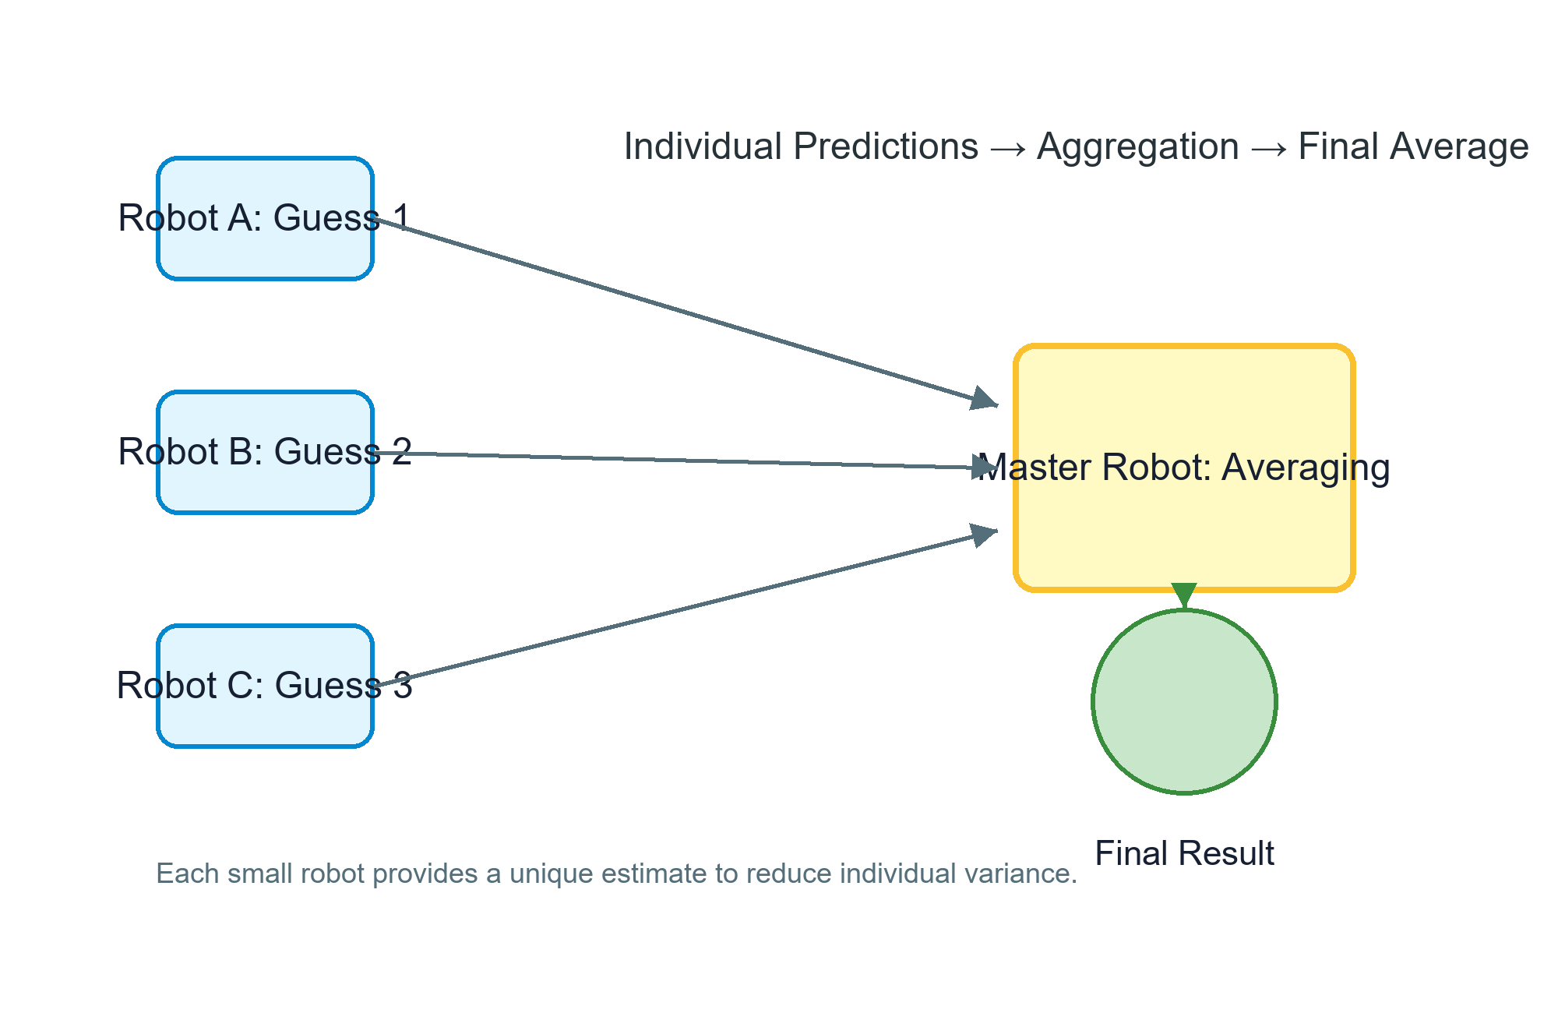
Ensemble Learning: Teamwork!
Combining models to cancel out errors
Bagging (Bootstrap Aggregating): Averaging many high-variance models (like Random Forests) to smooth out the noise.
→
Boosting: Combining many high-bias 'weak learners' sequentially, where each new model fixes the mistakes of the previous one (like XGBoost).
→
The Result: By combining different perspectives, the ensemble reduces overall error and finds a more stable balance.
17 / 20
Notes:
Introduce the idea that one model might be biased or variant, but a crowd of models usually reaches the truth.

Slide 18
Summary: The Cheat Sheet
Key takeaways for every model tuner
• Bias = Over-simplicity = Underfitting (Consistently wrong, ignores data).
• Variance = Over-complexity = Overfitting (Too sensitive, memorizes noise).
• Tradeoff = The search for the 'Goldilocks Zone' where Total Error is minimized.
• Fixes = Underfit? Add features/complexity. Overfit? Add data/simplify/regularize.
18 / 20
Notes:
This is the 'take-home' slide. Review the core definitions one last time.

Slide 19
Quick Quiz: Test Your Brain!
Can you diagnose these models?
Perspective 1
Perspective 2
• Scenario A: A model gets 100% accuracy on training data but only 50% on testing data. What is the problem? (Answer: High Variance/Overfitting)
• Scenario B: A model gets 60% accuracy on training and 60% on testing. What is the problem? (Answer: High Bias/Underfitting)
• Challenge: Which of these two scenarios would benefit most from adding more training data? (Answer: Scenario A)
19 / 20
Notes:
Engage the students. Let them guess before revealing the answers. Explain why Scenario A needs more data (to break the memorization).

Slide 20
You are now a Model Tuner!
Go forth and build balanced AI
Go forth and build balanced AI
• Remember: Machine Learning is not about perfection, but about balance.
• Keep Experimenting: The best models are found through iterative testing and tuning.
• The Goal: Build models that don't just 'know' the data, but 'understand' the world to generalize to the real world.
20 / 20
Notes:
End on an encouraging note. Remind them that even professional data scientists spend most of their time fighting this tradeoff.

