Slide 1



INFOSYS SPRINGBOARD · DATA VISUALIZATION PROJECT
SMART URBAN MOBILITY AND TRAFFIC INTELLIGENCE DASHBOARD
Urban Pulse — Smart City Mobility Intelligence Platform
Group 1 · DV-Team E · Power BI Analytics · Multimodal Mobility Data
07
04 / 04
08
09
ANALYTICS MODULES
MILESTONES COMPLETE
WEEK DELIVERY SPRINT
LIVE DASHBOARD VIEWS
TEAM
Sameer Singh & Deepak Gavhane
Data Engineering & Geospatial Analytics
Suyash Agrawaal
BI Lead & Project Management
Vaishnavi Gorakhanath Kshirsagar
Micromobility & Equity Analysis
Chandushree J B
Transit & Ride-Hailing Analytics
CITIES ANALYZED
: Bengaluru · Delhi
Infosys Springboard · Data Visualization Project

Slide 2
PROJECT STATEMENT
Why Urban Pulse?
Mobility data is abundant but fragmented — planners still lack one unified view of the city
01
Siloed Data Sources
02
No Cross-Modal View
03
Reactive, Not Predictive
04
Equity Blind Spots
Transit, ride-hailing, cycling and weather data are collected and managed independently, with no shared model.
Analysts can't see how demand shifts between transit, ride-hailing and micromobility across the same trip.
Without forecasting or anomaly detection, agencies respond to congestion instead of anticipating it.
Underserved neighborhoods and accessibility gaps go unmeasured without a common access index.
GOAL
Build a unified smart-city mobility intelligence platform that integrates multimodal transportation data, weather information, demographic indicators, and geospatial datasets into one decision-support system — enabling city planners, transit operators, and administrators to monitor demand, evaluate equity, and forecast mobility trends through interactive dashboards.
Raw multimodal data, disconnected. We turned it into one integrated mobility-intelligence platform.
Smart Urban Mobility and Traffic Intelligence Dashboard · Urban Pulse · Group 1 · DV-Team E
Infosys Springboard · 02 / 16

Slide 3
PROJECT OBJECTIVES
Objectives & Deliverables
End-to-end scope of what Urban Pulse delivers
1
Unified Multimodal Analytics
2
Interactive Dashboards
3
Automated ETL Pipeline
Integrate transit, ride-hailing, cycling, weather & demographic data into one model.
Role-based Power BI dashboards for demand, reliability and equity reporting.
Ingest and refresh mobility datasets from multiple public sources automatically.
4
Geospatial Analytics
5
Mobility Health Scoring
6
Forecasting & Anomaly Detection
Heatmaps, flow maps, accessibility isochrones and mobility-corridor visualization.
Mobility Access Index (MAI) and City Mobility Health Score for performance monitoring.
Predict demand trends and flag operational disruptions before they escalate.
KEY DELIVERABLES
Unified Mobility Datamart
9-Page Power BI Dashboard Suite
Final PPT + Project Report
GitHub Repository
Smart Urban Mobility and Traffic Intelligence Dashboard · Urban Pulse · Group 1 · DV-Team E
Infosys Springboard · 03 / 16

Slide 4
PLATFORM MODULES
Seven Analytics Modules
Each module is owned by a team track and feeds the shared mobility datamart
01
Data Acquisition & Integration
02
Geospatial Mobility Analytics
03
Transit Performance Analytics
04
Ride-Hailing & Demand Intelligence
Collect & standardize transit, ride-hailing, bike-share, weather and demographic data from 5 public sources.
Origin-destination flows, accessibility isochrones, congestion hotspot visualization.
Reliability metrics, schedule adherence, headway variance, route performance.
Demand patterns, surge behavior, modal substitution, fare elasticity.
05
Cycling & Micromobility Analytics
06
Mobility Equity Analysis
07
Executive Intelligence & Forecasting
Bike-share utilization, station availability, rebalancing prediction.
Mobility Access Index (MAI), demographic accessibility comparison.
City-wide mobility health metrics, trend forecasting, anomaly detection.
Smart Urban Mobility and Traffic Intelligence Dashboard · Urban Pulse · Group 1 · DV-Team E
Infosys Springboard · 04 / 16

Slide 5
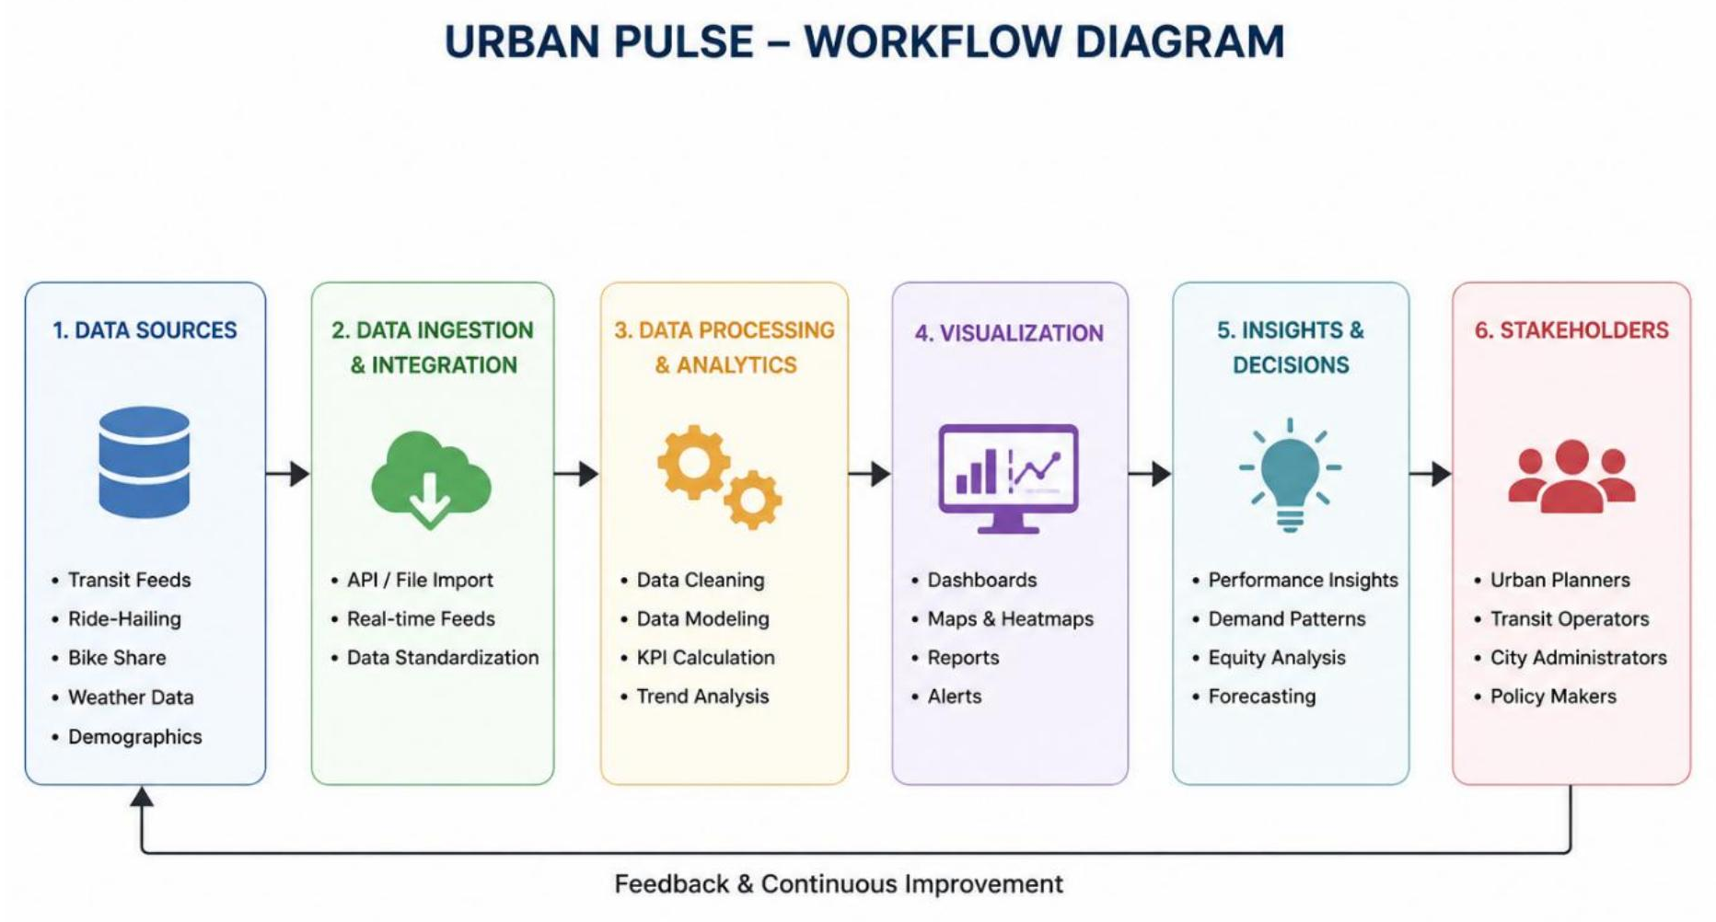
SYSTEM DESIGN
System Workflow
From raw multimodal data to stakeholder decisions, in six stages
Smart Urban Mobility and Traffic Intelligence Dashboard · Urban Pulse · Group 1 · DV-Team E
Infosys Springboard · 05 / 16

Slide 6
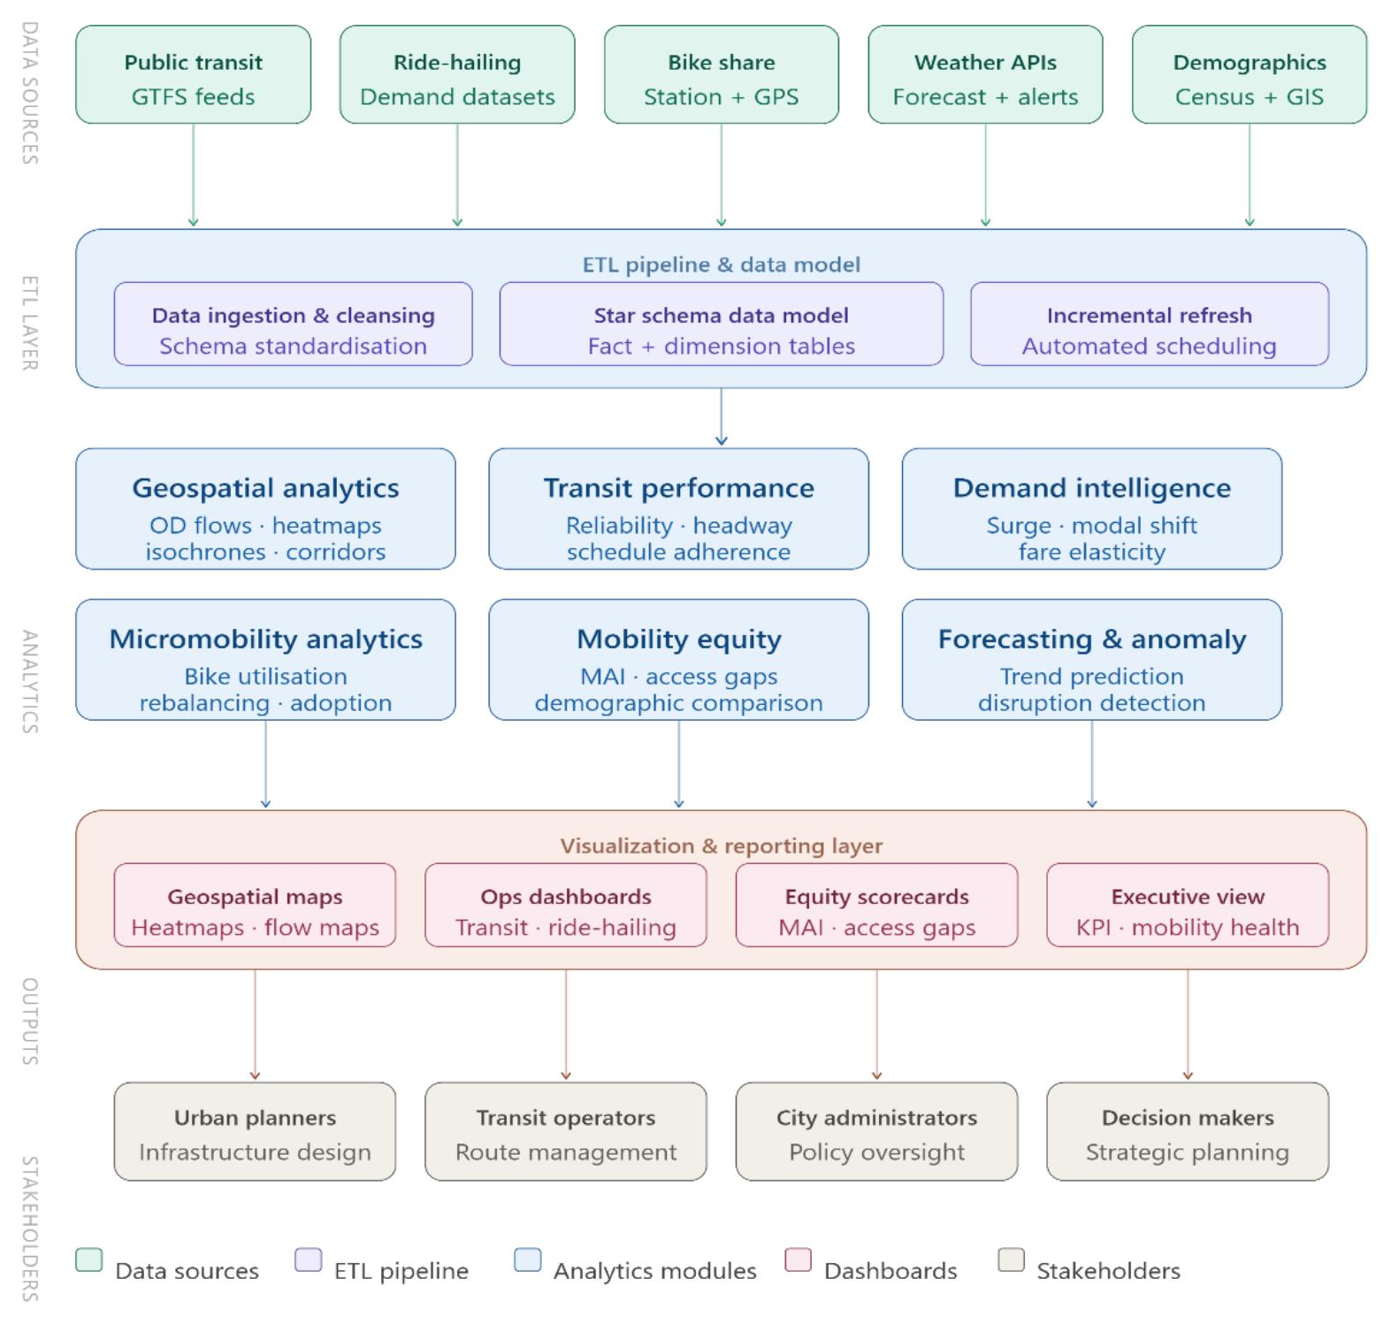
SYSTEM DESIGN
System Architecture
Data sources → ETL & modeling → analytics modules → visualization → stakeholders
Smart Urban Mobility and Traffic Intelligence Dashboard · Urban Pulse · Group 1 · DV-Team E
Infosys Springboard · 06 / 16

Slide 7
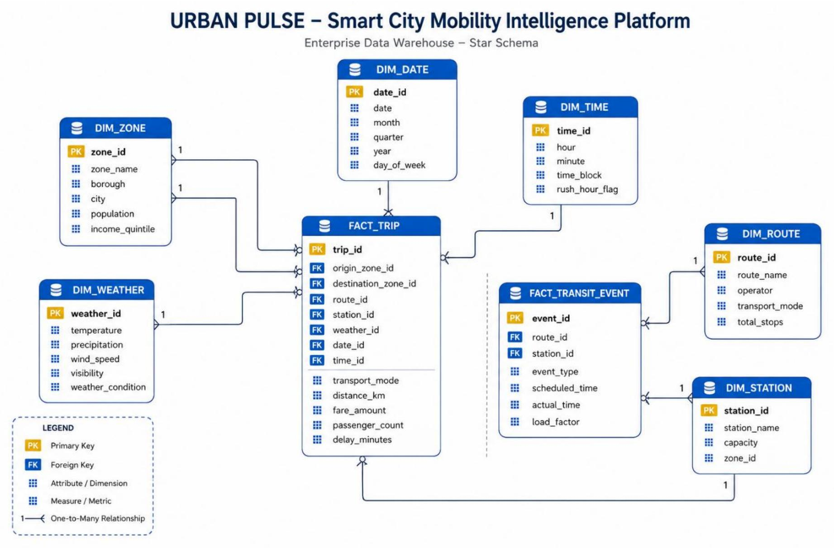
SYSTEM DESIGN
Database Schema
Enterprise data warehouse — star schema design, 2 fact tables + 6 shared dimensions
Smart Urban Mobility and Traffic Intelligence Dashboard · Urban Pulse · Group 1 · DV-Team E
Infosys Springboard · 07 / 16

Slide 8
UNDER THE HOOD
Technology Stack
The tools and platforms powering Urban Pulse, end to end
01
Data Sources
02
Data Preparation & Modeling
Public transit, ride-hailing, bike-share, weather and demographic data ingested from five external sources.
Schema standardization, cleansing and star-schema modeling before analytics begins.
KEY TOOLS
KEY TOOLS
GitHub
GTFS Feeds
Open-Meteo API
Govt. Handbooks
Power Query
Star Schema
DAX Measures
Incremental Refresh
Kaggle
03
Visualization & BI
04
Collaboration & Delivery
Nine interactive Power BI dashboards, one for every analytics module in the platform.
Agile, sprint-based delivery across four milestones with shared version control.
KEY TOOLS
KEY TOOLS
Power BI Desktop
Power BI Service
Geospatial Maps
GitHub
Agile Sprints
PowerPoint
Stakeholder Reviews
Drill-Through
Smart Urban Mobility and Traffic Intelligence Dashboard · Urban Pulse · Group 1 · DV-Team E
Infosys Springboard · 08 / 16

Slide 9
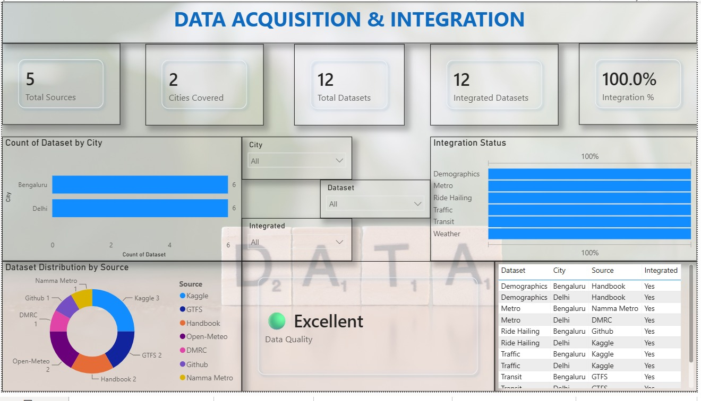
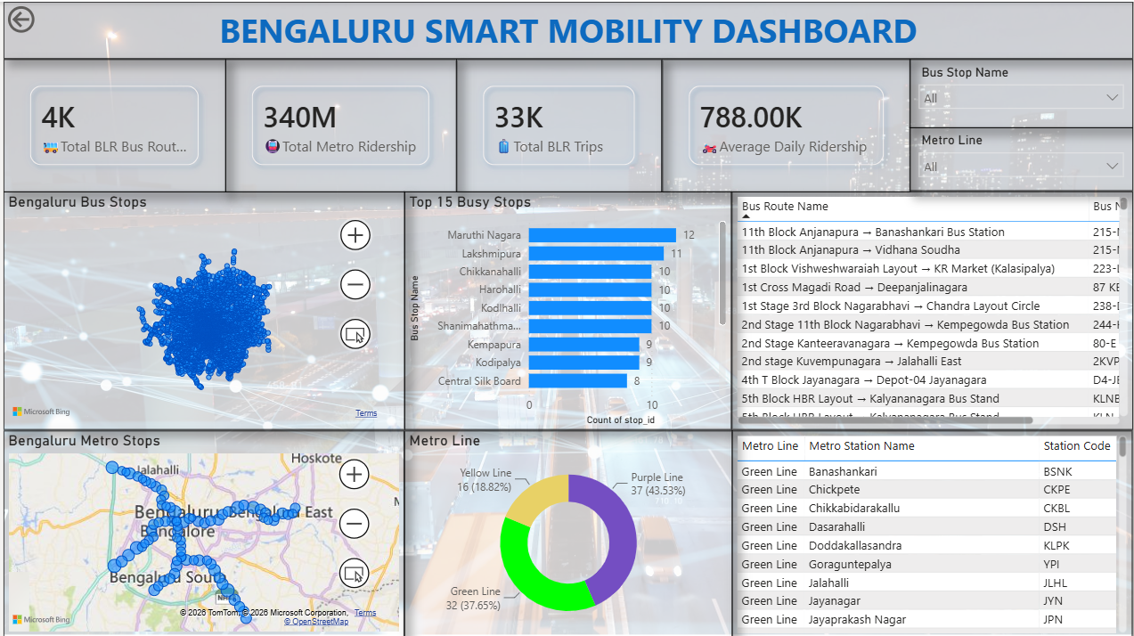
PROJECT MILESTONES
Milestones 1 & 2
Data Acquisition & Data Modeling · Geospatial & Transit Analytics · Weeks 1–4
MILESTONE 01 · WEEKS 1–2
MILESTONE 02 · WEEKS 3–4
Data Acquisition & Data Modeling
Geospatial & Transit Analytics
Connected 5 public data sources (GitHub, GTFS, govt. handbooks, Kaggle, Open-Meteo) spanning transit, ride-hailing, traffic, weather and demographic data.
Integrated 6 core datasets across Bengaluru and Delhi, reaching 100% integration status.
Designed a star-schema data model (Fact_Trip, Fact_Transit_Event + shared dimensions) for cross-domain analysis.
Mapped Bengaluru's bus-stop and metro-station network with interactive drill-down filters.
Ranked the Top-15 busiest stops and metro ridership by line (Green, Purple, Yellow).
Delivered map-based dashboards covering both the bus (4K+ routes) and metro networks.
Data Acquisition & Integration Dashboard
Bengaluru Smart Mobility Dashboard
Smart Urban Mobility and Traffic Intelligence Dashboard · Urban Pulse · Group 1 · DV-Team E
Infosys Springboard · 09 / 16

Slide 10
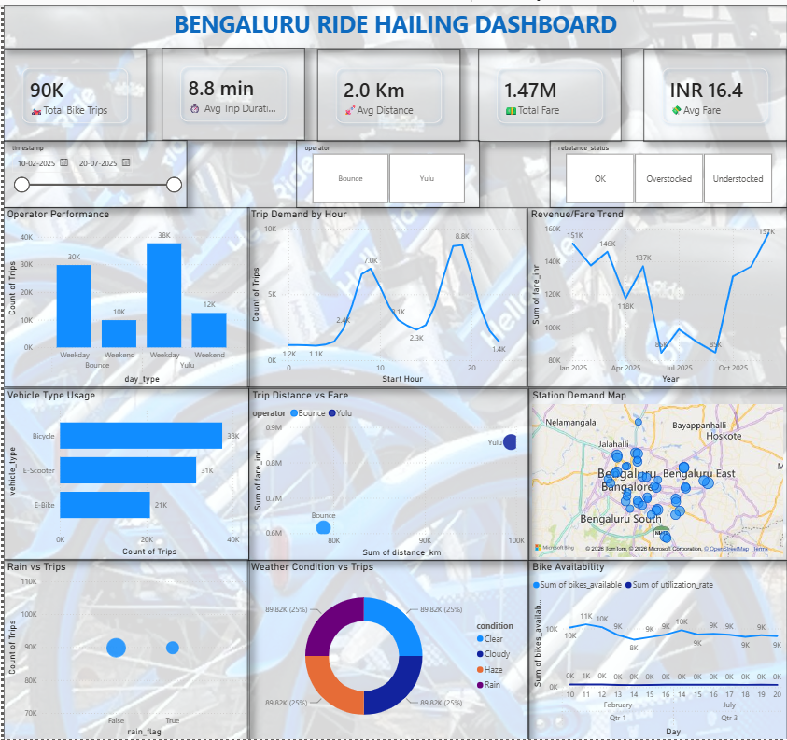
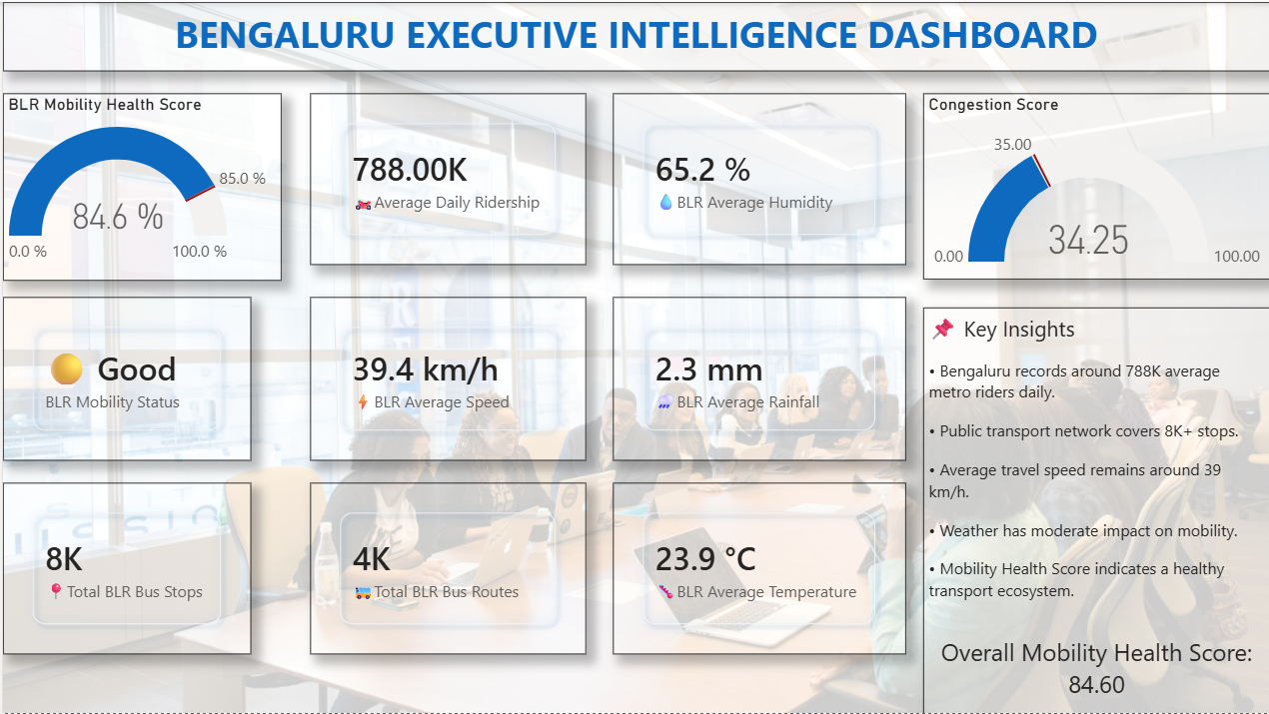
PROJECT MILESTONES
Milestones 3 & 4
Demand Intelligence & Mobility Analytics · Equity, Forecasting & Finalization · Weeks 5–8
MILESTONE 03 · WEEKS 5–6
MILESTONE 04 · WEEKS 7–8
Demand Intelligence & Mobility Analytics
Equity, Forecasting & Finalization
Tracked bike/e-scooter demand across Bounce and Yulu by weekday, hour and fare trend.
Compared vehicle-type usage and trip distance vs fare; monitored rebalancing status.
Surfaced two sharp daily demand peaks — morning and evening — to guide fleet rebalancing.
Built the City Mobility Health Score (84.6%) combining transit, traffic and weather signals.
Tracked congestion, speed, ridership and weather in one executive read-out ('Good').
Delivered a single-page executive rollup covering 8K bus stops and 4K routes.
Ride-Hailing Dashboard
Bengaluru Executive Intelligence Dashboard
Smart Urban Mobility and Traffic Intelligence Dashboard · Urban Pulse · Group 1 · DV-Team E
Infosys Springboard · 10 / 16

Slide 11
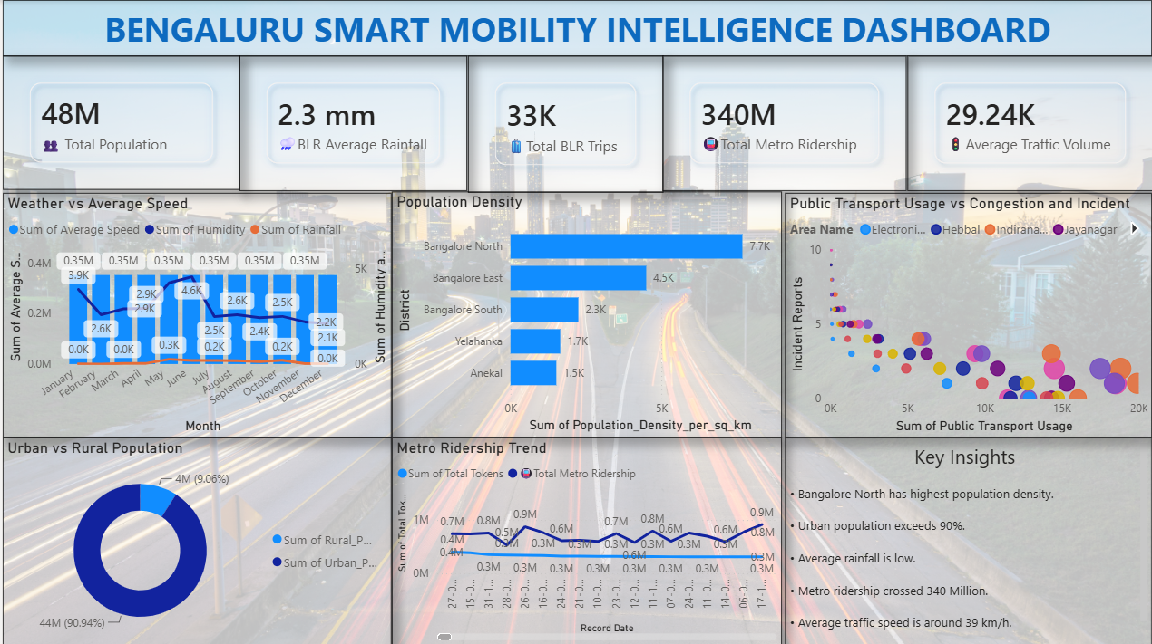
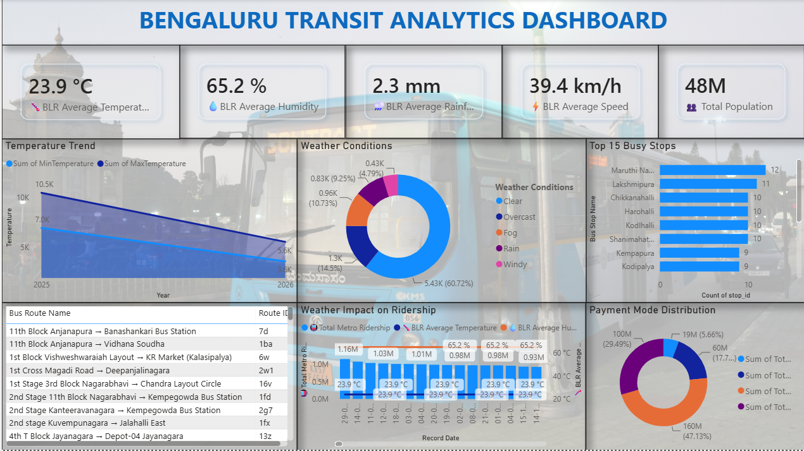
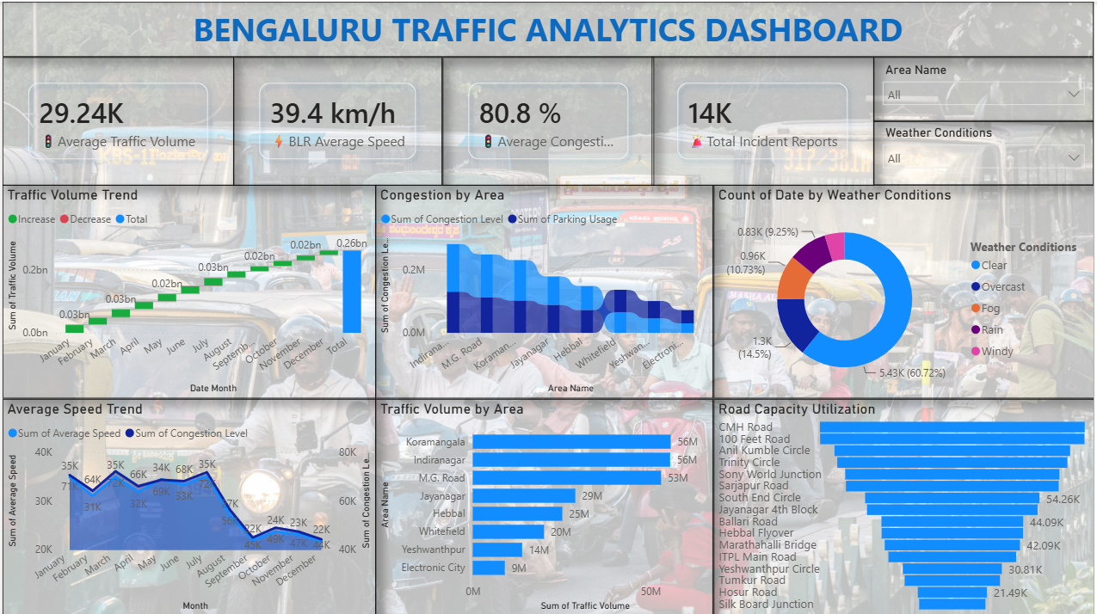
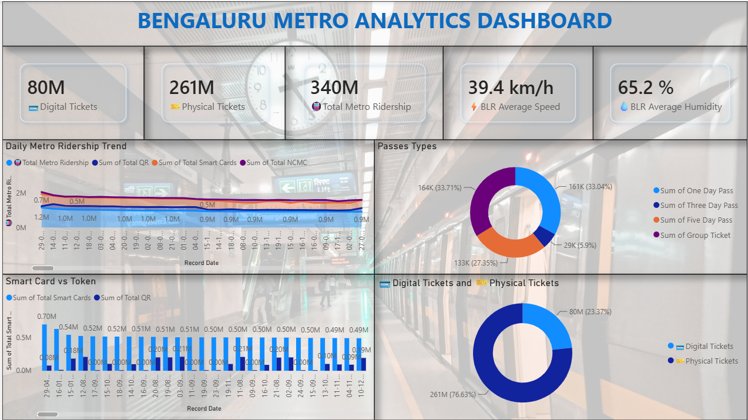
DASHBOARD DEEP-DIVE
Additional Dashboard Highlights
A closer look at four more Power BI views from the Urban Pulse suite
Bengaluru Smart Mobility Intelligence
Bengaluru Transit Analytics
A single-page view that fuses population, weather and traffic signals for the whole city.
Weather, routes and payments — the operational pulse of the bus network.
48M population · 90.9% urban · 340M metro rides tracked
65.2% avg. humidity · 39.4 km/h avg. speed · 15 stops ranked
Bengaluru Traffic Analytics
Bengaluru Metro Analytics
Congestion, road capacity and incidents across the city's busiest corridors.
Ticketing behavior and ridership trends across the metro network.
80.8% avg. congestion · 14K incidents · 29.24K avg. traffic volume
340M total ridership · 76.6% physical tickets · 4 pass types
Smart Urban Mobility and Traffic Intelligence Dashboard · Urban Pulse · Group 1 · DV-Team E
Infosys Springboard · 11 / 16

Slide 12
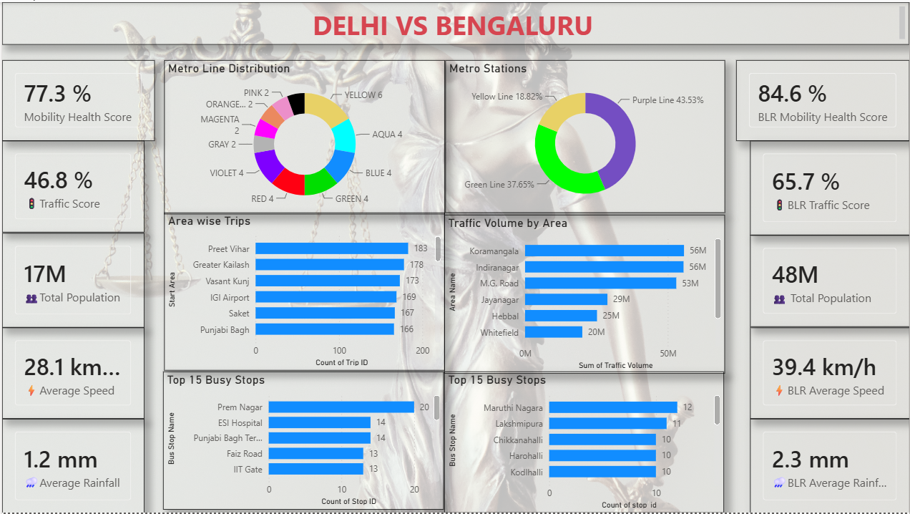
COMPARATIVE ANALYSIS
Cross-City Benchmarking
Comparative mobility health — Delhi vs Bengaluru
KEY TAKEAWAYS
Bengaluru's Mobility Health Score (84.6%) reflects a denser metro + bus network across a larger population base (48M vs 17M).
Bengaluru posts a higher average travel speed (39.4 km/h) than Delhi (28.1 km/h) in this sample corridor set.
Delhi's metro ridership skews toward the Purple and Yellow lines; Bengaluru's Green and Purple lines dominate.
Cross-city benchmarking helps prioritize which mobility interventions transfer well between metros.
Delhi vs Bengaluru — comparative mobility dashboard
Smart Urban Mobility and Traffic Intelligence Dashboard · Urban Pulse · Group 1 · DV-Team E
Infosys Springboard · 12 / 16

Slide 13
SYNTHESIS
Key Insights & Business Impact
What the numbers add up to, why it matters, and what we recommend doing about it
INSIGHT
INSIGHT
INSIGHT
Physical ticketing still dominates the metro (76.6%).
Bangalore North is the densest, highest-demand district.
Congestion averages 80.8% with 14K incidents logged.
IMPACT
IMPACT
IMPACT
Slower boarding, thinner ridership data and higher cash-handling overhead for operators.
Under-investment here compounds overcrowding faster than in any other zone.
Two corridors account for a disproportionate share of delays and safety risk.
RECOMMENDATION
RECOMMENDATION
RECOMMENDATION
Prioritize digital-ticket incentives to cut queue times and boost data granularity.
Front-load transit and micromobility infrastructure investment here first.
Target CMH Road and 100 Feet Road first for capacity and safety upgrades.
INSIGHT
INSIGHT
INSIGHT
Weather has a measurable but moderate effect on mobility.
Bike & e-scooter demand peaks sharply at two daily windows.
Bengaluru's Mobility Health Score (84.6%) leads the benchmark.
IMPACT
IMPACT
IMPACT
Fixed schedules over- or under-provision service on atypical-weather days.
Fixed rebalancing timers leave fleets empty or overstocked outside peak hours.
The underlying data model has already proven itself at city scale.
RECOMMENDATION
RECOMMENDATION
RECOMMENDATION
Build weather-adjusted forecasting rather than static, fixed schedules.
Shift to dynamic fleet rebalancing around commute peaks, not fixed timers.
Use Bengaluru's data model as the template for future city rollouts.
Smart Urban Mobility and Traffic Intelligence Dashboard · Urban Pulse · Group 1 · DV-Team E
Infosys Springboard · 13 / 16

Slide 14
OUR TEAM
Team & Responsibilities
DV-Team E · Group 1 · 5-student, 8-week sprint
01
Data Engineer
02
Geospatial Analyst
03
Transit & Ride-Hailing Analyst
Sameer Singh / Deepak Gavhane
Sameer Singh / Deepak Gavhane
Chandushree J B
Data Acquisition & Integration · Database / Star Schema
Geospatial Mobility Analytics
Transit Performance Analytics · Ride-Hailing & Demand Intelligence
Collected & standardized transit, ride-hailing, bike-share, weather and demographic data; built ETL pipelines with incremental refresh; designed and loaded the star schema; ensured data-quality thresholds were met.
Built origin-destination flow analysis, accessibility & isochrone maps, congestion hotspot visualization, geographic drill-down and weather overlays.
Calculated reliability metrics, schedule adherence and headway variance; analyzed ride-hailing demand, surge behavior, modal substitution and fare elasticity.
04
Micromobility & Equity Analyst
05
BI Lead / Project Manager
Vaishnavi Gorakhanath Kshirsagar
Suyash Agrawaal
Cycling & Micromobility Analytics · Mobility Equity Analysis
Executive Intelligence & Forecasting · Project Coordination & QA
Tracked bike-share utilization & station availability, predicted rebalancing needs; calculated the Mobility Access Index (MAI) and identified underserved neighborhoods.
Built the City Mobility Health Score, forecasting & anomaly detection, executive dashboards; coordinated sprint planning, integration testing and stakeholder reporting.
Smart Urban Mobility and Traffic Intelligence Dashboard · Urban Pulse · Group 1 · DV-Team E
Infosys Springboard · 14 / 16

Slide 15
RETROSPECTIVE
Challenges & Solutions
Key issues encountered during the sprint and how the team resolved them
CHALLENGE
SOLUTION
Heterogeneous Data Formats
Built a standardized schema-mapping layer and automated cleansing workflows before loading into the shared star schema, so every dashboard reads from one validated source of truth.
Five independent sources — GTFS feeds, ride-hailing exports, bike-share logs and weather APIs — each shipped different schemas, units and identifiers, risking silent data-quality errors downstream.
CHALLENGE
SOLUTION
Defining a Fair Mobility Access Index
Benchmarked MAI against transit frequency, walk-time and income-quintile data to produce a normalized 0–100 score city planners can act on directly.
Comparing accessibility across demographic groups needed a normalized, defensible scoring method — an ad-hoc metric would have undermined the equity findings.
CHALLENGE
SOLUTION
Dashboard Performance at Scale
Optimized the star schema with incremental refresh and pre-aggregated tables, keeping every executive-level view fast under real data volumes.
Trip-level and transit-event-level fact tables grew large enough to slow interactive filtering, threatening the responsiveness executives expect from a live dashboard.
CHALLENGE
SOLUTION
Coordinating Five Parallel Tracks
Ran weekly sprint check-ins against a shared milestone tracker, catching integration gaps early and keeping all four milestones on schedule.
Five module owners working independently on a tight 8-week timeline risked integration drift between datasets, naming conventions and delivery dates.
Smart Urban Mobility and Traffic Intelligence Dashboard · Urban Pulse · Group 1 · DV-Team E
Infosys Springboard · 15 / 16

Slide 16
WHAT'S NEXT
Future Scope
Where Urban Pulse goes beyond this 8-week sprint
1. Scale to More Cities
2. Real-Time Data Refresh
3. Public Equity Scorecard
Extend the same data model beyond Bengaluru and Delhi to additional Tier-1 and Tier-2 Indian cities.
Move from batch-based ETL to streaming refresh so dashboards reflect live operational conditions.
Publish the Mobility Access Index as a public-facing scorecard for city administrators and residents.
4. Predictive Maintenance Alerts
5. Citizen-Facing Companion App
6. Open Data & API Access
Feed anomaly detection directly into transit-operator workflows and real-time alerting.
Surface personalized, MAI-aware route recommendations for everyday commuters.
Publish anonymized mobility datasets via a public API for researchers and civic-tech partners.
Thank You
Smart Urban Mobility and Traffic Intelligence Dashboard · Urban Pulse — Smart City Mobility Intelligence Platform
We'd love to answer your questions.
Infosys Springboard · Data Visualization Project · August 2026

