Slide 1
SMART INDIA HACKATHON 2026
Idea / Approach submission
Problem Statement ID
26119
x2
Problem Statement Title
Indigenous GPU-Accelerated Optimization Solver —
a Sovereign Alternative to IBM ILOG CPLEX / Gurobi / FICO Xpress
x*
optimal vertex
Theme
______________________________
PS Category
Software
Team ID
______________________________
x1
Team Name (Registered on portal)
minimise c · x subject to A x ≤ b , x ≥ 0
______________________________
The simplex method walks the vertices of this polytope to an optimum.
Everything that does the walking here — the pivoting, the basis solves,
the branch-and-bound tree above it — is our own code.
SANKHYA
Sovereign Algorithmic Numerical Kernel
01
A from-scratch LP, MILP and QP solver core — the solver itself is the deliverable.
Smart India Hackathon 2026 · PS 26119 · SANKHYA

Slide 2
Proposed Solution
What we are building, and what is already working
SANKHYA
What we are building
A mathematical optimization solver core, written from the algorithms upward. The solver is
the product; the modelling layer stays deliberately thin — a CLI, an MPS reader, a small API.
No external optimization solver is called anywhere inside it: not CPLEX, Gurobi, Xpress,
HiGHS, CBC, GLPK, SCIP, OR-Tools, PuLP, Pyomo, CVXPY or scipy.optimize. Even the linear
algebra is ours — every basis solve is hand-written Gaussian elimination with partial
pivoting, not a library call. numpy stores arrays; it never solves the problem.
Sovereign Algorithmic Numerical Kernel —
Hybrid · Yield-verified · Auditable
sankhya (Sanskrit): number, enumeration — which is
what the core actually does: enumerate vertices with
the simplex, enumerate integer points with branch
and bound.
The gap is not modelling tools. It is that the solver core underneath every one of them is foreign.
Solver architecture
MODEL
PRESOLVE
SOLVER CORE
NUMERICAL ENGINE
ACCELERATION
OUTPUT
LP · MILP · QP
variables, bounds,
rows, objective
MPS file or API
row and column
reductions,
fully reversible
by postsolve
two-phase revised
simplex (Bland)
branch and bound
QP layer: next
basis solves,
equilibration,
pivot tolerances,
factorization
sparse kernels,
parallel vector ops,
GPU where profiling
shows a benefit
status, objective,
solution vector,
MIP gap, runtime,
verification, log
BUILD NEXT
VALIDATED NOW — implemented, tested and reproducible in the repository
BUILD NEXT — designed, not yet built, and not claimed as working
— Two-phase revised simplex, Bland's rule, our own Gaussian-elimination basis solves
— Reversible presolve and postsolve
— Branch and bound MILP built on our own LP relaxations
— Automatic matrix equilibration recovers ill-conditioned models
— Independent verification of every reported solution
— MPS input, benchmark runner, exact rational optimality oracle
— QP layer: convex quadratic objective on the same numerical engine
— Sparse LU factorization with product-form updates
— Bounded-variable simplex; dual simplex and warm starts
— Cutting planes, pseudocost branching, primal heuristics
— GPU kernels for the numerical hot path
— Netlib / MIPLIB validation and a reference-solver comparison
From-scratch solver core
Numerical transparency
Selective acceleration
Industrial model focus
Verifiable output
Simplex, branch and bound and every
basis solve are our own code.
Pivot rules, tolerances and scaling
are visible and changeable.
GPU aimed at a profiled bottleneck,
not at the whole solver.
Built against refinery blending and
scheduling structure.
Every solution is re-checked by code
that did not produce it.
02
The solver core is the product — the modelling layer stays thin on purpose.
Smart India Hackathon 2026 · PS 26119 · SANKHYA

Slide 3
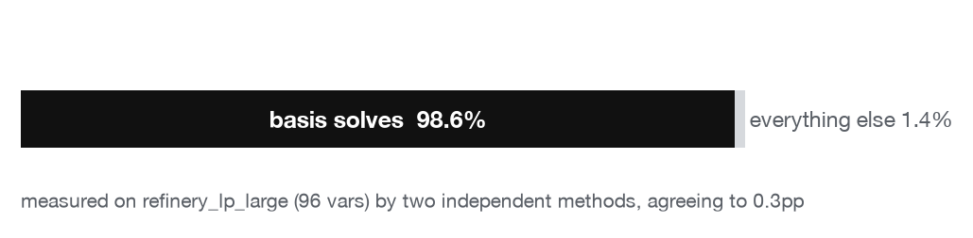
Technical Approach
Methodology · selective acceleration · what makes the output trustworthy
How a model is actually solved
MODEL
PRESOLVE
NUMERICAL CORE
OPTIMIZATION
ACCELERATION
VERIFY
RESULT
rows, columns,
bounds, objective
reduce and record,
reversibly
basis solves,
scaling, tolerances
simplex pivots,
B&B tree search
kernel level
(build next)
independent
re-check
status, objective,
gap, solver log
numerical failure or a badly conditioned basis → re-scale, re-factorize, re-solve
Where the time actually goes — measured, not assumed
Selective acceleration — what runs where
CPU — control flow
model parsing · presolve · pivot selection · branch decisions · tree management
NUMERICAL KERNELS — the hot path
basis factorization · triangular solves · sparse mat-vec · vector updates
GPU — candidate, never the default
only kernels large enough to amortise transfer, chosen by profiling
98.6% of solve time on refinery_lp_large (96 variables) is inside our own
Gaussian elimination. cProfile and direct instrumentation were run separately
and agree to 0.3 percentage points. Presolve, pivot selection, the ratio test
and verification together are the other 1.4%.
That one number decides the acceleration plan. There is a single hot path, and
its first fix is sparse LU with factorization updates on the CPU — not a GPU.
At this size the basis is tens of rows: far too small to pay for a transfer.
CPU — results
incumbent bookkeeping · independent verification · solution, gap and log
GPU acceleration is applied to measurable numerical
bottlenecks, not forced onto irregular solver logic.
No GPU experiment has been run. No GPU speedup is claimed anywhere.
Three checks that make the output trustworthy
Independent verification
Sound optimality claims
Exact rational oracle
Every reported solution is re-checked against
the original model from raw coefficients, by
code separate from the solver. If it fails, the
status is NUMERICAL_FAILURE, never OPTIMAL.
No path may report OPTIMAL, a 0% gap or
INFEASIBLE unless it was actually proven. An
audit found two paths that did; both are fixed
and locked by tests.
Declared optima are re-derived in exact Fraction
arithmetic — Cramer's rule for LP, exhaustive
enumeration for MILP — sharing no code and no
floating point with the simplex. 8/8 confirmed.
03
Acceleration follows a measurement: 98.6% of solve time is in our own basis solves.
Smart India Hackathon 2026 · PS 26119 · SANKHYA

Slide 4
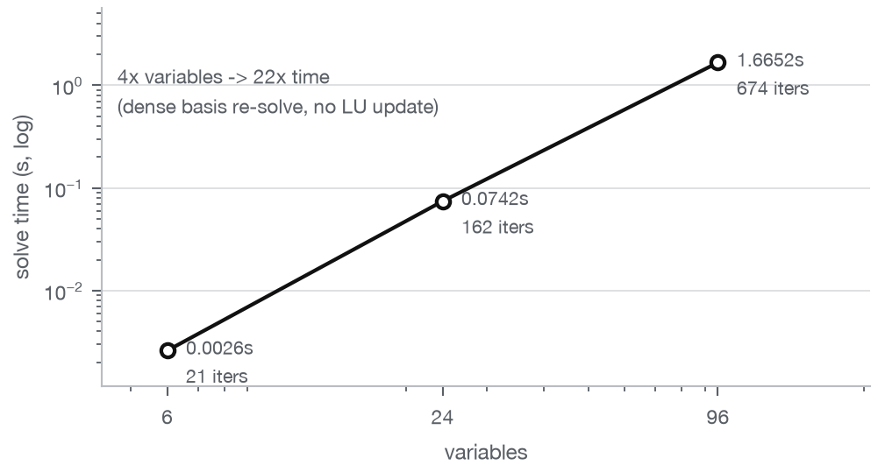
Feasibility and Viability
What is already validated · what is still hard · what comes next
60
15
14
1
8/8
0
tests passed
0 failed, 0 skipped
benchmark instances
run end to end
solved OPTIMAL
and verified
correctly detected
INFEASIBLE
known optima matched
by an exact oracle
numerical failures
0 exceptions
Three representative results
Measured cost of the current basis solve
Instance
What it is
Result
Time
refinery_lp_large
96 vars, 37 rows
synthetic refinery LP
OPTIMAL
674 simplex iterations
1.6652 s
refinery_milp_small_batches
6 vars, 10 rows
integer batch sizes
OPTIMAL
15 B&B nodes, 0.0000% gap
0.0378 s
lp_ill_conditioned_1e12
coefficient spread
of 1e12
NUMERICAL_FAILURE without scaling
OPTIMAL with auto scaling
0.0002 s
Risks we can already name, and what we do about them
Risk
Why it matters
What we do about it
Numerical instability
A badly scaled basis makes an absolute pivot tolerance
meaningless; the solver can return a confident wrong answer.
Automatic equilibration, shipped and measured. Independent verification
downgrades anything it cannot confirm to NUMERICAL_FAILURE.
Search explosion on MILP
Branch and bound is exponential. On wide integer domains it
runs out of nodes before it proves anything.
Node and time limits, and a status that refuses to say OPTIMAL over a tree
we did not finish. Measured: 0.49% gap left after 5000 nodes, published.
Scale — dense basis re-solve
Rebuilding and re-solving the basis every iteration is O(m³).
At 96 variables that is 1.67 s; industrial sizes will not finish.
Sparse LU with factorization updates is Stage 2, and the 98.6% profile says
it is the right target. No large-scale claim until it is measured.
GPU overhead
Small kernels lose more to host-device transfer than they gain.
A GPU port done for its own sake would be slower, not faster.
Profile first, CPU sparse LU second, GPU only where a measurement justifies
it — and no GPU claim of any kind in the meantime.
Stage 1 — Prototype core
Stage 2 — Numerical performance
Stage 3 — Optimization strength
Stage 4 — Acceleration
Stage 5 — External validation
done: LP, MILP, presolve, verification
sparse LU, factorization updates, bounds
dual simplex, warm starts, cuts, branching
parallel kernels; GPU where profiling justifies
Netlib, MIPLIB, reference-solver comparison
04
Stages carry no dates on purpose — each one is gated on a measured result, not a calendar.
Smart India Hackathon 2026 · PS 26119 · SANKHYA

Slide 5
Impact and Benefits
What changes when the solver core is ours
Today — the core is foreign
With a sovereign solver core
— The solver core is foreign, commercial and closed
— Licences renew for as long as the models are used
— Internal algorithms cannot be inspected or changed
— Numerical behaviour cannot be tuned when a model misbehaves
— Sensitive industrial models are built inside external tooling
— Domestic capability stops at the modelling layer
— The solver core is ours: simplex, branch and bound, basis solves
— Runs locally and offline; no external optimization engine in the loop
— Every algorithm is readable, testable and modifiable
— The numerical layer can be changed for the models that need it
— Models stay inside the organisation that owns them
— One core serves refinery, power, logistics and manufacturing
No rupee saving and no percentage cost reduction appears anywhere on this slide, because neither has been measured. The benefit being claimed is control over the solver core.
Why sovereign, specifically
Synthetic refinery case study
Commercial solver
Our solver core
Crude C1
Petrol
Solver internals
closed
open, in this repository
BLENDING
and yields
Modifiability
not available
any layer, including the pivot rule
Crude C2
Diesel
Deployment control
vendor terms
local, offline, ours
Crude C3
ATF
Algorithm visibility
documented behaviour
source, tests, measured results
Model ownership
tied to vendor tooling
plain files, our own reader
Constraints: crude availability · plant capacity · product demand range ·
sulfur quality limit · material balance
Objective: minimise blending cost, equivalently maximise margin
Domestic extensibility
none
the entire point of the project
This is a claim about control and inspectability, not about speed. Commercial solvers are
mature, fast and very well engineered — which is exactly why owning a core of our own
matters, and why no performance comparison against them appears anywhere in this deck.
Largest instance solved: 96 variables, 37 constraints — OPTIMAL in 1.6652 s,
674 simplex iterations, independently verified. Integer batch variant: OPTIMAL
in 15 branch-and-bound nodes with a 0.0000% gap, in 0.0378 s.
Synthetic case study. The structure is realistic — crudes, yields, quality limits, demand
ranges — but the data is generated by industrial/refinery.py. No real plant's proprietary
model was used or solved.
05
The claim is control over the solver core, not a cost number we have not measured.
Smart India Hackathon 2026 · PS 26119 · SANKHYA

Slide 6
Research and References
Every source below was checked before it was listed
The methods we implemented, and where they come from
Dantzig, G. B. — Linear Programming and Extensions. Princeton University Press, 1963.
Implemented: the simplex method, in its revised two-phase form.
Bland, R. G. — New finite pivoting rules for the simplex method. Mathematics of Operations
Research 2(2), 1977. Implemented: the anti-cycling pivot rule used in both phases.
Land, A. H. and Doig, A. G. — An automatic method of solving discrete programming problems.
Econometrica 28(3), 1960. Implemented: branch and bound over our own LP relaxations.
Curtis, A. R. and Reid, J. K. — On the automatic scaling of matrices for Gaussian elimination.
IMA Journal of Applied Mathematics 10(1), 118–124, 1972. Implemented: row and column
equilibration, with power-of-two factors so scaling introduces no error of its own.
Bartels, R. H. and Golub, G. H. — The simplex method of linear programming using LU
decomposition. Communications of the ACM 12(5), 1969. Stage 2. Not yet built.
Forrest, J. J. H. and Tomlin, J. A. — Updated triangular factors of the basis to maintain sparsity
in the product form simplex method. Mathematical Programming 2, 1972. Stage 2, not yet
built: these are the factorization updates that would remove our measured 98.6% hot path.
Applegate, D., Díaz, M., Hinder, O., Lu, H., Lubin, M., O'Donoghue, B. and Schudy, W. —
Practical Large-Scale Linear Programming using Primal-Dual Hybrid Gradient. NeurIPS 2021
(arXiv:2106.04756). Why large LPs parallelise through first-order methods.
Lu, H., Yang, J., Hu, H., Huangfu, Q., Liu, J., Liu, T., Ye, Y., Zhang, C. and Ge, D. — cuPDLP-C:
A Strengthened Implementation of cuPDLP for Linear Programming by C language.
arXiv:2312.14832, 2023. Evidence that GPU linear programming works through first-order
methods rather than a GPU simplex — which is why our GPU stage targets kernels, not pivots.
Stage 5 validation targets: Netlib LP (netlib.org/lp), MIPLIB 2017 (miplib.zib.de), Mittelmann
benchmarks (plato.asu.edu/bench.html). None has been run: this build environment has no
general internet access, so nothing in the repository is labelled as Netlib or MIPLIB data.
A sovereign optimization
engine, built from the
mathematical core upward.
Model → Solve → Accelerate → Verify
LP · MILP · QP
LP and MILP are implemented and validated.
QP is the next layer, and is not built yet.
Open architecture · Local control · Inspectable algorithms
SANKHYA
Sovereign Algorithmic Numerical Kernel
Smart India Hackathon 2026 · Problem Statement 26119
What a judge can run, in this repository
./run_demo.sh — tests, an LP solve, an MILP solve, the full 15-instance benchmark, the
scaling A/B and the plots, in one command.
python3 scripts/verify_known_optima.py — re-derives every declared optimum in exact
rational arithmetic, with no simplex involved.
python3 scripts/profile_hotspots.py — reproduces the 98.6% measurement that this deck's
acceleration plan rests on.
06
Every source here was checked, and everything not yet done is listed as not yet done.
Smart India Hackathon 2026 · PS 26119 · SANKHYA

Slide 7
TARK | Technical Methodology
Indigenous Optimization Solver · SIH 2026 · PS 26119
MAIN SOLVE PATH
from model to an independently checked answer
Industrial
Optimization Model
Model Parser
& Validation
Presolve
Numerical
Conditioning
LP Solver Core
LP / MILP
MPS / structured
model input
Remove redundant constraints
Tighten bounds · simplify
Automatic matrix equilibration
Detect ill-conditioning
Two-Phase Revised Simplex
Basis management · pivot selection
Numerical linear algebra
MILP path
LP path
LP Relaxation
Branch & Bound
Optimality /
Termination
continuous bound
Node selection · branching
Bounds · incumbent update
proof or limit
Independent Verification
Feasibility · constraints · objective
Integer feasibility
Verified Solution
Optimal · Infeasible · Limit Reached
DEVELOPMENT ROADMAP
Performance & Future Acceleration · not currently implemented
Profiling
Sparse Linear Algebra
Parallel Computation
GPU Acceleration
identify bottlenecks
factorization + basis updates
multi-core execution
CUDA kernels for suitable workloads
07
TARK develops the optimization engine itself: parse, solve, branch, verify.
Smart India Hackathon 2026 · PS 26119 · SANKHYA

