Slide 1
SMART ELECTRIC ENERGY METER
THE SECOND METER
Deepak Kharah 11
Balkrishna Shah 12
Parshva Vora 32

Slide 2
ABSTRACT
Electricity is one of the most important resource of human life. With the advancement of Technology, the generation of electricity becomes easier. Even though we have many renewable sources of electricity but the majority of the electricity is generated from carbon based fuels. is carbon based fuels are very poor way to generate electricity as the amount of pollution it creates. Secondly the generation of electricity is not free and hence the user is charged for every watt of electricity they use. There are many companies that generate electricity and supply them to the users and they charge according to their feasibility.
The monitoring of electricity consumption is done by the corporate companies that generate and supply electricity to the users and for this they use their own equipment which sometimes may be faulty. User may request the company to recheck the power consumption but it is usually not very convenient thing to do because they don't have reports of their own and hence there is a requirement of a system that user can install and monitor the consumption of electricity by their own so during at time of dispute they can refer to that second opinion to prove there point.

Slide 3
Drawbacks in current system
Process is slow.
Corporate meter is the single source of truth.
No actionable information on time.

Slide 4
SCOPE

Slide 5
SCOPE
Home monitoring
Rental properties
Colleges

Slide 6
ELECTRONIC COMPONENTS

Slide 7
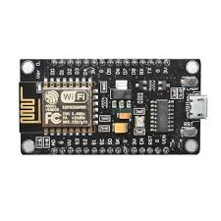
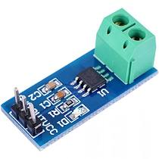
Electronic components
Components | Specifications
NodeMCU | Type: Single-board microcontroller Introductory Operating system: XTOS CPU: ESP8266[9] Memory: 128kBytes Storage: 4 MB [10] Power: USB
ACS 712 current sensor | Supply Voltage: 4.5V ~ 5.5V DC Measure Current Range: -20A ~ 20A Sensitivity: 100mV/A

Slide 8
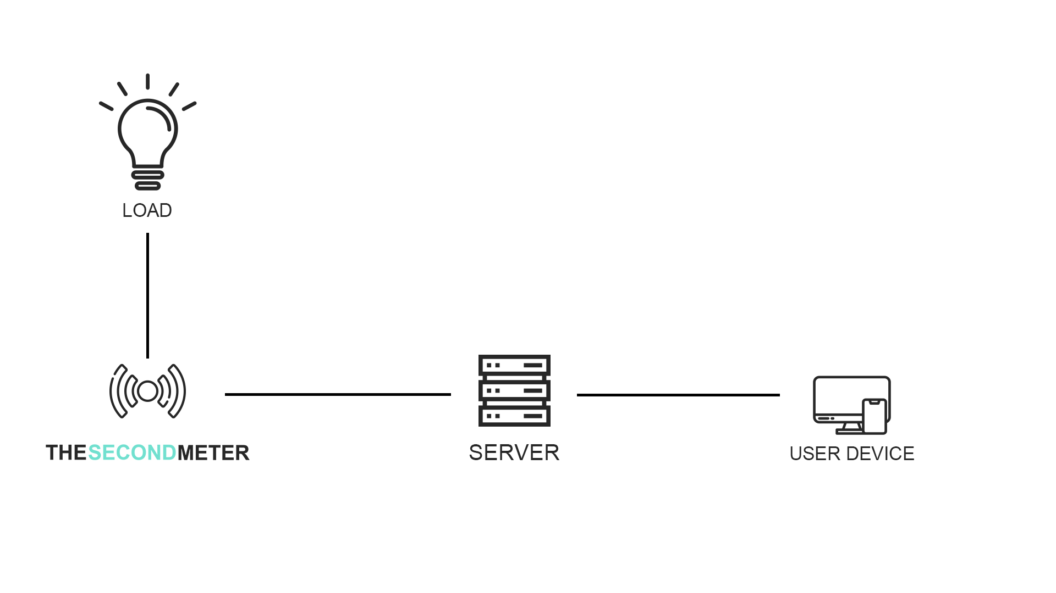

Slide 9
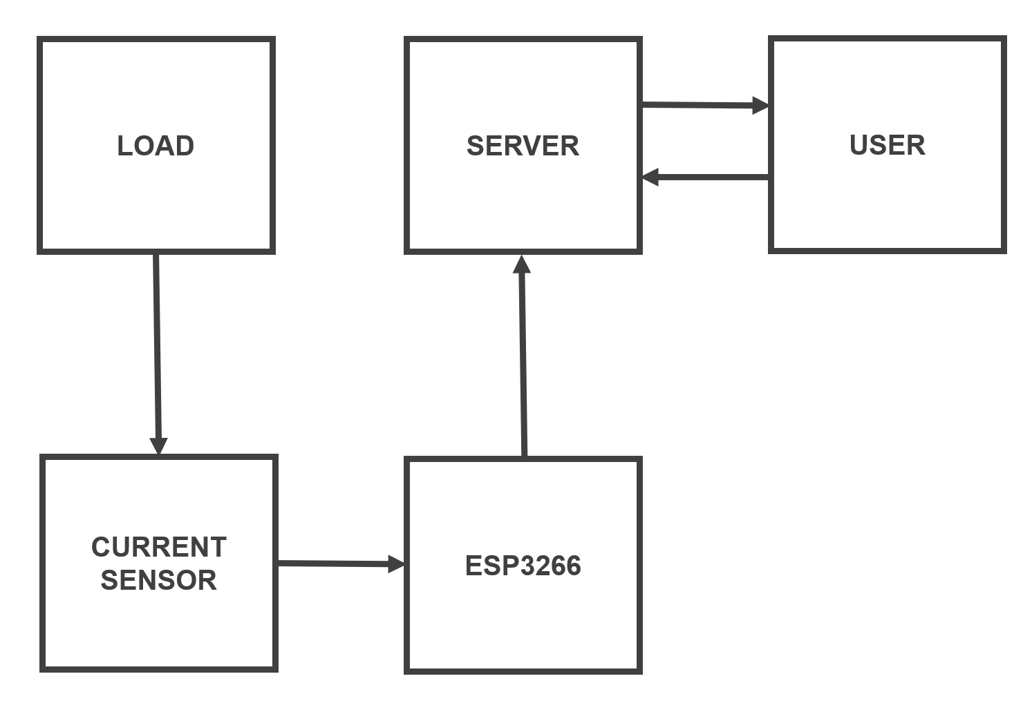
Block Diagram

Slide 10
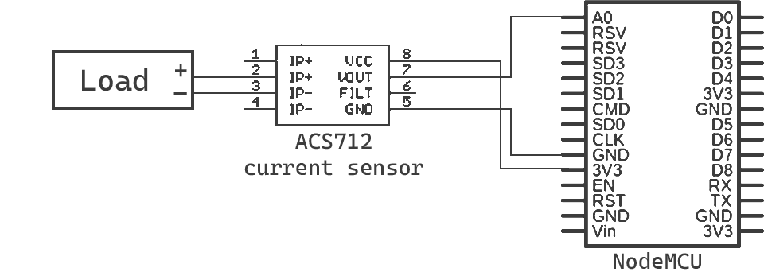
Hardware Diagram

Slide 11
BLOCK DIAGRAM

Slide 12
ACS712-20A
ESP3266

Slide 13
Home monitoring
Rental properties
Colleges
Industries

Slide 14
THANK YOU

