Slide 1
Computational Model Of Visual Information Processing
Computational modeling is the use of computers to simulate and study complex systems using mathematics, physics and computer science

Slide 2
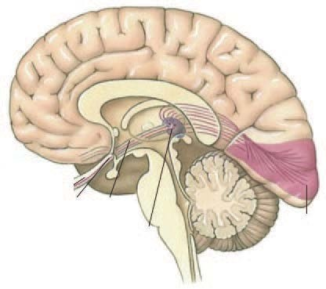



NEURAL CODING: VISION
Based on Ruben Coen-Cagli’s Lecture at Cognitive Computational Neuroscience (CCN) 2017 (http://www.ccneuro.org))

Slide 3
NEURAL CODING: VISION
State of the world “tiger”
Sensory input
Cortical activity
Action “run”
Based on Ruben Coen-Cagli’s Lecture at Cognitive Computational Neuroscience (CCN) 2017 (http://www.ccneuro.org))

Slide 4
NEURAL CODING: VISION
y
r = g(x)
x = f ( y, ,…)
a = h(r)
Based on Ruben Coen-Cagli’s Lecture at Cognitive Computational Neuroscience (CCN) 2017 (http://www.ccneuro.org))

Slide 5


NEURAL CODING: VISION
y x = f ( y, z,…)
x → yˆ
Computation
dim( yˆ ) << dim(x)
Based on Ruben Coen-Cagli’s Lecture at Cognitive Computational Neuroscience (CCN) 2017 (http://www.ccneuro.org))

Slide 6
NEURAL CODING: VISION
Encoding
r = g(x)
y x = f ( y, z,…)
Decoding
yˆ = q(r)
x → yˆ
Computation
dim( yˆ) << dim(x)
Neural computation
Based on Ruben Coen-Cagli’s Lecture at Cognitive Computational Neuroscience (CCN) 2017 (http://www.ccneuro.org))

Slide 7
p(r | x)
NEURAL CODING: VISION AS EXAMPLE
Encoding
p( y)
p(x | y)
Decoding
p( y | r)
p( y | x)
Probabilistic (Bayesian) computation
Bayesian approach to neural computation
Based on Ruben Coen-Cagli’s Lecture at Cognitive Computational Neuroscience (CCN) 2017 (http://www.ccneuro.org))

Slide 8
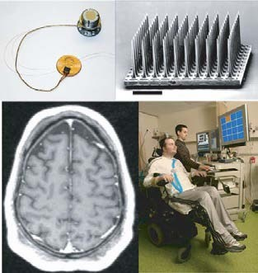
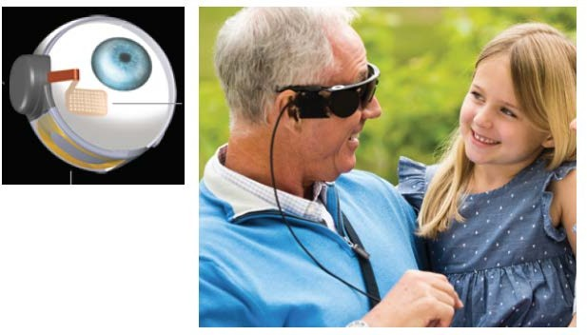
NEURAL CODING: VISION
Encoding
p(r | x)
Predict neural activity in response to external stimuli
Process neural activity to simulate external stimuli
Decoding
p( y | r) ∝ p(r | y) p( y)
Quantify accuracy of the neural code
Predict intended behavior from neural activity
Based on Ruben Coen-Cagli’s Lecture at Cognitive Computational Neuroscience (CCN) 2017 (http://www.ccneuro.org))

Slide 9
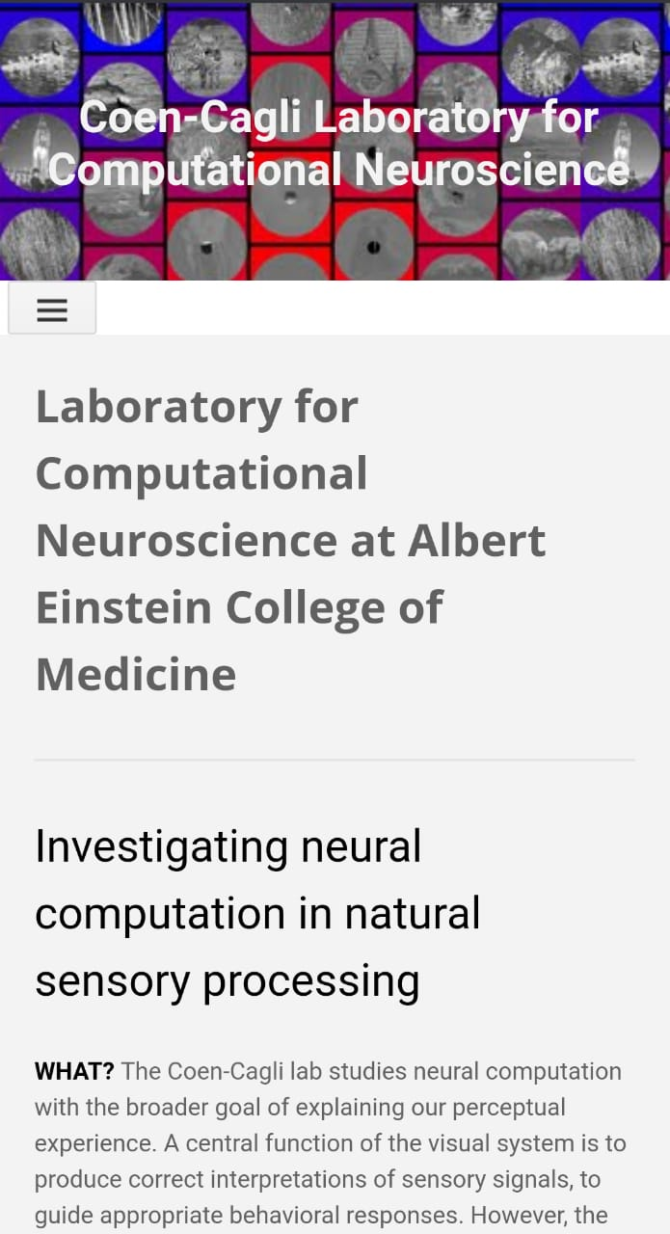
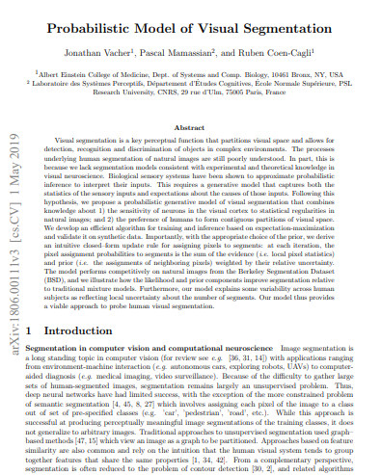
CONCLUSION:The probabilistic framework allowed us to include a regularization in the form of a prior that favors grouping of nearby pixels, while also exactly respecting reliability–based weighting of the likelihood and prior. Such a prior can be conceptualized as an effect from contextual knowledge provided by nearby visual features, and could therefore be linked to lateral interactions between cortical neurons.
This proposed model offered novel insight into the variability of human segmentation maps, suggesting that it may reflect uncertainty due to image ambiguity, which we found to be particularly prominent nearby the boundaries of different segments

Slide 10
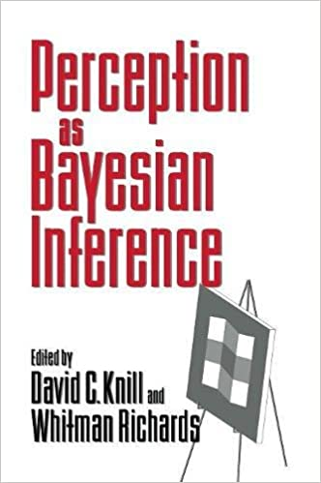
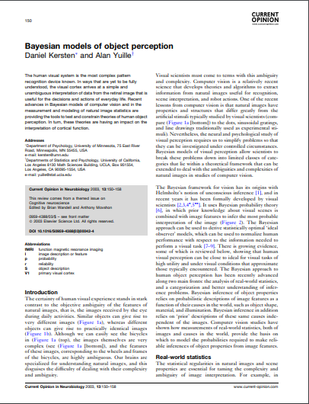
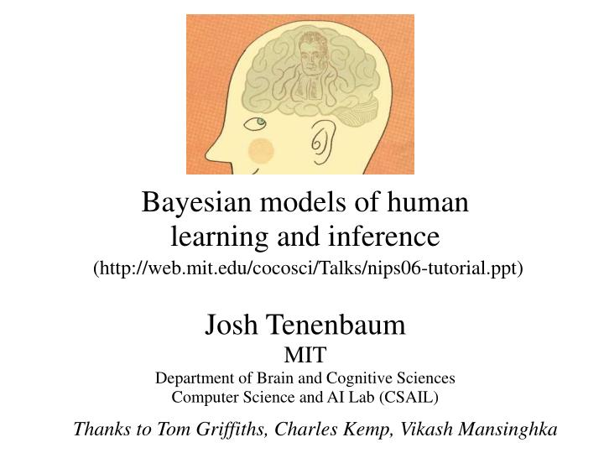
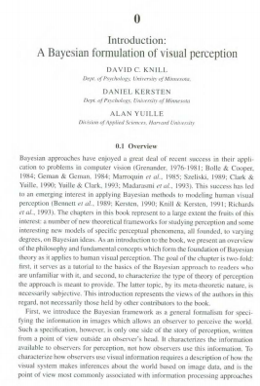
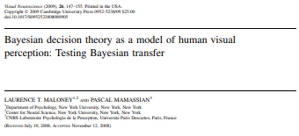

Slide 11
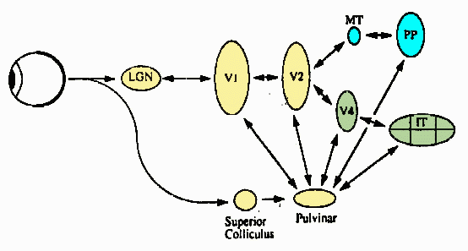
Research in the area of Visual Information Processing

Slide 12
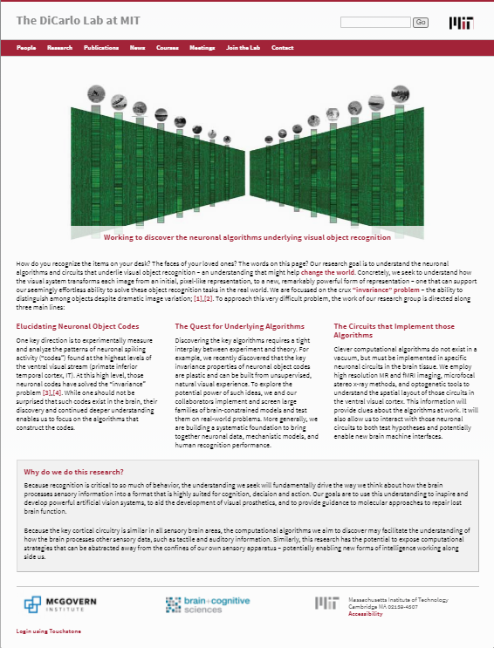
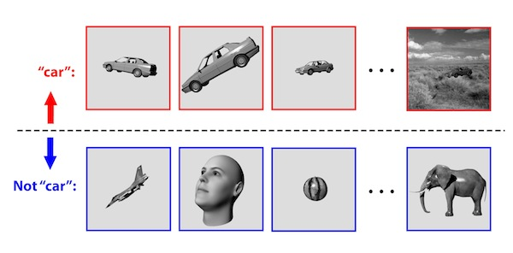
Working to discover the neuronal algorithms underlying visual object recognition
This research group is focused on understanding the neuronal representations and computational mechanisms that underlie visual object recognition
The “Invariance” Problem
Each object category can present an essentially infinite number of images to us – due to changes in object position, distance, pose, lighting, background, deformation, and exemplar variation. Yet somehow the brain is able to determine that all of these images still contain the same object category (e.g. all contain a “car” in the examples below).

Slide 13
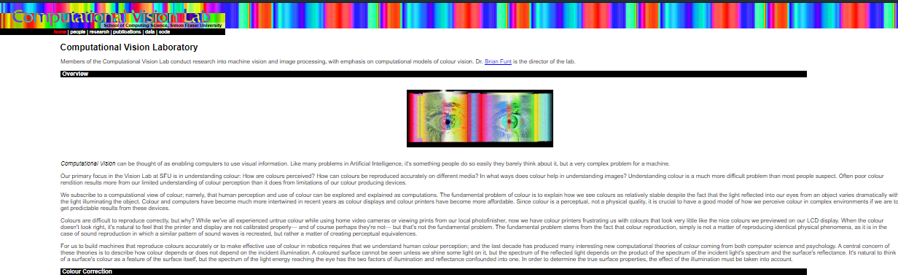
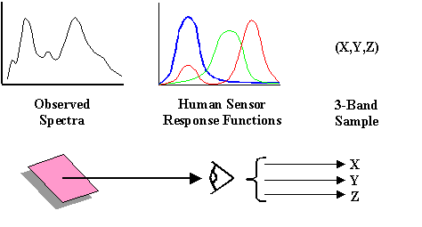
https://www2.cs.sfu.ca/~colour/research/
Computational Vision can be thought of as enabling computers to use visual information. Primary focus of the Vision Lab at SFU is in understanding colour: How are colours perceived? How can colours be reproduced accurately on different media? In what ways does colour help in understanding images?

Slide 14
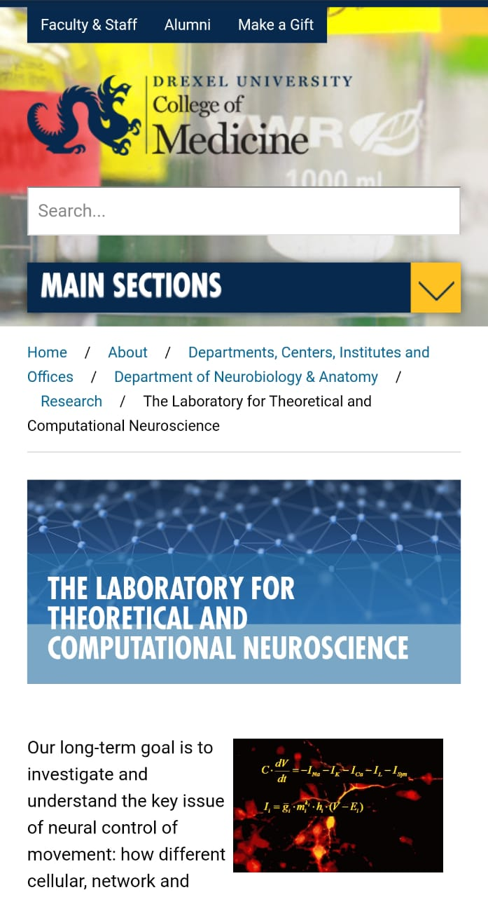
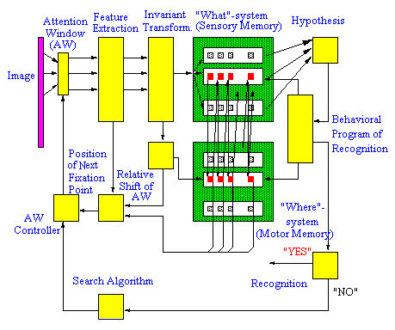
Schematic of the Model
(i) separated processing and representation of "what" (object features) and "where" (spatial features: elementary eye movements) information at the high levels of the visual system
(ii) using a frame of reference attached to the "basic" feature at each fixation point for the invariant encoding of "what" and "where" pieces of information, i.e., a feature-based frame of reference
(iii) testing a hypothesis formed at single fixation during a series of consequent fixations under top-down control of attention
(iv) mechanisms of visual attention that use "where" information stored in the memory to direct sequential image processing (hypothesis testing)
(v) mechanisms which provide matching the current object features to the expected features ( "what" information stored in the memory) at each fixation
https://drexel.edu/medicine/about/departments/neurobiology-anatomy/research/laboratory-for-theoretical-and-computational-neuroscience/

Slide 15
Thank YOU

