Slide 1
CAPSTONE PROJECT
KEY LOGGER AND SECURITY
Presented By:
1. Deepak Rajeshkumar – College of Engineering, Guindy – Computer science and Engineering

Slide 2
OUTLINE
Problem Statement
Proposed System/Solution
System Development Approach
Algorithm & Deployment
Result
Conclusion
Future Scope
References

Slide 3
Problem Statement
In today's digital world, there's a sneaky type of software causing big problems called keyloggers. These programs secretly watch what you type on your computer without you knowing. Imagine someone looking over your shoulder as you type your passwords or credit card numbers - that's what keyloggers do, but much sneakier! They can snatch up all sorts of personal info, like your logins, money details, and even private messages. This is super worrying because it can lead to things like identity theft and money scams. So, it's important to be aware of keyloggers and how to protect yourself from them to keep your info safe online

Slide 4
Proposed Solution
Keystroke Capture:
It utilizes the pynput library to capture keyboard events. Each keystroke is recorded and stored in a list named "keys_used." It distinguishes between different types of key actions (pressed, held, released) for potential future analysis, although the current code does not make use of this distinction.
Data Storage:
Two output files are generated:
key_log.txt: Contains a straightforward text log detailing the sequence of pressed keys.
key_log.json: Saves a JSON-formatted list of keys along with additional data regarding their press/release statuses (if a key was held down).
Graphical User Interface (GUI):
Utilizes the tkinter library to construct a basic GUI featuring:
A label that shows status updates.
"Start" and "Stop" buttons for managing the keylogging function.

Slide 5
System Approach
System Requirements
Functional Requirements:
Capture keystroke events (presses and releases) using a library like pynput.
Store captured keystrokes in a designated file format (text or JSON in this case).
Provide a user interface (GUI) for controlling the keylogging process.
The GUI should offer functions to:
Start keylogging.
Stop keylogging.
Non-Functional Requirements:
User-friendly interface with clear labels and functionality.
Reliable keystroke capture with minimal errors.

Slide 6
Libraries and Tools
Keystroke Capture:
The code utilizes the pynput library to listen for keyboard events.
Data Storage:
The code currently stores keystrokes in two files: key_log.txt (plain text) and key_log.json (JSON format). Secure storage methods like encryption are not implemented (important for future enhancements).
User Interface:
The code employs the tkinter library to create a simple GUI with "Start" and "Stop" buttons for controlling keylogging.

Slide 7
Algorithm & Deployment
1. Library Import:
The code starts by importing the necessary library: pynput. This library provides functions to listen for keyboard events on the user's computer.
2. Keystroke Capture Function:
A function named on_press is defined. This function gets called whenever a key is pressed on the keyboard.
Inside the on_press function:
The pressed_key variable stores the information about the pressed key using key.char (for printable characters) or key.name (for non-printable keys like function keys).
The captured key information (potentially including press/release state) is appended to a list named keys_used.
3. Data Storage:
The code defines two functions for storing the captured keystrokes:
write_keys_to_file(keys_used):
This function takes the list of captured keys (keys_used) and writes them to a plain text file named key_log.txt. Each key is written on a separate line.

Slide 8
write_keys_to_json(keys_used):
This function also takes the keys_used list, but it converts it into JSON format and writes it to a file named key_log.json. This JSON file potentially allows for storing additional information about the keystrokes .
4. User Interface (GUI):
The code utilizes the tkinter library to create a simple graphical user interface (GUI).
The GUI consists of a label displaying a message ("Log Started" or "Log Stopped") and two buttons:
"Start": clicking this button starts the keylogging process by calling the on_press function whenever a key is pressed.
"Stop": Clicking this button stops the keylogging process by presumably preventing the on_press function from being called.
5. Main Execution:
The code includes a main function that creates the GUI window and starts the event loop, waiting for user interaction with the buttons.

Slide 9
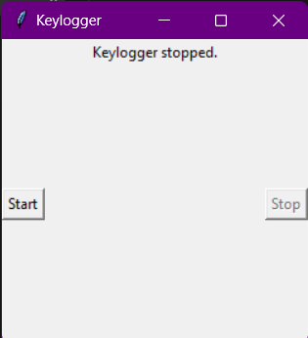
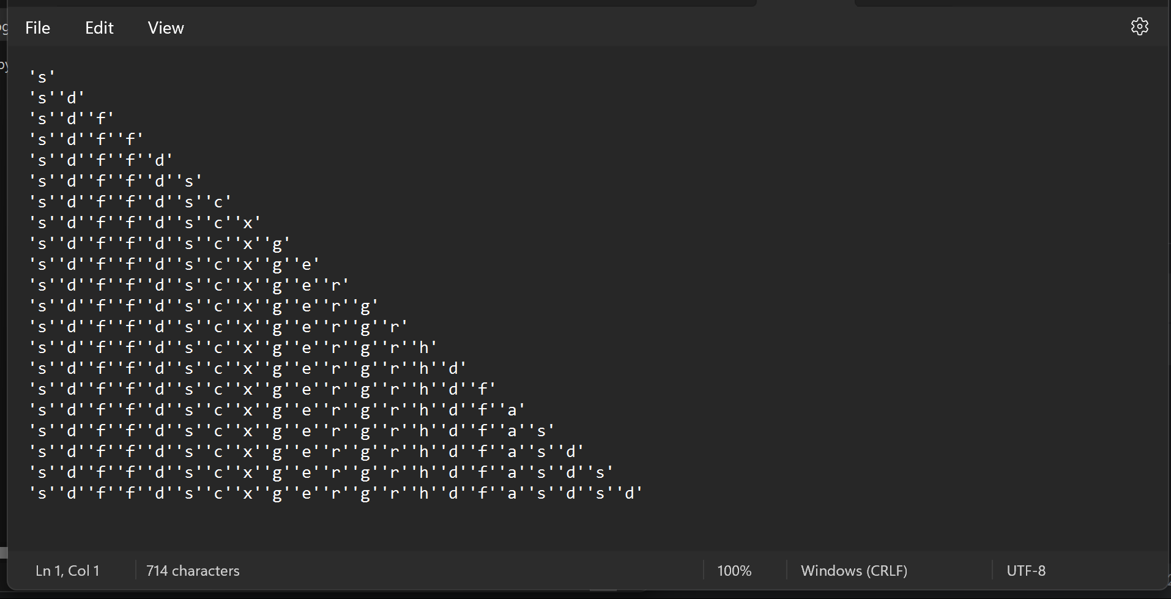
Result

Slide 10
Conclusion
Our project aims to develop a basic keylogger using Python and the pynput library. The keylogger records key presses, holds, and releases, storing the data in both text and JSON formats. We've created a simple GUI using Tkinter, allowing users to easily start and stop the keylogging process.Key observations highlight the successful implementation of keylogging features, a user-friendly interface, and efficient file management for storing keystroke data. We faced challenges such as potential detection by antivirus software and limited error handling.
Potential enhancements could include improved logging capabilities, robust error handling, and attention to security and compatibility across different platforms.
In summary, our project offers insights into keylogging methods, their practical uses, and the ethical considerations involved in their deployment.

Slide 11
Future scope
Focus on Ethical Enhancements:
Prioritize user consent, data security (encryption, access controls), and transparency.
Improve Core Functionality:
Implement secure storage for captured keystrokes.
Integrate user management and logging control options (if ethically justifiable).
Data Analysis :
Explore feature engineering, data preprocessing, and anonymized machine learning for specific analysis goals.
Emerging Technologies:
Investigate edge computing for privacy-preserving analysis (if applicable).
Explore advanced machine learning techniques cautiously, prioritizing user consent and privacy-preserving methods.

Slide 12
References
Rai, S., Choubey, V., & Garg, P. (2022, July). A Systematic Review of Encryption and Keylogging for Computer System Security. In 2022 Fifth International Conference on Computational Intelligence and Communication Technologies (CCICT) (pp. 157-163). IEEE
Joy, J., Rajaram, V., Aditya, A. R., & Pandimurugan, V. (2023, December). Developing Advanced Software Keylogger using Python and Creating Awareness of their Functionalities. In 2023 2nd International Conference on Automation, Computing and Renewable Systems (ICACRS) (pp. 1551-1557). IEEE
Shirke, A., Pawar, R., Bivalkar, M., Waghela, H., & Shah, Z. (2023, December). Advance Keylogger–Capturing Keystrokes. In 2023 6th International Conference on Advances in Science and Technology (ICAST) (pp. 250-255). IEEE.
Bejo, S. P., Kumar, B., Banerjee, P., Jha, P., Singh, A. N., & Dehury, M. K. (2023, March). Design, Analysis and Implementation of an Advanced Keylogger to Defend Cyber Threats. In 2023 9th International Conference on Advanced Computing and Communication Systems (ICACCS) (Vol. 1, pp. 2269-2274). IEEE.
Ahmed, M. B., Shoikot, M., Hossain, J., & Rahman, A. (2019). Key logger detection using memory forensic and network monitoring. International Journal of Computer Applications, 975, 8887.
Parekh, D. H., Adhvaryu, N., & Dahiy, V. (2020). Keystroke Logging: Integrating Natural Language Processing Technique to Analyze Log Data. International Journal of Innovative Technology and Exploring Engineering (IJITEE), 9(3), 2028-2033.

Slide 13
THANK YOU

