Slide 1
AXON • HEALTHCARE DATA PROJECT
PATIENT HEALTHCARE
ANALYTICS
From raw healthcare records to validated, interactive dashboards
PRESENTED BY — GROUP 4
P.L. Deepak
Ananya TS
DSV Sahithi
Alwyn Samuel
EXCEL → POWER BI → TABLEAU → MYSQL / SQL QA

Slide 2
Presentation roadmap
A clear walkthrough of the project from preparation to findings
01
Project overview and data structure
02
Ten KPIs and what they tell us
03
Excel: cleaning, PivotTables and dashboard
04
Power BI: Power Query, modelling and report
05
Tableau: worksheets, dashboard and filters
06
MySQL: quality assurance and KPI validation
07
Findings, recommended actions and conclusion
AXON | PATIENT HEALTHCARE ANALYTICS | GROUP 4
2

Slide 3
Project overview
Objective • data • workflow
PROJECT OBJECTIVE
DATASET AT A GLANCE
Turn patient, doctor, visit, treatment and lab-result records into understandable views that support operational review and data-driven questions.
Patients
10,000
Doctors
1,000
WHAT WE DID
Visits
10,000
Prepared and reviewed data before visualisation.
Built dashboards in Excel, Power BI and Tableau.
Used MySQL queries to check records and validate selected measures.
Treatments
10,000
Lab results
10,000
AXON | PATIENT HEALTHCARE ANALYTICS | GROUP 4
3

Slide 4
Ten core healthcare KPIs
Each measure is shown separately; values follow the supplied dashboards and SQL outputs
01
Total patients
10,000
02
Total doctors
1,000
Patient records in the dataset.
Doctor records in the dataset.
03
Total visits
10,000
04
Average patient age
48.94 years
Recorded visit entries.
Mean age across patient records.
05
Top 5 conditions
5 categories
06
Follow-up rate
49.84%
Migraine, Hypertension, Asthma, Healthy, Diabetes.
4,984 records marked Yes.
07
Average treatment cost
₹524.75
08
Total lab tests
10,000
Average recorded treatment cost.
Lab-result records available.
09
Abnormal lab results
33.54%
10
Doctor workload
10.0
3,354 records marked Abnormal.
10,000 visits ÷ 1,000 doctors.
AXON | PATIENT HEALTHCARE ANALYTICS | GROUP 4
4

Slide 5
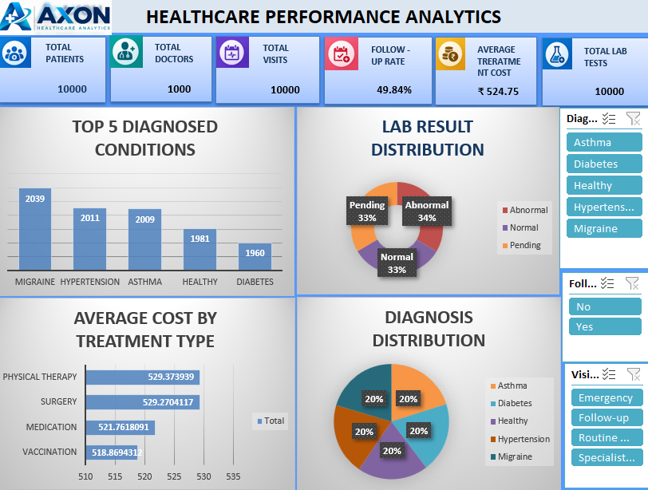
Excel dashboard
Initial KPI overview • PivotTables • interactive slicers
WHAT THE DASHBOARD PROVIDES
Headline KPI cards for quick scanning.
Charts for diagnosis, lab status and operational measures.
Slicers to focus the view on selected categories.
Consistent number formats, titles, colours and spacing.
AXON | PATIENT HEALTHCARE ANALYTICS | GROUP 4
5

Slide 6
Excel workflow — data preparation
Step-by-step process used before building the dashboard
1. Inspect and understand the workbook
Reviewed sheets, column headings, field meaning and record structure. Identified the patient, doctor, visit, treatment and lab-result information needed for the analysis.
2. Clean and transform the data
Checked column names, blank values, data types, category spelling and values that could affect summaries. Standardised fields where needed so dates, IDs, text and numeric values could be used consistently.
3. Check quality before analysis
Looked for duplicate records and reviewed whether values were complete and logically consistent. These checks help identify potential issues; they do not prove every source value is clinically accurate.
4. Load and prepare the analysis range
Organised the prepared data into a usable Excel range/table, making it easier for PivotTables and charts to reference the source and refresh when the data changes.
AXON | PATIENT HEALTHCARE ANALYTICS | GROUP 4
6

Slide 7
Excel workflow — KPIs and PivotTables
How the source data became summary measures
1. Calculate the ten KPIs
Prepared headline measures for patient and doctor counts, visit counts, average age, top condition categories, follow-up rate, average treatment cost, lab-result count, abnormal-lab rate and average visits per doctor.
2. Build PivotTables
Grouped and summarised fields to count visits by diagnosis, compare lab-result status, review follow-up categories and aggregate relevant operational measures. Selected Count, Average or other aggregations according to the question.
3. Create visuals from the summaries
Created charts linked to the PivotTables so the visuals could communicate category comparisons and status distributions more quickly than raw rows.
4. Validate the outputs
Compared the displayed summaries with expected counts and formulas. The aim was to keep KPI cards, PivotTables and charts aligned with the same definitions.
AXON | PATIENT HEALTHCARE ANALYTICS | GROUP 4
7

Slide 8
Excel workflow — dashboard design
Presentation and interaction choices that made the dashboard easier to use
1. Arrange information by priority
Placed headline metrics prominently and grouped supporting charts into a clear reading order. Used concise titles and labels so viewers could interpret each visual without searching through the source data.
2. Add slicers and connect them
Inserted slicers for relevant categories and connected each slicer to the PivotTables it should control. Checked the report connections so a filter updates the intended charts rather than leaving unrelated visuals unchanged.
3. Apply consistent formatting
Adjusted chart sizes, alignments, fonts, number formats, borders and colour choices. Used a consistent visual hierarchy to make the dashboard look professional and reduce clutter.
4. Add design elements and review
Added dashboard branding, icons/symbols for KPI cards such as patients and doctors, and a background image/design element. Reviewed spacing, readability and whether key numbers remained visible after filtering.
AXON | PATIENT HEALTHCARE ANALYTICS | GROUP 4
8

Slide 9
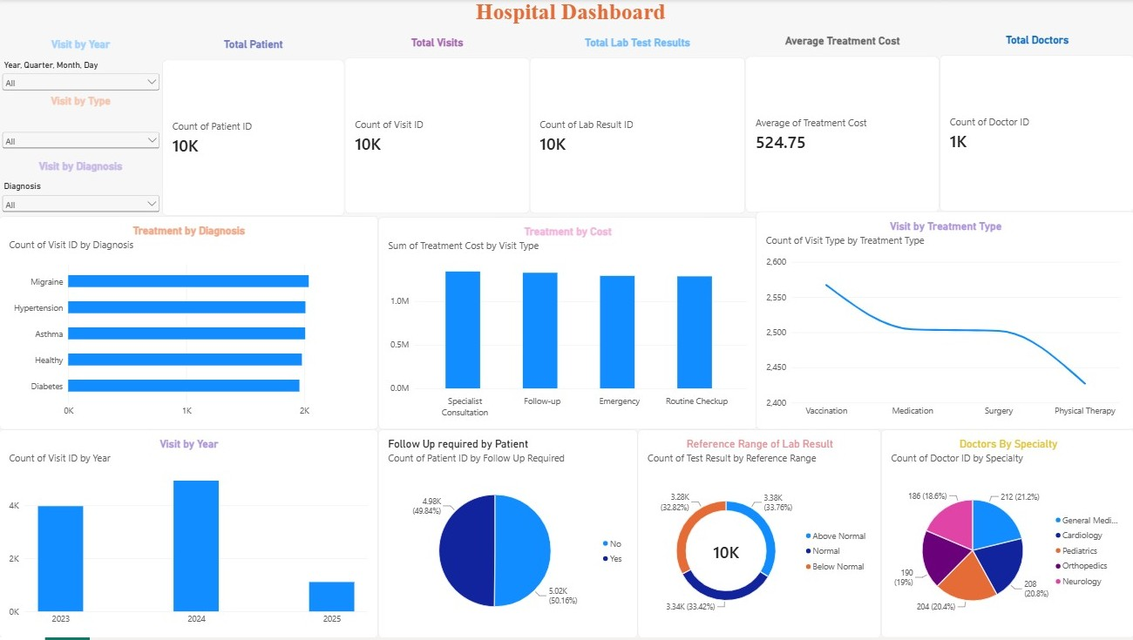
Power BI dashboard
Power Query • data model • measures • interactive report
REPORT FOCUS
KPI cards and summary visuals.
Diagnosis and lab-result breakdowns.
Follow-up and visit comparisons.
Filters that allow focused exploration.
AXON | PATIENT HEALTHCARE ANALYTICS | GROUP 4
9

Slide 10
Power BI workflow — Power Query and model
Preparation steps that support reliable relationships and calculations
1. Import and inspect tables
Loaded the relevant healthcare tables and reviewed field names, data types, IDs and category columns before building visuals.
2. Clean and transform in Power Query
Checked types for dates, numbers and text; reviewed nulls and category consistency; renamed or adjusted fields where appropriate. Applied transformations before loading the cleaned result into the report model.
3. Review relationships and data grain
Connected related tables through the appropriate keys, checking that the relationships represented how patient, doctor, visit, treatment and lab-result records relate. Correct relationships reduce the risk of incorrect counts or duplicated totals.
4. Apply modelling discipline
Kept identifiers distinct from numeric measures, checked relationship direction and cardinality where applicable, and ensured date and category fields could be used meaningfully in filters and visuals.
AXON | PATIENT HEALTHCARE ANALYTICS | GROUP 4
10

Slide 11
Power BI workflow — measures and report design
How measures, visuals and filters work together
1. Define calculations and measures
Created or used calculations for patient counts, visit counts, average age, follow-up percentage, average treatment cost, abnormal-lab percentage and visits per doctor. Used aggregation logic that matches each KPI definition.
2. Build KPI cards and supporting charts
Used cards for the headline figures and charts for condition categories, lab-result status, follow-up and visit patterns. Each visual was selected to answer a specific question rather than simply fill space.
3. Add slicers and configure interactions
Added relevant filters such as visit year, visit type and diagnosis. Reviewed which visuals should respond to each slicer so users can explore a subset without confusing or misleading interactions.
4. Format and validate the report
Aligned visuals, applied consistent titles and colours, checked units and labels, and compared key outputs with the Excel summaries and SQL checks where available.
AXON | PATIENT HEALTHCARE ANALYTICS | GROUP 4
11

Slide 12
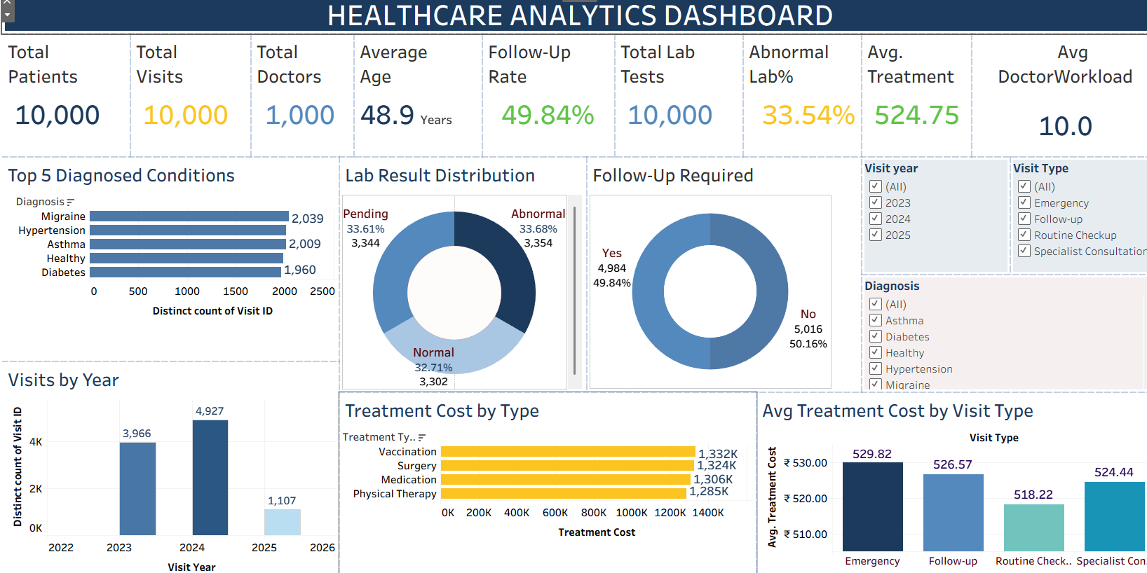
Tableau dashboard
Worksheets combined into a single visual exploration space
TABLEAU VIEW
KPI and category summaries.
Separate worksheets for different questions.
Dashboard layout to compare views together.
Filters for exploring selected data.
AXON | PATIENT HEALTHCARE ANALYTICS | GROUP 4
12

Slide 13
Tableau workflow — connect, prepare and build worksheets
From source fields to individual analytical views
1. Connect to the healthcare data
Opened the relevant data source and reviewed the available tables and fields. Checked field types and roles so dates, categories, IDs and numeric values were interpreted appropriately.
2. Prepare fields for analysis
Reviewed data types and category values; used suitable aggregations or calculated fields when a measure required a defined calculation. Distinguished dimensions used to group data from measures used to calculate totals or averages.
3. Build individual worksheets
Created separate views for selected KPI and operational questions, such as diagnosis distribution, lab-result categories, follow-up status and visit comparisons. Used chart types that suit each comparison.
4. Check worksheet meaning
Added clear titles and labels, reviewed axes and aggregation choices, and ensured the chart represented counts, averages or percentages as intended.
AXON | PATIENT HEALTHCARE ANALYTICS | GROUP 4
13

Slide 14
Tableau workflow — dashboard and interactivity
How separate views became one report experience
1. Assemble the dashboard
Placed the prepared worksheets into one dashboard, giving headline metrics priority and positioning supporting charts nearby for comparison.
2. Add filters and control scope
Added relevant filters and checked whether they should affect one worksheet or multiple views. Filter scope matters because an unexpected scope can make charts appear inconsistent.
3. Format for readability
Aligned the views, used concise titles and consistent colour choices, and avoided unnecessary decoration so users can focus on the healthcare measures.
4. Compare with other tools
Reviewed whether key totals and categories were consistent with the Excel and Power BI outputs. Differences should be investigated for filter settings, aggregation rules or field definitions before being interpreted.
AXON | PATIENT HEALTHCARE ANALYTICS | GROUP 4
14

Slide 15
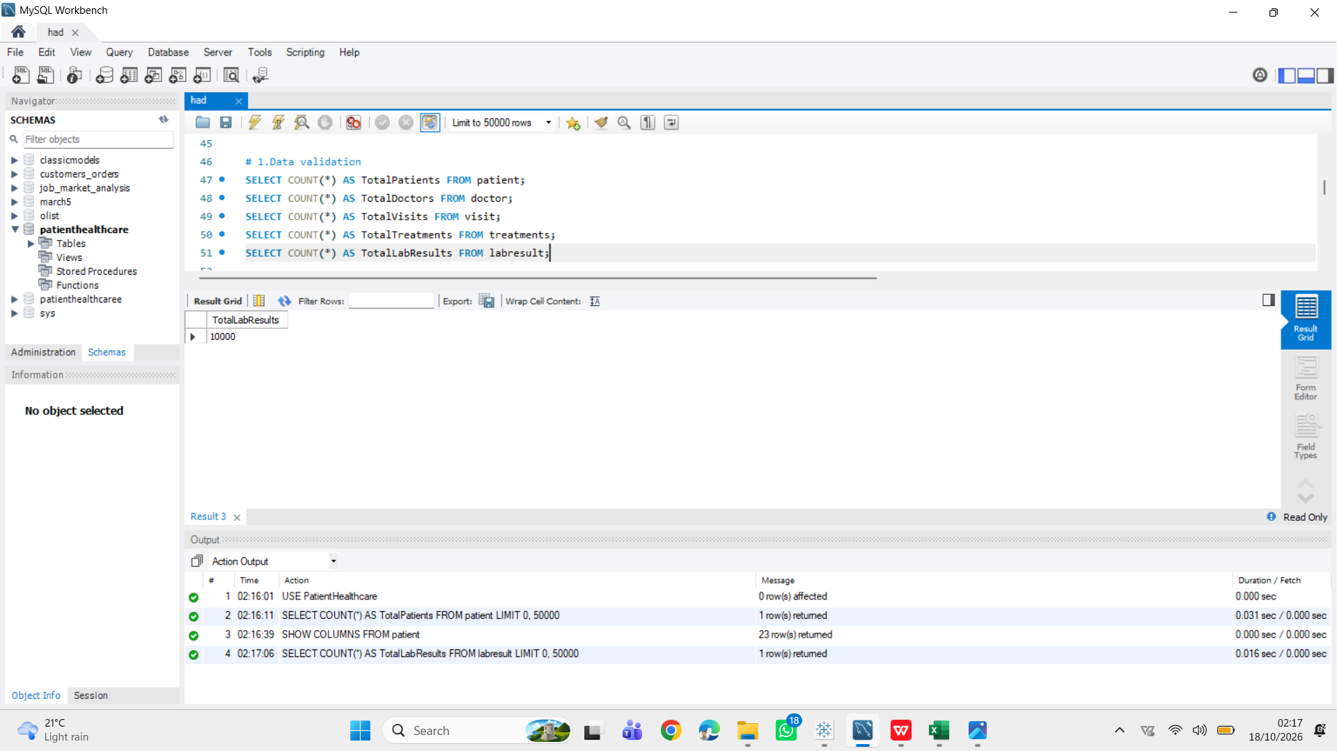
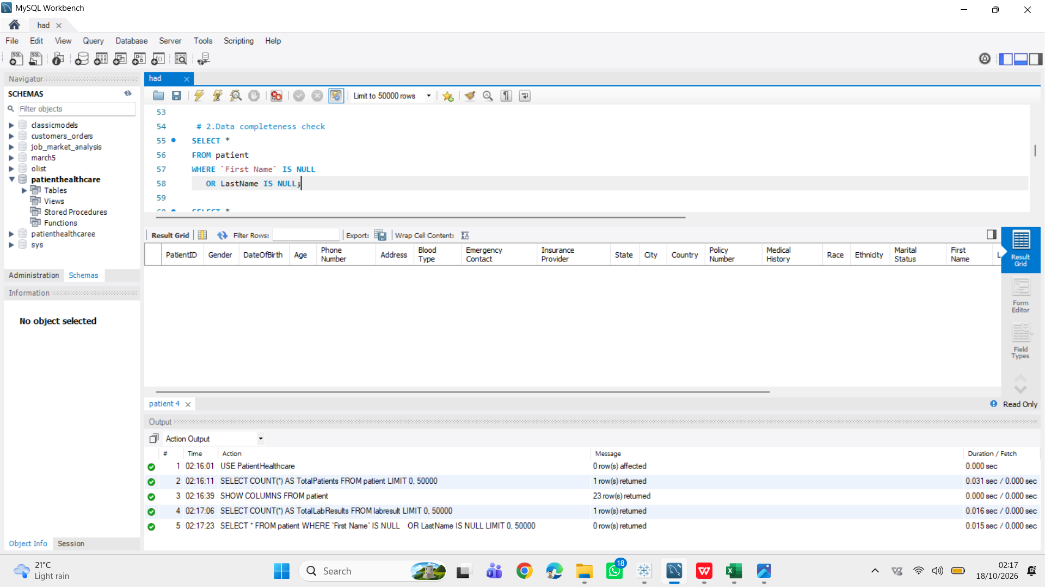
MySQL and SQL quality assurance
Structured checks to validate records and selected KPI outputs
CHECKS PERFORMED
Table structures and record counts.
Completeness checks for required fields.
Consistency checks for related IDs.
Duplicate checks on patient identifiers.
Aggregations to compare dashboard KPIs.
EXPLAIN ANALYZE to inspect a query plan.
AXON | PATIENT HEALTHCARE ANALYTICS | GROUP 4
15

Slide 16
MySQL workflow — database and data quality
How SQL was used to inspect the data before interpreting the results
1. Select the database and inspect tables
Worked in the PatientHealthcare schema and inspected the relevant table structures. The displayed Patient table check showed 10,000 records and 23 columns.
2. Validate record counts
Used COUNT queries to verify records in the tables used by the project, including Patient, Doctor, Visit, Treatments and LabResult. Record counts provide a baseline for checking that imports and joins have not unexpectedly changed the number of rows.
3. Check completeness and consistency
Ran checks for missing required values and reviewed whether foreign-key-style identifiers matched related records in the displayed checks. Zero rows returned by a particular issue query means that query found no matching issues under its stated conditions; it does not prove every possible data issue is absent.
4. Look for duplicate records
Grouped patient identifiers to look for repeated IDs. The displayed duplicate check showed no duplicate PatientID groups. This is a useful structural check, but duplicate business records can require additional fields to identify.
AXON | PATIENT HEALTHCARE ANALYTICS | GROUP 4
16

Slide 17
MySQL workflow — KPI validation and query review
SQL results were used to cross-check dashboard values
1. Recalculate summary metrics
Used aggregation queries to calculate values such as average patient age. The displayed SQL output showed an average age of approximately 48.94 years.
2. Validate operational KPIs
Reviewed counts and calculations used in the dashboards, including patient and visit totals, lab-result categories and follow-up status. Average workload was calculated as 10,000 visits divided by 1,000 doctors, giving 10 visits per doctor on average.
3. Inspect a query plan
Used EXPLAIN ANALYZE for a date-filtered Visit query. The plan inspection helps understand how a query is executed; the exercise alone should not be described as proof that performance improved.
4. Compare tools consistently
Where the same measure appeared in Excel, Power BI, Tableau and SQL, the definition and filters should match. Any mismatch should be traced to filter scope, date parsing, aggregation level or relationship logic before drawing a conclusion.
AXON | PATIENT HEALTHCARE ANALYTICS | GROUP 4
17

Slide 18
Key findings — what the data suggests
These are descriptive observations from the supplied dataset, not clinical conclusions
Follow-up is almost evenly split
4,984 records are marked Yes, or 49.84%. This indicates that follow-up status is common in the records. It does not tell us whether every patient who needed follow-up received it. Action: review follow-up eligibility, due dates and completion separately, and prioritise overdue cases.
About one-third of lab results are abnormal
3,354 of 10,000 lab-result records are marked Abnormal (33.54%). This is a descriptive status count, not a diagnosis or evidence of poor care. Action: use a clinical review process to prioritise abnormal results, document escalation and track resolution.
A substantial share of results are pending
3,344 records are Pending (33.44%). Pending results may reflect workflow timing or other factors; the dataset alone does not establish the cause. Action: analyse pending age and test type, set appropriate turnaround targets and monitor overdue results.
Visits and doctors imply an average of ten visits per doctor
This is a simple overall average, not a measure of workload balance. Action: break workload down by doctor, date and visit type before making staffing decisions.
AXON | PATIENT HEALTHCARE ANALYTICS | GROUP 4
18

Slide 19
Recommended actions and further analysis
Move from summary dashboards to operational follow-up
1. Improve follow-up visibility
Separate patients requiring follow-up from those with a follow-up recorded. Add due date, completion date and overdue status if available; monitor the percentage completed within the expected timeframe.
2. Monitor lab-result turnaround
Track pending results by age, test type and responsible team. Establish review and escalation rules with clinical stakeholders; do not infer clinical urgency from status alone.
3. Investigate condition patterns carefully
The top categories are Migraine (2,039), Hypertension (2,011), Asthma (2,009), Healthy (1,981) and Diabetes (1,960). Counts are close together. Confirm the meaning of “Healthy” and the coding rules before using these categories for clinical comparisons.
4. Examine cost and workload distributions
Average treatment cost is ₹524.75 and average visits per doctor is 10.0. Averages can hide variation. Compare distributions by visit type, time period and doctor while accounting for data completeness and context.
5. Keep KPI definitions documented
Maintain a KPI dictionary with formula, source table, filter scope and refresh date. Reconcile Excel, Power BI, Tableau and SQL outputs after changes to prevent conflicting numbers.
AXON | PATIENT HEALTHCARE ANALYTICS | GROUP 4
19

Slide 20
Data interpretation and limitations
Important safeguards for presenting healthcare analytics
Counts and percentages describe the supplied records; they do not independently establish clinical quality, patient outcomes or the cause of a pattern.
“Healthy” appears in the diagnosis category values and is reported as stored. Confirm its definition before treating it as a diagnosis category comparable to the others.
An abnormal lab result is not itself a confirmed diagnosis. Clinical context, reference ranges and professional review are needed.
A zero-row issue check means no rows matched that specific query condition; it is not a guarantee of perfect data quality.
Average treatment cost and average doctor workload can hide variation. Further breakdowns are needed before making operational decisions.
For final reporting, confirm date filters, KPI definitions and refresh timing across all three dashboard tools and SQL.
AXON | PATIENT HEALTHCARE ANALYTICS | GROUP 4
20

Slide 21
Conclusion and next steps
From data preparation to cross-tool validation
PROJECT SUMMARY
NEXT STEPS
Excel provided the initial KPI overview with PivotTables, charts and slicers.
Power BI used Power Query and data modelling to present an interactive report.
Tableau provided another dashboard view through worksheets and filters.
MySQL supported data-quality checks and validation of selected measures.
Together, the tools made the data easier to explore while highlighting areas for further review.
Document KPI formulas and filters.
Review overdue follow-ups and pending results.
Investigate workload and cost variation.
Refresh and reconcile dashboards regularly.
Validate interpretations with healthcare stakeholders.
AXON | PATIENT HEALTHCARE ANALYTICS | GROUP 4
21

Slide 22
THANK YOU
PATIENT HEALTHCARE ANALYTICS • GROUP 4
P.L. Deepak • Ananya TS • DSV Sahithi • Alwyn Samuel

