Slide 1
SUPPLY CHAIN Project
[ DATA ANALYTICS ]
Presented by (Group : 7)
1. Deepak
2. Diksha
3. Ketaki

Slide 2
CONTENTS
01. Introduction & Objectives
02. Tools & Project Workflow
03. Key Performance Indicators – Part 1
04. Key Performance Indicators – Part 2
05. Dashboard Visualizations [ Excel,tableau and power bi ]
07. MySQL Queries & Analysis
08. Key Insights & Conclusion

Slide 3
INTRODUCTION & OBJECTIVES
INTRODUCTION
This project focuses on analyzing supply chain, order, delivery, customer and revenue data to evaluate overall business performance.
The project uses data analytics techniques to calculate important Key Performance Indicators (KPIs) and identify trends and performance patterns.
The analysis is implemented using Excel, MySQL, Tableau and Power BI to convert raw data into meaningful business insights.
OBJECTIVES
Analyze supply chain and order performance.
Calculate and monitor 20 important KPIs.
Analyze revenue, profitability and delivery performance.
Identify regional and monthly revenue trends.
Perform data analysis using MySQL queries and Build interactive dashboards using Excel, Tableau, Power BI.

Slide 4
TOOLS used
TOOLS USED
📊 EXCEL
Data cleaning, calculations and dashboard creation.
🗄️ MYSQL
Data querying, aggregation and KPI analysis.
📈 TABLEAU
Interactive visualizations and dashboard development.
📊 POWER BI
Interactive executive dashboard, KPIs, charts and slicers.

Slide 5
workflow
Raw Data
↓
Data Cleaning & Preparation
↓
Data Transformation
↓
MySQL Analysis
↓
KPI Calculation
↓
Visualization
↓
Dashboard Development
↓
Business Insights

Slide 6
20 KPIs:
1. Total Revenue -Measures the total revenue generated from orders.
2. Gross Margin % - Measures the percentage of revenue remaining after the cost of goods sold.
3. On-Time Delivery (OTD) % - Measures the percentage of orders delivered on or before the promised date.
4. Fill Rate % - Measures the percentage of ordered quantities successfully fulfilled.
5. Perfect Order Rate % - Measures the percentage of orders completed without errors or delivery issues.
6. Order Cycle Time - Measures the time taken to complete an order from placement to delivery.
7. Average Order Quantity - Measures the average quantity ordered per order.
8. Average Processing Time - Measures the average time required to process an order.
9. Average Delay - Measures the average number of days by which delayed orders exceed the expected delivery date.
10. Delayed Orders - Measures the total number of orders that were delivered later than the promised date.

Slide 7
11. Cost of Goods Sold (COGS) - Measures the direct cost associated with the products sold.
12. Gross Profit - Measures the profit generated after deducting the cost of goods sold from revenue.
13. Shipping Cost - Measures the total cost incurred for shipping orders.
14. Revenue per Order - Measures the average revenue generated from each order.
15. Revenue Share % - Measures the percentage contribution of a region/customer/category to total revenue.
16. Average Transportation Time - Measures the average time taken for transportation and delivery.
17. Order Quantity - Measures the total quantity of products ordered.
18. Processing Days - Measures the number of days required to process an order.
19. Delivery Performance - Evaluates the effectiveness of the delivery process based on delivery status and timing.
20. Customer/Regional Revenue - Measures revenue contribution across different customers and geographical regions.

Slide 8
DASHBOARD VISUALIZATION
EXCEL DASHBOARD
The Excel dashboard provides an overview of key supply-chain performance indicators through KPI cards, charts and interactive analysis.
Key Analysis:
Revenue performance
Delivery performance
Order performance
Regional analysis
Monthly trends

Slide 9
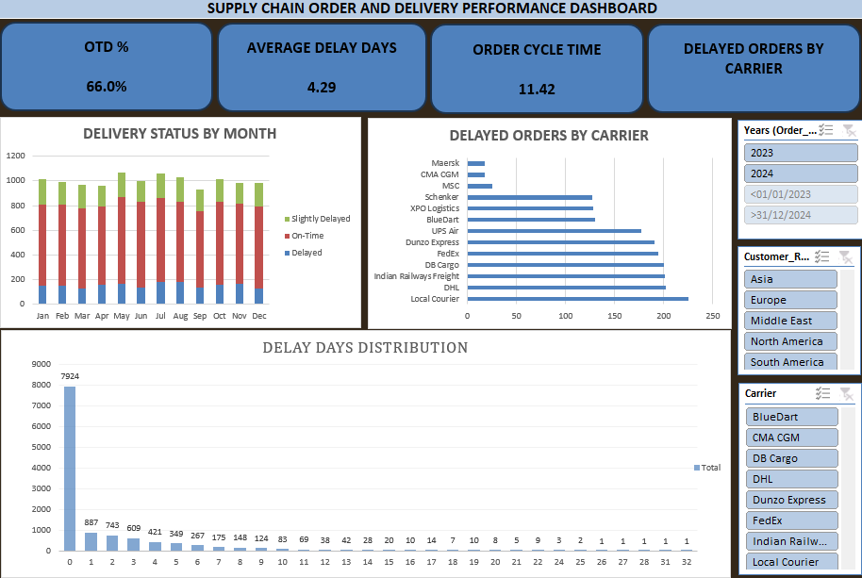
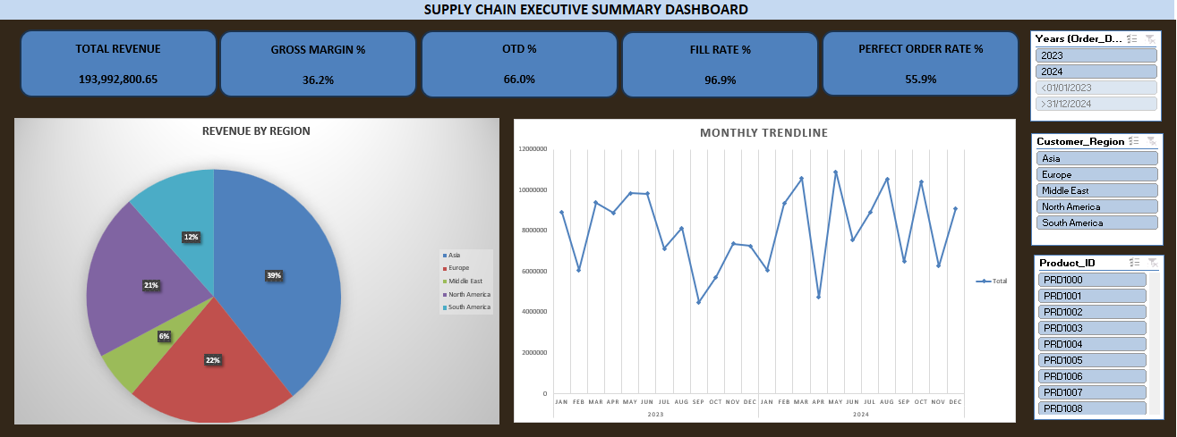
EXCEL DASHBOARDS

Slide 10
DASHBOARD VISUALIZATION
TABLEAU DASHBOARD
The Tableau dashboard provides interactive analysis of:
Revenue by customer region
Revenue by customer country
Monthly revenue trend
Revenue distribution
Geographical performance

Slide 11
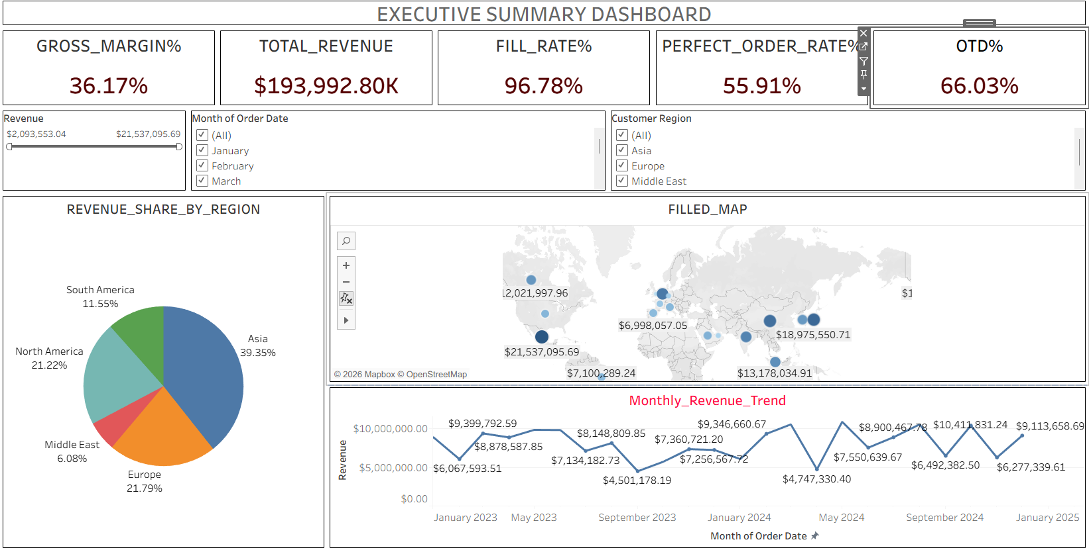
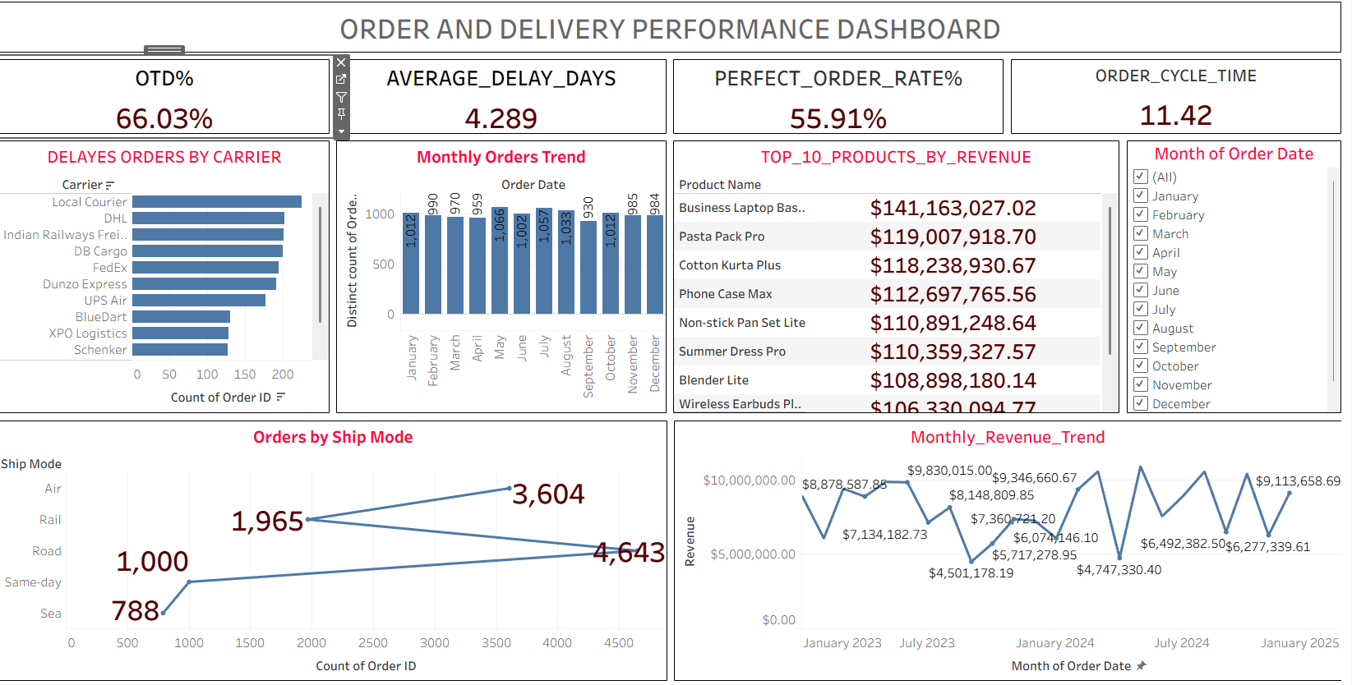
TABLEAU DASHBOARDS

Slide 12
DASHBOARD VISUALIZATION
POWER BI DASHBOARD
The Power BI dashboard provides an interactive executive-level view of overall supply-chain performanc
KEY ANALYSIS
Monthly Revenue Trend
Revenue Share by Region
Revenue by Customer Country
Customer Region Slicer
Order Date Slicer
Revenue Slicer

Slide 13
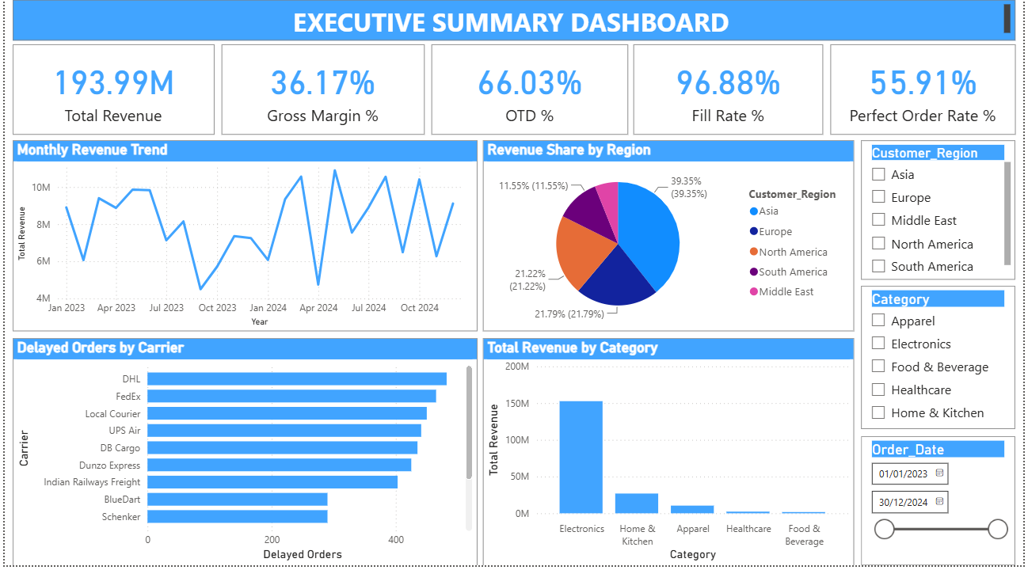
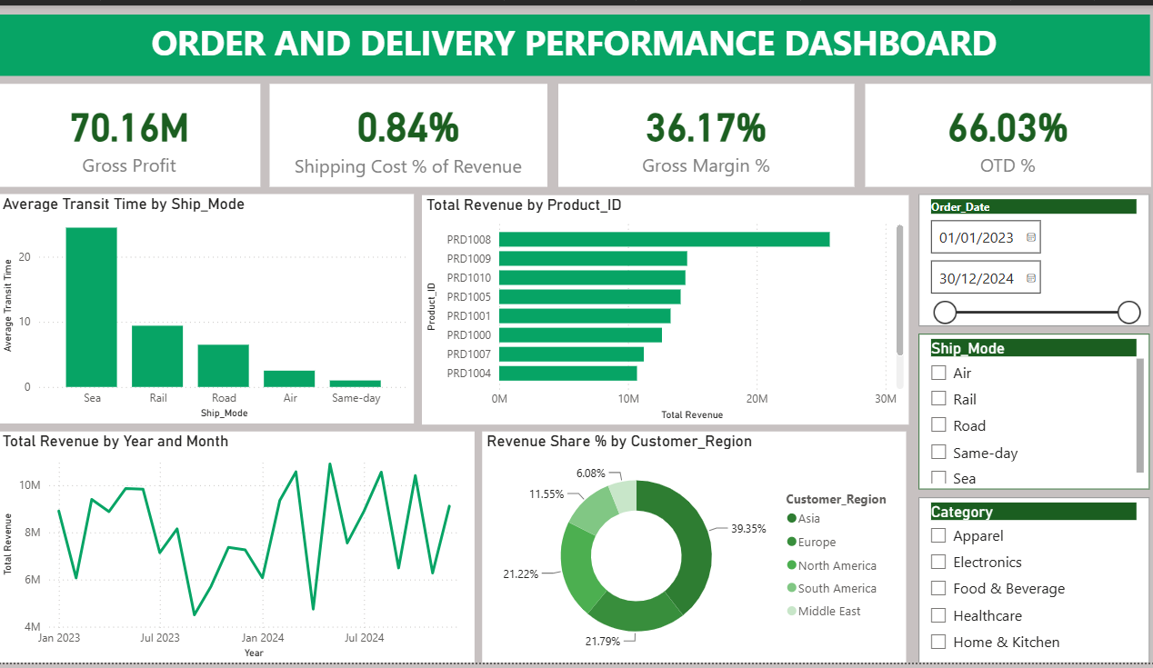
POWER BI DASHBOARDS

Slide 14
MYSQL QUERIES & ANALYSIS
MYSQL — DATA ANALYSIS
MySQL was used to extract, aggregate and analyze the data required for KPI calculation and dashboard development.
KEY SQL OPERATIONS
SELECT – Retrieve required data
WHERE – Filter records
JOIN – Combine related tables
GROUP BY – Aggregate data by categories
ORDER BY – Sort analysis results
SUM / AVG / COUNT – Calculate performance metrics

Slide 15
MYSQL QUERIES & ANALYSIS
KEY ANALYSIS PERFORMED
Total Revenue calculation
Revenue by Region
Monthly Revenue Analysis
Order and Delivery Performance
Delayed Order Analysis
KPI calculations
Customer and Product analysis

Slide 16
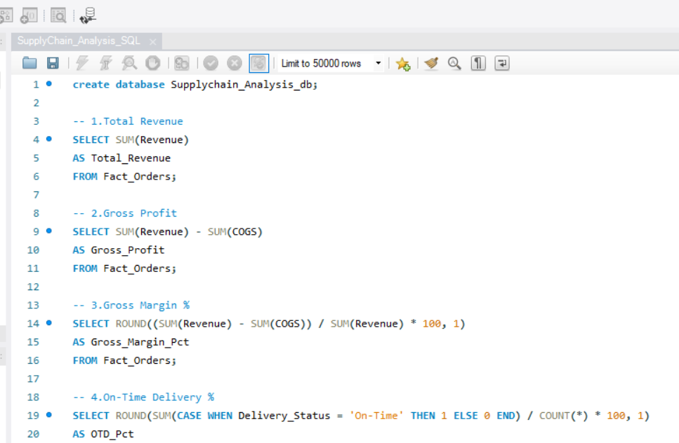
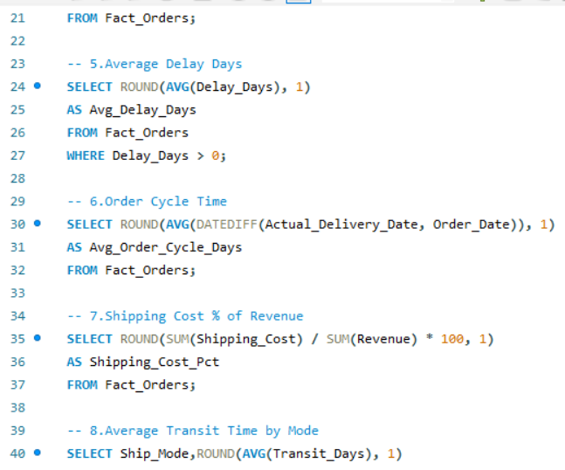
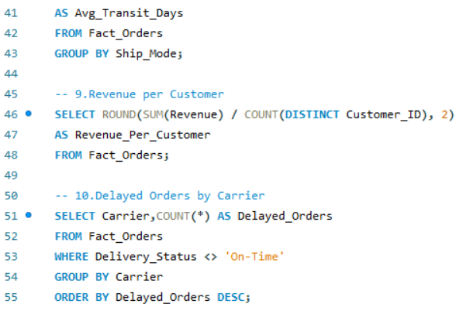
MYSQL QUERIES & ANALYSIS

Slide 17
KEY INSIGHTS & CONCLUSION
KEY INSIGHTS
Total revenue generated is approximately 193.99M.
Gross Margin is 36.17%, indicating the profitability level of the business and On-Time Delivery performance is 66.03%.
Fill Rate is 96.88%, indicating strong order fulfillment.
Perfect Order Rate is 55.91%, highlighting opportunities to improve overall order quality.
Revenue varies significantly across different customer regions.
Monthly analysis reveals fluctuations in revenue throughout the year.
Customer-country analysis helps identify important geographical revenue contributors.
CONCLUSION - The project demonstrates how data analytics can transform raw supply-chain data into meaningful business insights. By combining Excel, MySQL, Tableau and Power BI, the project provides a complete workflow for data preparation, KPI analysis, visualization and interactive reporting.

