Slide 1

AgriSense: Cultivating a Sustainable Future
AgriSense is revolutionizing agriculture with an innovative IoT sensor network designed for precision farming. Our technology delivers significant reductions in water usage, particularly in arid climates, paving the way for more sustainable and efficient food production.

Slide 2

OUR MISSION
Innovating for a Thirsty Planet
Precision Farming
Water Conservation
Leveraging advanced IoT sensors for real-time data collection and analysis.
Achieving up to 40% reduction in water usage in arid regions, a critical environmental impact.
Sustainable Agriculture
Empowering farmers to produce more with less, ensuring food security for future generations.

Slide 3

THE PROBLEM
The Global Water Crisis in Agriculture
Agriculture accounts for approximately 70% of global freshwater withdrawals, a figure that is unsustainable given increasing population demands and climate change. Inefficient irrigation practices lead to massive water waste, particularly in regions facing severe water scarcity.
Depleting aquifers and rivers
Rising operational costs for farmers
Reduced crop yields due to water stress
Environmental degradation and soil salinization

Slide 4

OUR SOLUTION
AgriSense: Smart Irrigation, Smarter Farms
Advanced IoT Sensors
1
Our network collects real-time data on soil moisture, temperature, and nutrient levels.
AI-Powered Analytics
2
Proprietary algorithms analyze data to provide precise irrigation recommendations.
Automated Control
3
Integrates with existing irrigation systems for automated, optimized water delivery.
User-Friendly Platform
4
Intuitive dashboard for farmers to monitor and manage their fields remotely.

Slide 5




IMPACT
Transforming Water Usage and Sustainability
40%
20%
Water Reduction
Yield Increase
Proven water savings in arid climates.
Optimized irrigation leads to healthier, more productive crops.
15%
Cost Savings
Reduced water and energy consumption lowers operational expenses.

Slide 6
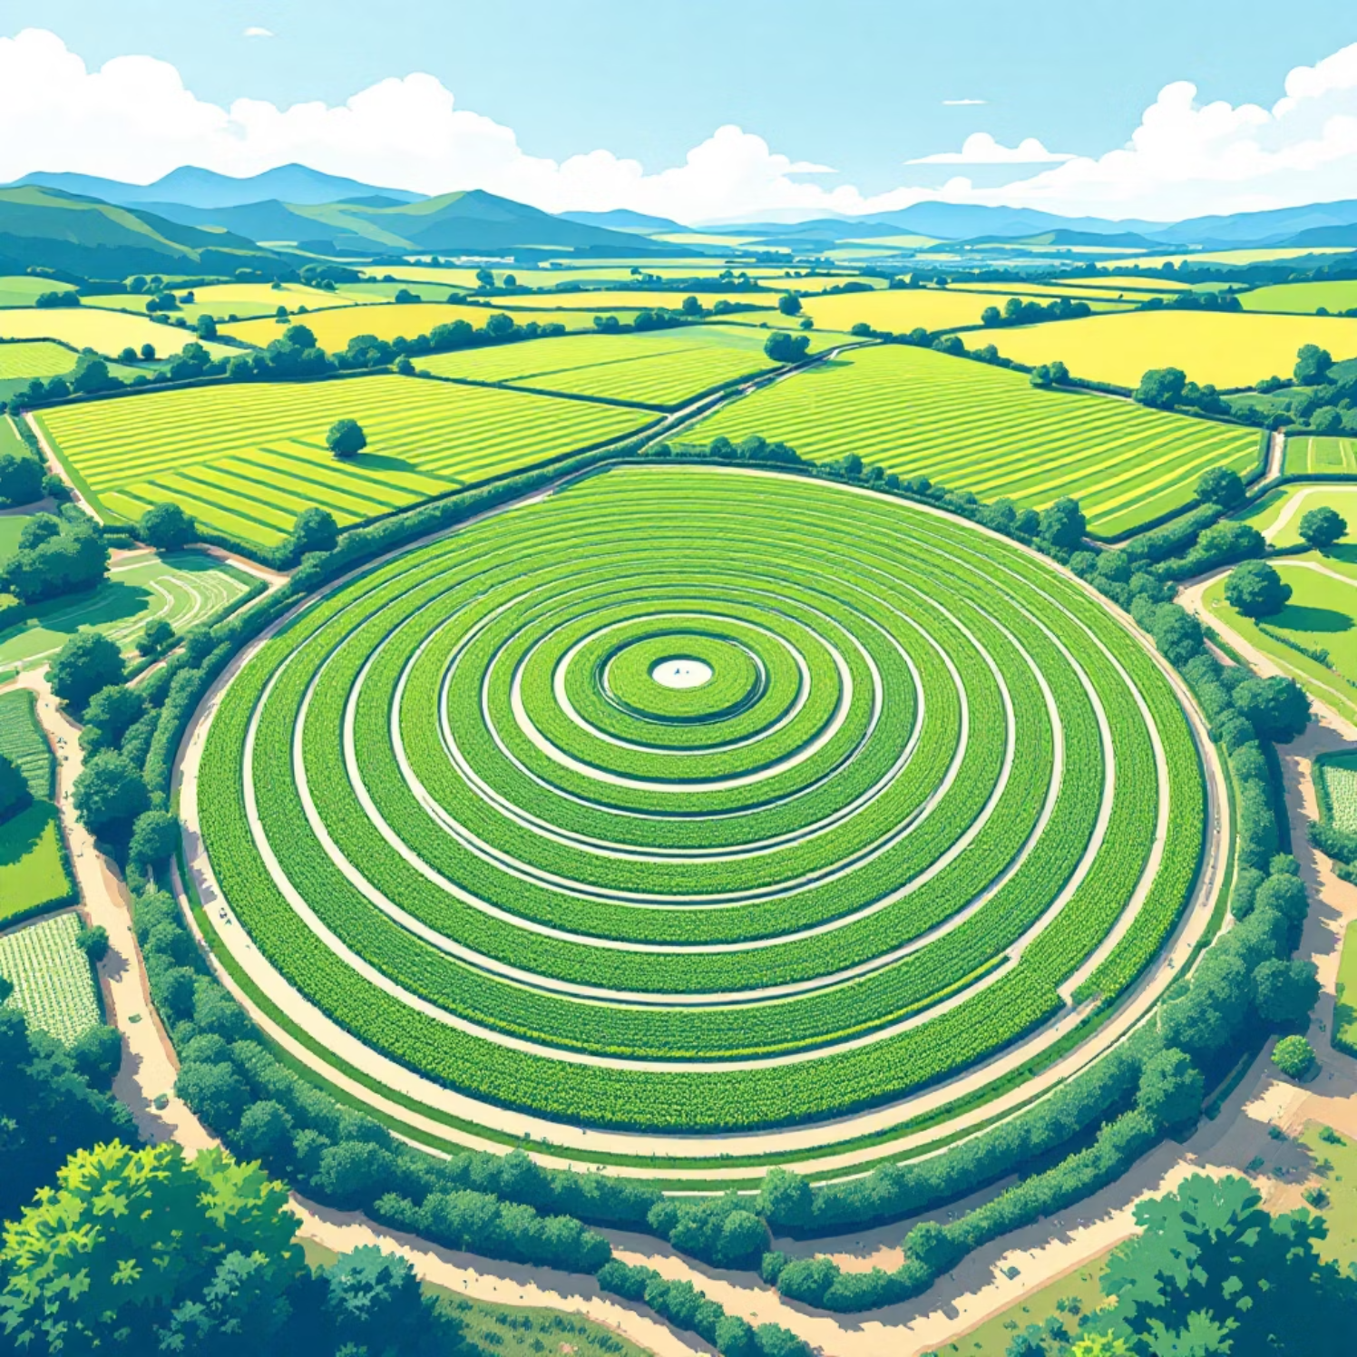
TRACTION
Proven Results from Active Pilots
We currently have 3 active pilot programs demonstrating the efficacy and impact of AgriSense in diverse agricultural settings. These pilots are generating invaluable data and refining our solution for broader market adoption.
Pilot 1: Almond Farm, California - 35% water savings
Pilot 2: Vineyard, Texas - 28% water savings, improved grape quality
Pilot 3: Vegetable Farm, Arizona - 42% water savings, 20% yield increase

Slide 7


MARKET OPPORTUNITY
Addressing a Multi-Billion Dollar Industry
The global precision agriculture market is projected to reach over $12 billion by 2028, driven by the urgent need for sustainable practices and increased efficiency. AgriSense is uniquely positioned to capture a significant share of this rapidly expanding market.
Global Reach
Significant ROI
Addressing water scarcity challenges worldwide.
Clear financial benefits for farmers and investors.
Environmental Imperative
Meeting the demand for eco-friendly solutions.

Slide 8



OUR TEAM
Experienced Leaders in AgriTech
Dr. Anya Sharma
Mark Jensen
Sarah Chen
CEO & Co-founder, 15+ years in IoT and agricultural science.
CTO & Co-founder, 10+ years in sensor development and AI.
Head of Business Development, 8+ years in agricultural markets.

Slide 9

INVESTMENT OPPORTUNITY
Join Us in Cultivating Change
We are seeking $0.5M in pre-seed funding to accelerate product development, expand our pilot programs, and scale our market outreach. Your investment will fuel the next phase of growth for AgriSense.
Ask Amount: $0.5M
Equity Offered: 15%
Valuation: [To be determined post-negotiation]

Slide 10

Grow the Future
Partner with AgriSense for a Greener Tomorrow
Contact Us: info@agrisense.com | Austin, TX

