Slide 1



Insight to Marketing Team in Food & Beverages Industry
Company : Codex
Domain – Food & beverages
Function : marketing
Tool – SQL, PowerPoint
Prepared by – Deepak p.

Slide 2



ABOUT CODEX
Codex is a German beverage company that is aiming to make its mark in the Indian emerging market.
A few months ago, they launched their energy drink in 10 cities of India.
Their marketing team is trying to increasing brand awareness, market share, and product development.
So, they conducted a survey in those 10 cities and received results from 10k respondents (Random Sampling).
OBJECTIVE
As a data analyst is tasked to convert these survey results to meaningful insights which the team can use to drive actions.

Slide 3
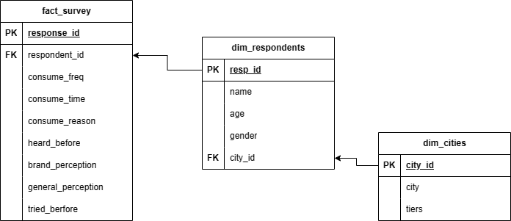
Snowflake schema

Slide 4

Who prefers energy drink more?
Demographic Insight
Around 60% of Male prefers energy drink followed by Female with 35% and Non-Binary with 5%.

Slide 5
Which age group prefers energy drinks more?
Demographic Insight
The Age group between 19-45 prefers energy drink more.

Slide 6
Which type of Marketing reaches the most Youth (15-30)?
Demographic Insight
Online Ads & TV Commercials has the major contribution for marketing reach out to youth.

Slide 7

What are the preferred ingredients of energy drinks among respondents?
Consumer Preferences
With 3896 (39%) respondent, Caffeine has the highest preferred ingredient of energy drink followed by Vitamins with 2534 (25%).

Slide 8
What packaging preferences do respondents have for energy drinks?
Consumer Preferences
Respondent prefers Compact & portable cans, Innovative bottle design (like Paper Bottle)

Slide 9

Who are the Current market leaders?
Competition Analysis
Cola-coka, Bepsi & Gangster are dominating the market with 25%, 21% & 18% of market share respectively.
Codex has the 10% of market share. Moreover, it has done great job in term of market capture

Slide 10
What are the primary reasons consumers preferring those brands over ours?
Competition Analysis
Primary reason was majority of time the brand is not available in store which is around 24%
And second is Health concerns which is around 22.5%. The marketing team should also bring the awareness regarding the pros & cons of product.

Slide 11

Which marketing channel can be used to reach more customers?
Marketing & Brand Awareness
Online Ads & TV Commercials are the most channel which reaches to customer

Slide 12

What do people think about our brand? (overall rating)
Brand Penetration
Average Rating of our brand is 3.28 which is good.
But in term of Brand perception perspective still 60% of people think Neutral and only 22% of people feels positive.
3.28

Slide 13
Which cities do we need to focus more on?
Brand Penetration
Kolkata, Ahmedabad, Delhi, Lucknow are the cities we need to focus on brand penetration.

Slide 14

Where do respondents prefer to purchase energy drinks?
Purchase Behavior
Supermarket & Online retailers are the most preference to purchase the energy drink as they offer discounts & offer than other

Slide 15
What are the typical consumption situations for energy drinks among respondents?
Purchase Behavior
Exercise & Studying/working late professional having more consumption situation for energy drink.

Slide 16
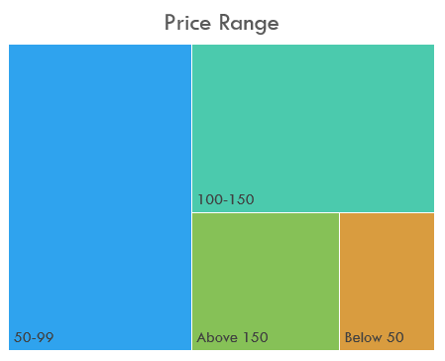
What factors influence respondents' purchase decisions?
Purchase Behavior
Price Range is the major factor where respondent make purchase decision
Another reason is likely due to brand reputation, Taste & Availability.

Slide 17

Which area of business should we focus more on our product development? (Branding/taste/availability)
Product Development
The area of business we need to focus on Brand Perception and the Effectiveness

Slide 18
Recommendations
Marketing Campaign
GYM
Marathon
Price Range
50-99
100-150
Immediate Improvement
Brand awareness
Target Audience
Youth (19-45)
Sports person

Slide 19
Recommendations
TRY TO BRING THE BRAND AWARENESS ACCORDING TO CITY

