Slide 1
Feature Matching Using Nearest Neighbour Matching
DEEPAK R 205229106

Slide 2
Introduction
What is a Feature?
When you see a mango image, how can you identify it as a mango?
By analyzing the color, shape, and texture you can say that it is a mango.
The clues which are used to identify or recognize an image are called features of an image. In the same way, computer functions, to detect various features in an image.

Slide 3
Feature Matching
Features matching or generally image matching, a part of many computer vision applications such as image registration, camera calibration and object recognition, is the task of establishing correspondences between two images of the same scene/object Feature matching between images in OpenCV can be done with
Brute-Force matcher
FLANN based matcher.

Slide 4
Brute-Force (BF) Matcher
BF Matcher matches the descriptor of a feature from one image with all other features of another image and returns the match based on the distance.
It is slow since it checks match with all the features
FLANN based matcher
Fast Library for Approximate Nearest Neighbors (FLANN) is optimised to find the matches with search even with large datasets hence its fast when compared to Brute-Force matcher.

Slide 5
Requirement
OpenCv
Numpy
Matplotlib

Slide 6
Implementation

Slide 7
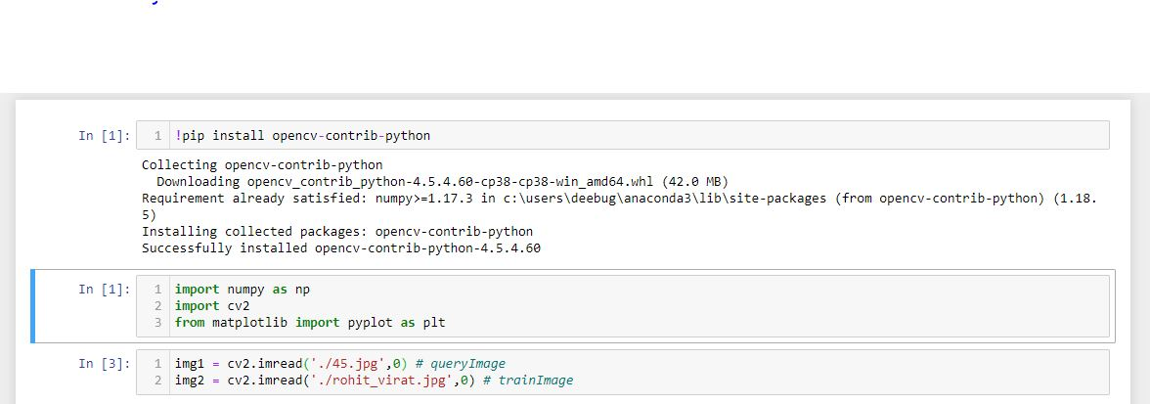

Slide 8
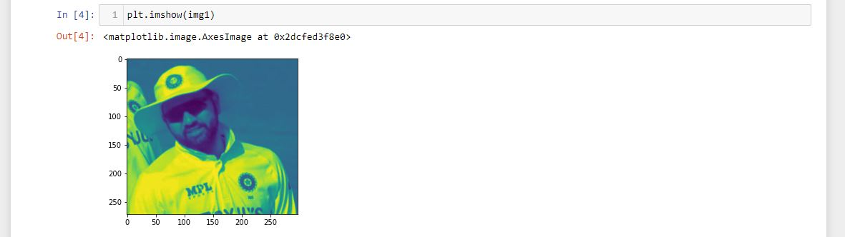

Slide 9
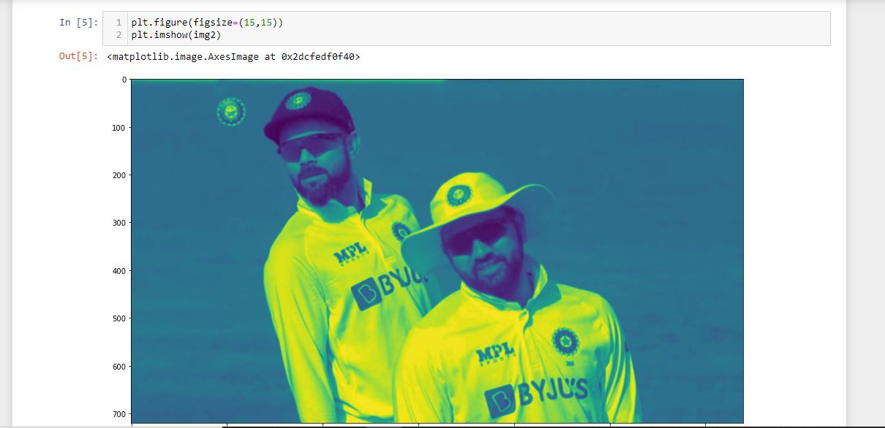

Slide 10
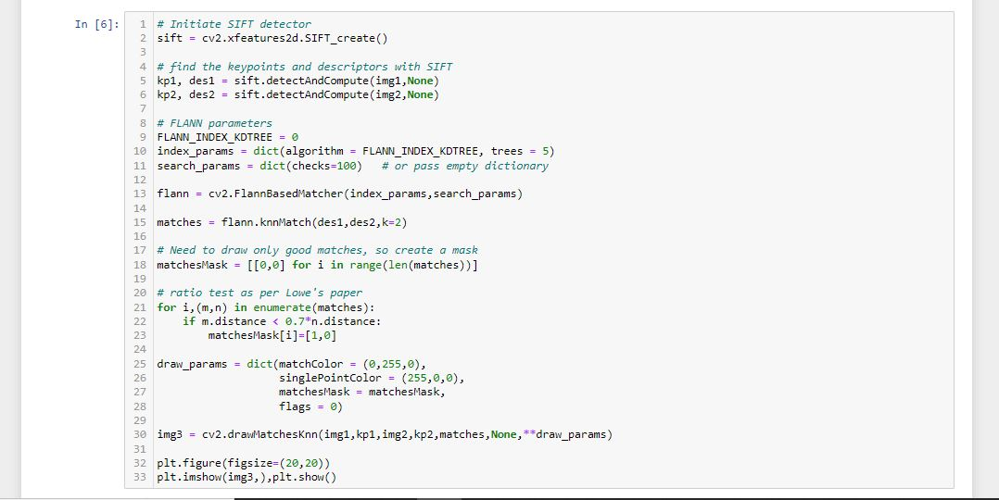

Slide 11
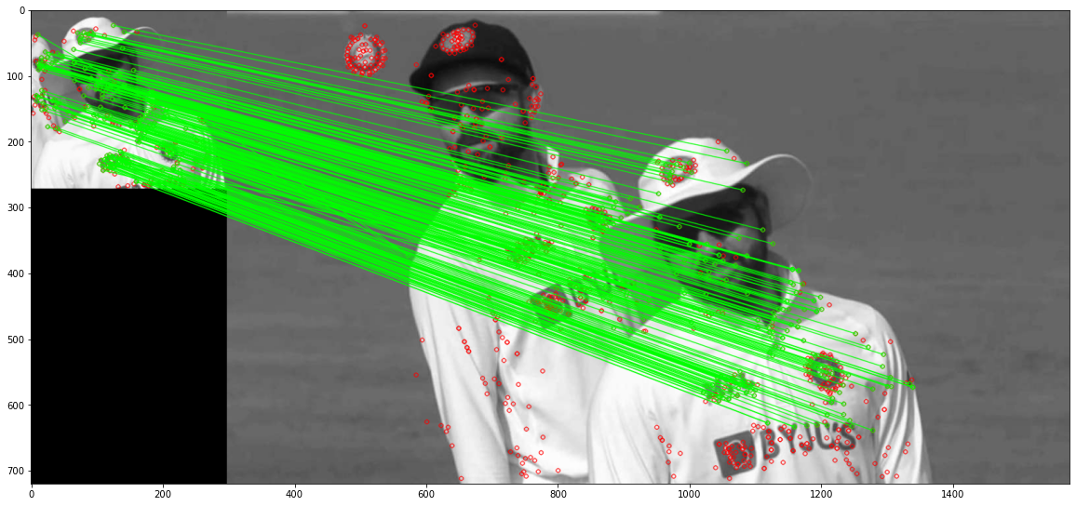
Output

Slide 12
References
OpenCV Documentation
https://docs.opencv.org/4.5.2/dc/dc3/tutorial_py_matcher.html

Slide 13


