Slide 1

BANK CUSTOMER’S CHURN PREDICTION USING MACHINE LEARNING

Slide 2

AIML INTERNSHIP
HENOTIC TECHNOLOGY PRIVATE LIMITED
May 2022 to July 2022
Presented by
G. Deepak
DEPARTMENT OF COMPUTER SCIENCE AND ENGINEERING
SAGI RAMA KRISHNAM RAJU ENGINEERING COLLEGE BHIMAVARAM
CHINNA AMIRAM , BHIMAVARAM

Slide 3
CONTENTS
ABSTRACT
INTRODUCTION
BENEFITS OF USING ML
DATASET
STEPS
METHODOLOGY
CONCLUSION
RESULTS
REFERENCES

Slide 4
ABSTRACT
Banking is one of the highly competitive sectors where customer relations is of utmost importance for any bank. Each customer is considered as a customer for life by the banks.
The term “Customer Churn” refers to the state in which the customer or the subscriber stops involving in business transactions with a company or a service provider.
To deal with this, this project represents the work done towards predicting the customer churn rate, using machine learning models which will indicate whether a customer will leave the bank or not based on many factors, this in turn will help the bank in knowing which category of customers generally tend to leave the bank.
Further the banks can bring in exciting offers so that it can retain its customers.

Slide 5
INTRODUCTION
Data Mining automates the extraction of patterns and trends from vast databases, uncovering valuable insights to address business challenges. It utilizes machine learning techniques to identify regularities and structures within the data. With the proliferation of databases, Data Mining emerges as a vital technology for businesses.
Customer churn, or attrition, signifies whether a customer will continue transactions with an organization. It's influenced by various factors across industries like banking and telecom. In today's competitive markets, tracking churn is crucial. Retaining existing customers saves significant costs compared to acquiring new ones, prompting organizations to analyze churn factors diligently.
Once importance of customers and customer churn was identified by various leading companies, they started to gather data on customer behaviour like how often does a customer purchase a product, etc, with this, the collection, storage and managing of the customer data on a time basis became really crucial for the companies. Thus, the decision making process shifted from being an event-driven approach to a data-driven approach.

Slide 6
MACHINE LEARNING
Machine learning is a subset of AI, which enables the machine to automatically learn from data, improve performance from past experiences, and make predictions. Machine learning contains a set of algorithms that work on a huge amount of data. Data is fed to these algorithms to train them, and on the basis of training, they build the model & perform a specific task.
Based on the methods and way of learning, machine learning is divided into mainly three types, which are:
1.Supervised Machine Learning
2. Unsupervised Machine Learning
3. Reinforcement Learning

Slide 7
Benefits of using machine learning
Identify at-risk customers : Machine learning algorithms assess client behavior to accurately measure churn propability. By comparing past cancellations with current clients, ML predicts likely churners based on correlated actions.
Identify pain points : Machine learning churn prediction considers brand-related aspects, including product quality, features, design, and customer service.ML forecasts address pain points and prevent churn by providing customized discounts and incentives
Identify methods to implement : Companies adjust products and strategies based on root cause analysis of customer churn. Beyond model building, leveraging domain knowledge is crucial for optimal solutions in churn prediction, informed by data, processes, and behavior.

Slide 8
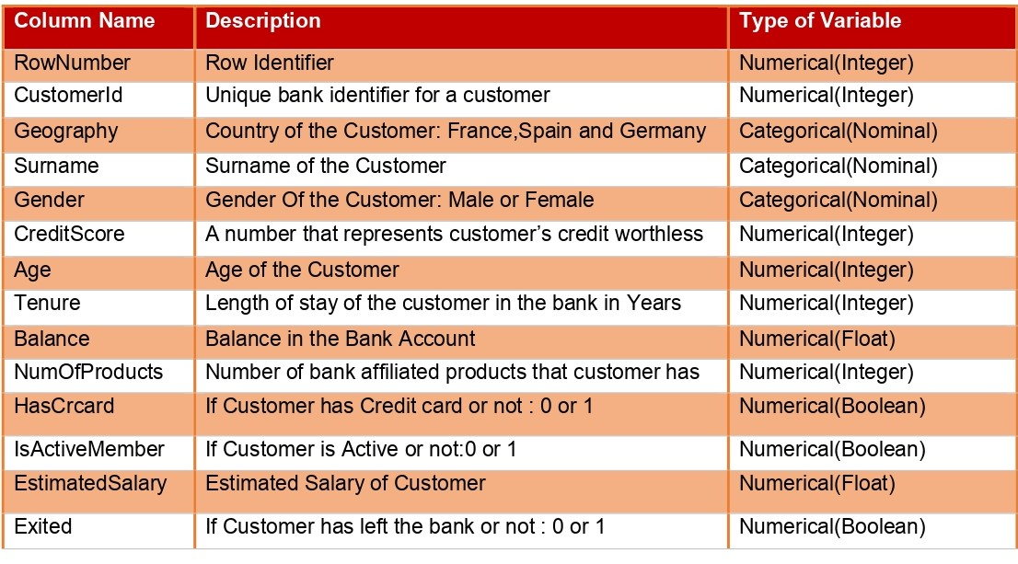
dataset
Dataset link:
https://www.Kaggle.com/datasets/santoshd3/bank-customers
Dataset name:
Churn_Modeling.csv containing 10000 rows and 14 columns
Dataset has customer details such as customer id, age, balance, credit score ,Tenure in a bank
6495 customer have more than 3 years tenure in bank
No missing data is identified.

Slide 9
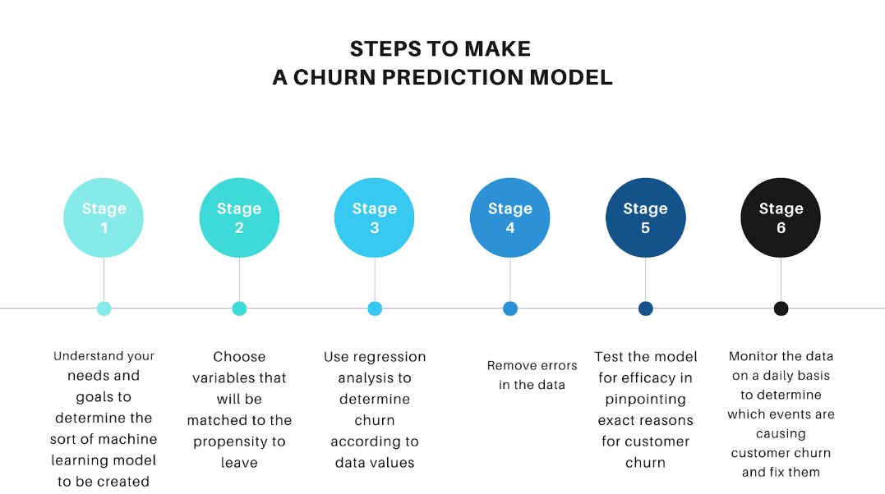
STEPS

Slide 10

METHODOLOGY
Data is collected from the kaggle website and then it is processed for finding the customer’s churn.
All the missing values and unrelated data is removed and made it clean for model assessment.
We built the model by using various algorithms to predict the bank customer’s churn rate.
Based on the model output we can easily predict whether the customer can withdraw his account from the bank or not.

Slide 11
MODELS USED
Logistic Regression : A popular supervised learning algorithm for predicting categorical outcomes based on independent variables. Logistic regression provides probabilistic values between 0 and 1, representing categorical outcomes
Decision Tree : A supervised learning technique for classification and regression. It forms a tree structure with decision nodes and leaf nodes. Decision nodes make choices based on features, while leaf nodes provide final outcomes
Random Forest : It is an ensemble learning algorithm that combines multiple decision trees. It uses subsets of the dataset to build individual trees and aggregates their predictions to improve accuracy in classification and regression tasks

Slide 12
CONTD..
Extra Trees Classifier : It is an ensemble learning technique that aggregates results from multiple de-correlated decision trees. It closely resembles the Random Forest Classifier but differs in how decision trees are constructed.
K-Nearest Neighbor (K-NN): It is a straightforward supervised learning algorithm that classifies new data points based on their similarity to existing cases. It stores all available data and assigns the new case to the category most similar to the existing ones.
Support Vector Machine (SVM) : It is a popular supervised learning algorithm used for classification and regression tasks. It aims to create a hyperplane that effectively separates n-dimensional space into classes, with support vectors playing a crucial role in defining this boundary.

Slide 13
CONTD..
Bagging classifier : It is an ensemble technique that fits base classifiers on random subsets of the original dataset. It aggregates their predictions to form a final output, reducing variance and enhancing performance. It’s particularly useful for improving black-box estimators like decision trees.
Gradient Boosting : It is a powerful ensemble algorithm that combines weak learning models (often decision trees) to create a robust predictive model. Unlike Adaboost, it corrects errors by training each predictor using the residual errors from its predecessor.
LightGBM: It is a powerful gradient boosting classifier that uses tree-based learning algorithms. It’s designed for efficiency, with faster training speed, lower memory usage, and improved accuracy. LightGBM is widely used in the machine learning community for various classification tasks.

Slide 14
CONCLUSION
The model results in the following order by considering the model accuracy, F1 score and RoC AUC score.
1) Gradient Boosting.
2) LightGBM (Light Gradient Boosting Machine.
3) Random Forest.
We recommend model – Gradient Boosting Classifier with Simple Random Sampling technique as a best fit for the given Bank Customer’s dataset. We considered Gradient Boosting Classifier because it uses In gradient boosting, each predictor corrects its predecessor’s error. In contrast to Ada boost, the weights of the training instances are not tweaked, instead, each predictor is trained using the residual errors of predecessor as labels for Bank Customer’s Churn dataset.

Slide 15
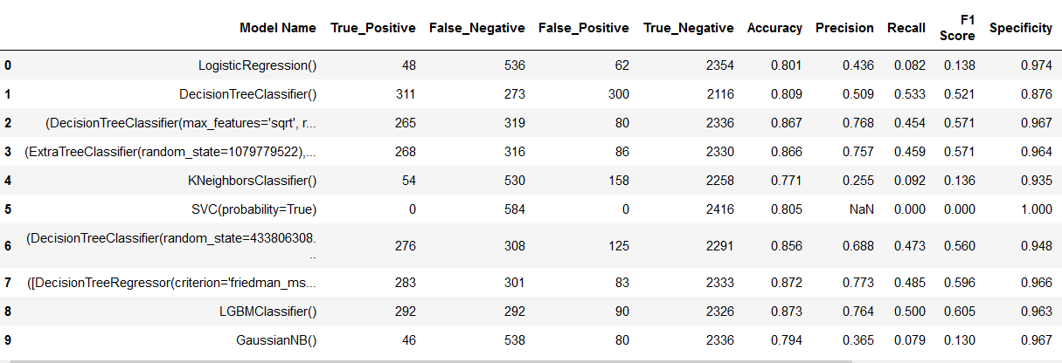
RESULTS

Slide 16
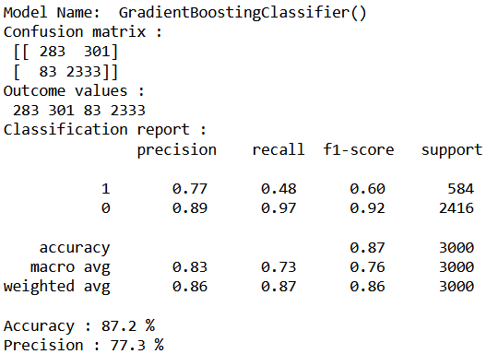
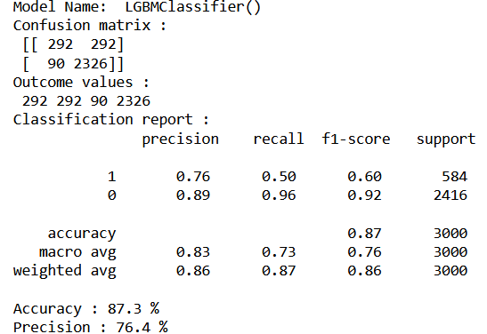
RESULTS
GRADIENT BOOSTING CLASSIFIER
LIGHTGBM CLASSIFIER

Slide 17
HYPERPARAMETER TUNING
Hyperparameter tuning is the process of selecting the optimal values for a machine learning model’s hyperparameters. Hyperparameters are settings that control the learning process of the model, such as the learning rate, the number of neurons in a neural network, or the kernel size in a support vector machine. The goal of hyperparameter tuning is to find the values that lead to the best performance on a given task.
The two best strategies for Hyperparameter tuning are:
1. GridSearchCV
2. RandomizedSearchCV

Slide 18
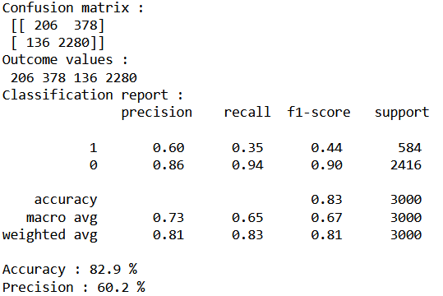
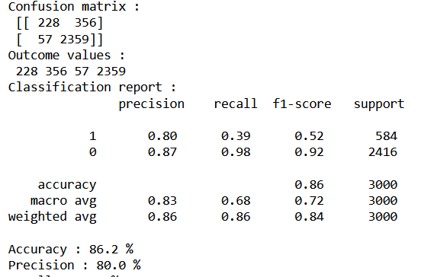
HYPERPARAMETER TUNING RESULTS
RandomizedSearchCV
GridSearchCV

Slide 19
REFERENCES
AMIN, Adnan, et al. Customer churn prediction in telecommunication industry using data certainty. Journal of Business Research, 2019, 94:290-301.
Qureshii SA, Rehman AS, Qamar AM, Kamal A, Rehman A. Telecommunication subscribers churn prediction model using machine learning. In: Eighth international conference on digital information management. 2013. P.131—6.
ULLAH, Irfan, et al. A churn prediction model using random forest: analysis of machine learning techniques for churn prediction and factor identification in telecom sector. IEEE Access, 2019, 7: 60134-60149.
Umayaparvathi V, Iyakutti K. A survey on customer churn prediction in telecom industry: datasets, methods and metric. Int Res J Eng Technol. 2016; 3(4):1065—70.
Abbasimehr H, Setak M, Tarokh M (2011) A neuro-fuzzy classifier for customer churn prediction. International Journal of Computer Applications 19(8):35–41.

Slide 20
THANK YOU

