Slide 1

ONLINE QUIZ WEBSITE

Slide 2

FULL STACK INTERNSHIP
HENOTIC TECHNOLOGY IT SOLUTIONS
March 2023 to May 2023
Presented by
G. Deepak
DEPARTMENT OF COMPUTER SCIENCE AND ENGINEERING
SAGI RAMA KRISHNAM RAJU ENGINEERING COLLEGE BHIMAVRAM
CHINNA AMIRAM, BHIMAVARAM

Slide 3
CONTENTS
ABSTRACT
INTRODUCTION
EXISTING SYSTEM
PROPOSED SYSTEM
MODULES
SOFTWARE REQUIREMENTS
METHODOLOGY
RESULTS

Slide 4
ABSTRACT
The Online Quiz System automates manual processes through computerized tools and software, enabling efficient data storage, retrieval, and manipulation while utilizing readily available hardware and software resources.
Online Quiz System, as described above, can lead to error free, secure, reliable and fast management system. It can assist the user to concentrate on their other activities rather to concentrate on the record keeping. Basically the project describes how to manage for good performance and better services to the peoples who are taking part in the quiz.
The system will show result after the examination is finished. A teacher has control in the question bank and is supposed to make schedule for the quiz. The system carries out the examination and auto-grading for multiple choice questions which is fed into the system. Administrative control of the whole system is provided.

Slide 5
INTRODUCTION
The main aim of Online Quiz System is to facilitate a user friendly environment of e-book implementation and reduces the manual effort.
Users of the system are:
1. Teachers
2. Students
Advancements in technology have automated quiz scoring and question posing, ensuring secure data access and improved e-book design.
Service-based architecture is crucial for future scalability.
The system reduces manual workload, allowing teachers to create quizzes and participate while students can only take quizzes, with results displayed upon completion.
Both users can communicate with the administrator for queries and suggestions, enhancing project effectiveness.

Slide 6
EXISTING SYSTEM
The whole process of assigning test and evaluating their scores after the test, was done manually till date. Processing the test paper i.e. checking and distributing respective scores used to take time when the software was not installed.
DRAWBACKS OF EXISTING SYSTEM:
The current system is very time consuming
It is very difficult to analyze the exam manually.
•To take exam of more candidates more invigilators are required but no need of invigilator in case of on line exam.
Results are not precise as calculation and evaluations are done manually.
The chances of paper leakage are more in current system as compared to proposed system. Result processing takes more time as it is done manually

Slide 7
PROPOSED SYSTEM
The purpose of Online Quiz simulator is to take offline test in an efficient manner and no time wasting for checking the paper.
The main objective of offline test simulator is to efficiently evaluate the candidate thoroughly through a fully automated system that not only saves lot of time but also gives fast results.
For students they give papers according to their convenience and time and there is no need of using extra Thing like paper, pen etc.

Slide 8
ADVANTAGES OF PROPOSED SYSTEM:
The system is very simple in design and to implement. The system requires very low system resources and the system will work in almost all configurations. It has got following features :
Greater efficiency.
Better service.
User-friendliness and interaction.
Minimum time required.
It saves more time.
It saves the student's money.
It saves paper.

Slide 9
MODULES
Home page Module.
About us Module.
Admin Login Module.
Feedback Module.
Admin Dashboard Module.
Student Dashboard Module.

Slide 10
SOFWARE REQUIREMENTS
Visual Studio Code : Visual Studio Code is a lightweight but powerful source code editor which runs on your desktop and is available for Windows, macOS and Linux. It comes with built-in support for JavaScript, TypeScript and Node.js and has a rich ecosystem of extensions for other languages and runtimes (such as C++, C#, Java, Python, PHP, Go, .NET).
Browser : It provides an interface between the server and the client and it requests to the server for web documents and services. Whenever we search for anything on the internet, the browser loads a web page written in HTML, including text, links, images, and other items such as style sheets and JavaScript functions. Google Chrome, Microsoft Edge, Mozilla Firefox, and Safari are examples of web browsers.

Slide 11
XAAMP Server : XAMPP is one of the widely used cross-platform web servers, which helps developers to create and test their programs on a local webserver. It was developed by the Apache Friends, and its native source code can be revised or modified by the audience.
HTML : HTML (HyperText Markup Language) is the most basic building block of the Web. It defines the meaning and structure of web content.
CSS : CSS allows you to apply styles to HTML documents. It describes how a webpage should look.
JavaScript : JavaScript is the world's most popular programming language. JavaScript is the programming language of the Web. JavaScript is easy to learn.
PHP : The term PHP is an acronym for – Hypertext Preprocessor. PHP is a server-side scripting language designed specifically for web development. It is very simple to learn and use. The file extension of PHP is “.php”.

Slide 12
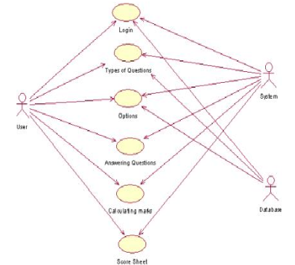
METHODOLOGY

Slide 13
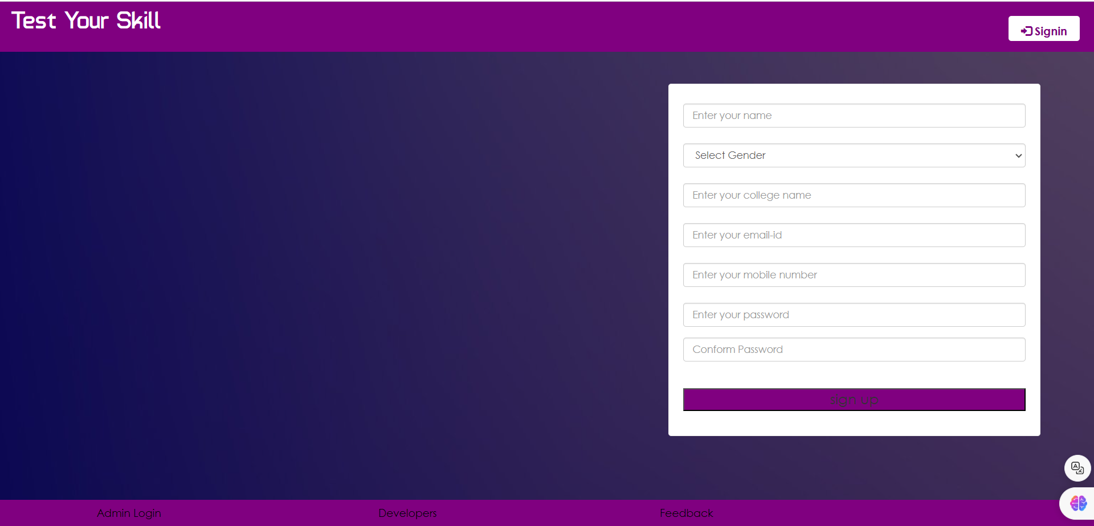
RESULTS – HOME PAGE

Slide 14
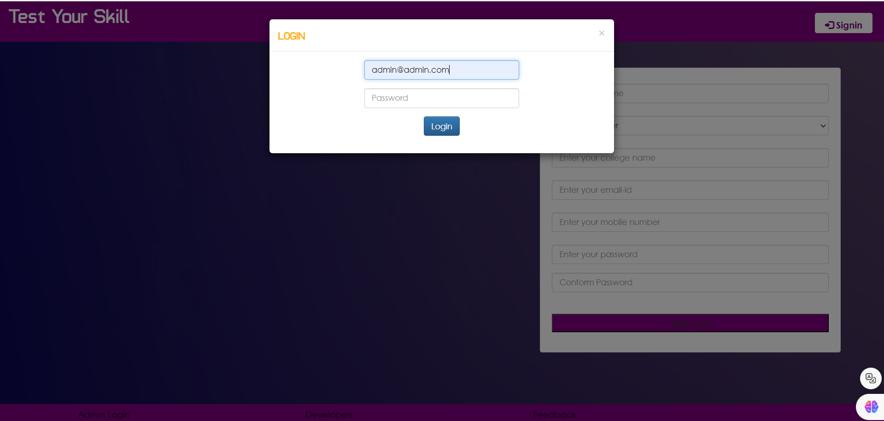
ADMIN LOGIN

Slide 15
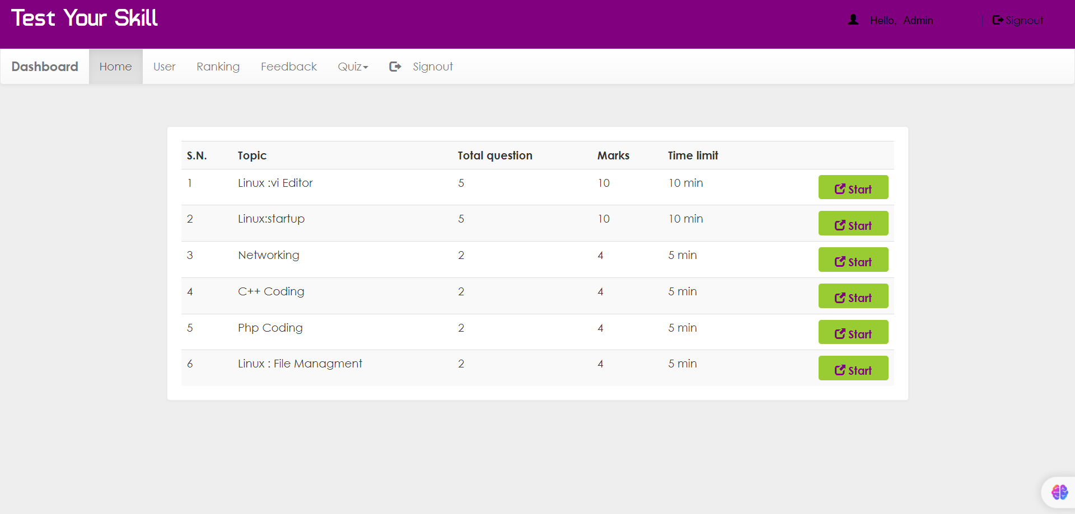
Admin HOME PAGE

Slide 16
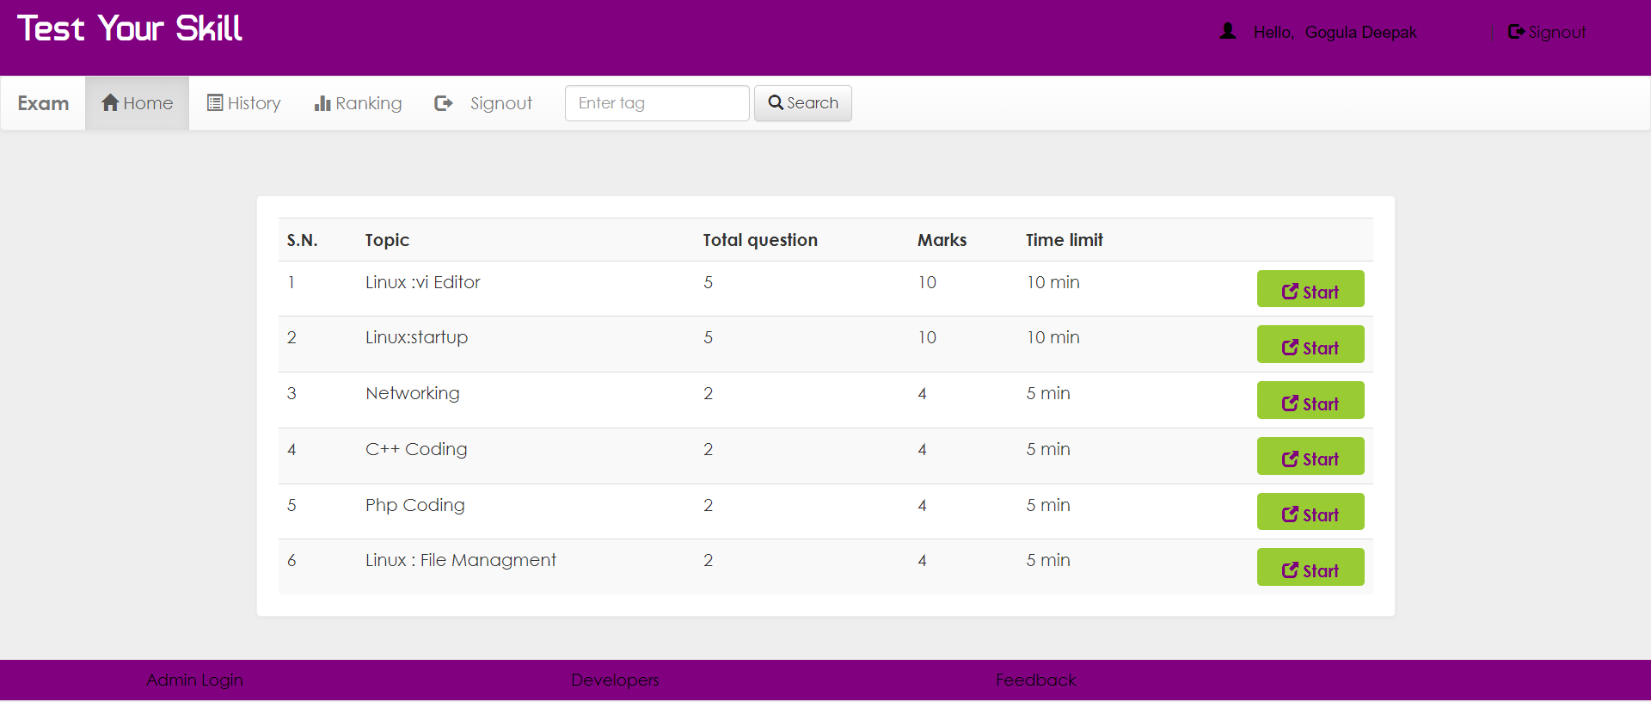
USER LOGIN

Slide 17
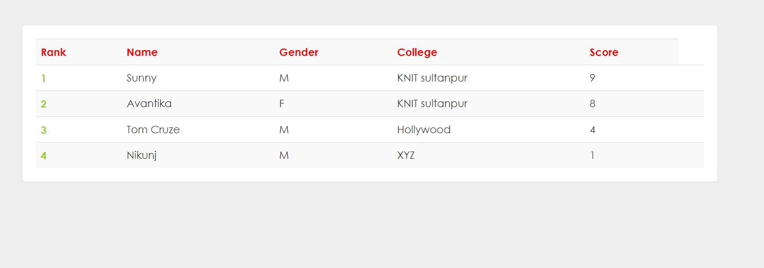
RANKING

Slide 18
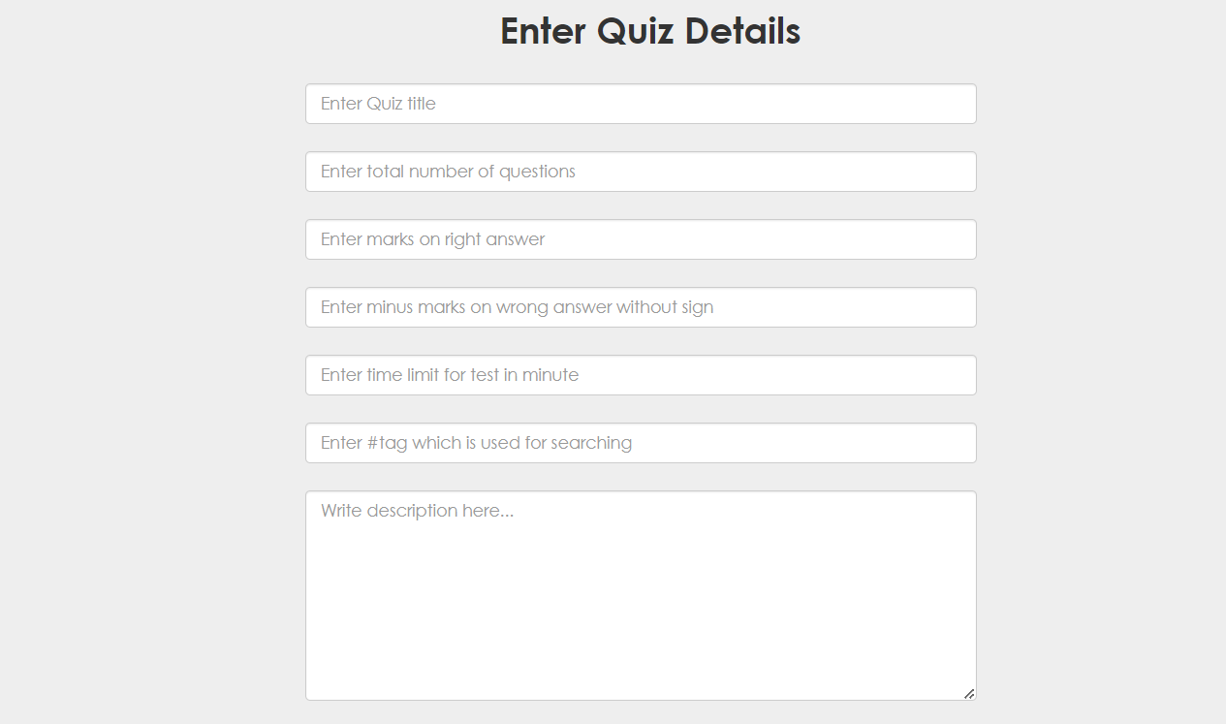
ADD QUIZ

Slide 19
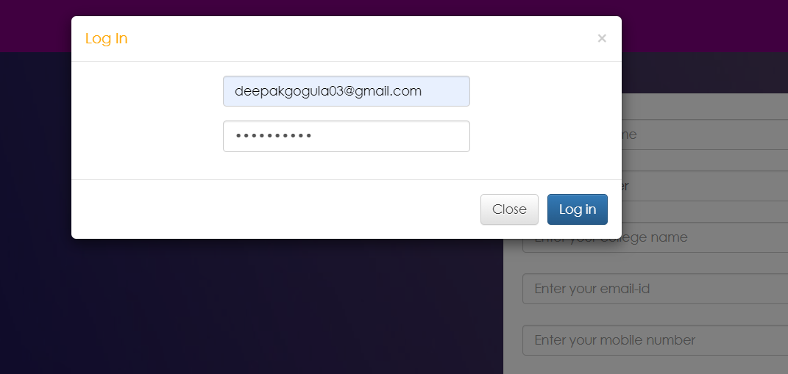
STUDENT SIGN-IN

Slide 20
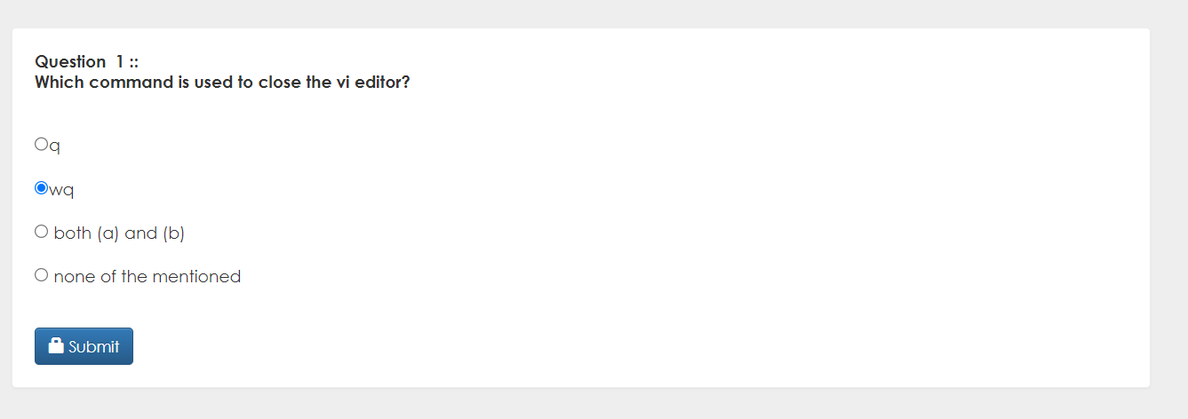
QUIZ

Slide 21
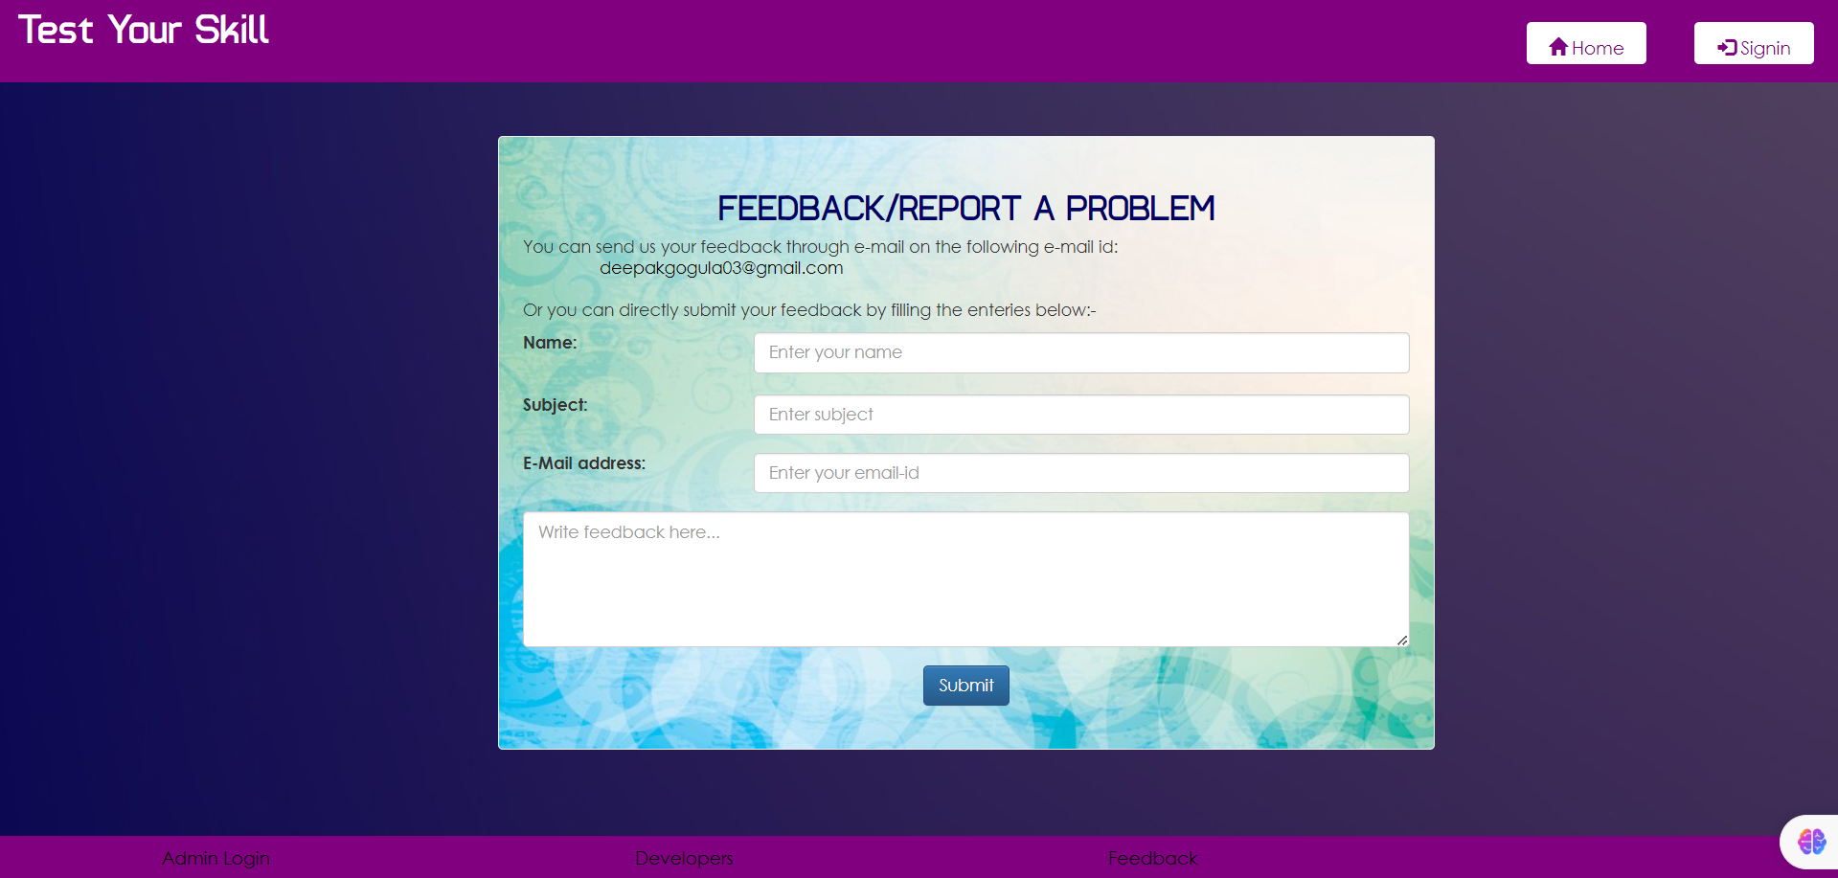
FEEDBACK

Slide 22
THANK YOU

