Slide 1
Deepak Sridharan M
LVADSUSR148-4356

Slide 2

1)
The average lead_time can be calculated by:
Remove blanks from work date and paste values to new sheet
Use formula work (Work_Date-Req_Date) to find lead_time for each row and name this column as Lead_time
Now use formula:average for the lead_time Column
=AVERAGE(W:W)=24038 days

Slide 3
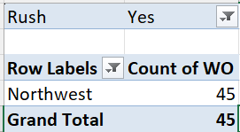
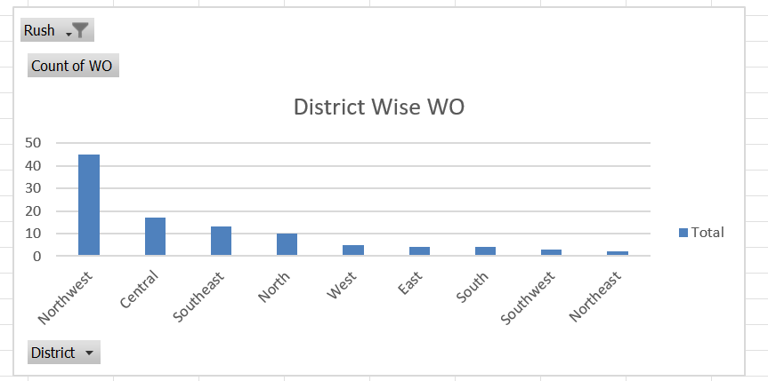
2)
The district with highest number of rush jobs is calculated by:
Using pivot table we add district to rows and count of wo to values and we add rush column to filter with values yes
We then sort the pivot table to get the district NorthWest

Slide 4
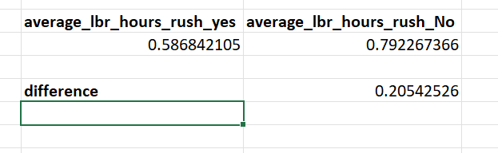
3)
Inference:
The average labour hours if theres a rush is 0.586842105 this is found using formula =AVERAGEIF(E:E,"Yes",K:K) and The average labour hours if theres a no rush is 0.792267366 this is found using formula = =AVERAGEIF(E:E,"",K:K)
Insights:
It is concluded that when there is a rush job the average labour hour is slightly less while compared to there is no rush which says that the labours work more time efficient and fast when theres a rush

Slide 5
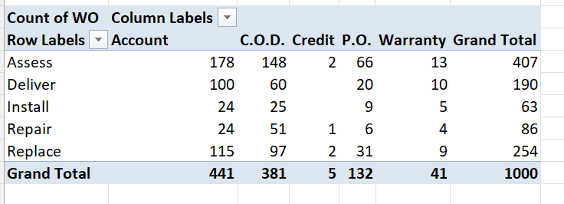
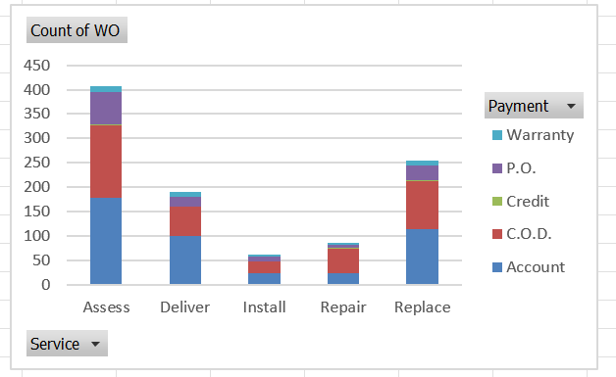
4)
Inference:
From the given distribution plotted using a pivot chart between the payment types and services we can generate a stacked bar chart
Insights:
From the distribution we can see the assess service uses the account and cod more than any other services and next to assess the replace service uses similarly a lolt of account and cod payments

Slide 6
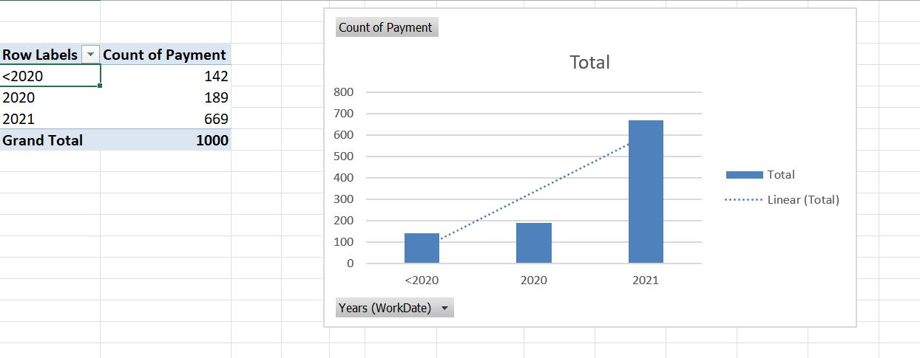
5)
Inference:
we plotted the pivot chart by using work date grouped into years as column
and count of different types of payment in the values and we plot this chart and we use a trendline
Insights:
from the observed trendline it is inferred that with the the usage of different types of payments increase over time we can see the trendline increasing

Slide 7
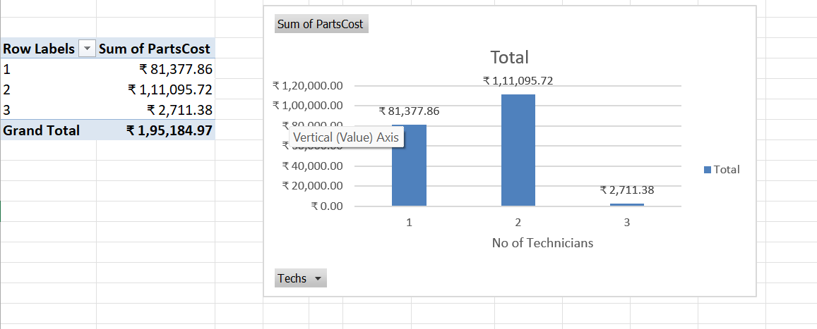
6)
Inference:
From the chart we can observe that the the number of technicians=3 has lesser part cost but it does not conclude anything as when the number is two the part cost is still high which doesn’t show any relation between them
Insights:
Since the cost of parts fluctuate and it is neither increasing nor decreasing with the number of technicians we can conclude there is no direct relationship between partscost and number of technicians

Slide 8
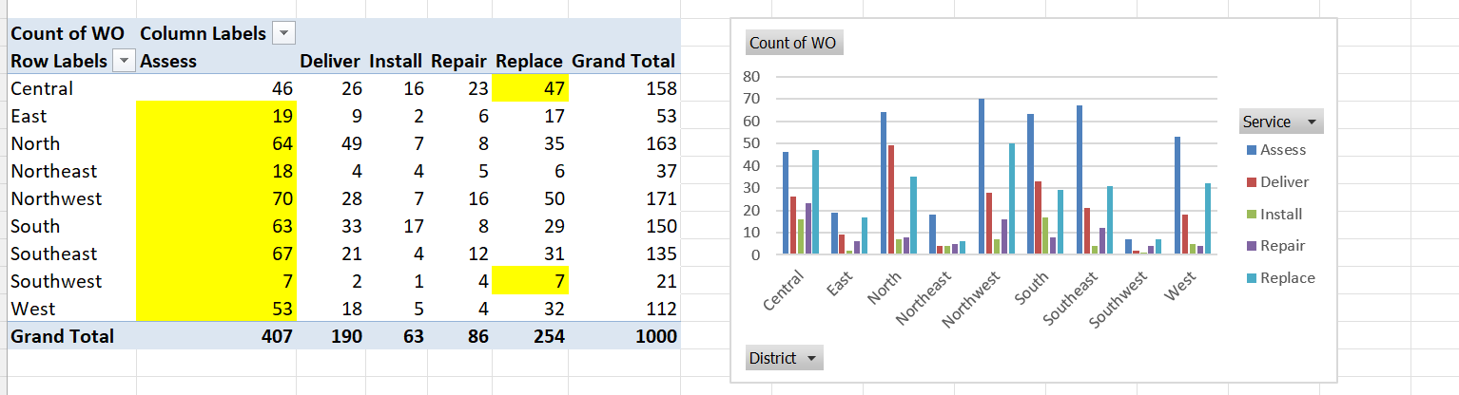
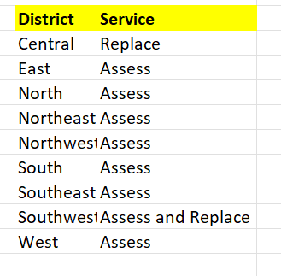
7)
Inference:
the pivot table is plotted by using district column as rows and service column as columns with count of wo in values,the highest value of each row is highlighted and that is the most requested service by that region
Insights:

Slide 9
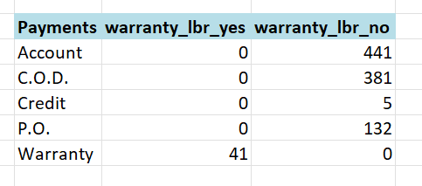
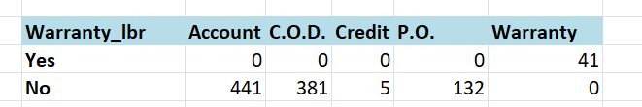
8)
Inference:
The distribution between payment types and warranty_labour is shown using the pivot table with count of wo as values and payment types as rows and warranty_lbs as columns
Insights:
When the payment type is warranty the labour warranty is present meanwhile when the labour warranty is not available the usage of other payment types prevail like account,cod,credit,po.

Slide 10
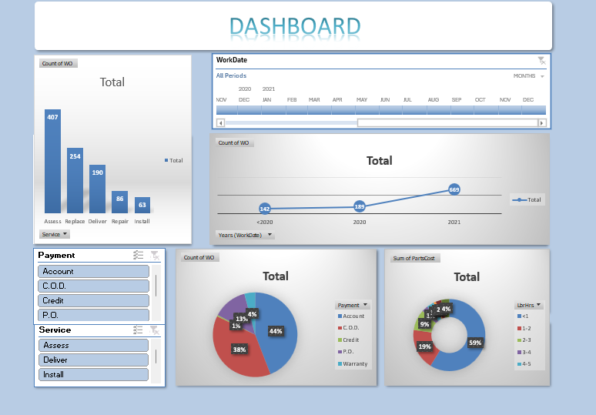
9)DASHBOARD

