Slide 1
Employee_id-4356 M Deepak Sridharan

Slide 2
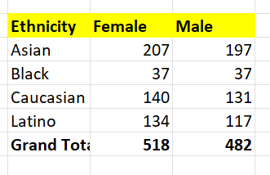
Question 1
Summary of gender and ethnicity distribution in the company is found using pivot table where we add ethnicity to row and gender in the column with ethnicity count in values

Slide 3

Question 2
The average days an employee stay in the organization is 1801 days this is found using average function on exitday-entryday table

Slide 4
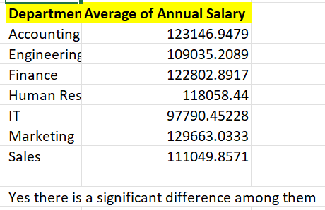
Question 3
Yes there is a significant difference among each departments annual salary the insight here is human resource has the highest deviation from all and this data is found using pivot table

Slide 5

Question 4
United states with the count of 643 found using pivot table

Slide 6

Question-5
The most common age range is 45-54 using pivot table

Slide 7

Question 6
The average bonus in the organization is 8.87 this is found out using average function in the bonus column and changing the answer cell type to percentage

Slide 8

Question 7
The director is the most common job title in the organization this is found out using pivot table by using job title as rows and count of eeid as values

Slide 9
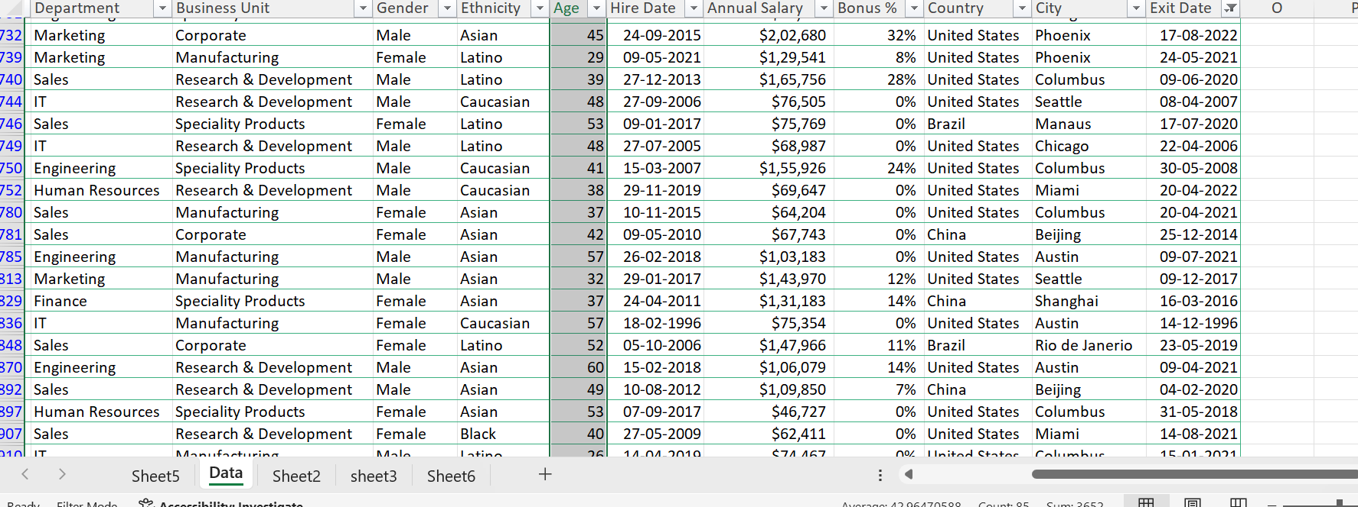
Question 8
The salary bonus and the age are the main reason for employee exit all most all their ages are 45+

Slide 10
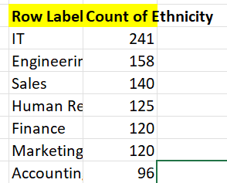
Question 9
The it and engineering dept has more diverse ethnicity this is found using pivot table

Slide 11
Question 10
Yes there has been an increase and decrease in the past few years

