Slide 1
Bank Account Management System
BAMS
Java 17 · Spring Boot 3 · Oracle XE · HTML / CSS / Vanilla JS
Presented: October 2026
1 / 20

Slide 2
🏦 BAMS — Bank Account Management System
Table of Contents
📋 Table of Contents
01
Project Overview & Objectives
11
Screenshot — Loans & Loan Payments
02
Technology Stack
12
Screenshot — Cards, Beneficiaries & Calendar
03
System Architecture
13
Screenshot — Reports & Audit Logs
04
Database Design — Oracle XE
14
Screenshot — Settings
05
Backend — Spring Boot Structure
15
Customer Self-Service Portal (New Feature)
06
Security & Role-Based Access Control
16
Screenshot — Customer Portal
07
Screenshot — Login Page
17
Backend → Frontend Integration Flow
08
Screenshot — Admin Dashboard
18
Build & Deployment
09
Screenshot — Customers & Accounts
19
Feature Highlights
10
Screenshot — Transactions Module
20
Conclusion
2 / 20

Slide 3
🏦 BAMS — Bank Account Management System
Project Overview
🏦 Project Overview & Objectives
🎯
BAMS is a complete, production-grade Core Banking System built entirely offline.
👥
Manages: Customers, Accounts, Transactions, Loans, Cards, Employees, Branches.
🔐
4-role access: ADMIN · MANAGER · STAFF · CUSTOMER (self-service portal).
⚙️
15 REST API controllers backed by Oracle XE with JDBC (no JPA/Hibernate).
🌐
14 frontend SPA modules — no frameworks, no CDN, fully offline.
💳
Atomic financial transactions with pessimistic locking & audit trails.
📊
Filtered transaction reports with CSV export & formula-injection guard.
📅
Banking calendar for events, loan due dates & employee schedules.
3 / 20

Slide 4
🏦 BAMS — Bank Account Management System
Technology Stack
⚙️ Technology Stack
Category
Component 1
Component 2
Component 3
Backend
Java 17 (Eclipse Adoptium JDK)
Spring Boot 3.2.5 + Spring Security 6
Spring JDBC + HikariCP connection pool
Database
Oracle Database 10g XE
JDBC with ROWNUM pagination
Sequences + Triggers for auto-increment
Frontend
Pure HTML5 + CSS3 + Vanilla JS
Hash-based SPA routing (no framework)
14 dynamic module loaders
Security
BCrypt strength 12 (password hash)
CSRF protection + Session management
Row-level data isolation for CUSTOMER role
Build
Apache Maven 3.9.9
maven-resources-plugin (frontend sync)
Single fat JAR output
Tools
Oracle SQL*Plus for DB admin
Microsoft Edge for frontend testing
Offline — no CDN dependencies
4 / 20

Slide 5
🏦 BAMS — Bank Account Management System
System Architecture
🏗️ 3-Tier System Architecture
🖥️ PRESENTATION LAYER (Frontend)
Pure HTML5 + CSS3 + Vanilla JavaScript • 14 SPA Modules • Hash-based routing • api.js fetch wrapper
↕ HTTP / REST API (JSON) ↕
⚙️ APPLICATION LAYER (Backend — Spring Boot)
AuthController • AccountController • TransactionController • 15 REST Controllers total
Spring Security 6 • BCrypt • CSRF • @Transactional • Row-level isolation
↕ JDBC / HikariCP ↕
🗃️ DATA LAYER (Oracle XE 10g)
APP_USER • CUSTOMER • ACCOUNT • TRANSACTION • LOAN • LOAN_PAYMENT • CARD • BENEFICIARY • AUDIT_LOG
5 / 20

Slide 6
🏦 BAMS — Bank Account Management System
Database Design
🗃️ Database Design — Oracle XE
APP_USER
Authentication & Role management (ADMIN/MANAGER/STAFF/CUSTOMER)
TRANSACTION
Full ledger (Deposit, Withdrawal, Transfer)
BANK
Bank entity (name, code, HQ)
LOAN
Loan disbursements (type, amount, rate, tenure)
BRANCH
Branch records linked to BANK
LOAN_PAYMENT
EMI repayment records
EMPLOYEE
Staff records linked to BRANCH
CARD
Debit / Credit card management
CUSTOMER
KYC records (name, DOB, PAN, Aadhar, address)
BENEFICIARY
Transfer payees per customer
ACCOUNT
Savings / Current accounts with balance
AUDIT_LOG
Security & operation event trail
★ All tables use Oracle SEQUENCES + TRIGGERS for auto-increment primary keys
6 / 20

Slide 7
🏦 BAMS — Bank Account Management System
Backend Architecture
☕ Backend — Spring Boot Layered Architecture
@RestController
15 controllers handle HTTP requests
Input validation + role enforcement via @PreAuthorize
15 REST Controllers
AuthController
BankController
↓
BranchController
@Service
Business logic layer with interfaces
@Transactional for atomic financial operations
EmployeeController
CustomerController
AccountController
↓
TransactionController
@Repository
JdbcTemplate SQL queries against Oracle XE
ROWNUM pagination · FOR UPDATE locking
LoanController
LoanPaymentController
CardController
↓
BeneficiaryController
Oracle XE
Local database on localhost:1521:XE
HikariCP connection pool
DashboardController
ReportController
AuditLogController
CsvController
7 / 20

Slide 8
🏦 BAMS — Bank Account Management System
Security & RBAC
🔐 Security & Role-Based Access Control
👑 ADMIN
🏢 MANAGER
👤 STAFF
🧑 CUSTOMER
Full system access
Loan approval/rejection
Customer onboarding
Own accounts only
User management
Branch-level operations
Account operations
Own transactions only
Reports & audit logs
Staff oversight
Transactions processing
Own loans & payments
All CRUD operations
Reports access
Basic card management
Own cards (block only)
CSV import/export
Customer management
Beneficiary management
Own beneficiaries
⚠️ Row-level data isolation enforced server-side via SecurityUtils — CUSTOMER cannot access other customers' data
8 / 20

Slide 9
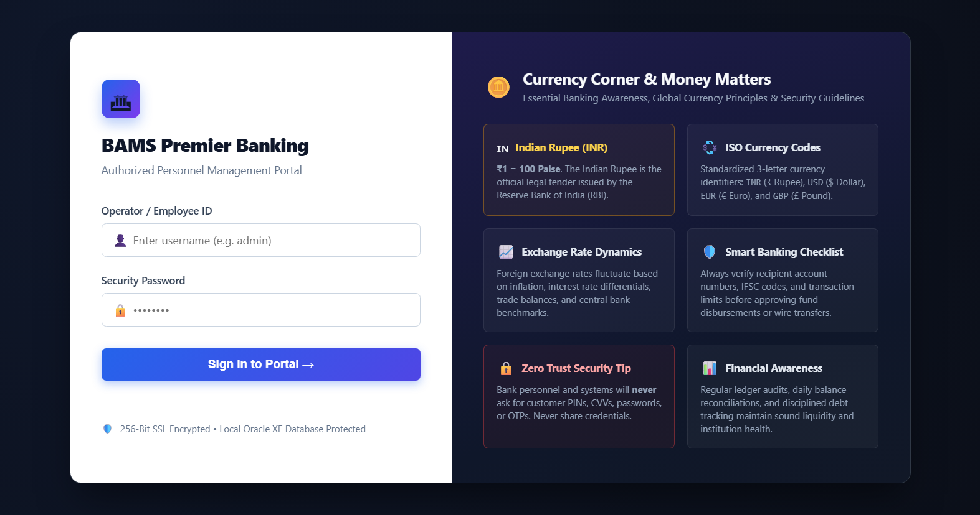
🏦 BAMS — Bank Account Management System
Screenshot — Login Page
🔑 Login Page — Dual-Panel Design
Left Panel:
Form Login
+ BCrypt Auth
Right Panel:
Currency Corner
& Banking Tips
256-bit SSL
Oracle XE
Protected
9 / 20

Slide 10
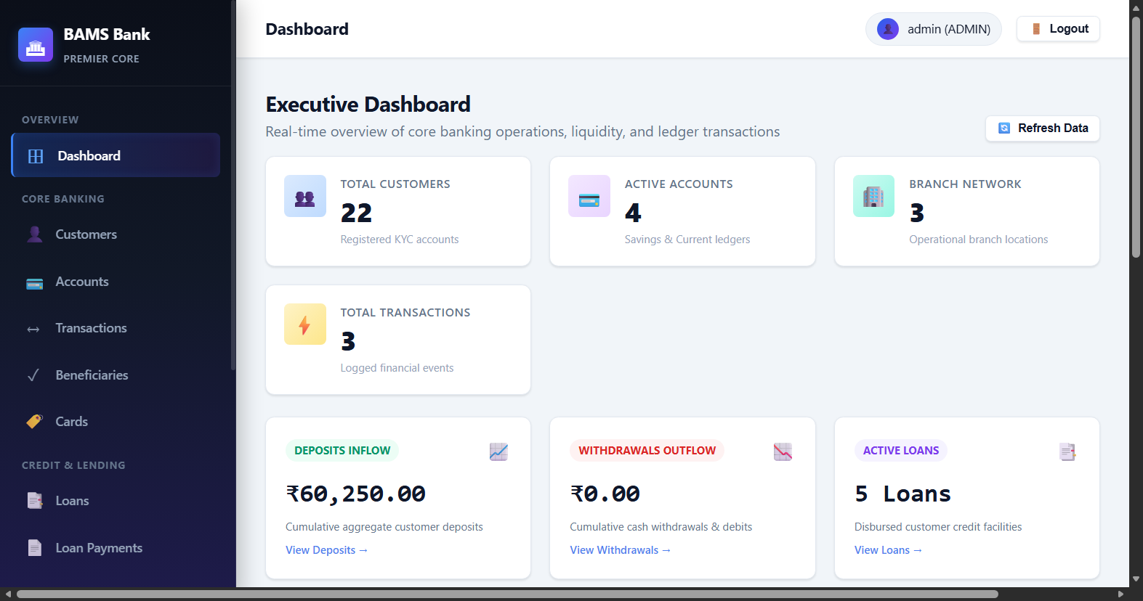
🏦 BAMS — Bank Account Management System
Screenshot — Admin Dashboard
📊 Admin Dashboard — Clickable Stat Cards
✨ Features
7 real-time stat cards
Each card clickable → module
Deposits Inflow / Outflow
Recent Transactions table
Quick Actions panel
Refresh Data button
Data from Oracle XE REST API
10 / 20

Slide 11
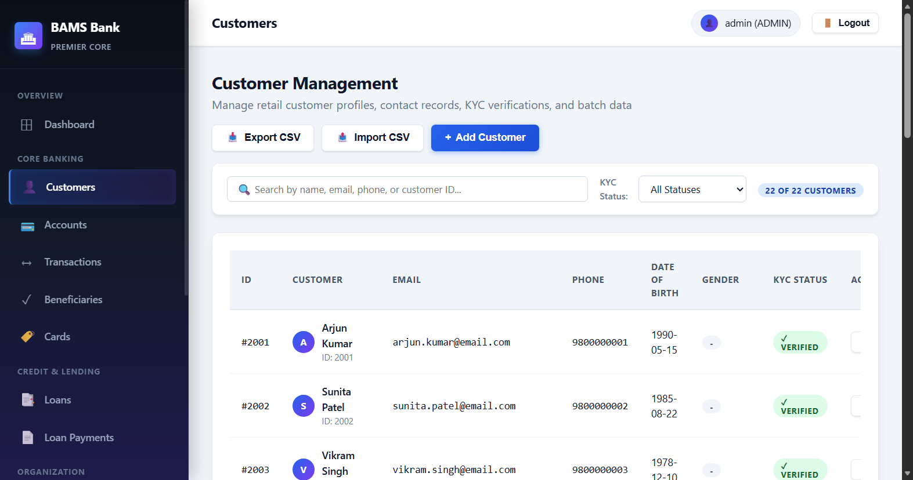
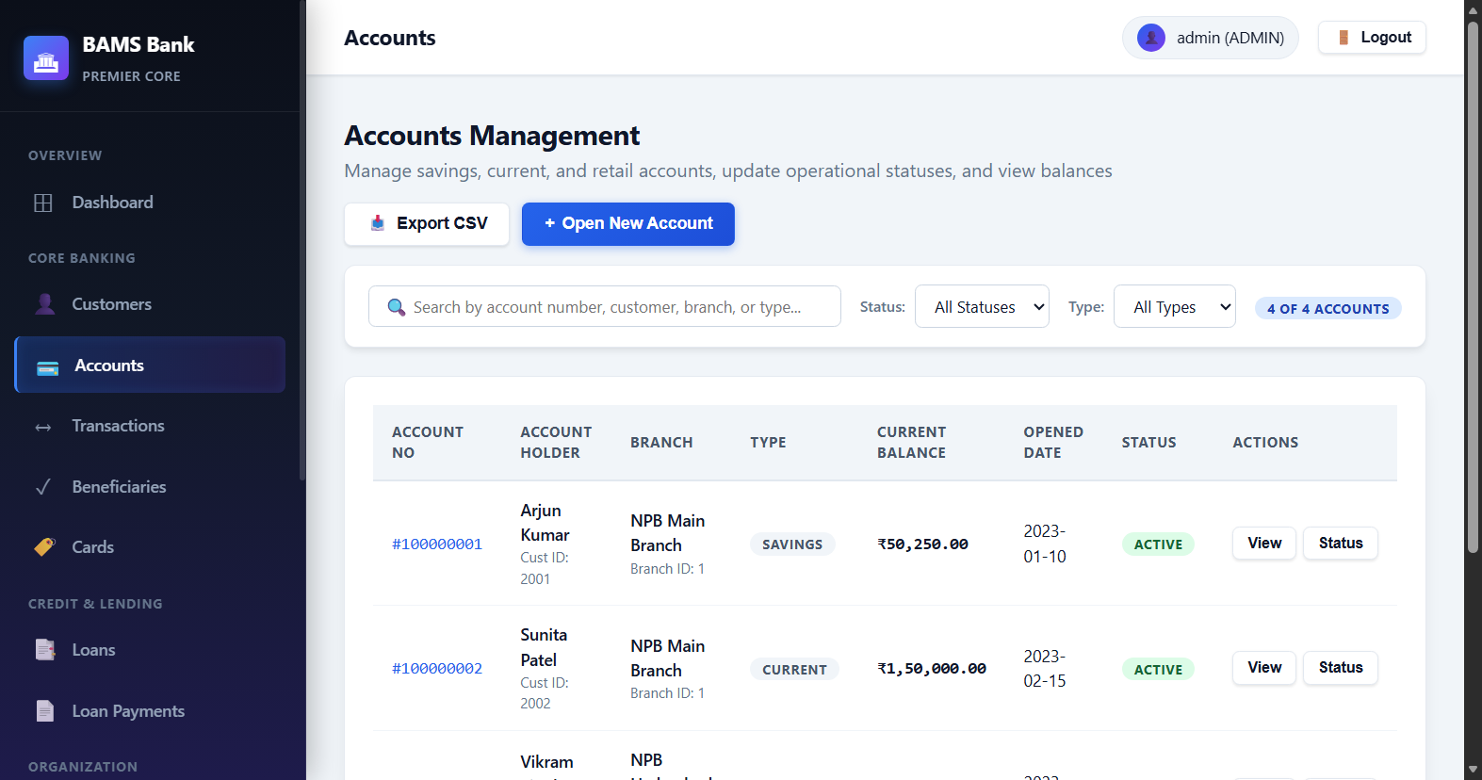
🏦 BAMS — Bank Account Management System
Screenshot — Customers & Accounts
👥 Customers & Accounts Modules
Customers Module
Accounts Module
11 / 20

Slide 12
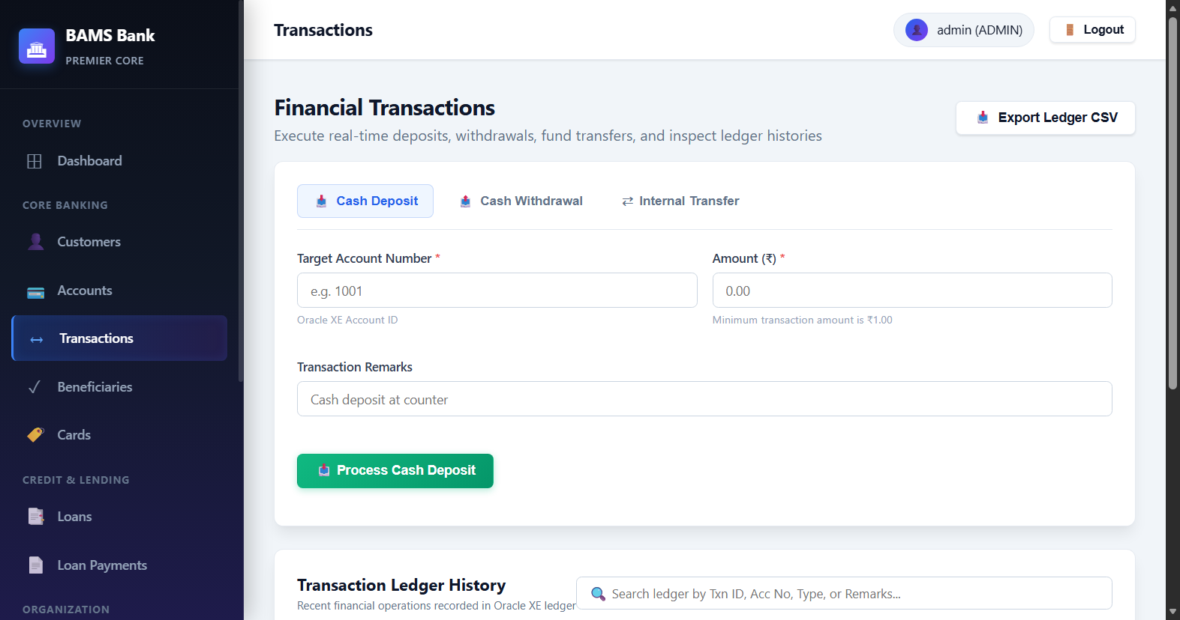
🏦 BAMS — Bank Account Management System
Screenshot — Transactions
💰 Transactions Module — Deposit · Withdraw · Transfer
🔒 Security
Tabbed: Deposit | Withdraw | Transfer
Server-side balance validation
Pessimistic locking (FOR UPDATE)
Balance never calculated client-side
Full transaction ledger history
Search + pagination
CSV export with injection guard
12 / 20

Slide 13
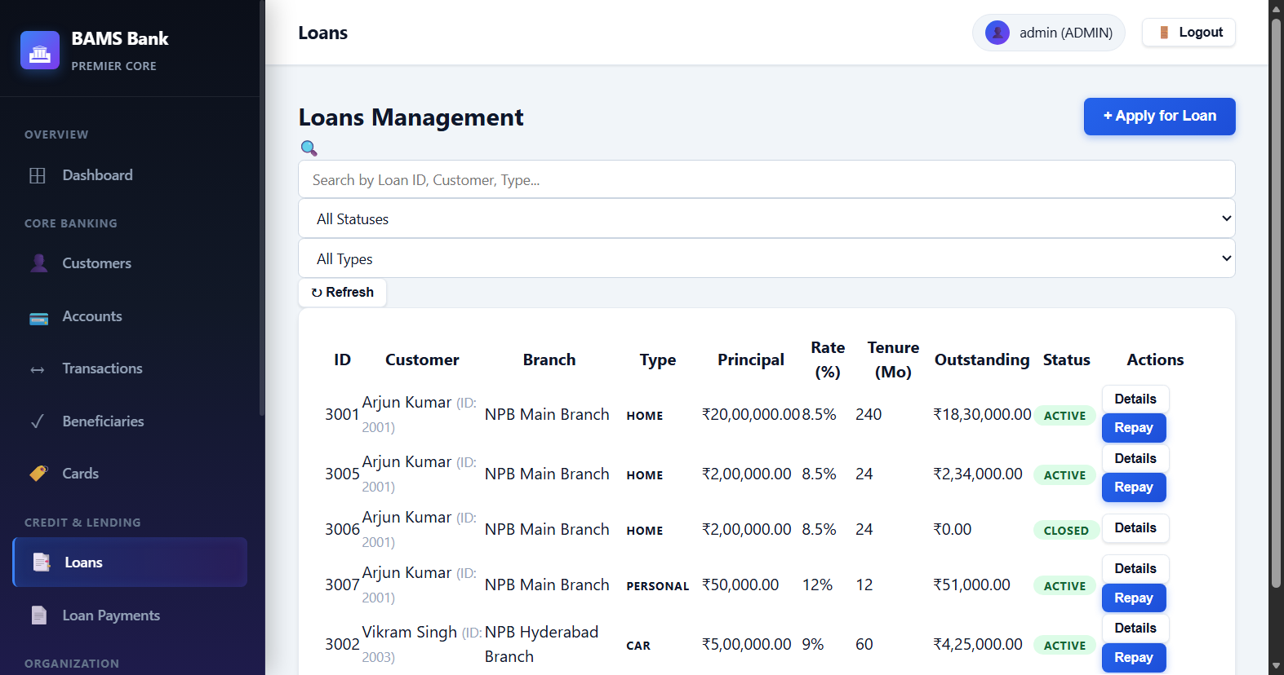
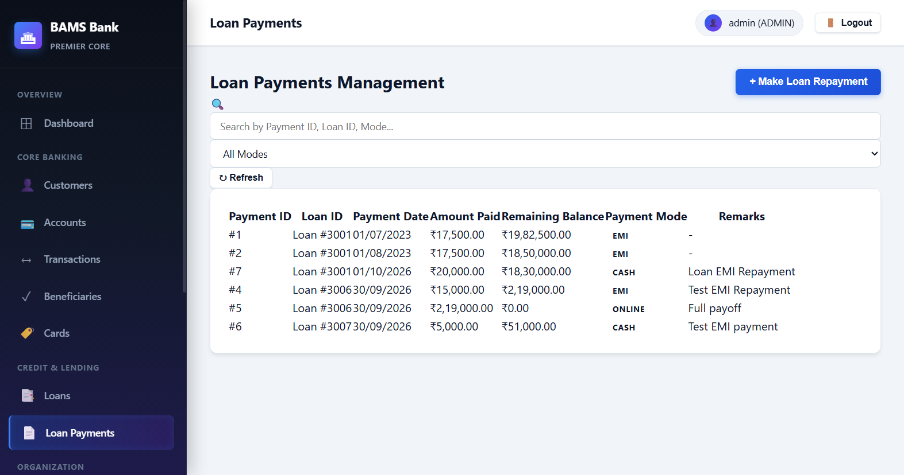
🏦 BAMS — Bank Account Management System
Screenshot — Loans & Payments
📑 Loans & Loan Payments Modules
Loans — Apply, Approve/Reject lifecycle
Loan Payments — EMI recording & outstanding balance
13 / 20

Slide 14
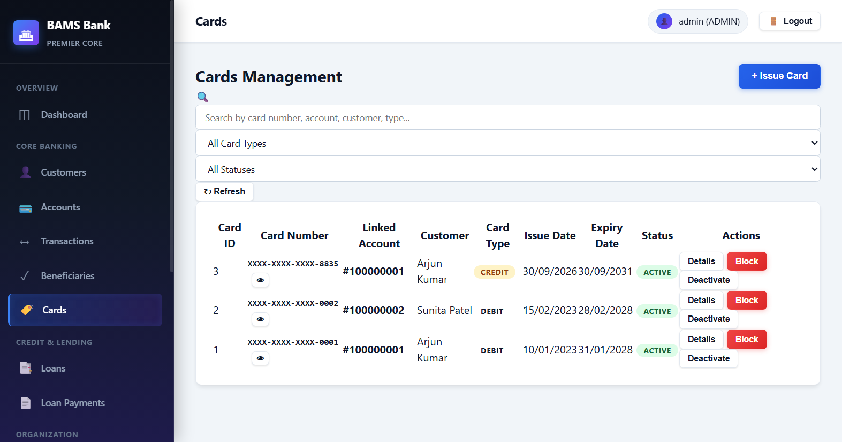
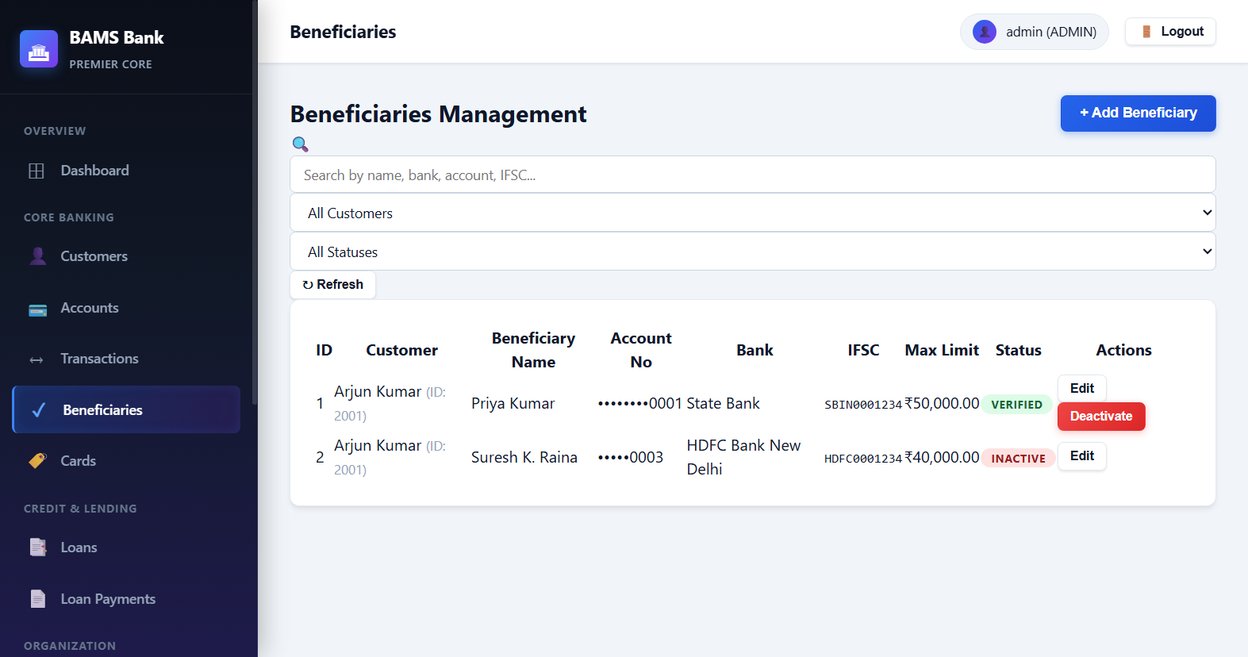
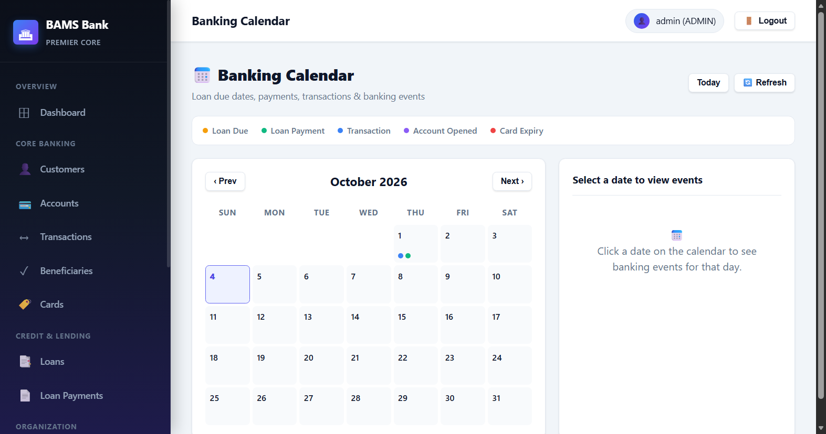
🏦 BAMS — Bank Account Management System
Screenshot — Cards, Beneficiaries & Calendar
💳 Cards · Beneficiaries · Banking Calendar
Cards Module
Beneficiaries
Banking Calendar
14 / 20

Slide 15
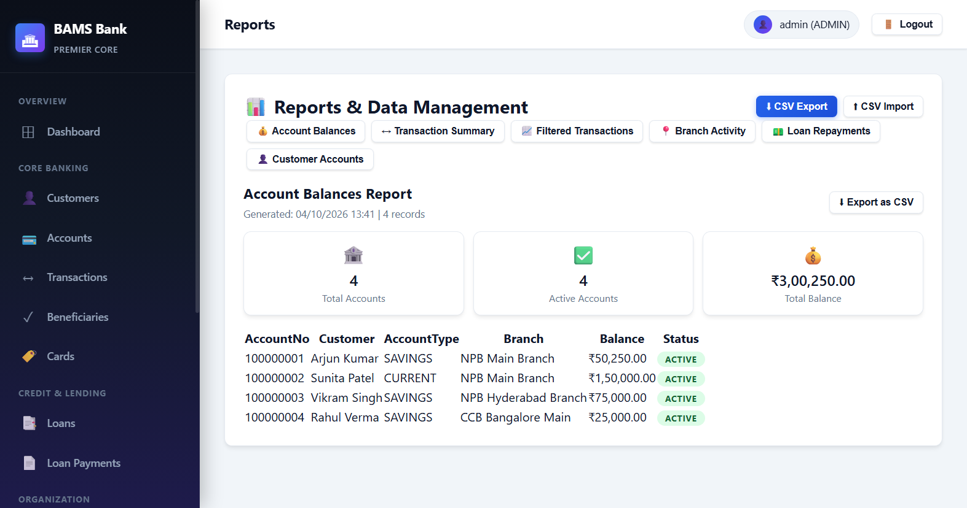
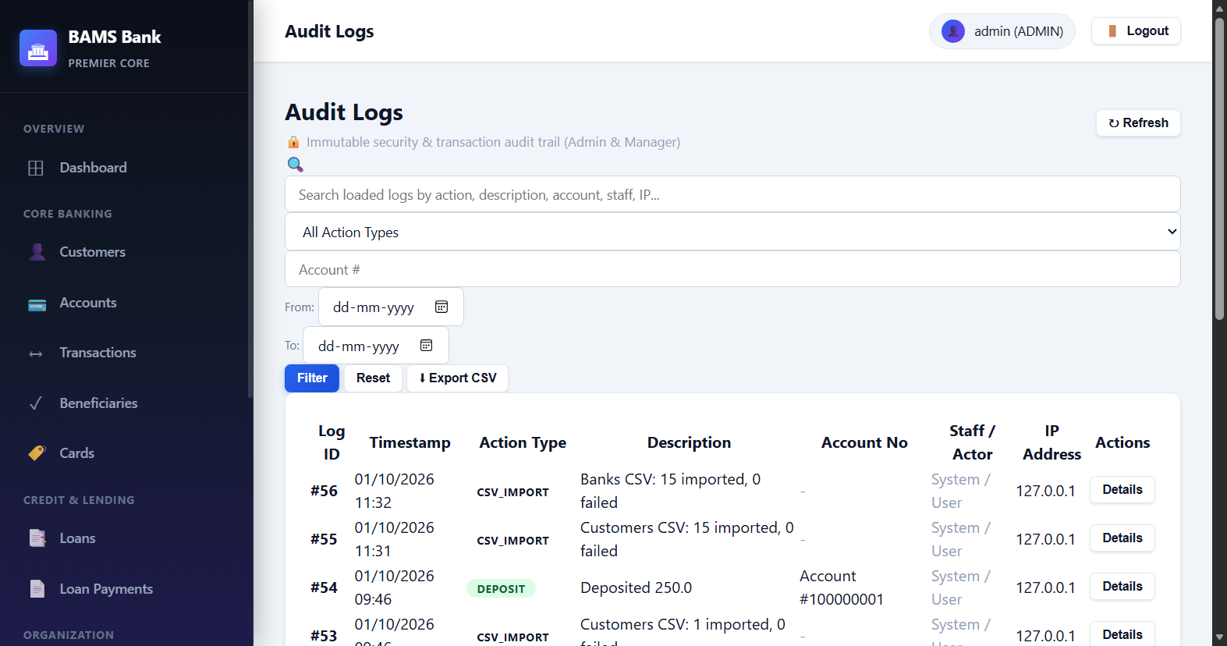
🏦 BAMS — Bank Account Management System
Screenshot — Reports & Audit Logs
📈 Reports & Audit Logs
Reports — Filtered CSV export (7 filters)
Audit Logs — Full event trail + CSV export
15 / 20

Slide 16
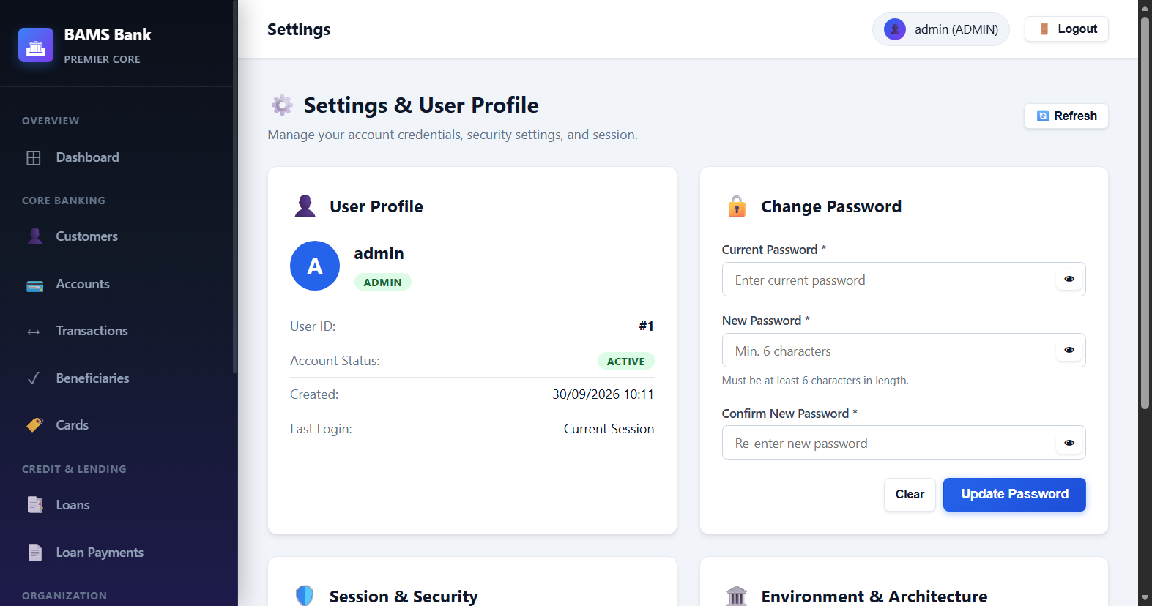
🏦 BAMS — Bank Account Management System
Screenshot — Settings
⚙️ Settings — Profile & Password Management
16 / 20

Slide 17
🏦 BAMS — Bank Account Management System
Customer Self-Service Portal
🧑 Customer Self-Service Portal — New Feature
🆕 New CUSTOMER Role
Added CUSTOMER as a 4th role in APP_USER. Linked to CUSTOMER table via CUSTOMER_ID foreign key.
🔐 Row-Level Security
SecurityUtils.validateAccountAccess() and validateLoanAccess() enforce that customers can ONLY see their own data, never others'.
🖥️ Custom Sidebar
applyCustomerRoleUI() hides admin-only nav items. Customer sees: My Accounts, My Transactions, My Loans, My Cards, Beneficiaries, Settings.
💳 Own Transactions
Customer can deposit, withdraw, and transfer from their own accounts. Backend validates account ownership before processing.
🏦 Own Loans
Customer can apply for new loans and see only their own loans and payments.
👤 Sample Logins
arjun.kumar / customer123 · sunita.patel / customer123
17 / 20

Slide 18
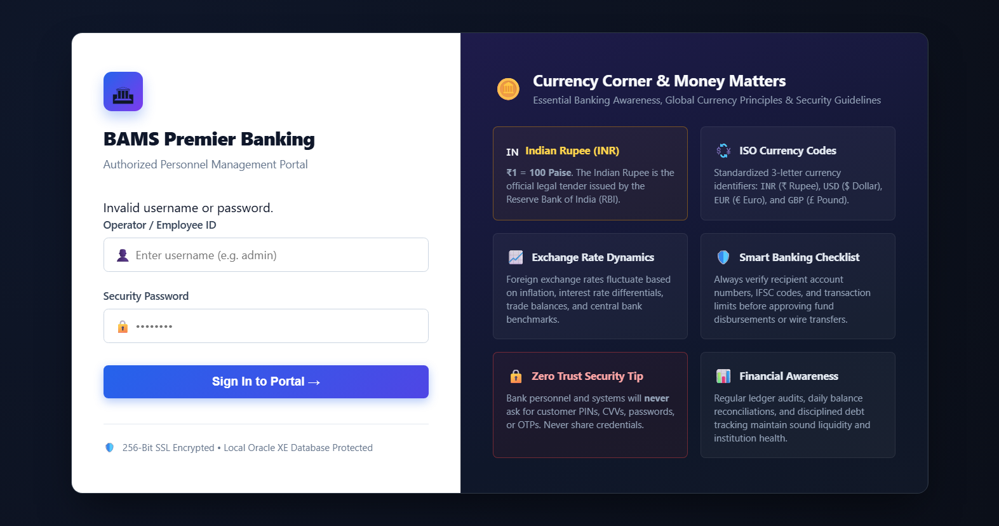
🏦 BAMS — Bank Account Management System
Screenshot — Customer Portal
🧑 Customer Portal — Logged in as arjun.kumar
Customer Dashboard
My Accounts (own only)
My Transactions (own only)
18 / 20

Slide 19
🏦 BAMS — Bank Account Management System
Backend → Frontend Integration
🔄 Backend → Frontend Integration Flow
1. Browser
User navigates to http://localhost:8081 — loads index.html SPA
2. Spring Security
Authentication + Role check → 401/403 for unauthorized requests
3. @RestController
Input validation, @PreAuthorize role guard, delegates to service
4. @Service
@Transactional business logic — atomic operations, locking
5. @Repository
JdbcTemplate SQL → Oracle XE — ROWNUM pagination, FOR UPDATE
6. Oracle XE
Sequences/Triggers → INSERT/UPDATE/SELECT with constraints
7. JSON Response
ApiResponse<T>{ success, message, data } returned to frontend
8. Frontend JS
api.js fetch → module renders HTML table/form with data
19 / 20

Slide 20
🏁 Conclusion
The Bank Account Management System (BAMS) is a production-grade, fully offline Core Banking Application demonstrating real-world enterprise software engineering.
✅ 12 Database Entities
✅ Financial Integrity
Oracle XE with sequences, triggers & constraints
Atomic JDBC transactions + pessimistic locking
✅ 15 REST Controllers
✅ Security
60+ API endpoints with role-based access
BCrypt, CSRF, Spring Security 6, Audit logging
✅ 4-Role Access Control
✅ Customer Portal
ADMIN · MANAGER · STAFF · CUSTOMER
Row-level data isolation for self-service customers
✅ 14 Frontend Modules
✅ Reports & Export
Fully offline SPA — no CDN, no frameworks
Filtered reports with CSV download + injection guard
Thank You! 🙏
20 / 20

