Slide 1



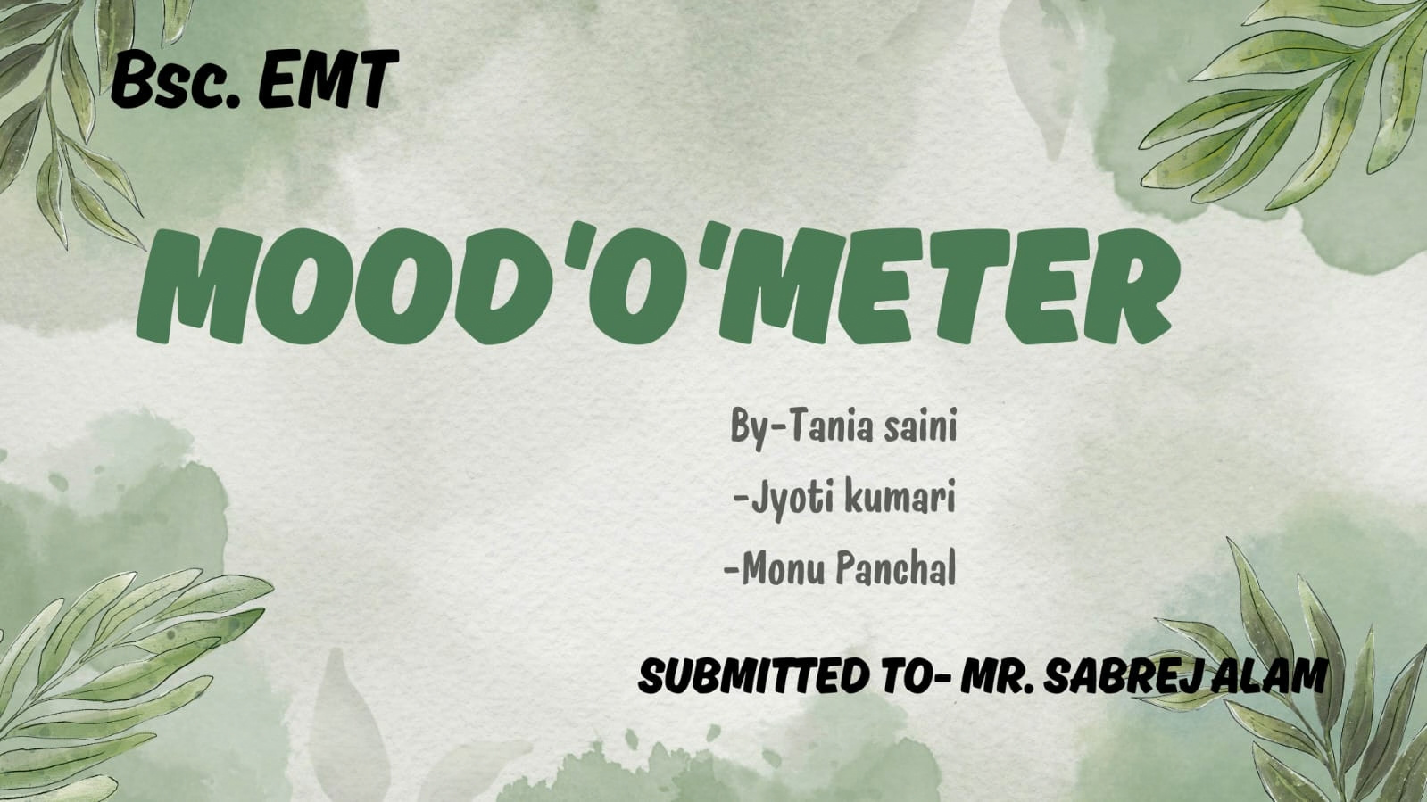



Slide 2



MOOD'O'METER
An AI supported , Human-led campus wellness system.
An early-warning and connection system, helping students reach professional support before their problems become severe

Slide 3
MOOD'O'METER
An AI supported , Human-led campus wellness system.
An early-warning and connection system, helping students reach professional support before their problems become severe

Slide 4

THE PROBLEM
1.Nowadays, stress, anxiety, and loneliness is increasing.
2. University has a counsellor, but students hesitate to visit due to stigma.
3. No early detection system- we only know when problem becomes severe.
4. Current system is reactive, not preventive.

Slide 5
OUR SOLUTION-MOOD-O-METER
    A voluntary , privacy- friendly wellness kiosk placed in a area of the university( one kiosk in one block)
    core principle-AI detects-AI supports-human solves
#AI will not replace counsellors, it will help counsellors find peoples who need help.

Slide 6
INTRODUCTION
we propse an idea of installing AI-empowered emotional wellness kiosks across for both the students & and the faculty , where they can voluntarily scan their face and listens to their voice on the questions asked on the screen like the brain detecting machine and gives a scorecard of your emotional & mental health & and the tips to reduce the stress, anxiety & depression based on scorecard it will also tell you whether you have to consult a psychologist / counselor or you can cope with your stress by doing some mindfulness other activity .
this is a first step in the detection of the mental emotional health.

Slide 7
The second step will be the counselling round in this we will appoint an clinical psychiatrist or psychologist in the university who will access the data of the moodometer , and personally contact those people who score very low in the activity and gave them counselling.
it is not AI based , it combines both the AI- detecting technology & the human - interaction as the second & important step to boost mental health & help patients.

Slide 8
ADVANTAGES
~ Combination of both AI and human interaction
~ Keeps the privacy
~No issue of facing disrespect as the data is private
and secure
~Keeps the day scheduling
~ Removes hesitation
~Direct contact with professionals

Slide 9
The best part of the proposal or the project is that it involves both the AI model & human , not the AI vs Human.
: AI detects- AI supports- human solve`s the problem (& help the patient to become fully recover)
# The AI should not replace counsellor but it`ll help them to detect the correct mental health situation at that time.
The kiosk act as an early-warning & connection system,helping patients reach professional support before their problems become severe, this is more scientifically responsible as it doesn`t directly based on the AI results, it just the roughly estimate of their mental health.

Slide 10
Talk to me option after giving the scorecard , the AI will give the questions on the screen what do you need right now?
Like;
- I want to talk?
- I want to calm down myself
-I feel lonely
- I`m stressed about studies
- I`m exhaused
- I just need motivation

Slide 11
It, also gives a 2 min sukoon features.
( A button- give 2 min sukoon)
* BREATHE - RELAX - REFLECT - RESET
also, gives some motivattional quote in the end based on the score card like;
= asking for help is the sign of the strength
= One bad day doesn`t mean the bad life
=You don`t have to productive every minute.

Slide 12
Things to be added in the university for this project;
1. we will appoint counsellors and volunteers for the counselling sessions.
2. will create a space place for the red zone patients .
SAFE PLACE/ RECOVERY ROOM
Objective- A safe place to pause, breathe & reconnect
It will be designed as a Safe, silence & recovery room, quite, low stimulating, calming , private, but never isolated from appropriate ( volunteers, counselors) supervision.
we will write motivational quotes on the walls like;
~ Safe place- Silence for the mind, support for the heart
~ A quiet place where everything feels too loud.

Slide 13
Ideal atmosphere for safe place;
Dim Warm light + Comfortable seating + optional gentle instrumental music + volunter or counselor
After making the patient relaxed at that time , they will be sent for counselling session the same day or within 24 hrs on priority basis.
The follow up session is very important in this after completing the counselling we will have them a follow up date.
Goal is to-
Detect- stablize- connect- follow up

Slide 14
REFERENCES OF RECOVERY ROOM;
- University of Alberta, Canada
(UCommons Calm Room- low stimulus room with comfortable seating, soothing lightning,sensory tools,breathing guides,audio relaxation, yoga mats, etc.)
- University of Florida, USA
(Relaxation room providing a quiet, low stimulation environment for stress reduction and mindfulness.)
- Parul University, INSIGHT: centre for counselling and psychological wellness
( it includes 1 to 1 counselling +crisis first response+ connection to app. help + campus mental - health training.)

Slide 15
CHARGES & FEES
:The charge for the MOODOMETER will be 50 and for the safe space it`ll be 0, as it is the emergency step.
:For the counselling step the fee will be 200 for every session & 3 sessions will be compulsory, later depend on the condition of the patient.
: Consent for the 3 sessions compulsory will be taken in 1st seating.

Slide 16
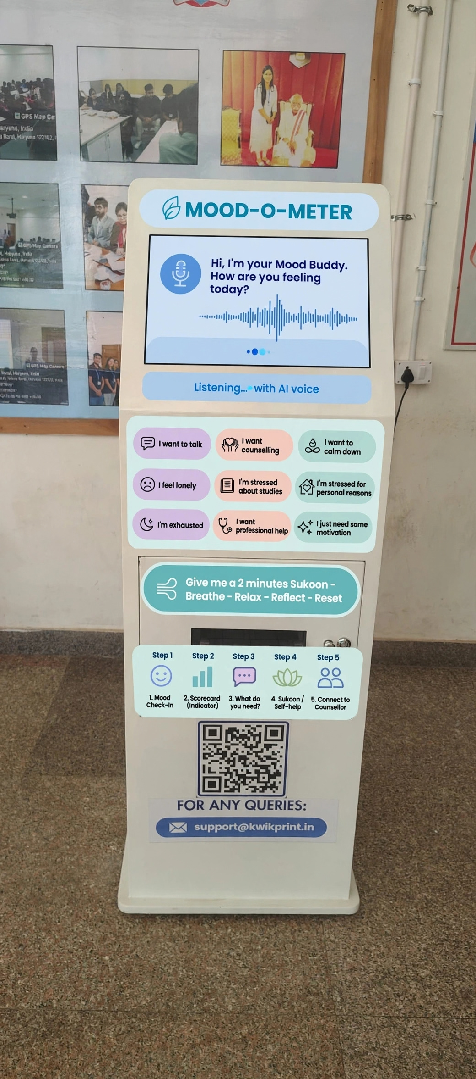
this is not the exact visual representation this is just for the idea purpose .

Slide 17
*MOOD-O-METER FLOW*
1. *MOOD-O-METER*
↓
2. *Mood Check-In*
↓
3. *AI Questionnaire* (by voice & facial expression)
↓
4. *Scorecard (Indicator)*
↓
*Splits into 3 zones:*
- *GREEN (10-8):* Wellness activity
- *YELLOW (8-4):* Self-help resources → (If they want counselling) → Counsellor
- *RED (4-0):* Danger / Red Zone → Needs emergency help → Human resource → Counsellor
5. *Counsellor*
↓
6. *Professional Care*

Slide 18
CONCLUSION
we don`t want to build a machine that understands emotions we want to build a whole system that helps and heals patient and make them feel understood.
The bestest part of the project is that it involves both the AI and human interaction as, everyone says that AI will replace counsellors but acc. to me it will never replace it, but yes definitely it`ll help psychologists or counsellors to the detect the condition of patient on the early stage, so that they can help them to avoid worsening their condition, also it saves the time for the counsellors as well as to the patients.

Slide 19
THANK YOU

