Slide 1


Bank of Baroda Hackathon - 2022
Technology Partner
Your Team Name : DeepCoders
Your team bio : Team of Coders
Date : 02-09-2022

Slide 2
Problem Statement?
Why did you decide to solve this Problem statement?
Contact Centre is a very important touch point for customer service. Customers interact with the contact center for a variety of service fulfillment, information about products and services, complaints, feedback, and interactions. For enhancing the contact center service levels, the customer interactions need to be analyzed and need to be mapped with customer satisfaction. Banks want to automate the process with the use of AI-based techniques to measure and monitor various KPIs such as call data quality, customer sentiment, Call Hygiene, customer satisfaction, etc.
Currently, call centers have a good amount of data but don’t analysis what is the major issues faced by the customer and that resides in their database servers only and key decisions or ideas are not given from this data by their managers and no key decisions are taken from this data from the complaints of the users and no improve improvement in a particular sector of banking.

Slide 3
User Segment & Pain Points
Which user segment would be early adopter of your product & why?
Multi linguistic (Indian languages) speech-to-text conversion to know to analyze user's complaints and provide insights to the company decision-makers.
To classify the speech based on gender and to provide some insights and providing sentiment analysis to know how happy the user is with our call center staff.
Also, it provides insight to the company about how many problems have been solved or not which also
provide KPI and centralized Dashboard for the company to boost & fix issues that are mostly faced by lots of users.
Centralized Dashboards for the company /organization to track daily analysis of their services and how many user complaints haved solved and to collect user feedback and also providing some suggestion to improve it

Slide 4
Prerequisite
What are the alternatives/competitive products for the problem you are solving?
Currently there are no such systems that can provide access to call centre complaints and call data and bring some information about the user's problems and identify them and through which we can provide some KPI to organizations so that some necessary measures can be taken by knowing the problems submitted by the users and which is faced by majority of the users and how many users get satisfied by the answers provided by the call centres.
There are no such mechanism which can tell the higher authorities about how complaints has been resolved successfully and how many are in pending status.

Slide 5
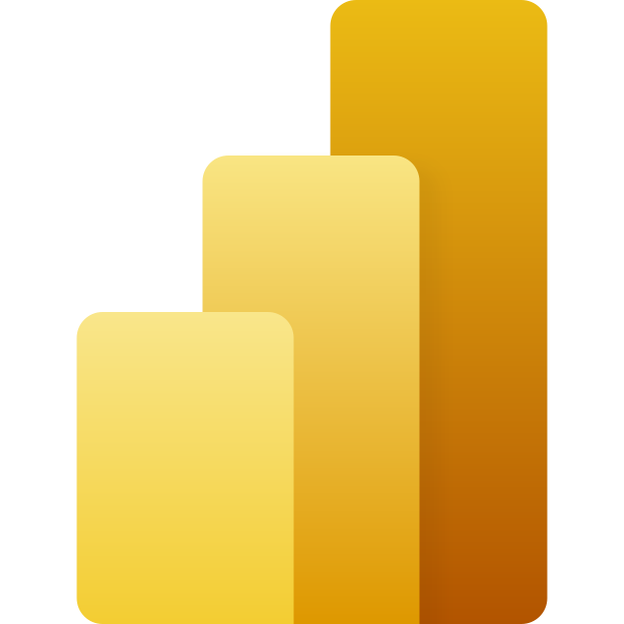

Azure tools or resources
Azure tools or resources which are likely to be used by you for the prototype, if your idea gets selected
We are using Azure Speech to Text for Multi Linguistic Indian Languages speech conversion into English text so that we can use sentiment analysis and various analyses to capture the complaints faced by the users
We are using various Machine learning, Deep Learning, And NLP techniques by using Microsoft Azure Machine Learning Studio Models for model development and analysis.
Also Using Microsoft PowerBI Dashboard For creating KPI reports and Centralized dashboards for the organization of call center

Slide 6
Any Supporting Functional Documents
Present your solution, talk about methodology, architecture & scalability

Slide 7
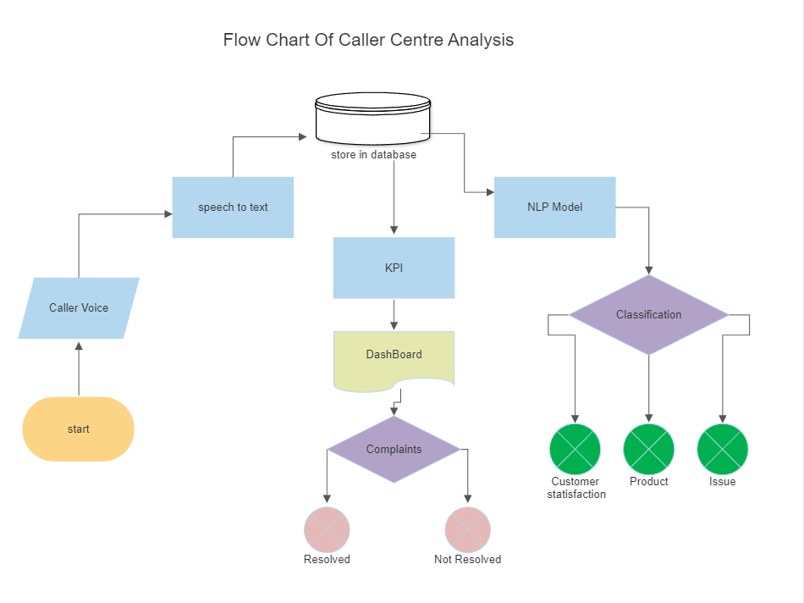

Slide 8
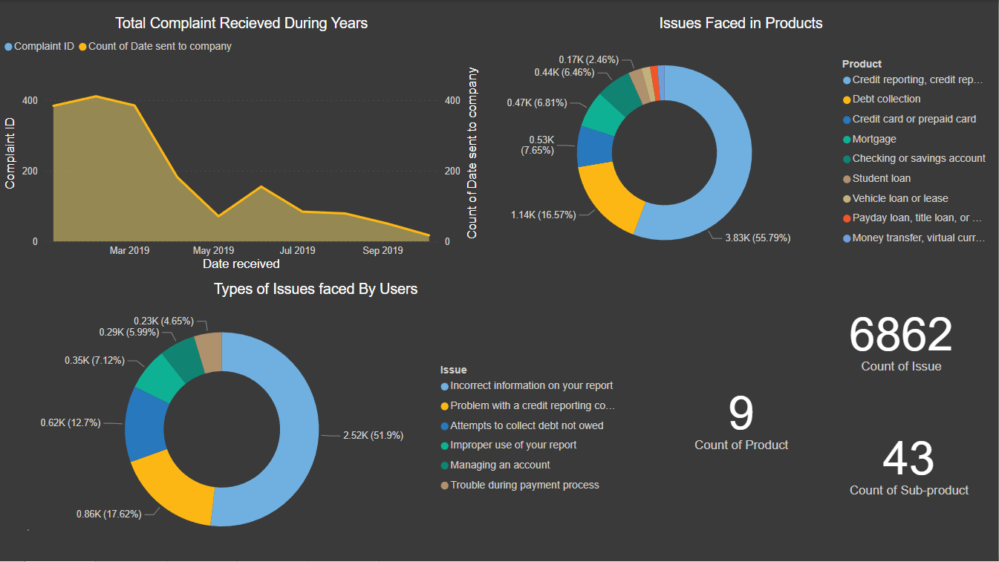
Dashboards

Slide 9
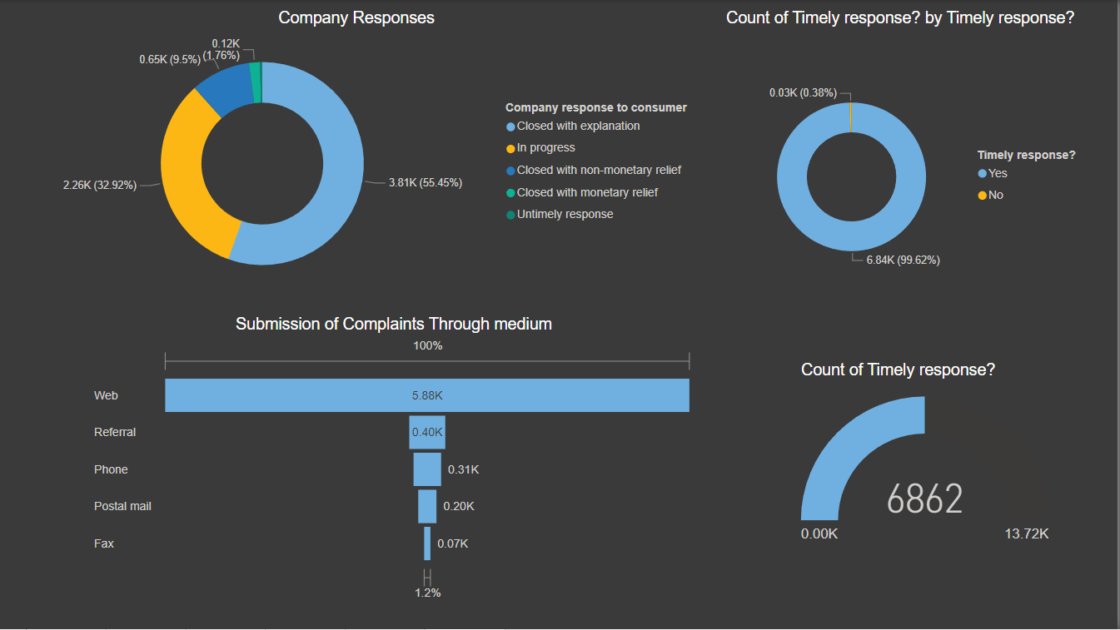

Slide 10
Key Differentiators & Adoption Plan
How is your solution better than alternatives and how do you plan to build adoption?
Multi linguistic (Indian languages) speech-to-text conversion to know to analyze user's complaints and provide insights to the company decision-makers.
To classify the speech based on gender and to provide some insights.
Providing sentiment analysis to know how happy the user is with our call center staff.
Also, it provides insight to the company about how many problems have been solved or not.
Provide KPI for the company to boost & fix issues that are mostly faced by lots of users.
Provide centralized Dashboards for the company To track daily analysis of their services and how

Slide 11
GitHub Repository Link & supporting diagrams, screenshots, if any
How far it can go?

Slide 12
Thank You
Team member names
Deepak Prasad
Mayur Pimpude
Priyanshu Singh

