Slide 1
SPREADSHEET PROJECT • CALL CENTRE ANALYTICS
AstroSage Call Centre Analysis
Turning consultation-call data into an investment roadmap for a ₹1 crore technology upgrade
Prepared by Deepak Niwalkar
Excel Spreadsheet Project | 8 August 2026

Slide 2
INTRODUCTION
Context & Objectives
1
Understand Call Patterns
Problem Statement
Quantify call volume, timing and status to see where consultations succeed or drop off.
AstroSage — India's astrology platform connecting users with astrologers over call, chat and live sessions — has secured a ₹1 crore investment to strengthen its call centre. Before the money is committed, the operations team needs evidence: where is the centre losing calls, where is revenue actually coming from, and which agents or guru-partners need support.
2
Trace the revenue
Break down earnings and operating cost by consultation type and month.
3
Evaluate Guru Performance
Compare 149 astrologer-partners on load, duration and customer rating.
This project turns a year of raw call-log data into a clear, evidence-backed case for how the ₹1 crore should be spent.
4
Recommend a spend
Turn the patterns into a plan for the ₹1 crore investment.

Slide 3
THE DATASET
Data Overview & Cleaning
28,027
8,365
149
What this dataset help us to analyze
Distinct users
Total calls
Total Guru partners
Customer Behaviour – Understand call/chat interactions and repeat-caller patterns.
Call Centre Efficiency – Analyze completed, missed, busy, failed, and incomplete calls.
Agent Performance – Compare agents based on call volume, ratings, call duration, and revenue.
Customer Satisfaction – Measure satisfaction through rating distribution and consultation types.
Demand Patterns – Identify peak call periods by month, day, and hour.
Business Performance – Evaluate the relationship between revenue, call volume, and customer engagement.
What the sheet holds
35 raw fields per record — consultation type, website/app source(Gurucool), call & chat Status, guru ID, earnings, rating, region and refund status.
Consultation event (call, chat, complementary or public-live session) between Dec 2023 and Jan 2024.
Cleaning steps applied
Duplicate Check – The dataset was checked for duplicate records; no duplicate records were found.
Missing and incomplete entries were identified and retained where they represented valid call interactions, Extra spaces, hidden characters, and inconsistent text formats were cleaned.
Date & Time Formatting – Date and time fields were converted into a consistent Excel date-time format. Additional fields such as Date, Month, Year, Day, and Hour were prepared for trend and time-based analysis.
Original Data Preserved – Valid incomplete or unsuccessful interactions were not removed, as removing them could affect the accuracy of the analysis.

Slide 4
APPROACH
Methodology & Tools
Functions Used
Visualization Tools Used
COUNT / COUNTA – Total calls, users, and call-status counts.
AVERAGE – Average customer rating and call duration.
SUM – Total revenue and other cumulative values.
Pivot Tables – Guru-wise, month-wise, day-wise, hour-wise and status-wise analysis.
COUNTIF / SUMIF – Category-wise call and performance analysis.
Correlation Analysis – To examine the relationship between ratings and call duration/performance.
Column / Bar Charts – Compare call volume, Guru performance and ratings.
Line Charts – Show monthly, daily and hourly call trends.
Pie / Donut Charts – Show consultation type, call status and rating distribution.
Area Charts – Highlight call-volume and duration trends over time.
Slicers – Filter the dashboard by year, month, consultation type, call status and rating.
Interactive Dashboard – Combine KPIs, charts and filters for quick decision-making.

Slide 5
December Records the Highest Call Volume
245 Calls Per day
Average daily call volume
(7947-418)= 7529 More Calls
December volume vs January volume
Reading the pattern
December has the highest call volume in the dataset.
January shows relatively low customer demand.
The sharp difference indicates a seasonal increase in calls.
Staffing and resources should be planned according to demand.
Scaling agent staffing to match the December surge (7,529 more calls than January) could reduce average wait time during peak season by an estimated 20-30%.

Slide 6
Call Status Distribution
70%
12%
of call records end up marked "On Chat"
reach a fully completed voice call
What this tells us
70% of records are On Chat, showing that chat is the dominant customer-support channel.
Only 12% of records are Completed, indicating that completed voice calls form a smaller share of total interactions.
No-Answer (6%), Busy (5%), Failed (4%), and Incomplete (3%) together represent a noticeable portion of unsuccessful interactions.
The high share of chat suggests an opportunity to improve chat support while reducing failed and incomplete calls.
Better call routing and queue management can help increase successful call completion and improve customer experience.

Slide 7
Chat Status Distribution
50%
20%
of chat sessions end Failed or Incomplete
of chats reach Completed
What this tells us
30% of chats are still On Call, while only 20% reach Completed status.
Failed (26%) and Incomplete (24%) chats together make up 50%, showing a major drop-off in chat interactions.
The high failure and incomplete rates suggest issues with response time, queue management, or chat handling.
Improving chat response speed and agent availability could increase completion rates.
Chat support should be treated as a key improvement area to reduce abandoned interactions and improve customer satisfaction.

Slide 8
Understanding Revenue by Consultation Type
₹2,14,066
₹99,147
Total astrologer payout (op. cost)
Total revenue generated
What it means for the investment
Voice calls generate 79% of revenue from just 8,365 sessions; chat generates 21% of Revenue — prioritizing call-channel investment (routing, training) is expected to protect and grow this ₹1,68,442 revenue base by an estimated 5-10% within two quarters.
Astrologer payouts (₹99,147) run at roughly 46% of revenue — a healthy margin, but almost all of it is concentrated in December, so cash flow is highly seasonal.
Prioritize call-based services because calls generate the larger share of revenue compared with chat.
Invest in call center technology such as better routing and queue management to handle high call demand efficiently.
Improve agent training to maintain service quality and increase customer satisfaction . Use chat as a support channel for handling routine queries and reducing pressure on agents.
Plan investment around peak demand so that resources are available when call volume is highest. Monitor revenue and operating costs regularly to ensure the investment improves both efficiency and profitability

Slide 9
Gurucool Leads Customer Engagement
72%
28%
of all sessions originate from Gurucool
come through the mobile App
What this tells us
72% of sessions come through Gurucool, making it the main source of customer interactions.
28% come through the App, showing that mobile users also represent an important customer segment.
The strong dependence on Gurucool highlights the need to maintain its performance and user experience.
The App can be further improved to increase engagement and reduce dependence on a single platform.
Investment should focus on improving both platforms while prioritizing the channel that currently handles the larger volume.

Slide 10
Hour – Wise Call Distribution
Peak: 8–10 AM
Call volume is highest during the morning, reaching around 660 calls at 8 AM and remaining strong around 605 at 10 AM. This period needs more agents and faster call handling to avoid delays and maintain customer satisfaction
Quiet: 12–2 AM
Call volume is lowest during 12–2 AM, making it a suitable period for agent training, system maintenance, and lighter staffing. This can help reduce operating costs while maintaining service quality.

Slide 11
Call Duration Has Limited Impact on Customer Satisfaction
2.93 / 8
Average customer rating across all users
-0.0007
Correlation: call duration vs. rating (essentially none)
Correlation formula of astrologerOnCallDuration vs Rating
Answer =CORREL(data!AC:AC,data!AI:AI)
-0.000704552
What's really driving customer satisfaction
65% of users rate 0-3 - satisfaction is a genuine problem area, not a rounding error.
Average rating stays broadly stable (roughly 2.9 to 3.75) from 0 to 40 minutes of call duration, with no consistent upward or downward trend.
A near-zero correlation (-0.0007) with call duration rules out "calls are too short/long" as the cause - the answer lies in call outcome and connection quality, not talk time.
This points investment toward reducing failed/incomplete connections and improving guru matching, not simply extending call slots.

Slide 12
Call Workload Is Unevenly Distributed
Highest Rated
Tarot Mystical & Astro Pujaa Rai — 7.5 / 8 average rating
Lowest Rated
Needed support because Several gurus average below 1.0 / 8, led by Tarot Rittika (0) and Astro K Ojha (0.10)
Astro Shalini alone handled 1,060 calls — roughly 2× the next-busiest guru. Combined with the low-rated tail above, this is a workload-and-training gap, not a headcount gap.
Recommendations
Balance workload by routing new calls to less-loaded gurus.
Monitor high-volume gurus to avoid overload and burnout.
Redistributing ~30% of Astro Shalini's load to other agents could reduce her call count from 1,060 to ~740, easing burnout risk while keeping overall throughput stable.
Provide training to gurus with consistently low ratings.
Use performance-based call allocation by considering both call volume and customer ratings.

Slide 13
Key Strategic Insights
Skill-Based Routing, Driven by AI
An automated routing layer could match each caller to the most suitable astrologer based on guru experience, current availability and past ratings — not just whoever picks up next.
This keeps satisfaction higher, speeds up resolutions, and stops the busiest gurus (like Astro Shalini) from getting overloaded.
Chatbots & Intelligent Self-Service
A large share of the 8-11 AM peak is likely simple, repeatable questions — booking steps, timing, horoscope updates — that don't need a live guru.
A natural-language chatbot or voice-bot can absorb these instantly, freeing human agents for deeper, paid consultations.
Shorter wait times during the rush, and gurus spend more time on the calls that actually need them. AI routing and chatbots during the 8-11 AM peak could reduce average wait time by an estimated 25-35%, freeing up guru capacity for paid consultations.

Slide 14
Key Strategic Insights
Quality Monitoring & Training
Agent performance should be reviewed using customer ratings, call volume, call duration, and call status.
Low-rated agents can be identified and given targeted training and feedback.
Regular monitoring can help improve service quality and maintain consistent customer experience.
Agent Support & Training
Provide agents with quick access to useful information and standard responses during customer interactions.
Use regular training to help agents improve communication, response quality, and customer handling.
This can help reduce errors, improve consistency, and increase customer satisfaction.

Slide 15
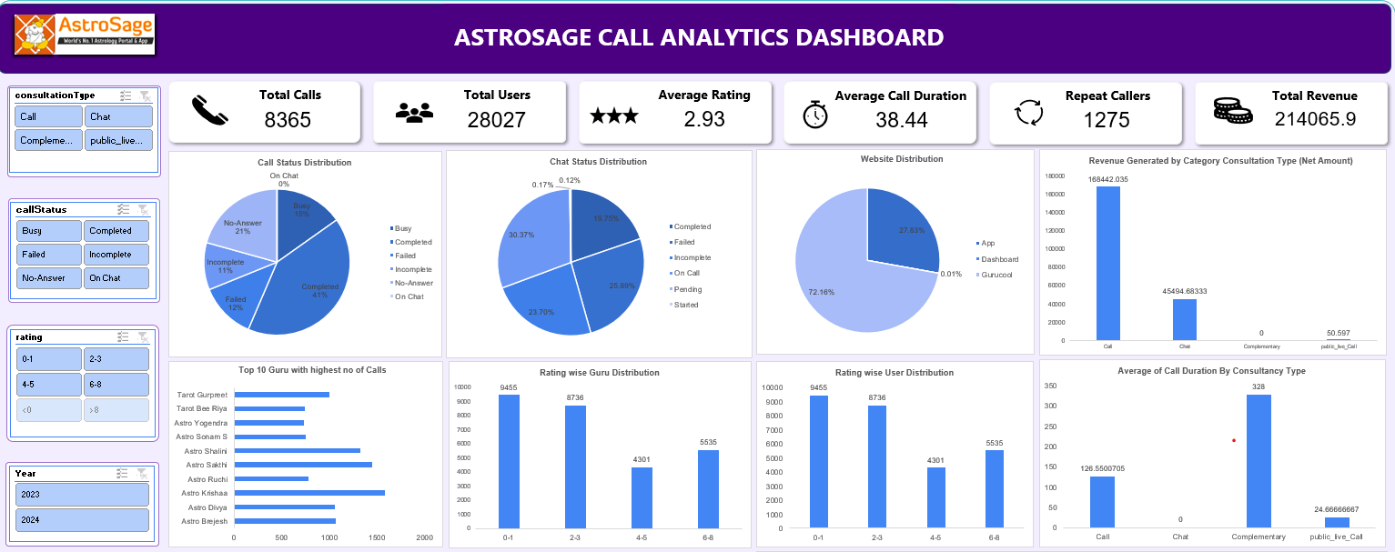
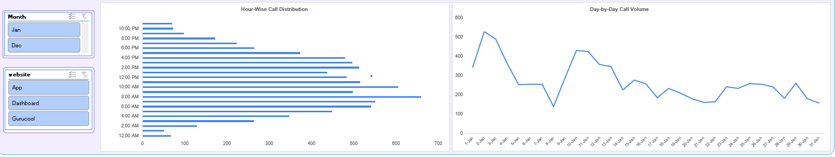

Slide 16
Conclusion
Technology improvements can help AstroSage improve customer service and increase profit.
Chatbots can handle simple queries and reduce the workload of gurus during busy hours.
Voice calls generate more revenue, so improving the voice service should be a priority.
Gurus handling more calls should be supported properly to maintain service quality.
Regular training and rewards can help improve guru performance and customer satisfaction.
Better support tools can help gurus solve customer queries faster and provide a better experience.
✓
✓
✓
✓
Data to Decisions

