Slide 1
SPREADSHEET PROJECT
Bike Sales Analysis
A simple look at who buys bikes, who doesn't, and why
Prepared by Deepak Niwalkar
Excel Spreadsheet Project

Slide 2
Context & Objectives
1
Profile the buyer
The Brief
Find out which customers are most likely to buy, based on age, income, job and family size.
A bike shop has data on 1,000 customers. Some bought a bike, most did not. The marketing team wants to know who is most likely to buy, so money is spent on the right people.
2
Spot the barriers
Understand why some groups, like people with more cars or higher income, buy less.
This project looks at income, age, job, family size and commute distance to find out what makes someone buy a bike. Every finding here comes straight from the data.
3
Compare regions
See where sales are strong today and where the biggest opportunity is.
4
Recommend next steps
Turn what the data shows into simple, practical marketing ideas.

Slide 3
Data Overview & Cleaning
1,000
481
18
Why this dataset matters
Customer records
Bike buyers (48.1%)
Fields per record
Every column sits right next to the Yes/No purchase result, so any customer detail can be checked against real buying behaviour.
With 1,000 customers split almost evenly between buyers and non-buyers, the comparisons here are based on real numbers, not guesses.
Because income, cars and commute are all in one sheet, we can tell apart who can afford a bike from who actually wants one.
What the sheet holds
Each row is one customer. It shows their marital status, gender, income, education, job, cars owned, commute distance, region, age, and whether they bought a bike.
A simple Yes/No column shows if they bought a bike, so every other detail can be checked against it.
Cleaning & enrichment steps
Made an Age-Group column (25-31, 32-54, 55-89) using a simple IF formula.
Added an Income Bracket column to group customers by how much they earn.
Flagged customers who earn over $70k, live close by, own no car, and already bought a bike.
Used conditional formatting to show high income (over $90k) in green and low income (under $40k) in red.

Slide 4
APPROACH
Methodology & Tools
Functions Used
Visualisation Tools Used
COUNTIFS / COUNTIF — count buyers, non-buyers and category totals.
AVERAGEIFS — average income, cars owned and age by segment.
Nested IF — build the Age-Group and Income Bracket columns.
PivotTables — occupation, region, education and job cross-tabs.
Correlation & purchase-rate formulas — compare groups fairly.
Bar / Column Charts — compare purchase rate across groups.
Pie Charts — show age-group and region splits.
Clustered Columns — compare two groups side by side (e.g. home owner vs not).
Slicers — filter the dashboard by region, job, education and age group.
Interactive Dashboard — combine KPIs, charts and filters in one view.

Slide 5
Higher Education Means More Bike Buyers
35% of buyers
Hold a Bachelor's degree — the single largest group
54.4%
Purchase rate among Professionals — the highest of any occupation
Reading the pattern
Bachelor's and Partial College graduates make up 60% of all buyers. Education level closely matches who buys a bike.
Professionals buy the most (54.4%), while Managers buy the least (42.2%) even though they earn more. So income alone doesn't decide the sale.

Slide 6
Cars Owned Affects Bike Buying
1.21 vs 1.66
Average cars owned: buyers vs non-buyers
178 customers
Own 2+ cars yet still bought a bike — a real but smaller segment
Reading the pattern
The purchase rate drops a lot as car count goes up — from 61% (0 cars) to just 36% (2+ cars). A bike seems to fill a transport need, not compete as an extra.
So car count is a better way to find buyers than income or age alone.

Slide 7
Age matters more than any other factor in deciding who buys
55.5%
31.2%
Highest purchase rate of any age group
Lowest purchase rate — 55-89 age group
What it means for targeting
78% of all buyers are aged 32-54. This one age group is the real customer base.
Younger and older customers buy at meaningfully lower rates. Relying on just one age group is risky.
Gender makes almost no difference — Male (47.4%) and Female (48.9%) buy at nearly the same rate. Age matters far more than gender.

Slide 8
More Data Points
131
113
$67,241
single women bought a bike. That is a big, clear group.
customers earning under $40k still bought a bike. Low income doesn't stop everyone.
is the average income of buyers with 3+ children — a wealthier family segment worth watching.
Skilled Manual
$86,647 avg.
18 customers
is the most common job among people who did not buy (140 people) — worth a closer look.
is the average income for Management, the highest of any job. But they buy the least (42.2%).
match all four best signs: high income, short commute, no car, and already bought a bike.

Slide 9
Best Sales Come From Pacific and Short Commutes
North America has the most buyers (220) but the lowest purchase rate — the biggest market with the most room to grow. For commute distance, 2-5 miles works best (58.6%), while 10+ miles barely converts at all (29.7%).

Slide 10
Who's most likely to buy — and why
Marital Status
Single
54.1% purchase rate vs 42.9% for married customers
Cars Owned
0 cars
61.1% purchase rate — the strongest single signal in the data
Age
32-54
55.5% purchase rate and 78% of all buyers
Commute
2-5 miles
58.6% purchase rate — the sweet spot, not too short or too long
Occupation
Professional
54.4% purchase rate — the best-converting occupation
In short: the ideal buyer is single, aged 32-54, works as a professional, owns 0-1 cars, and has a short commute. A bike fits their life easily.

Slide 11
More children, fewer bikes — money's the real reason
22.2%
Purchase rate for 5-child families — less than half the overall average
Reading the pattern
The pattern isn't a straight line — families with 1 or 3 children buy more than those with 2 or 4. But 5+ children is a clear drop, likely due to budget.
Low-income (40.1%) and low-education (26.3%) customers buy less than the 48.1% average. This is a real gap in the numbers — not a lack of interest.

Slide 12
Owning a home doesn't affect everyone the same way
58.8% vs 39.4%
Professionals without a home buy the most; Managers who own a home buy the least
M 47.4% · F 48.9%
Gender barely changes the purchase rate, and income is close too
What this tells us
Owning a home changes things differently for each job. For Professionals and Managers, not owning a home means buying more. For Clerical and Manual jobs, it is the opposite.
So home ownership is not one simple rule — it depends on the job. Marketing should not treat all home owners the same way.
Commute distance also shifts by region: Europe averages 2.1 miles, North America 4.2 miles, and Pacific 5.2 miles — worth knowing when setting region-wise messaging.

Slide 13
Recommendations
Target by Lifestyle, Not Just Demographics
Car ownership and commute distance are simpler, stronger clues than income, age, or gender on their own — 0-car households buy at 61.1% vs 36.3% for 2+ cars.
Use car ownership and commute distance as the main way to find buyers, ahead of income or age. This means better leads and less wasted ad spend.
Make Bikes Affordable for Every Budget
Partial High School customers buy at just 26.3% and under-$40k earners at 40.1% — both below the 48.1% average. But 113 low-income customers still bought, so the interest is real.
Offer EMI/financing options and a genuine low-cost bike model. Talk about savings and practical value, not lifestyle branding.
This closes part of the gap for these groups, without touching the premium line aimed at higher earners.

Slide 14
Recommendations
Grow North America Using the Pacific Playbook
North America has the most customers of any region (508 of 1,000) but only 43.3% buy. Pacific, the smallest region, converts 58.9% — the best of the three.
Study what works in the Pacific region and test the same approach in a small part of North America first. Closing even half this gap adds roughly 80 more buyers.
Personalise Outreach by Job and Home Ownership
Home ownership does not affect every job the same way. Professionals and Managers buy less once they own a home, while Clerical and Manual workers buy more.
Build two separate messages instead of one generic pitch — one for career-focused buyers still renting, one for settled working-class households.
This turns a confusing mixed signal into two clear, targetable groups.

Slide 15
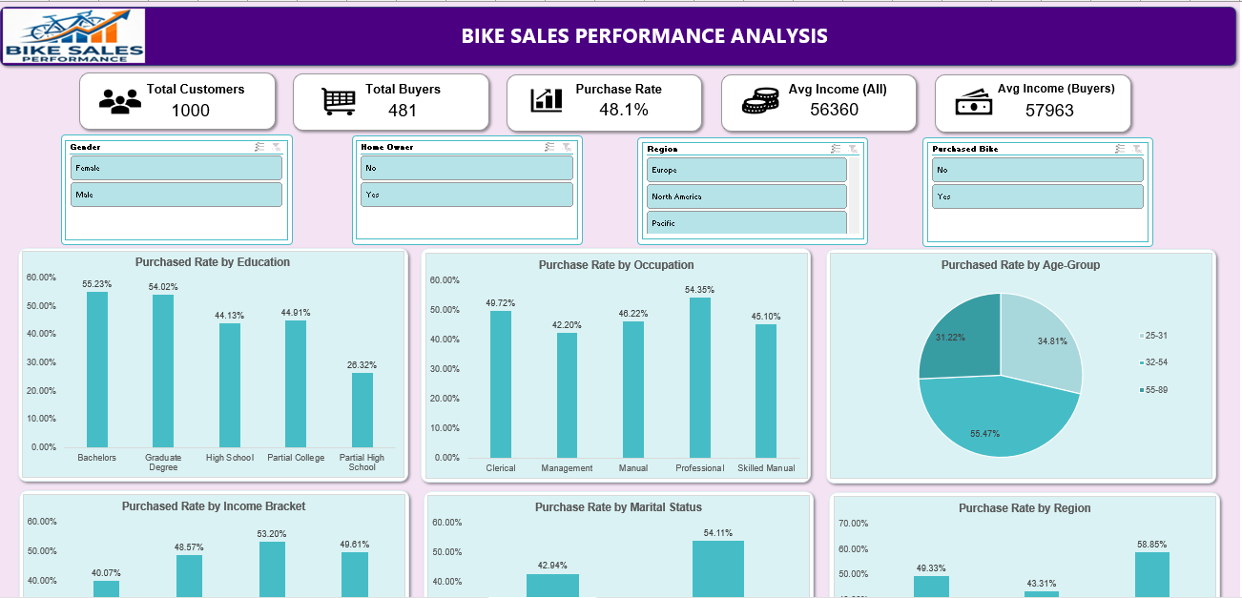
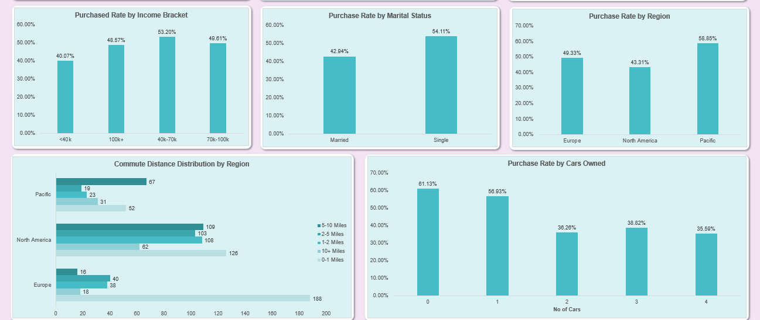

Slide 16
Conclusion
The ideal buyer is single, aged 32-54, works as a professional, and owns 0-1 cars.
A short commute and fewer cars matter more than a big income.
✓
The 32-54 age group makes up 78% of all buyers — the real core of the business.
Gender makes almost no difference in who buys a bike (Male 47.4%, Female 48.9%).
✓
Pacific converts best (58.9%), while North America has the most customers but converts worst (43.3%).
Data to Decisions
Home ownership only matters for some jobs — Professionals and Managers behave the opposite way to Clerical and Manual workers.
Families with 5 or more children buy far less, most likely because of budget.
Low income and low education customers still buy, just at a lower rate — the interest is there, money is the real barrier.
In short: lifestyle fit — cars, commute and age — predicts a bike sale better than income or gender ever could.

