Slide 1
Introduction to Data Structures

Slide 2
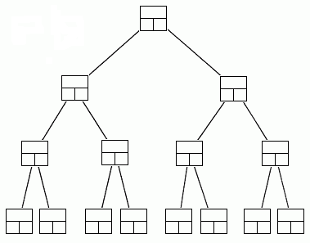
Data Structures
A data structure is a scheme for organizing data in the memory of a computer.
Some of the more commonly used data structures include lists, arrays, stacks, queues, heaps, trees, and graphs.
Binary Tree

Slide 3
Data Structures
The way in which the data is organized affects the performance of a program for different tasks.
Computer programmers decide which data structures to use based on the nature of the data and the processes that need to be performed on that data.
Binary Tree

Slide 4
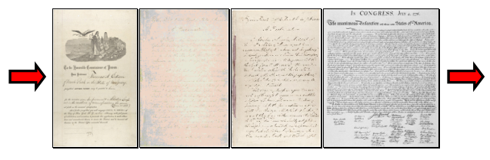
Example: A Queue
A queue is an example of commonly used simple data structure. A queue has beginning and end, called the front and back of the queue.
Data enters the queue at one end and leaves at the other. Because of this, data exits the queue in the same order in which it enters the queue, like people in a checkout line at a supermarket.

Slide 5
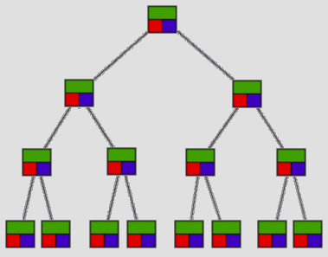
Example: A Binary Tree
A binary tree is another commonly used data structure. It is organized like an upside down tree.
Each spot on the tree, called a node, holds an item of data along with a left pointer and a right pointer.
Binary Tree

Slide 6
Example: A Binary Tree
The pointers are lined up so that the structure forms the upside down tree, with a single node at the top, called the root node, and branches increasing on the left and right as you go down the tree.
Binary Tree

Slide 7
Choosing Data Structures
By comparing the queue with the binary tree, you can see how the structure of the data affects what can be done efficiently with the data.

Slide 8
Choosing Data Structures
A queue is a good data structure to use for storing things that need to be kept in order, such as a set of documents waiting to be printed on a network printer.
.

Slide 9
Choosing Data Structures
The jobs will be printed in the order in which they are received.
Most network print servers maintain such a print queue.
.

Slide 10
Choosing Data Structures
A binary tree is a good data structure to use for searching sorted data.
The middle item from the list is stored in the root node, with lesser items to the left and greater items to the right.

Slide 11
Choosing Data Structures
A search begins at the root. The computer either find the data, or moves left or right, depending on the value for which you are searching.
Each move down the tree cuts the remaining data in half.

Slide 12
Choosing Data Structures
Items can be located very quickly in a tree.
Telephone directory assistance information is stored in a tree, so that a name and phone number can be found quickly.

Slide 13
Choosing Data Structures
For some applications, a queue is the best data structure to use.
For others, a binary tree is better.
Programmers choose from among many data structures based on how the data will be used by the program.

Slide 14
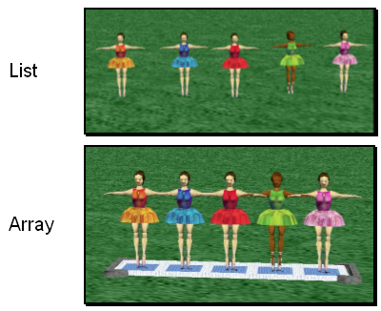
Data Structures in Alice
Alice has two built-in data structures that can be used to organize data, or to create other data structures:
Lists
Arrays
Notes:
The Redo button will reverse the last use of the Undo button, restoring the previous action.
The Ctrl-Y keyboard shortcut also can be used in place of the Redo button.

Slide 15
Lists
A list is an ordered set of data. It is often used to store objects that are to be processed sequentially.
A list can be used to create a queue.
Notes:
The Redo button will reverse the last use of the Undo button, restoring the previous action.
The Ctrl-Y keyboard shortcut also can be used in place of the Redo button.

Slide 16
Arrays
An array is an indexed set of variables, such as dancer_{[1]}, dancer_{[2]}, dancer_{[3]},… It is like a set of boxes that hold things.
A list is a set of items.
An array is a set of variables that each store an item.
Notes:
The Redo button will reverse the last use of the Undo button, restoring the previous action.
The Ctrl-Y keyboard shortcut also can be used in place of the Redo button.

Slide 17
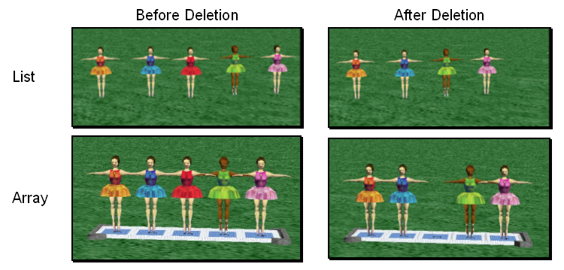
Arrays and Lists
You can see the difference between arrays and lists when you delete items.
Notes:
The Redo button will reverse the last use of the Undo button, restoring the previous action.
The Ctrl-Y keyboard shortcut also can be used in place of the Redo button.

Slide 18
Arrays and Lists
In a list, the missing spot is filled in when something is deleted.
Notes:
The Redo button will reverse the last use of the Undo button, restoring the previous action.
The Ctrl-Y keyboard shortcut also can be used in place of the Redo button.

Slide 19
Arrays and Lists
In an array, an empty variable is left behind when something is deleted.
Notes:
The Redo button will reverse the last use of the Undo button, restoring the previous action.
The Ctrl-Y keyboard shortcut also can be used in place of the Redo button.

Slide 20
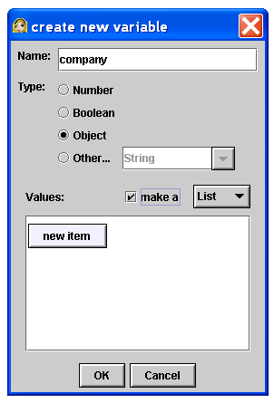
Lists
A list is created in Alice by checking the make a list box when creating a new variable.
Make a list box
Notes:
The Redo button will reverse the last use of the Undo button, restoring the previous action.
The Ctrl-Y keyboard shortcut also can be used in place of the Redo button.

Slide 21
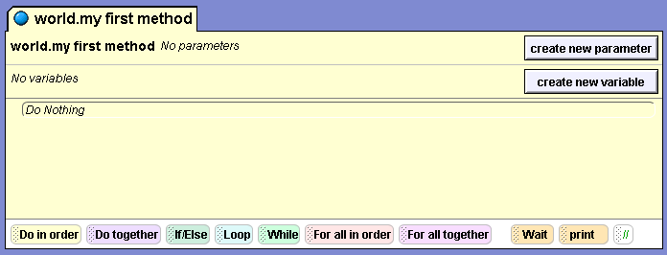
Lists
The For all in order and For all together tiles can be used to work with lists. They are at the bottom of the editor area.
Notes:
The Redo button will reverse the last use of the Undo button, restoring the previous action.
The Ctrl-Y keyboard shortcut also can be used in place of the Redo button.

Slide 22
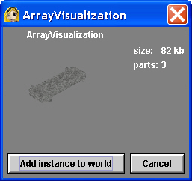
Arrays
Arrays can be created in a similar manner, but more often they are created using the array visualization object from the Alice local gallery.
The Array Visualization object has special properties and methods for manipulating the elements in an array.
Notes:
The Redo button will reverse the last use of the Undo button, restoring the previous action.
The Ctrl-Y keyboard shortcut also can be used in place of the Redo button.

Slide 23
Arrays
Alice has a set of built-in functions that can be performed on arrays.
Notes:
The Redo button will reverse the last use of the Undo button, restoring the previous action.
The Ctrl-Y keyboard shortcut also can be used in place of the Redo button.

