Slide 1

Introduction to Java Programming Language
Junji Zhi
University of Toronto

Slide 2
Content
Java language Syntax
“Hello World” program example
Compiling, Running and Debugging Java code
Inheritance
Threading
Synchronization

Slide 3
Java programming Language
Some buzzwords for Java
“Write Once, Run Anywhere”
Simple
Object oriented
Distributed
Multithreaded
Dynamic
Architecture neutral
Portable
High performance
Robust
Secure

Slide 4
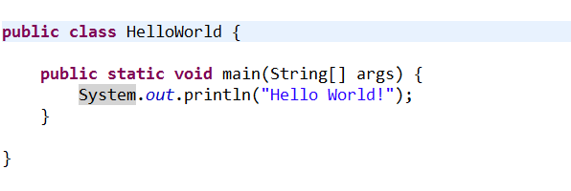
Example: Hello World Program
Everything is in a class
One file, one public class
In the runnable public class:
public static void main(String [] args)

Slide 5
Primitive Data Types
Primitive Data Types: byte, short, int, long, float, double, boolean, char
Arrays are also a class
long [] a = new long[5];
You can get the length by visiting the length field of array object a, like this: a.length
String class is very commonly used to represents character strings, for example
String s1 = “Hello ”, s2 = “Wolrd!”;
String s3 = s1 + s2;

Slide 6
Operators (same as C/C++) [3]
++,-- Auto increment/decrement
+,- Unary plus/minus
*,/ Multiplication/division
% Modulus
+,- Addition/subtraction

Slide 7
Declaring Variables [3]
int n = 1;
char ch = ‘A’;
String s = “Hello”;
Long L = new Long(100000);
boolean done = false;
final double pi = 3.14159265358979323846;
Employee joe = new Employee();
char [] a = new char[3];
Vector v = new Vector();

Slide 8
Compared with C/C++ [3]
Java has no:
pointers
typedef
preprocessor
struct
unions
multiple inheritance
goto
operator overloading
malloc
…

Slide 9
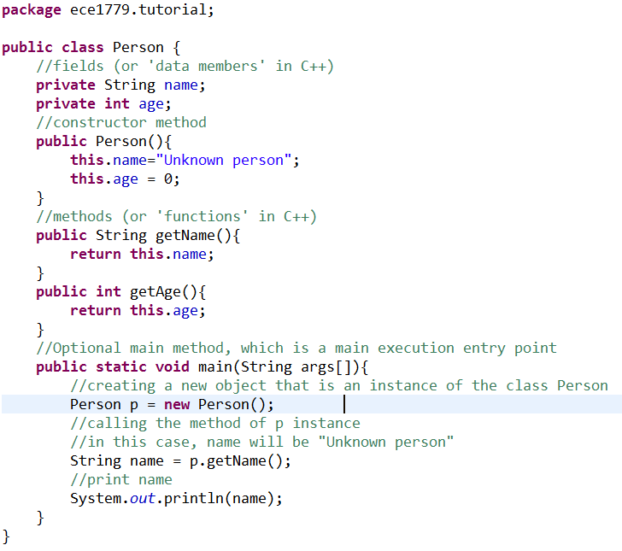
Declaring a class
package
Class name
Constructor
Fields
methods
Notes:
Package

Slide 10
Compiling, Running and Debugging Java Programs

Slide 11
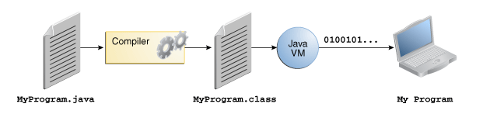
Java Development Process
.java => .class => JVM execution

Slide 12
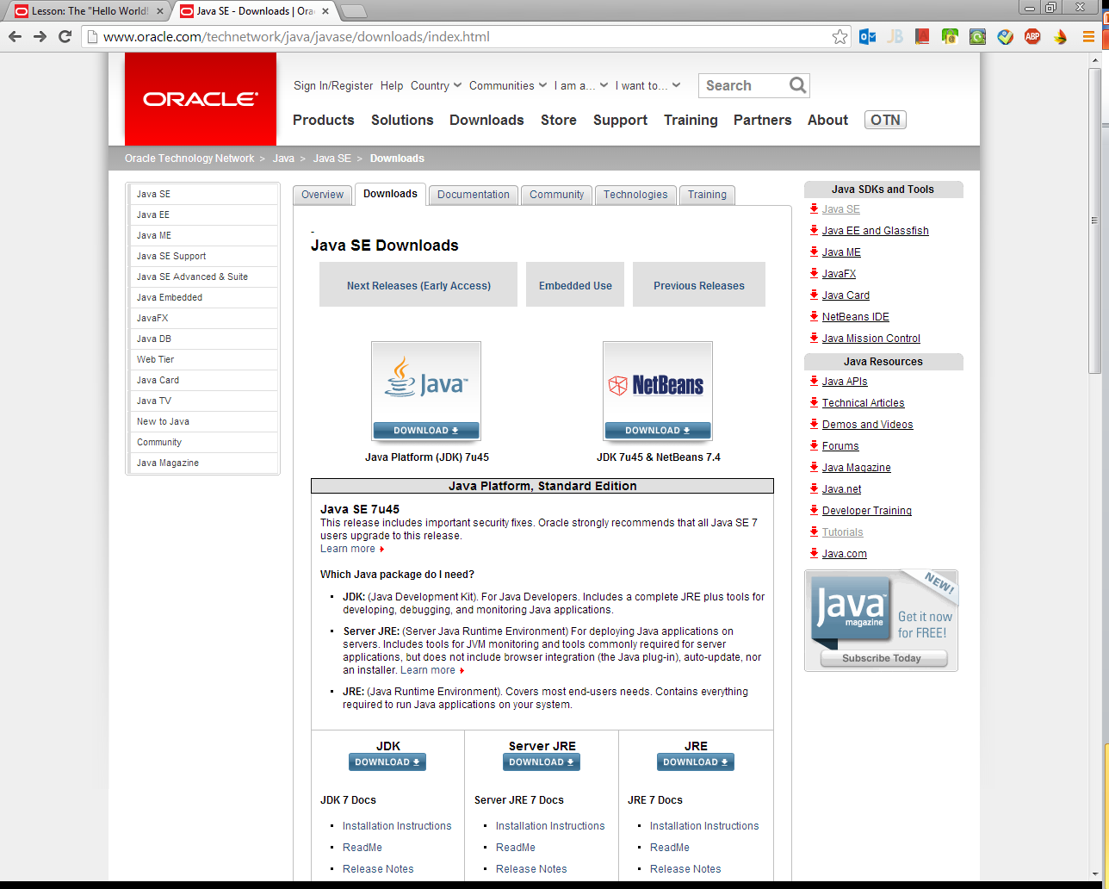
Installing Java in your machine (1)
Downloading Java Development Kit (JDK) from Oracle
Java Runtime Environment (JRE) is usually included in the JDK installation file.

Slide 13
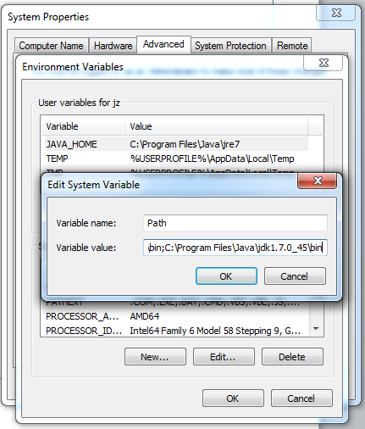
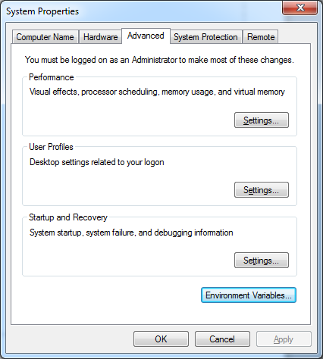
Installing Java in your machine (2)
Setting JAVA_HOME (Windows):
E.g., C:\Program Files\Java\jdk1.7.0_45
Setting path and classpath

Slide 14
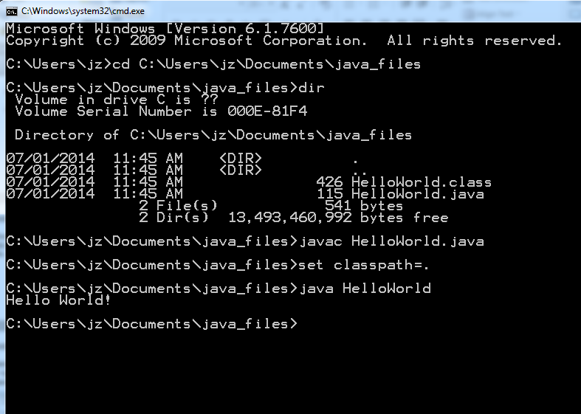
Compile .java File into a .class File (Command Line)

Slide 15
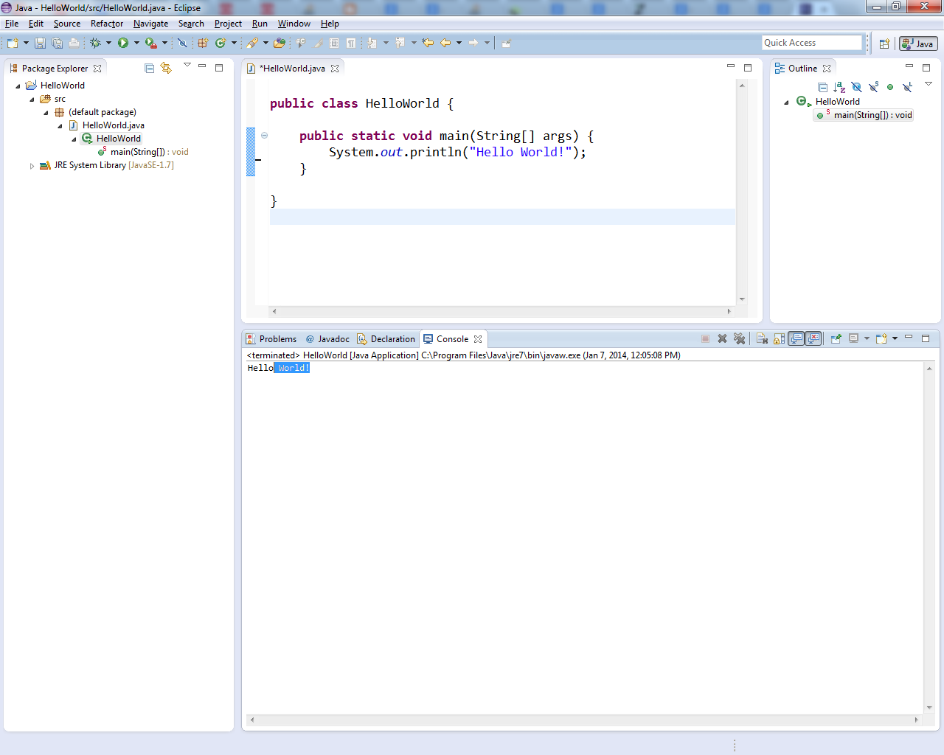
Running HelloWorld in Eclipse IDE
Eclipse Download from here.
Notes:
Eclipse is automatically compiling your code on the fly.

Slide 16
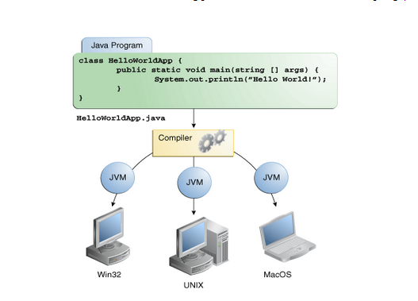
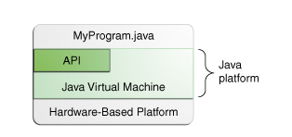
Java platform

Slide 17
Debugging Java in Eclipse (1)
Debugging means “run a program interactively while watching the source code and the variables during the execution.” [5]
Set breakpoints to stop the program at the middle of execution
Eclipse has a Debug Mode

Slide 18
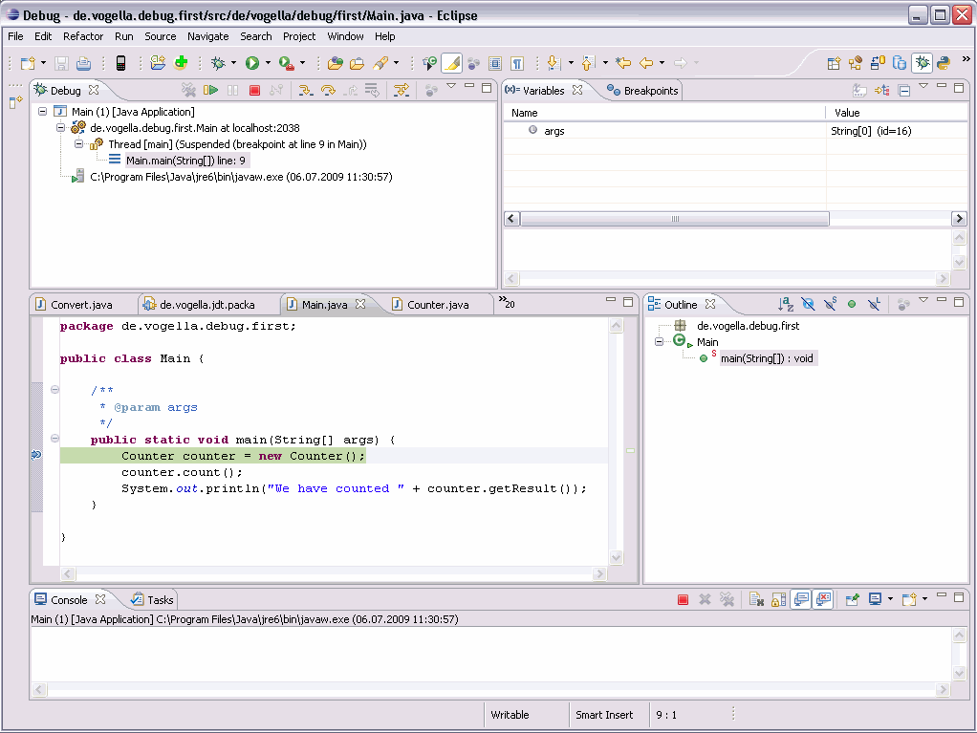
Debugging Java in Eclipse(2)
Image courtesy: http://www.vogella.com/tutorials/EclipseDebugging/images/xdebugstart20.gif.pagespeed.ic.SqCELlNeCm.png

Slide 19

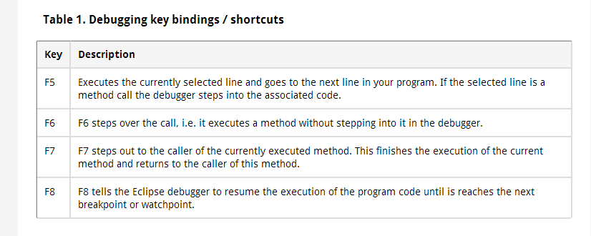
Debugging Java in Eclipse(3)
Table courtesy: http://www.vogella.com/tutorials/EclipseDebugging/article.html

Slide 20
Java Inheritance

Slide 21
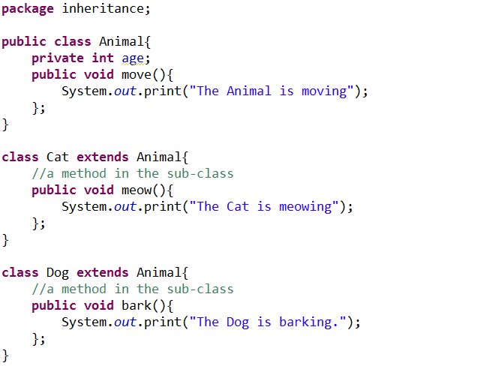
Inheritance in Java
Java classes can be derived from other classes, thereby inheriting fields and methods from those classes.

Slide 22
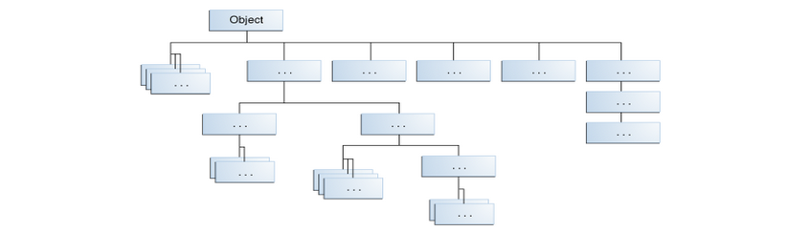
Common Root: Object

Slide 23
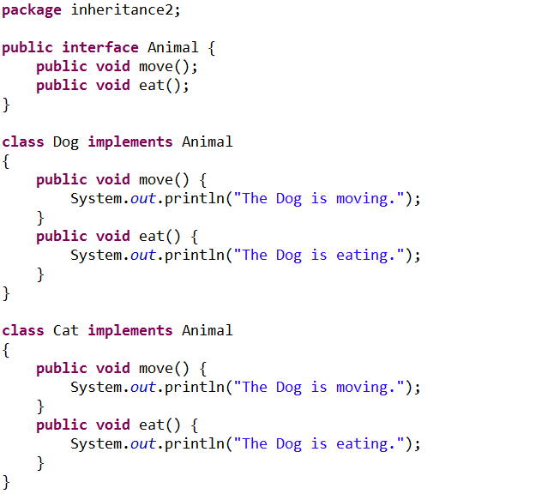
Interface

Slide 24
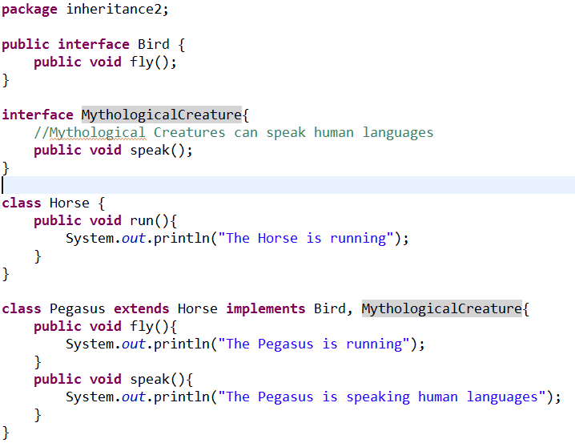
“Multiple Inheritance”

Slide 25
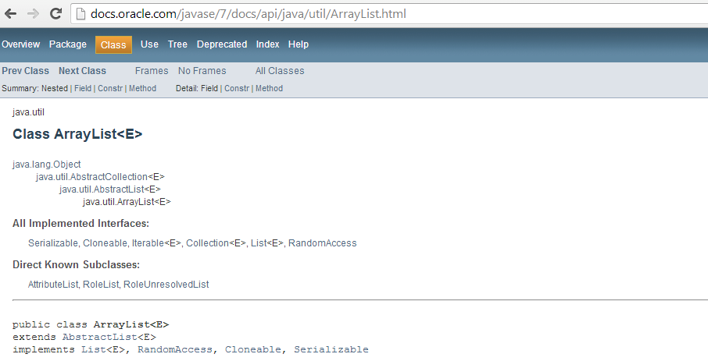
A Real World Example: ArrayList
http://docs.oracle.com/javase/7/docs/api/java/util/ArrayList.html

Slide 26
Java Threading

Slide 27
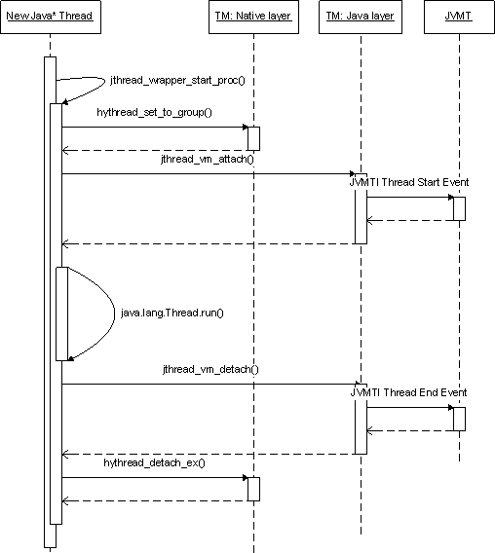
Java Threading
A thread is a thread of execution in a program [6]
JVM allows an application to have multiple threads running concurrently.
Apache Harmony example:
http://harmony.apache.org/subcomponents/drlvm/TM.html

Slide 28
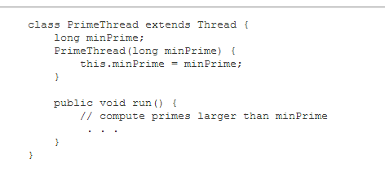

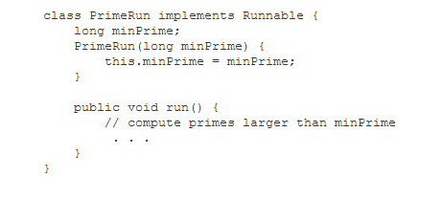

Two ways to do threading
Extends Thread class
Implements Runnable interface
http://docs.oracle.com/javase/7/docs/api/java/lang/Thread.html

Slide 29
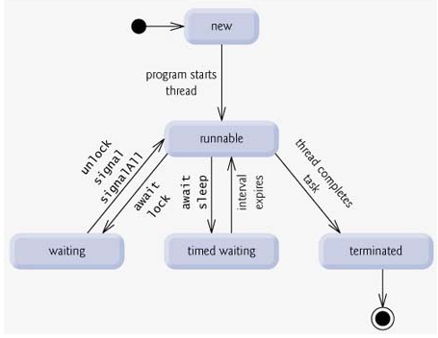
Thread lifecycle

Slide 30
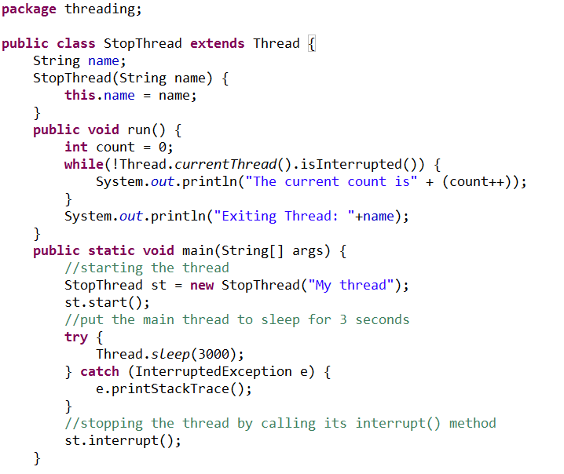
How to stop a Thread
Using Thread.interrupt() method:
http://stackoverflow.com/questions/7786305/stopping-a-specific-java-thread

Slide 31
Java Synchronization

Slide 32
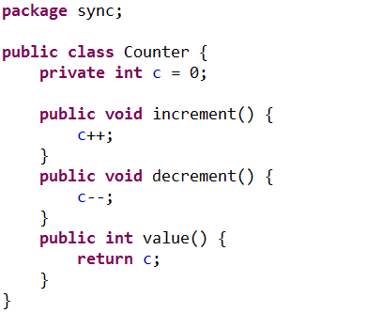
Thread Interference (1)
Increment operation is translated to multiple steps by the virtual machine :
Retrieve the current value of c.
Increment the retrieved value by 1.
Store the incremented value back in c.
Example from: http://docs.oracle.com/javase/tutorial/essential/concurrency/interfere.html

Slide 33
Thread Interference (2)
Assume we have 2 threads, A and B.
A increments c, and B decrements c.
Thread A and B runs together.
One possible order of the low-level steps:
Thread A: Retrieve c.
Thread B: Retrieve c.
Thread A: Increment retrieved value; result is 1.
Thread B: Decrement retrieved value; result is -1.
Thread A: Store result in c; c is now 1.
Thread B: Store result in c; c is now -1.
Is the result correct?
What if the thread A and B are bank transactions?

Slide 34
Problem Root Cause
Threads are visiting one field (resource) at the same time.
Multiple steps of an operation
No enforced “happen-before” relationship

Slide 35
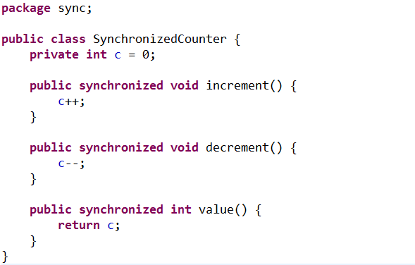
Solution: synchronized method
Example: http://docs.oracle.com/javase/tutorial/essential/concurrency/syncmeth.html

Slide 36
synchronized method
Enforce the ‘happen-before’ relationship in the method level.
Either one of the below instance will happen. But result is always 0, which is correct.
Thread A: Retrieve c.
Thread A: Increment retrieved value; result is 1.
Thread A: Store result in c; c is now 1.
Thread B: Retrieve c.
Thread B: Decrement retrieved value; result is 0.
Thread B: Store result in c; c is now 0.
Thread B: Retrieve c.
Thread B: Decrement retrieved value; result is -1.
Thread B: Store result in c; c is now -1.
Thread A: Retrieve c.
Thread A: Increment retrieved value; result is 0.
Thread A: Store result in c; c is now 0.
OR

Slide 37
synchronized statements (1)
Every object has an intrinsic lock associated with it
Primitive types (e.g., int, char) do not have intrinsic locks.
We can combine object intrinsic locks and synchronized keyword to create fine-grained synchronization control.

Slide 38
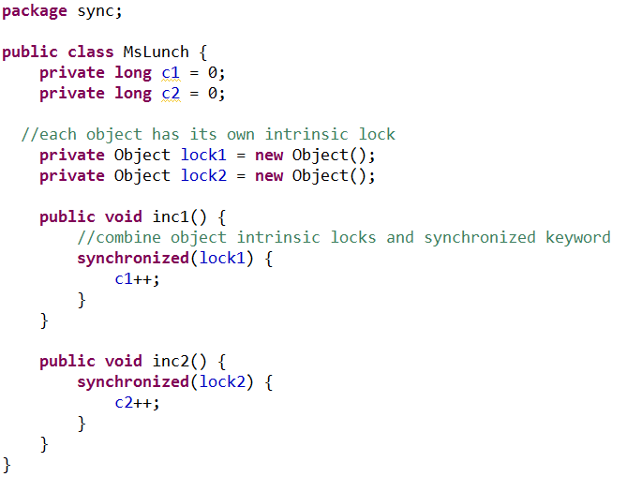
synchronized statements (2)
http://docs.oracle.com/javase/tutorial/essential/concurrency/locksync.html

Slide 39
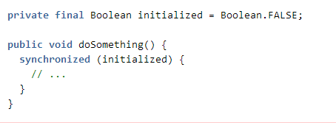
synchronized statement hazards (1)
Boolean has only two instances of Boolean
If another thread also synchronizes on the same Boolean instance, like this:
private final Boolean someLock = Boolean.FALSE;
The lock will be reused.
The system might be deadlock or unresponsive.
It is hard to detect this type of bugs!
More examples:
https://www.securecoding.cert.org/confluence/display/java/LCK01-J.+Do+not+synchronize+on+objects+that+may+be+reused

Slide 40
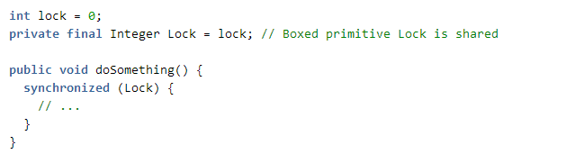
synchronized statement hazards (2)
Another example of the wrong way of using locks:
What will happen another thread also synchronizes on an integer instance with the 0 integer value?
https://www.securecoding.cert.org/confluence/display/java/LCK01-J.+Do+not+synchronize+on+objects+that+may+be+reused
Notes:
JVM implementations are also permitted to reuse wrapper objects for larger ranges of values. While use of the intrinsic lock associated with the boxed Integer wrapper object is insecure; instances of theInteger object constructed using the new operator (new Integer(value)) are unique and not reused.
In general, locks on any data type that contains a boxed value are insecure.

Slide 41
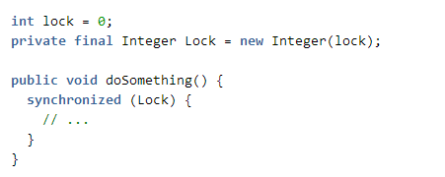
synchronized statement hazards (3)
Correct way of using locks: using new to instantiate an object
https://www.securecoding.cert.org/confluence/display/java/LCK01-J.+Do+not+synchronize+on+objects+that+may+be+reused

Slide 42
References
Thinking in Java 4th Ed, Bruce Eckel
Oracle Java tutorial (http://docs.oracle.com/javase/tutorial/index.html)
www.cs.drexel.edu/~spiros/teaching/CS575/slides/java.ppt‎
http://eclipsetutorial.sourceforge.net/Total_Beginner_Companion_Document.pdf
http://www.vogella.com/tutorials/EclipseDebugging/article.html

