Slide 1
Introduction to Oracle 10g
Chapter 13
Database Administration
James Perry and Gerald Post

Slide 2
Chapter Outline
Overview of a DBA’s Duties
Using the Enterprise Manager
Understanding Oracle Storage Files
Configuring Space for Schema Objects
Exporting and Importing Data
Maintaining the DBMS
Backing up the Database
Monitoring and Improving Database Performance
Obtaining Useful Information from System Views

Slide 3
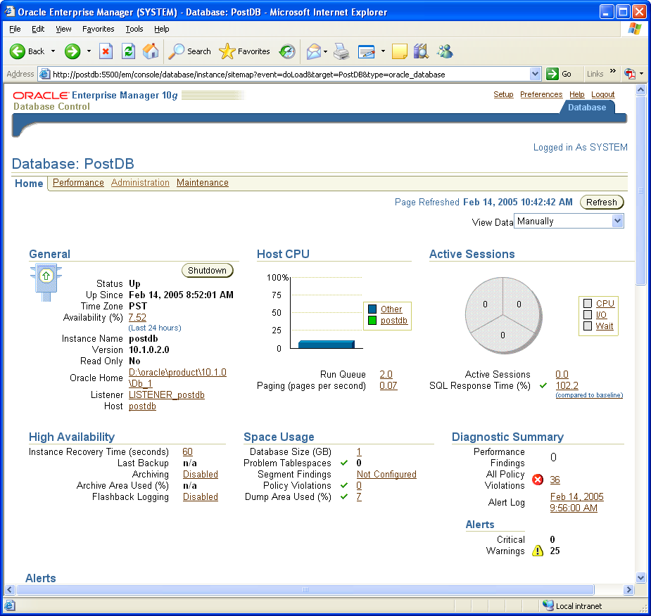
13.1 The Enterprise Manager main page
Using the Enterprise Manager

Slide 4
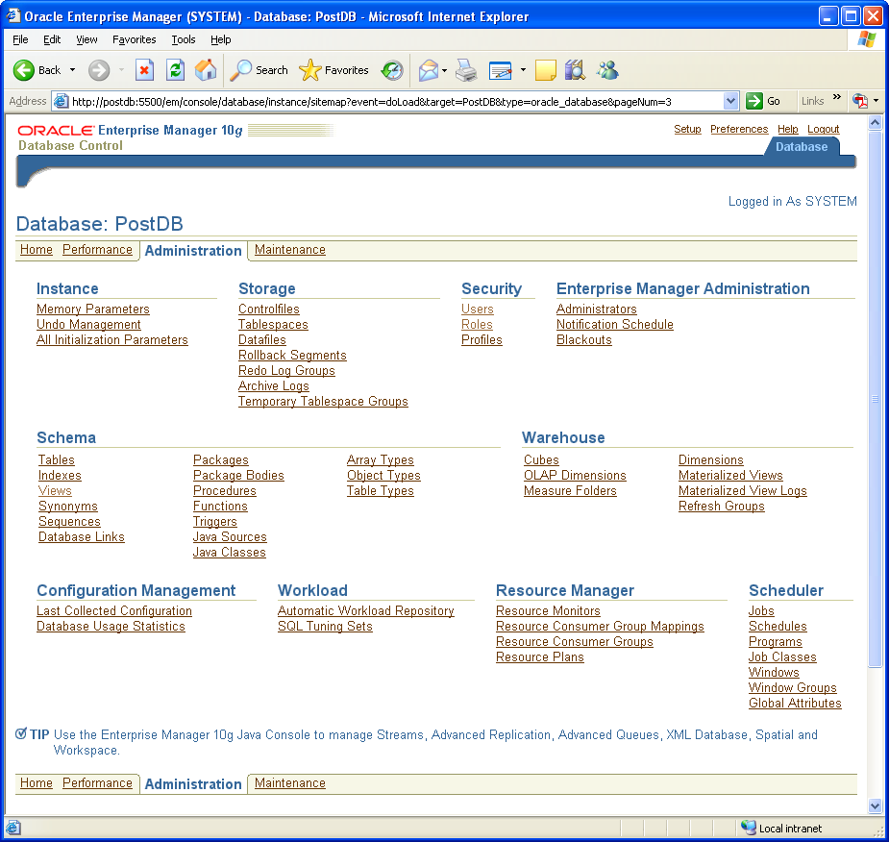
13.2 Enterprise Manager Administration page

Slide 5
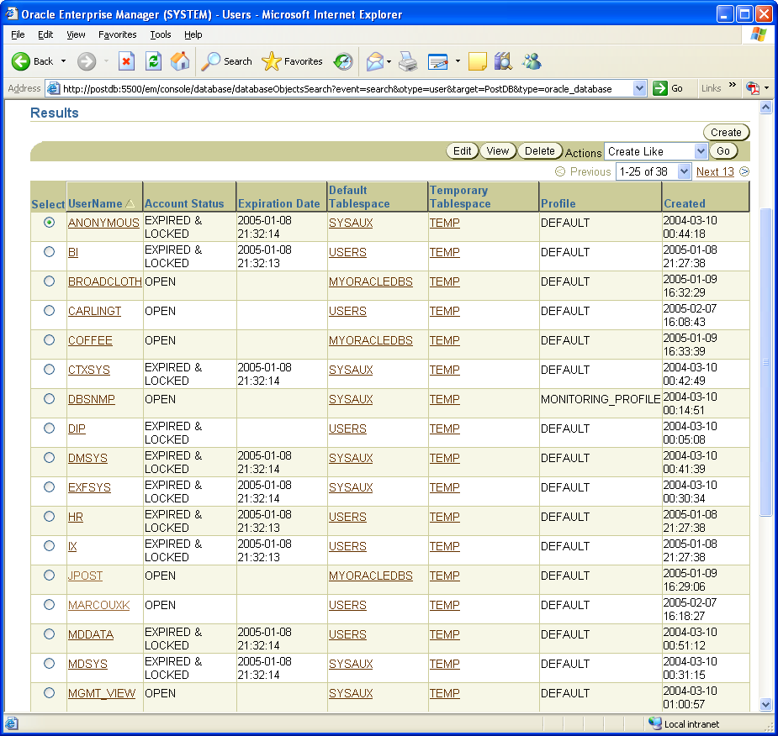
13.3 Enterprise Manager Administration/Security/Users page
Modify existing
User account
Create new user
MarcouxK user
Created in Chapter 13

Slide 6
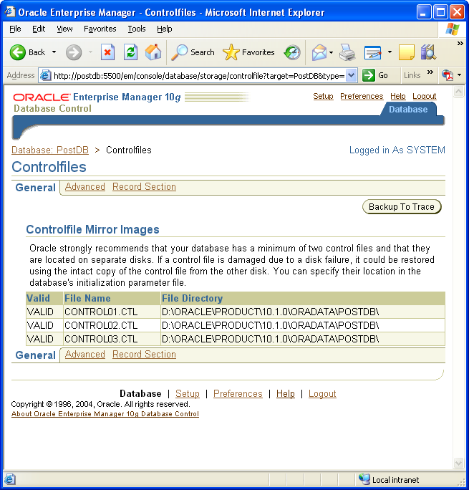
13.4 Location of current control files
Understanding Oracle storage files

Slide 7
13.5 Oracle tablespaces and datafiles
Redwood tables
Redwood indexes
RW01.DBF
RWTablespace1
RWTablespace2
RW02.DBF
RWI01.DBF
RW03.DBF
Segment
Extent
Data blocks

Slide 8
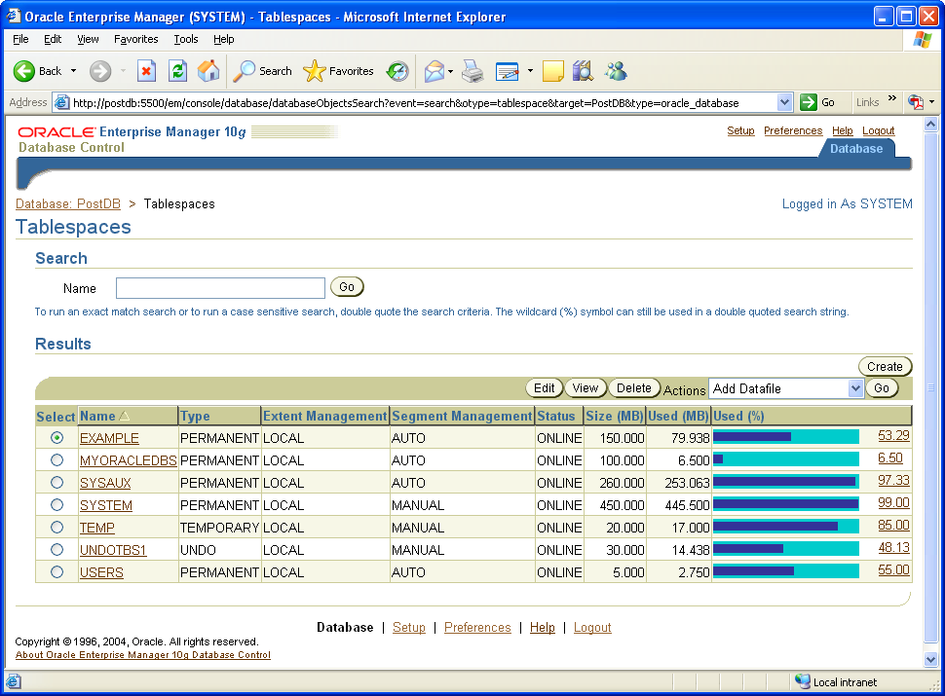
13.6 Sample tablespaces

Slide 9
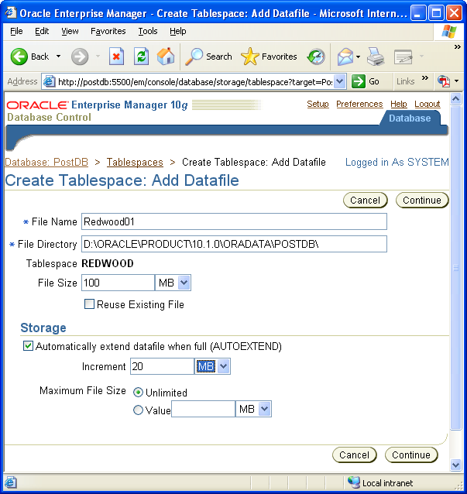
13.7 Creating a new datafile

Slide 10
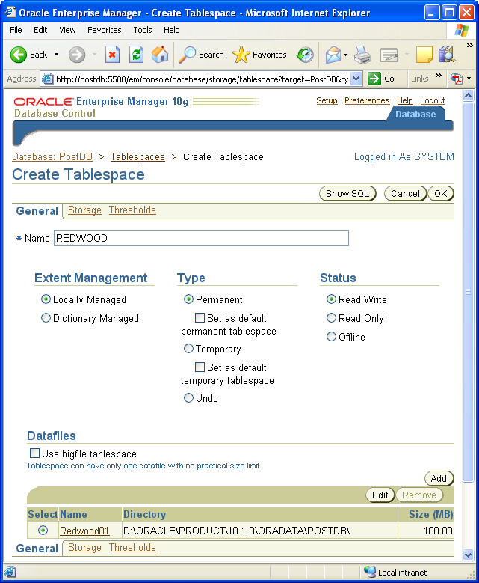
13.8 Creating a new tablespace

Slide 11
13.9 Effect of the PCTFREE parameter
PCTFREE 20%
Reserved for Updates
Data block
Row data from inserts
Free space
Administrative data
overhead

Slide 12
Table 13.1 Effects of choosing PCTFREE value
Smaller PCTFREE | Less room for updates to existing table rows. Inserts fill the block with less wasted space. May require fewer total data blocks, saving space with faster retrieval.
Larger PCTFREE | More room for updates to existing table rows. May require more blocks. May improve Update performance because the database does not have to migrate rows.

Slide 13
Table 13.2 Oracle recommendations for PCTFREE and PCTUSED
Table Characteristics | Settings | Reasoning
Default | PCTFREE=10 PCTUSED=40 | Default values for general purpose tables.
Many UPDATE statements increase the size of rows. | PCTFREE=20 PCTUSED=40 | More free space to allow rows to grow. PCTUSED reduces processing during high update activity.
Row sizes rarely change. | PCTFREE=5 PCTUSED=60 | Need less free space since row space can be reused. PCTUSED reduces wasted space, allowing space to be reused faster.
Large table and most activity is read only. | PCTFREE=5 PCTUSED=40 | With a large table, you want to minimize the empty space.

Slide 14
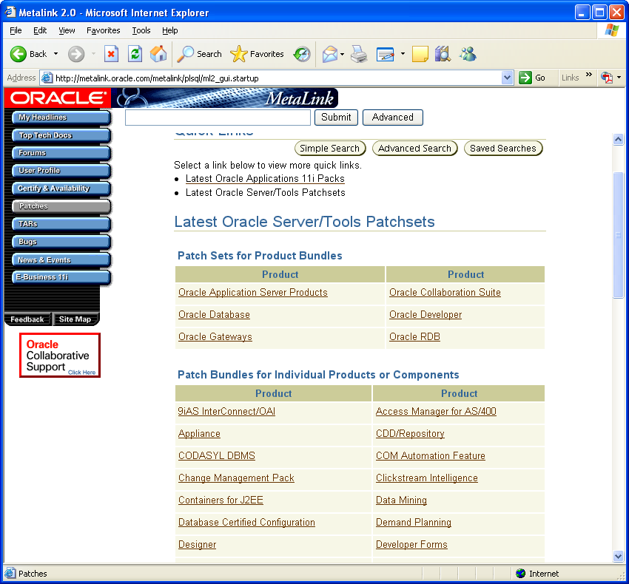
13.10 MetaLink patch search
Maintaining the DBMS

Slide 15
Table 13.3 Shutdown options
Shutdown Command Option | Description
Shutdown normal (default) | No new connections are allowed, but the system waits for all users to disconnect before shutting down.
Shutdown transactional | No new connections are allowed. No new transactions can be started. After all transactions are completed, the database shuts down.
Shutdown immediate | No new connections are allowed. No new transactions can be started. Uncommitted transactions are rolled back.
Shutdown abort | All transactions are terminated. Current SQL statements are terminated. The database will have to go through recovery when it restarts. Avoid this option except in emergencies.

Slide 16
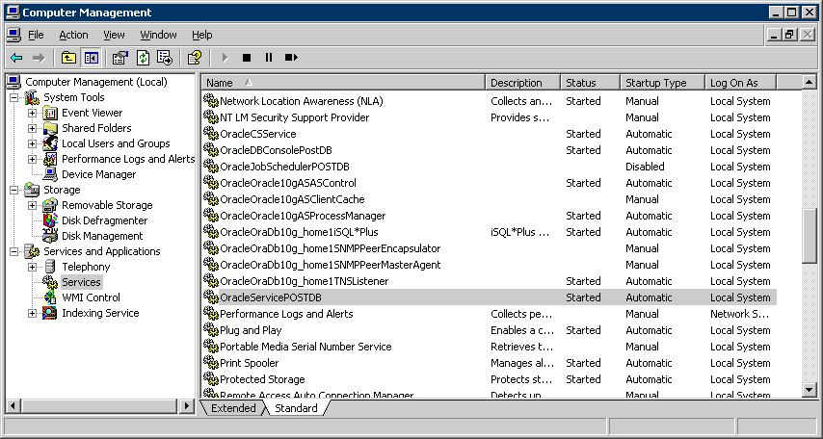
13.11 Shutting down Oracle with the Windows service manager
Stop a service
Listener for
Enterprise Manager
Listener for
iSQL*Plus
Main Oracle services

Slide 17
Table 13.4 Startup options
Startup command option | Description
Startup | Starts the instance, mounts the database, and allows everyone to log in.
Startup nomount | Starts the instance, but does not mount the database. Used when you want to create a new database.
Startup mount | Starts the instance, sets up the database, but does not open it. Used for configuring red logs files and performing full database recovery.
Startup restrict | Starts and mounts the database, but only certain users (DBAs) can log in. Useful when you need to export data, load large tables, or during upgrade migrations.

Slide 18
13.12 Recovering an active database
Primary database
Disk crash
Recovered database
Time
Redo Archive log
Full backup copy

Slide 19
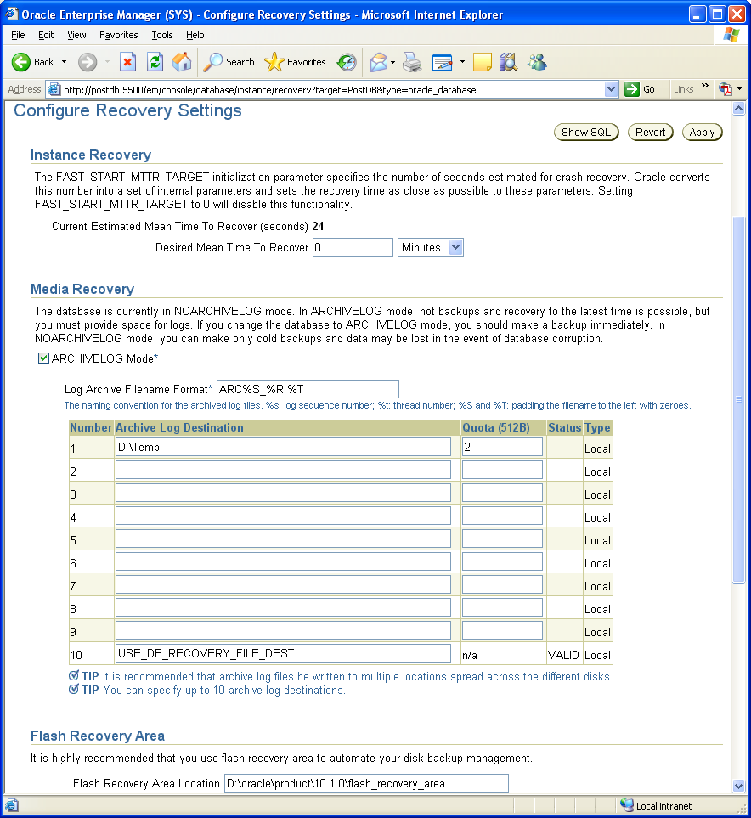
13.13 Configuring the ArchiveLog property

Slide 20
Table 13.5 Oracle file names and common locations
File type | Typical Name | Typical Location
Control File | CONTROL01.CTL | ORACLE_HOME\Oradata\DBName\
SPFile | SPFILE<DBName>.ORA | ORACLE_HOME\<instance>\Database
Password file | PWD<DBName>.ORA | ORACLE_HOME\Database\
Data Files | SYSTEM01.DBF | ORACLE_HOME\Oradata\DBName\ Plus other locations if you create your own tablespaces and datafiles.
Archive Logs |  | Depends on what you entered.
Flash Recovery Area |  | ORACLE_HOME\flash_recovery_area
Redo Logs | REDO01.LOG | ORACLE_HOME\Oradata\DBName\

Slide 21
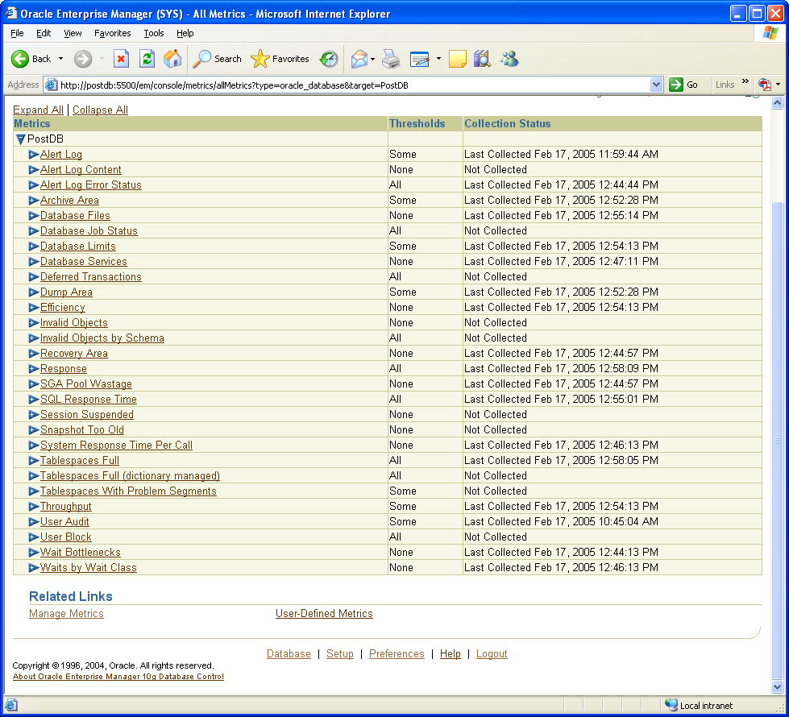
13.14 Metrics used for standard alerts
Monitoring the DBMS

Slide 22
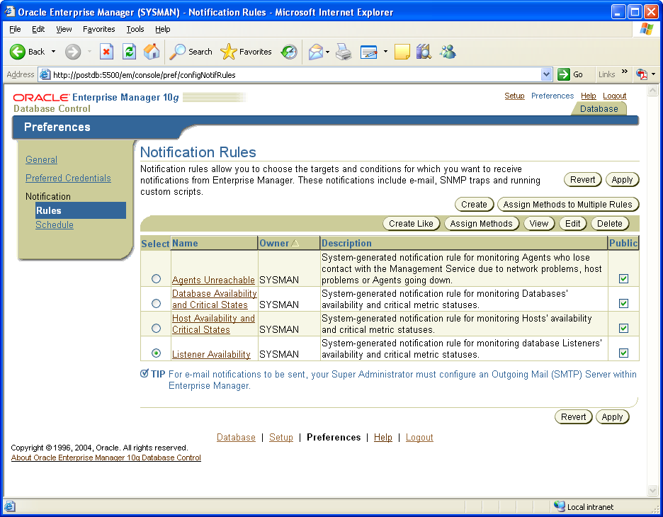
13.15 Setting an alert to send you an e-mail message
Setup to enter e-mail
server information
General to enter
your e-mail address
Preferences
Rules to pick events

Slide 23
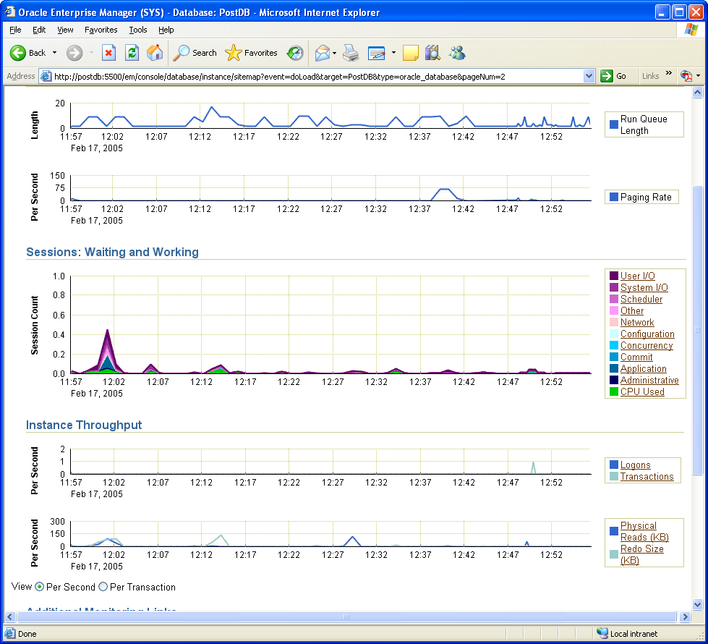
13.16 Default statistics in the performance monitor

Slide 24
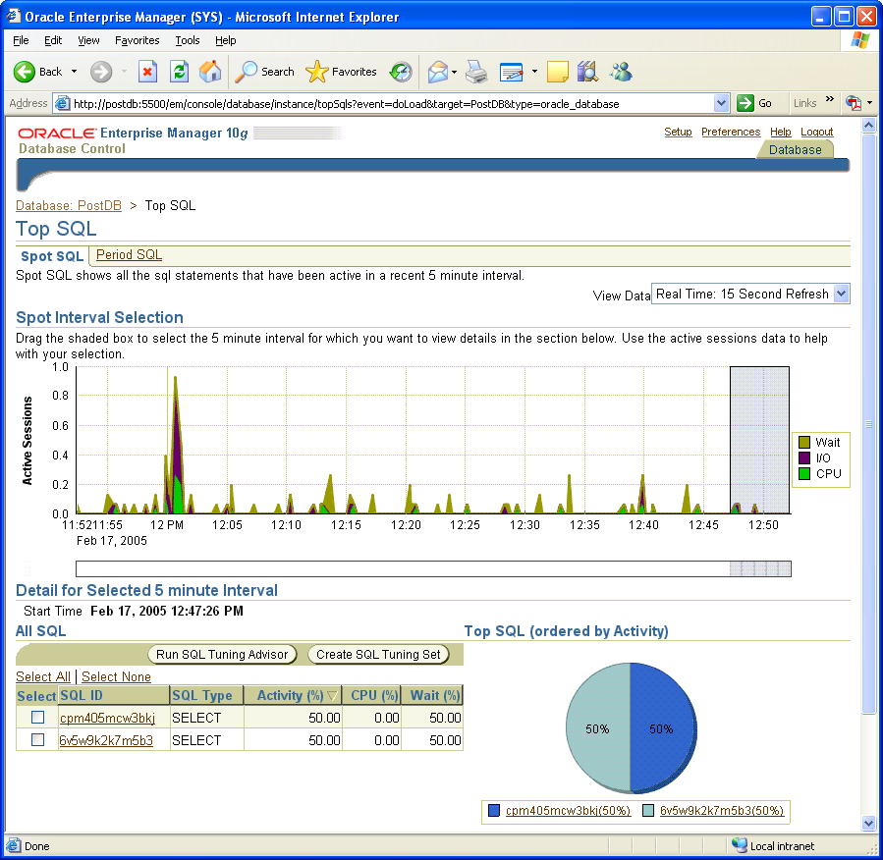
13.17 Performance monitor showing the top SQL commands

Slide 25
Table 13.6 Tuning advisors
Advisor | Description
ADDM Advisor | The automatic analyzer examines usage, self-diagnoses problems, and recommends overall improvements.
SQL Tuning Advisor | Analyzes SQL statements and recommends rewrites to improve performance on individual queries.
SQL Access Advisor | Analyzes SQL statements and recommends indexes and materialized views.
Memory Advisor Shared Pool Advisor Buffer Cache Advisor PGA Advisor | Analyzes the use of system memory and can automatically reconfigure it for optimal performance. You can also run SGA and PGA advisors manually.
Segment Advisor | Analyzes segments to decide if you should run the shrink option to compact the space. It also maintains usage reports that are useful for capacity planning.
Undo Advisor | Identifies problems in the undo tablespace and helps set the optimal size, threshold values, and retention period for the undo and flashback segments.

Slide 26
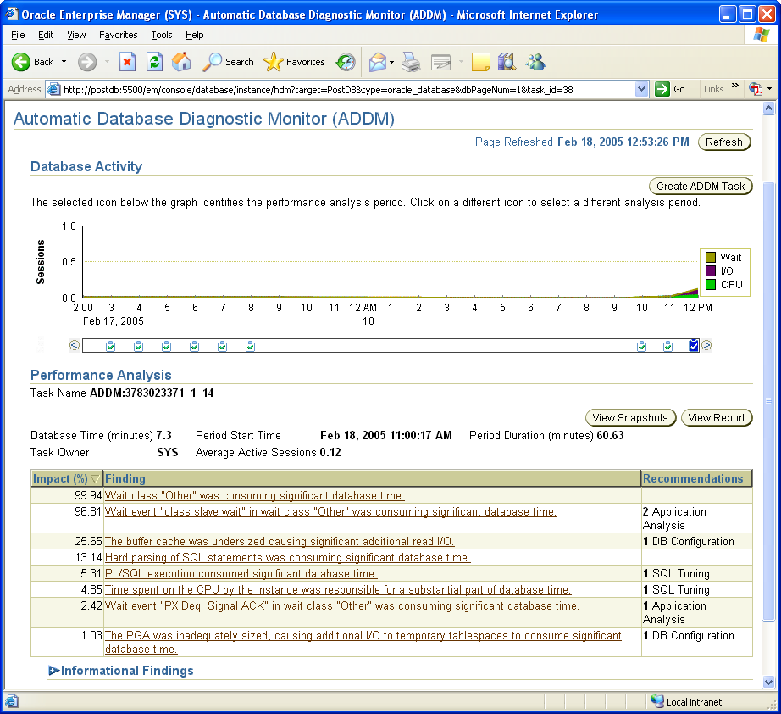
13.18 Automated performance analysis problems found
Select a time period
Choose a finding

Slide 27
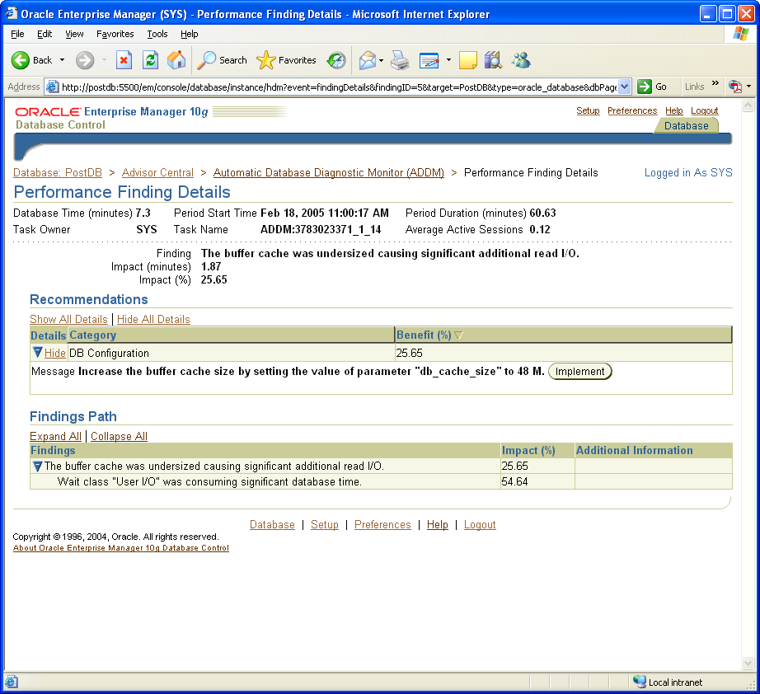
13.19 Configuring the ArchiveLog property

Slide 28
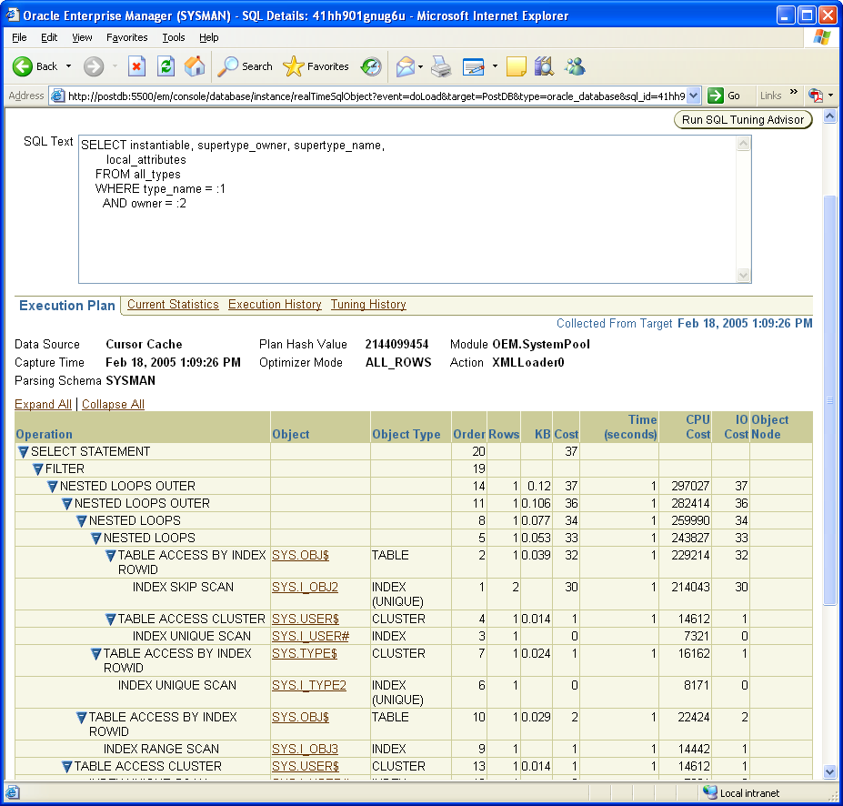
13.20 Query execution plan
Optimizing queries

Slide 29
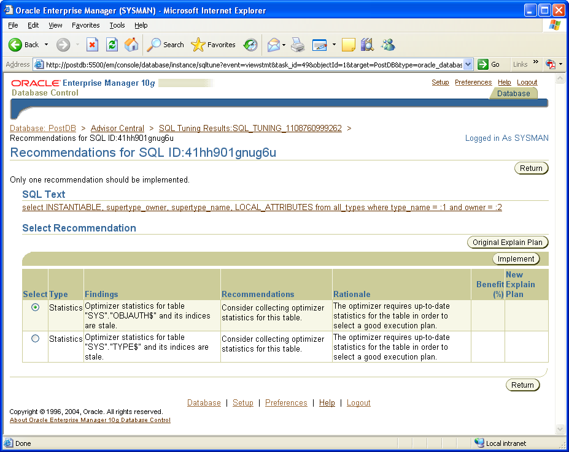
13.21 Tuning advisor recommendations

Slide 30
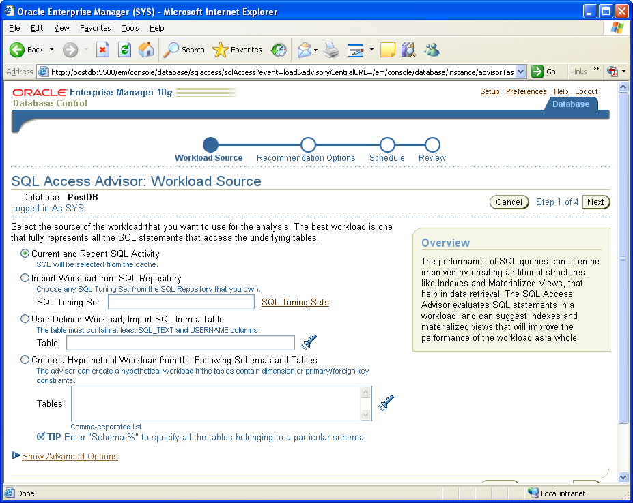
13.22 Configuring the SQL Access advisor

Slide 31
Table 13.7 Common DBA views
DBA View | Description
dba_views | List of all views available to the DBA. Individual users can use user_views instead.
dba_tab_comments | List of comments for tables and views.
dba_col_comments | List of comments for specific columns.
dba_tablespaces | Data on tablespaces. Also look at dba_segments and dba_data_files.
dba_tables | List of table names and storage data. Also look at dba_indexes.
dba_tab_cols | List of columns in tables.
dba_procedures | List of procedures and functions in the database. Also look at dba_triggers.
dba_sequences | List of sequences in the database.
dba_synonyms | List of synonyms. Also look at dba_directories.
dba_users | List of all users.
dba_roles | List of all roles.
dba_role_privs | List of roles assigned to users (or other roles).
dba_sys_privs | List of system privileges assigned to users.
dba_tab_privs | List of all granted privileges in the database.

Slide 32
Table 13.8 A few V$ performance views
V$ View | Description
v$fixed_table v$fixed_view_definition | A list of all V$, X$, and GV$ views. The SQL query used for each view.
v$database v$instance v$tablespace v$datafile v$controlfile v$option v$version | Configuration data about the database.
v$open_cursor v$sql v$sqlarea v$sql_plan | Cursors and SQL statements.
V$ View | Description
v$sort_usage v$sysstat v$transaction v$osstat v$session v$session_wait_history v$lock v$locked_object | Overall system and session performance.
v$archive v$backup_datafile v$recovery_status v$recovery_file_dest v$rollstat v$undostat | Archives, backup, and recovery, and rollback performance.

