Slide 1
Tools for JavaScript Development
Unleash the Power of JavaScript Tooling
Telerik Software Academy
Learning & Development
http://academy.telerik.com

Slide 2
Table of Contents
JavaScript Editors
JetBrains WebStorm
Sublime Text 2/3
Project tools
Package Management: NPM & Bower
Scaffolding: Yeoman
Task Automation: Grunt

Slide 3
JavaScript Editors

Slide 4
JetBrains WebStorm
JavaScript IDE suitable for both client-side JavaScript and server (Node.js) development
Livereload
Build
Code highlighting/Intellisense for:
LESS/SASS/Stylus CSS preprocessors
CoffeeScript/TypeScript JavaScript preprocessors
Emmet Coding
Has only 30-days-long free trial

Slide 5
JetBrains WebStorm
Live Demo

Slide 6
Sublime Text 2/3
Editor for scripting languages
JavaScript, PHP, Python, Ruby, etc…
Basic code highlighting with vanilla installation
Endless number of configurable plugins
Free product
Paid only if used commercially
With plugins support for:
LESS/SASS/Stylus
CoffeeScript/TypeScript

Slide 7
Sublime Text 2/3
Live Demo

Slide 8
Project Tools
No matter the Editor

Slide 9
Project Tools
NPM & Bower
Install Node.js packages or client libraries
Grunt
Tasks runner
Create different tasks for build/development/test cases
Yeoman
Scaffolding of applications
One-line-of-code to create a project template with views/routes/modules/etc…

Slide 10
Package Management
Bower & NPM

Slide 11
Package Management: NPM
Node.js Package Management (NPM)
Package manager for Node.js modules
$ npm init in CMD (Win) or Terminal (MAC/Linux)
Initializes an empty Node.js project with package.json file
$ npm init
//enter package details
name: "NPM demos"
version: 0.0.1
description: "Demos for the NPM package management"
entry point: main.js
test command: test
git repository: http://github.com/user/repository-name
keywords: npm, package management
author: doncho.minkov@telerik.com
license: BSD-2-Clause

Slide 12
Package Management: NPM (2)
Installing modules
$ npm install package-name [--save-dev]
Installs a package to the Node.js project
--save-dev suffix adds dependency in package.json
$ npm install express --save-dev
$ npm install jade --save-dev
Before running the project
$ npm install
Installs all missing packages from package.json
$ npm install

Slide 13
Package Management: NPM
Live Demo

Slide 14
Package Management: Bower
Bower is a package management tool for installing client-side JavaScript libraries
Like jQuery, KendoUI, AngularJS, etc…
It is a Node.js package and should be installed first
$ npm install –g bower
$ bower init in CMD (Win) or Terminal (Mac/Linux)
$ bower init
Asks for pretty much the same details as $ npm init
Creates bower.json file to manage libraries

Slide 15
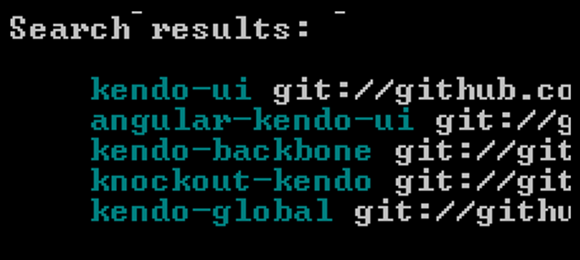
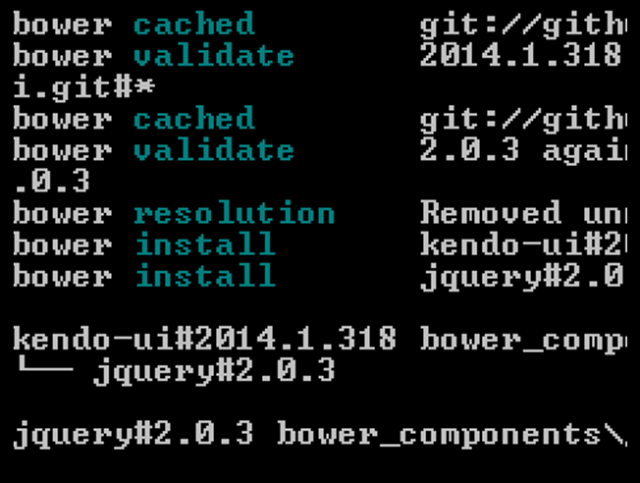
Package Management: Bower (2)
Searching for libraries
$ bower search kendo
Installing libraries
$ bower install kendo-ui

Slide 16
Package Management: Bower
Live Demo

Slide 17
Grunt
Tasks Runner

Slide 18
Grunt
Grunt is a Node.js task runner
It can runs different tasks, based on configuration
Tasks can be:
Concat and minify JavaScript/CSS files
Compile SASS/LESS/Stylus
Run jshint, csshint
Run Unit Tests
Deploy to Git, Cloud, etc…
And many many more

Slide 19
Grunt (2)
Why use a task runner?
Task runners gives us automation, even for different profiles:
jshint
stylus
csshint
connect
watch
DEVELOPMENT
jshint
stylus
csshint
mocha
TEST
jshint
stylus
csshint
concat
uglify
copy
usemin
BUILD

Slide 20
Configuring Grunt
To configure grunt, create a Gruntfile.js file in the root directory of your application
It is plain-old Node.js
Grunt is configured programmatically
Create an module that exports a single function with one parameter – the grunt object
module.exports = function (grunt) {
//configure grunt
};

Slide 21
Configuring Grunt (2)
All the configuration is done inside the module
First execute the grunt.initConfig() method and pass it the configuration
module.exports = function (grunt) {
grunt.initConfig({
...
});
};

Slide 22
Configuring Grunt Plugins
To use a plugin in grunt:
Install the plugin
$ npm install grunt-contrib-jshint --save-dev
Load the plugin
//inside the grunt module
grunt.loadNpmTasks('grunt-contrib-jshint');
Configure the plugin
//inside the grunt.initConfig()
grunt.initConfig({
jshint: {
app: ['Gruntfile.js', 'path/to/scripts/**/*.js']
}
});

Slide 23
Configuring Grunt Plugins
Live Demo

Slide 24
Grunt Plugins

Slide 25
Grunt Plugins: Build
jshint (grunt-contrib-jshint )
Runs jshint for specified files
csslint(grunt-contrib-csshint)
Runs csslint for specified files
stylus (grunt-contrib-stylus)
Compiles STYL files into CSS files
uglify (grunt-contrib-uglify)
Minifies configured JavaScript files
concat (grunt-contrib-concat)
Concats configured JavaScript files

Slide 26
Grunt Plugins for Build
Live Demo

Slide 27
Grunt Plugins: Development
connect (grunt-contrib-connect)
Stars a Web server on a given port and host
watch (grunt-contrib-watch)
Watches for changes to configured files
Can run other tasks on file changed

Slide 28
Grunt Plugins for Development
Live Demo

Slide 29
Yeoman
Application Scaffolding

Slide 30
Yeoman
Yeoman is a Node.js package for application scaffolding
Uses bower & NPM to install the js package
Has lots of generators for many types of applications:
MEAN, AngularJS, Kendo-UI, WebApp, WordPress, Backbone, Express, etc…
Each generators install both needed Node.js packages and client-side JavaScript libraries
Generated Gruntfile.js for build/test/serve

Slide 31
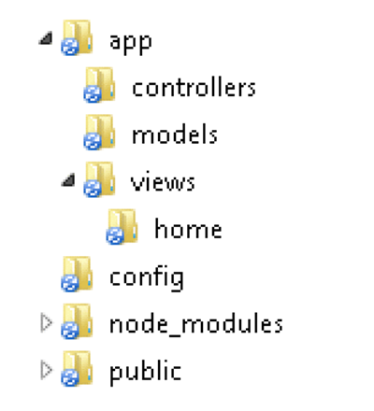
Yeoman (2)
Install Yeoman:
$ npm install –g yo
Install Yeoman generator:
$ npm install –g generator-express
Scaffold Express application:
$ cd path/to/app/directory
$ yo express
Generates:

Slide 32
Yeoman Scaffolding
Live Demo

Slide 33
Tools for JavaScript Development
http://academy.telerik.com

Slide 34
Homework
Create a project with a Gruntfile.js and three folders – DEV folder, APP folder and DIST folder
Write some CoffeeScript, Jade and Stylus in APP
Register the following grunt tasks:
Serve:
Compiles the CoffeeScript to JS and puts them into DEV/scripts
Runs jshint on the compiled JS files
Compiles the Jade to HTML and puts them into DEV
Compiles the Stylus to CSS and puts them into DEV/styles
Copies every image from the APP/images to DEV/images
Connect a server on port 9578 and show the contents of DEV
Watch for changes to the CoffeeScript, Stylus and Jade files, and if changed – reload the page into the browser

Slide 35
Homework (2)
*cont. Create a project with a Gruntfile.js and three folders – DEV folder, APP folder and DIST folder
Write some CoffeeScript, Jade and Stylus in APP
Register the following grunt tasks:
Build:
Compiles CoffeeScript, Stylus and Jade
Runs jshint and csslint
Concats all CSS files into one file and minify it into DIST/styles
Concats all JS files into one file and uglify it into DIST/scripts
Uglifies the HTML files into DIST
Copies all images into DIST/images

