Slide 1
EduLearn for BrightFuture Academy
Name | Student ID
Deepak Negi | 20015622
Aakarsh Dhiman | 20023581
Sivakumar | 20028671
Chandan Reddy | 20024201
MSc Business Analytics Project Management for Business Analytics – B9BA105 Lecturer: Luciana Nascimento

Slide 2
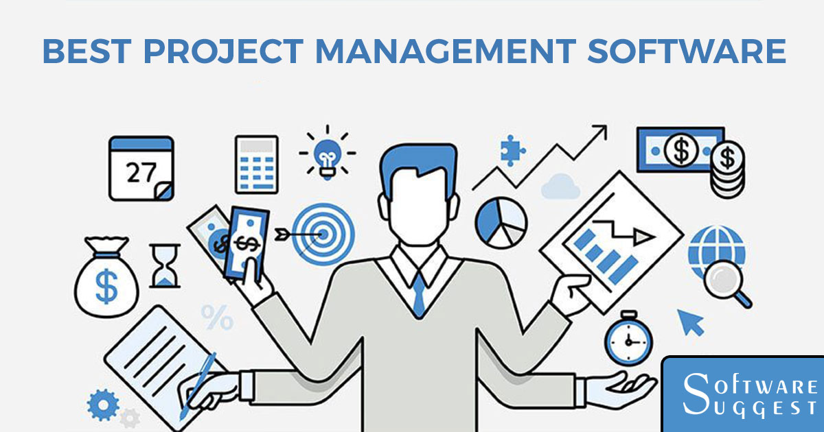
Introduction
EduLearn for BrightFuture Academy Is a modern learning management that aims to improve an online education providing company’s educational process.
With the integration of the essential tools for the course delivery, real time progress tracking and assessment tools, EduLearn will become an easy to use and highly effective system for both students and teachers.
The project aims at enhancing Student success at BrightFuture Academy, and in delivering quality education through use of technology.

Slide 3
Project analysis slide 2
Project Goals
To create an effective Learning Management System
The system integration of these functionalities will increase the interest of students in studying
6 Goal of this Project
To simplify the abilities related to the online courses
The system integration of these functionalities will enhance the efficiency of courses
To simplify the abilities related to track student performance
To simplify the abilities related to assessment together with effective feedback

Slide 4
Project analysis slide 3
Project Objectives
Course Management
Student Tracking
Assessment and Feedback
User Experience
Data Security and Compliance
Design a strong module of Web Course Creation, Organization, and Management.
Among these are options for content uploading, time scheduling, and tailoring for the seats of the BrightFuture Academy curriculum.
For effective and efficient student management, provide a proper method of tracking the level of performance of the students, attendance, and submission of assignments as well as their performance in exams.
Include functions for quiz, tests and assignments and options for automated grading and feedback.
Develop an easy, straight-forward and simplistic look and feel for the application both for educators and students.
Make sure that the LMS respects the data protection law and preserves the users’ data’s integrity and confidentiality.

Slide 5
Project Milestones
Milestones | Month 1 | Month 2 | Month 3 | Month 4 | Month 5 | Month 6 | Month 7 | Month 8 | Month 9
Requirements Gathering and Analysis
System Design and Architecture
Development Phase
Testing and Quality Assurance
Deployment and Training
Post-Launch Support

Slide 6
Schedule Plan
Phase | Task | Duration | Start Date | End Date
Planning | Define project scope and requirements | 2 weeks | 01-Aug-2024 | 14-Aug-2024
Design | Create wireframes and UI/UX designs | 3 weeks | 15-Aug-2024 | 04-Sep-2024
Development | Develop core LMS features | 6 weeks | 05-Sep-2024 | 16-Oct-2024
Testing | Unit testing and bug fixes | 3 weeks | 17-Oct-2024 | 06-Nov-2024
Deployment | Launch beta version and gather feedback | 2 weeks | 07-Nov-2024 | 20-Nov-2024
Final Adjustments | Implement final changes and improvements | 2 weeks | 21-Nov-2024 | 04-Dec-2024
Go Live | Full release and monitoring | Ongoing | 05-Dec-2024 | TBD

Slide 7
Waterfall Methodology with Change Management Integration
Why This Approach?
Aligns with clear project phases
Supports defined deliverables
Integrates change management focus
Enables detailed upfront planning
Suits linear project progression
Meets stakeholder expectations
Facilitates regulatory compliance
Key Features
Sequential phase structure
Clearly defined milestones and deliverables
Incorporation of Lewin's Change Management Model
Comprehensive planning and documentation

Slide 8
Implementation Strategy
Follow Gantt chart for sequential phases
Integrate Change Management process (Unfreeze, Change, Refreeze)
Conduct thorough planning at each phase
Implement robust change control process
Perform formal reviews and approvals between phases
Benefits
Provides structure and predictability
Addresses organizational change alongside technical development
Supports clear timeline and defined outcomes
Facilitates comprehensive documentation
Conclusion
Optimal approach for EduLearn LMS project
Balances technical development with organizational change
Ensures structured, predictable project delivery

Slide 9
Project analysis slide 8
Project Communications Plan including Stakeholder Analysis
Keep Satisfied
Manage Closely
Stakeholders in this group are Senior Executives, Major Funding Bodies.
Communication approach is routine reports to the management on the status of the projects and its funds, and significant advancements through monthly, weekly or daily briefs.
Stakeholders in this group are Project Sponsors, Key Internal Team Members (e.g., IT, HR).
Ensuring that the project entails periodical scheduled meetings focused on the development of the project as well as addressing any severe problems that may surface.
Monitor
Keep Informed
Stakeholders in this group are End Users (Students and Educators), Technical Support Staff.
Communication approach is meetings and questionnaires as the ways to maintain the user satisfaction level and to analyse the weak points (Bahadorestani, Naderpajouh and Sadiq, 2020).
Stakeholders in this group are General Staff, External Partners.
Communication approach is standard bulletin by way of weekly newsletter, monthly email alerts on the ongoing project, new additions in the project and other relevant changes (Shakeri and Khalilzadeh, 2020).

Slide 10
Critical Evaluation for Project Assumptions and Project Constraints
Project Assumptions
Project Constraints
The assumption is that any resource that is deemed necessary for the completion of the project will be available at the particular time it is needed could lead to complications in terms of time in situations where there are some hitches in the procurement or staffing (Kaźmierczak et al., 2020).
Lack of capital is a big area of concern since feature scalability may be reduced or quality/functionalities may need to be compromised.
Also, technological constraints resulting from the incompatibility with the existing systems may reduce the number of integration choices or will call for additional developments.

Slide 11
Comprehensive Risk Management Plan
Risk ID | Risk Description | Risk Category | Likelihood (1-5) | Impact (1-5) | Risk Score | Qualitative Assessment | Quantitative Assessment | Risk Tolerance | Risk Threshold | Mitigation Plan
R001 | Delay in project schedule due to resource unavailability | Schedule | 4 | 3 | 12 | High probability of delay affecting milestones | 30-day delay resulting in $50,000 extra cost | Low (must be avoided) | 15-day delay acceptable | Identify backup resources, cross-train team members
R002 | Budget overrun due to unforeseen expenses | Financial | 3 | 4 | 12 | Potential for significant budget impact | 10% budget increase resulting in $100,000 impact | Medium (can be managed) | 5% budget overrun | Regular budget reviews, contingency funds allocation
R003 | Technical failure causing downtime | Technical | 2 | 5 | 10 | Critical system failure affecting operations | 1-day downtime resulting in $20,000 loss | High (tolerable short-term) | 2-hour downtime | Implement redundant systems, regular maintenance
R004 | Regulatory changes impacting project compliance | Compliance | 3 | 3 | 9 | Medium likelihood with significant compliance cost | $30,000 cost for compliance adaptation | Medium (requires adjustments) | Minor adjustments | Monitor regulatory changes, engage compliance experts
R005 | Key stakeholder withdrawal | Strategic | 2 | 4 | 8 | Low likelihood but high impact on project scope | Loss of $200,000 funding | Low (critical impact) | Stakeholder re-engagement | Engage stakeholders regularly, diversify funding sources
R006 | Negative public perception impacting project approval | Reputational | 3 | 2 | 6 | Medium likelihood with manageable impact | Reduced community support costing $10,000 | Medium (manage PR) | Minimal negative feedback | Public relations campaign, stakeholder engagement

Slide 12
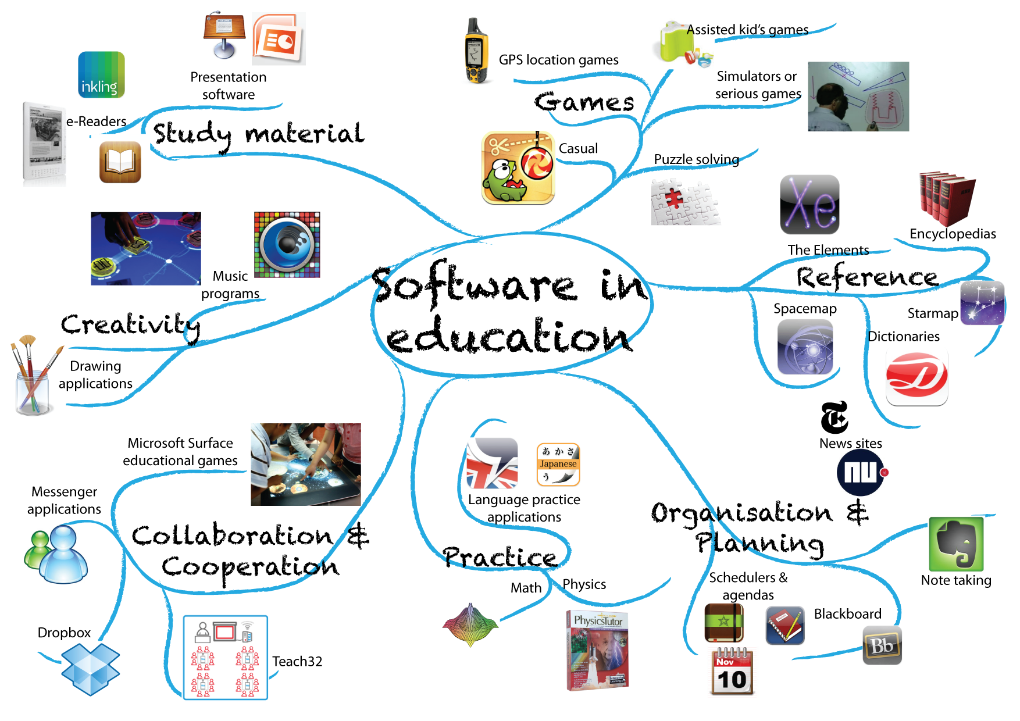
Conclusion
The Edu Learn project for Bright Future Academy will be developed using a Waterfall Methodology with Change Management Integration. This approach provides a structured timeline while still allowing for addressing necessary changes and stakeholder feedback within a controlled framework.
The Waterfall approach provides a solid framework for managing the project's technical development, while the integrated Change Management component ensures the organization can adapt to the new system effectively.
This methodology allows for comprehensive planning and documentation, critical for addressing compliance requirements and managing stakeholder expectations in an educational technology project.
By combining the structured approach of Waterfall with strategic change management, the Edu Learn project aims to deliver a robust, user-friendly Learning Management System that meets the needs of Bright Future Academy while navigating the complexities of technological education implementation in a controlled and predictable manner.

Slide 13
References
Bahadorestani, A., Naderpajouh, N. and Sadiq, R., 2020. Planning for sustainable stakeholder engagement based on the assessment of conflicting interests in projects. Journal of Cleaner Production, 242, p.118402.
Ciric Lalic, D., Lalic, B., Delić, M., Gracanin, D. and Stefanovic, D., 2022. How project management approach impact project success? From traditional to agile. International Journal of Managing Projects in Business, 15(3), pp.494-521.
Fioravanti, M.L., Braga, R.V. and Barbosa, E.F., 2023. Software project management education during the covid-19 pandemic: an experience report of emergency remote education. In EDULEARN23 Proceedings (pp. 3811-3815). IATED.
Kaźmierczak, J., Bartnicka, J., Borgosz, G., Ikem, B., Jurasik, J., Kręt, P., Pietrulińska, N. and Radomski, M., 2020. Developing the Cognitive Abilities of Elderly People with the Use of IT Technologies: Presentation of the Project Assumptions and Description of the Research Concept. Multidisciplinary Aspects of Production Engineering, 3(1), pp.505-516.
Shakeri, H. and Khalilzadeh, M., 2020. Analysis of factors affecting project communications with a hybrid DEMATEL-ISM approach (A case study in Iran). Heliyon, 6(8).
Watermeyer, K. and Zimmermann, J., 2020. A branch-and-bound procedure for the resource-constrained project scheduling problem with partially renewable resources and general temporal constraints. OR spectrum, 42, pp.427-460.

Slide 14
Thank You

