Slide 1
NatureFruit.com
Present by-
MR. Deepak Gupta

Slide 2
INTRODUCTION
The main aim of this project is to sell fruits online through internet.
This project is an attempt to provide the advantages of online shopping to customers of a real shop.
This project helps us to maintain the details of all the sales and billing details.
It deals with monitoring the information and transactions .

Slide 3
Features
Registration and Login.
Search of product.
Detail of product.
Shopping cart.
Wish list.
Discount on products.
Stock management.
Profile of user.
Chat bot for recommendation.
AI voice bot (Deepak).
CRM (Customer Relation Management).
Cash on delivery payment method.
Shortcuts browse new page.
Admin Panel for Admin.

Slide 4
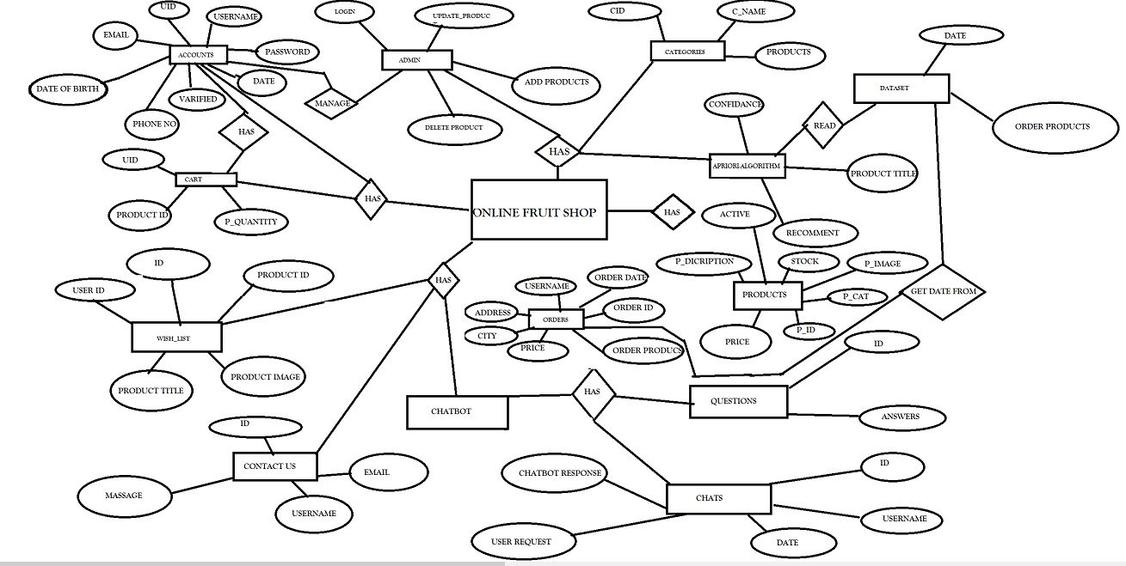

Slide 5
Languages & Tools
Languages
TOOLS
HTML 5
CSS 3
JAVASCRIPT
PHP
AJAX
BOOTSTREP
WAMP SERVER
MYSQL DATABASE

Slide 6
REFERENCES
http://naturefruit.epizy.com/

Slide 7
THANK YOU

