Slide 1
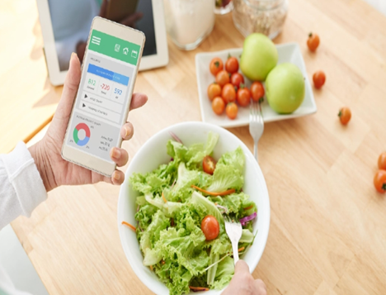
Nutri Me
TEAM MEMBERS
GURUNATH BUSETTI
HARIPRASATH SOMASUNDARAM
SRI DHANALAKHSMI KAMARAJ
NISHA CHOURASIA

Slide 2
CONTENT
PROBLEM STATEMENT
OBJECTIVE
MICROSERVICES
PROJECT ARCHITECTURE
PROJECT FLOW
TECHNOLOGY AND TOOLS USED
CONCLUSION

Slide 3
PROBLEM STATEMENT
Build a system to search for a specific food to find it’s nutrition details, show list of matching food, view the nutrition content for a selected food and bookmark favorite food for later reference.

Slide 4
OBJECTIVE
Nutri Me application is built with an objective to help users to find nutrition details of food, lose weight, be healthy, and get stronger. There are multiple benefits to utilizing the Nutri Me app, including a calorie counter, BMI tracker and nutrition planning to adopt a healthy diet.
Features of Nutri Me Application:
Search Food
Add To Favorites
Add To Meal
BMI Tracker
Analyze Nutrition content of the meal selected

Slide 5
Microservices

Slide 6




Nutri Me
Angular
Node.js
API
GATEWAY
Spring Cloud
SERVICE & REGISTRY DISCOVERY
EUREKA
SEARCH
MICROSERVICE
FAVOURITE
MICROSERVICE
MEAL
MICROSERVICE
USER
MICROSERVICE
Spring Cloud
Spring Cloud
Spring Cloud
Spring Security
3rd Party API
MySQL
MySQL
MongoDB

Slide 7
Project Architecture

Slide 8

EUREKA
REST
API
SEARCH
MICROSERVICE
3rd Party
API
REST
Template
[GET] Feign Client
GET
REST
API
API GATEWAY
[8080]
GET/
POST/
DELETE
FAVOURITES
MICROSERVICE
MYSQL
CLIENT
[Angular]
GET/
POST
USER
MICROSERVICE
[Spring Security, JWT]
[GET] Feign Client
GET/
POST/
DELETE
REST
API
MEAL
MICROSERVICE
MYSQL
MONGODB

Slide 9
Project Flow

Slide 10
Home/Browser
Forgot Password
Login
Register/
Signup
Home
About Us
Search
Favorite
Meal
BMI
User Profile
Search
Food
Add Favorite
Add
Meal
View
Favorite
Delete
Favorite
Analyze Meal
Delete Meal
Calculate
BMI
Update
User
Change Password

Slide 11




















TOOLS & TECHNOLOGIES USED

Slide 12
Conclusion
Nutri Me Application help users to find the Nutrition content of the food and provides the complete Nutrition analysis report of the meal selected by User.
Users can save their favorite food for later use
BMI tracker helps user to track their Body Mass Index and helps to choose their Nutrition Food
Nutri Me Application fetch the food result from USDA 3rd Party API and then gives the detailed result to the user to choose their meal

Slide 13
Thank you

