Slide 1
GROUP PROJECT WALKTHROUGH
AI Wealth Navigator
An agentic financial wellness platform where every number on the screen can be traced back to the arithmetic that produced it.
React + TypeScript
Node + Express
Monte Carlo engine
LLM agent
deepak17kb.github.io/BroadBridge
Notes:
Open on the live link. Say: this is a financial planning platform we built end to end - the maths, the interface and an AI agent on top. Everything you will see is computed live in the browser.

Slide 2
IN ONE SENTENCE
It reads your real financial position, projects it against thousands of simulated markets, and tells you what to do next — showing its work every time.
Notes:
Pause here. The key phrase is "showing its work". Most finance apps give you a number. This one gives you the number and the arithmetic behind it.

Slide 3
THE PROBLEM
Financial advice is either generic or a black box
Generic content
Black-box apps
A model alone hallucinates
Blogs and calculators do not know your income, your loans, your dependents or your horizon. A 20% savings rule means nothing to someone paying 42% on a credit card.
Robo-advisors output an allocation with no visible reasoning. You cannot disagree with it, because you cannot see what it assumed.
Ask a chatbot to plan your retirement and it will invent plausible arithmetic. Confident, fluent, and wrong by crores.
Our answer: compute everything with a deterministic engine, let the model only narrate and prioritise, and print the assumptions next to every figure.
2
Notes:
Three failure modes. Land the third one hard - it is the reason the architecture looks the way it does. We never let the language model do arithmetic.

Slide 4
WHAT WE WILL COVER
Nine parts
01
02
03
The idea
Architecture
Dashboard
What makes it different
Monorepo, shared engine
Wellness, impact, cashflow
04
05
06
Goals
Scenario Lab
Portfolio
Inflation, funding, optimiser
Levers and Monte Carlo
Allocation, drift, risk
07
08
09
Actions
AI Assistant
Engineering
The planning waterfall
Agent loop and grounding
Tests, CI, deployment
3
Notes:
Quick roadmap so nobody gets lost. Do not read every box - just say we go from the idea, through the architecture, then screen by screen, and finish with how it is built and shipped.

Slide 5
THE DESIGN RULE
The engine decides. The model only speaks.
Deterministic
Reproducible
Auditable
Two users with the same balance sheet get the same actions, every time. The recommendation set is generated by rules, not by a model.
Every Monte Carlo run is seeded, so the same inputs always draw the same fan chart. A cited success probability can be checked.
Every action carries the arithmetic behind its impact figure, and every projection lists the assumptions it used.
4
Notes:
This is the single most important slide in the deck. If the audience remembers one thing, it should be: the language model never computes a number, it only explains numbers the engine produced.

Slide 6
TRY IT WITHOUT TYPING ANYTHING
Three synthetic personas
Aarav, 26
Meera, 38
Rohan, 52
Early career. Good income, no buffer, a 42% credit-card balance. The engine refuses to discuss investing until that is fixed.
Mid career, two kids. Competing goals bidding for one surplus, education costs inflating fastest, only 4x income of life cover.
Pre-retirement. 78% equity with a quarter of it in one stock. Sequencing risk dominates; the glide path should pull risk down hard.
Each persona is a complete balance sheet — income, expenses by category, holdings, liabilities, goals and risk answers — so the whole platform lights up the moment you pick one. All data is fabricated for this project.
5
Notes:
Explain why personas exist: a planning tool is useless with an empty profile, and nobody wants to type their salary into a demo. Each persona is designed to trigger a different part of the engine.

Slide 7
PART 2 — ARCHITECTURE
Three packages, one npm workspace
packages/shared
packages/server
packages/web
The finance engine
API + agent
React client
Types, market assumptions and every calculation. 4,500 lines. Imported by both sides.
Express routes, the agent orchestrator, tool catalogue, knowledge base and the grounding verifier.
Nine screens, custom chart components, design tokens, and a browser-only client for static hosting.
Vite aliases @wealth/shared at TypeScript source, not a build output — so a change to the maths is live in the browser on the next hot-reload, with no build step between the packages.
6
Notes:
Walk left to right. The point of the last line: there is no compiled copy of the engine that can drift out of date. The browser compiles the same source files the server imports.

Slide 8
WHY IT MATTERS
One engine, two runtimes
A slider in the browser has to feel instant, so the client computes the what-if locally. The server has to compute the same thing for the agent’s tool calls.
If those were two implementations they would drift, and the number the agent quotes would stop matching the number on the screen.
buildSnapshot()
the whole dashboard
runMonteCarlo()
simulated outcomes
generateActions()
the recommendations
They are the same functions. Identical by construction, not by luck.
scoreWellness()
the five pillars
scoreRisk()
tolerance vs capacity
optimiseGoalFunding()
the surplus split
7
Notes:
A concrete example helps: drag a slider on the Scenario page and the number updates before your finger leaves the mouse - that is the engine running in the browser. Ask the assistant the same question and it calls the identical function server side.

Slide 9
TOOLING
The stack, and why each piece
Layer | Choice | Why
Language | TypeScript | One language across engine, API and UI; the profile type is checked everywhere
Client | React 18 + Vite | Hot reload over TS source, and a small production bundle
Routing | React Router 6 | Real URLs, so every screen is linkable
Charts | Recharts + custom SVG | Recharts for the fan chart; hand-written SVG where we needed exact control
Server | Express 4 | Thin — the routes are wrappers over the shared engine
Validation | Zod | Every request body is bounded, so a bad number cannot corrupt a profile
Model | Claude / Groq / rules | Three interchangeable providers behind one interface
Tests | node:test + tsx | No framework to configure; runs straight off TypeScript
8
Notes:
Do not read the table aloud. Pick two rows: Zod, because validation is what stops one bad request from permanently breaking a profile, and the model row, because we can swap providers without touching the app.

Slide 10
DATA MODEL
One profile is the only input
age, retirementAge, dependents
horizon, protection
goals[]
target, year, priority
cashflow
income, growth, expenses
riskAnswers
the questionnaire
holdings[]
units, price, asset class
assumptionOverrides
your edits to the house view
liabilities[]
outstanding, APR, EMI
insurance cover
life and health
Change one number here and every projection, chart and recommendation changes with it. There is no separate "dashboard data" to keep in sync.
9
Notes:
The important idea: there is exactly one source of truth. Everything else in the app is derived. That is why editing your age instantly re-scores ten different things.

Slide 11
THE CORE FUNCTION
buildSnapshot(): profile in, everything out
01
02
03
04
05
06
07
08
09
Inputs
Risk
Allocation
Portfolio
Cashflow
Goals
Retirement
Wellness
Actions
house view + overrides
tolerance and capacity
for bucket + horizon
value, drift, spread
surplus, rate, DTI
each at its own return
required vs projected
five weighted pillars
the ranked list
Each step feeds the next: the risk bucket picks the allocation, the allocation sets the expected return, the return drives every goal projection, and the goals feed the wellness score. One function call produces the entire dashboard.
10
Notes:
Trace the dependency out loud: risk decides allocation, allocation decides return, return decides whether your goals are on track, and that decides your score. Change your risk answers and all nine steps re-run.

Slide 12
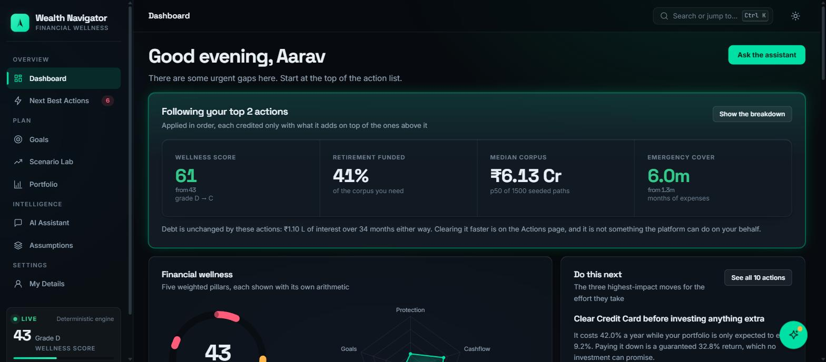
PART 3 — DASHBOARD
The screen you land on
11
Notes:
Point at the four numbers along the top. Say: this is Aarav. His wellness score is 43 out of 100, grade D. The banner above is not his position today - it is what his position becomes if he follows the top two recommendations.

Slide 13
DASHBOARD — THE BANNER
What following the advice is actually worth
Most apps rank advice by a score you cannot interpret. This banner answers the only question that matters: if I do these things, what changes?
Wellness score
43 → 61
Grade
D → C
The engine applies the top actions to a copy of the profile, re-runs the entire snapshot, and reports the difference. Actions are applied in order, each credited only with what it adds on top of the ones above it — so two overlapping tips cannot both claim the same gain.
Retirement funded
41%
Emergency cover
1.3m → 6.0m
It also states what does not change: "Debt is unchanged by these actions." The headline figure is never allowed to quietly absorb advice the platform cannot carry out.
12
Notes:
This is our favourite feature. Emphasise the ordering rule - if one tip says "save more" and another says "cut spending", naively adding them double-counts the same rupee. And read the amber line out loud; honesty about what the tool cannot do is a feature.

Slide 14
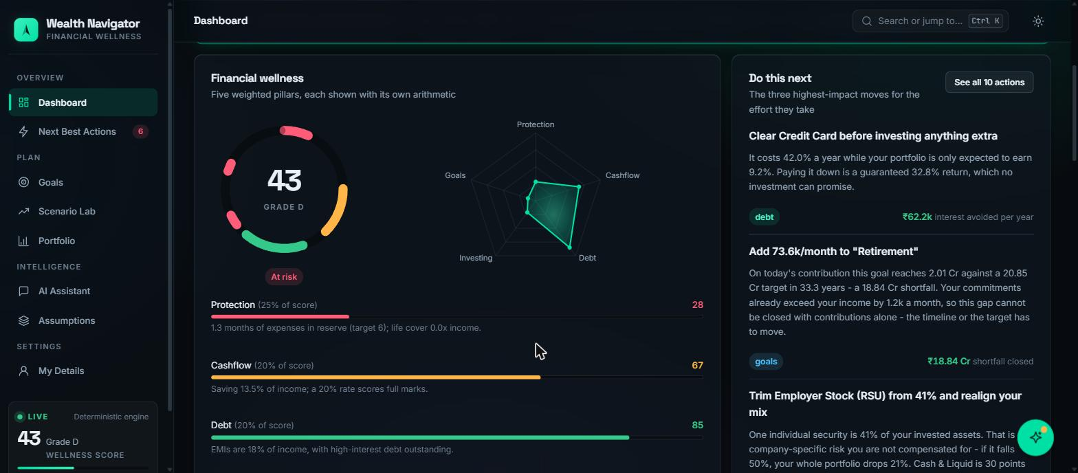
DASHBOARD — WELLNESS
Financial wellness, five weighted pillars
13
Notes:
Three different views of the same five numbers. Explain why three: the ring is the headline, the radar shows the shape of the weakness, and the bars give the actual arithmetic. Different questions, same data.

Slide 15
HOW THE SCORE IS BUILT
Five pillars, explicit weights
Pillar | Weight | Aarav | Full marks means
Protection | 25% | 28 | 6 months of expenses, 10x income life cover, health cover at the age-banded target
Cashflow | 20% | 67 | Saving 20% of income
Debt | 20% | 85 | EMIs under 20% of income, with no balance above 15% APR
Investing | 15% | 21 | A diversification score of 100 across classes and individual names
Goals | 20% | 36 | Every goal fully funded, plus retirement readiness
Total = sum of (pillar score x weight). Grades: A at 80+, B at 65+, C at 45+, D below 45. A pillar computed from data you never entered is marked unscored rather than given a free pass.
14
Notes:
The last sentence matters. A 10x-income life cover rule is trivially satisfied when income is zero - that false pass used to flow into the headline grade, so we made missing data visible instead.

Slide 16
CHART EXPLAINED
The score ring
A donut where each arc is one pillar, and the arc’s length is that pillar’s share of the total score, not an equal fifth.
Why a ring, not a bar
A single score is a part-to-whole relationship. A ring shows the whole and the parts in one shape, and the empty arc is as readable as the filled one.
Protection is 25% of the score, so it owns a quarter of the circle. Its colour is the status of that pillar — red, amber or green. The gap between arcs is the score you have not earned.
The number in the middle is the weighted total. The arcs draw themselves in on first paint, one after another, so the eye follows the contribution order.
The "At risk" pill
Shown below the ring when the grade is D, so the headline is never just a number without a verdict.
15
Notes:
If someone asks why the arcs are different lengths: because the pillars are weighted differently. Protection is a quarter of the whole score, so it gets a quarter of the ring.

Slide 17
CHART EXPLAINED
The radar (spider) chart
What it plots
How to read it
Why it earns a place
Five axes, one per pillar, each 0 at the centre and 100 at the rim. The shape drawn by joining the five points is the shape of your financial health.
A balanced plan is a regular pentagon. A spike means one strength carrying the score; a dent means a specific weakness. Aarav dents hard on Protection and Investing.
The ring gives you one number. The radar answers the next question instantly — where is it weak? — without reading five separate bars.
Note the honest limitation: a radar chart’s enclosed area is not meaningful — it changes if you reorder the axes. We use it only for the shape, and the real arithmetic sits in the bars underneath.
16
Notes:
Mentioning the limitation is a strong move in a viva. Radar charts are often criticised because area is misleading - we know, and that is why the bars below carry the real numbers.

Slide 18
CHART EXPLAINED
The pillar bars
One horizontal bar per pillar, labelled with its weight, its score out of 100, and — the part that matters — a sentence of arithmetic underneath.
Colour is a threshold, not decoration
Red below 40, amber below 70, green above. The same thresholds are used everywhere in the app, so colour means one thing.
"1.3 months of expenses in reserve (target 6); life cover 0.0x income."
"Saving 13.5% of income; a 20% rate scores full marks."
You can disagree with it
Because the sentence names the input and the target, you can check the claim. "Target 6 months" is itself editable on the Assumptions page.
"EMIs are 18% of income, with high-interest debt outstanding."
17
Notes:
This is the "show your work" principle made visible. Read one of the sentences aloud and point out that it names the number, the target, and therefore lets you argue with the score.

Slide 19
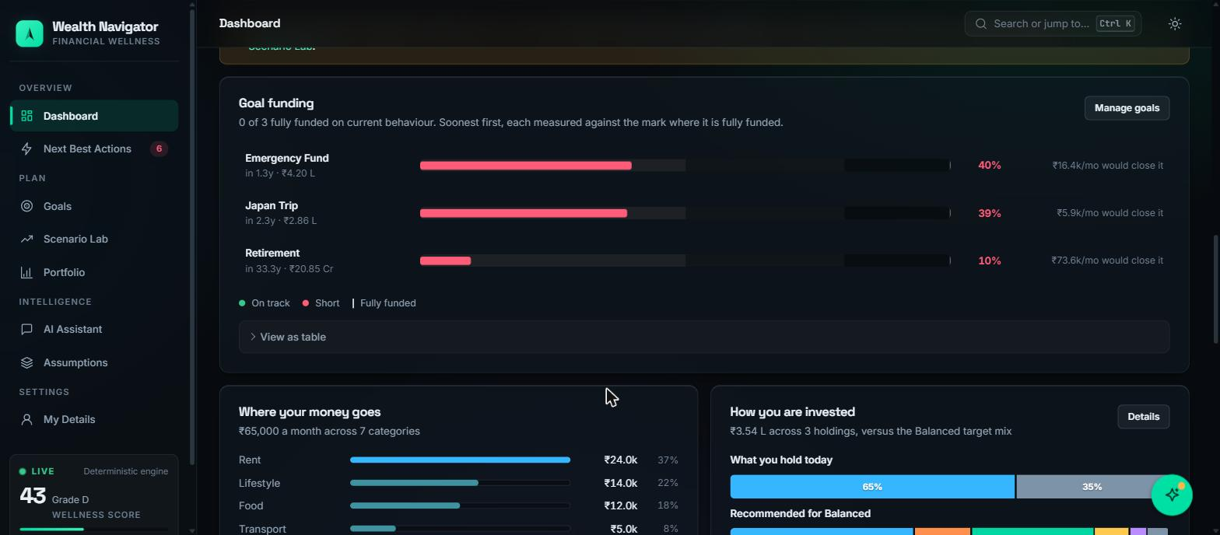
CHART EXPLAINED
Goal funding — the bullet chart
The bar
The tick
The fix
How much of the goal is funded on current behaviour. Emergency Fund is 40% funded.
The vertical marker is the 100% line. Every goal is measured against its own target, so different sizes share one scale.
The right column states the monthly contribution that would close the gap. Advice, not just diagnosis.
18
Notes:
Bullet charts beat pie charts here because goals differ by orders of magnitude - a 4 lakh emergency fund against a 20 crore retirement. Plotting percent funded puts them on one honest scale.

Slide 20
DASHBOARD — CASHFLOW
Where your money goes
A ranked horizontal bar per spending category, with the rupee amount and the share of income. Sorted largest first, because the top two rows are where any real change happens.
Monthly surplus
income − expenses − EMIs − goals
Savings rate
scored against 20%
From this the engine derives three figures that feed the rest of the platform:
Debt-to-income
drives Debt pillar + risk capacity
Aarav’s surplus is negative — minus 1,200 a month. The platform surfaces that rather than hiding it, because it is the reason every goal recommendation says "the timeline or the target has to move".
19
Notes:
The negative surplus is a good teaching moment. A lot of tools would just show a zero. We show the negative number because it changes which advice is even possible.

Slide 21
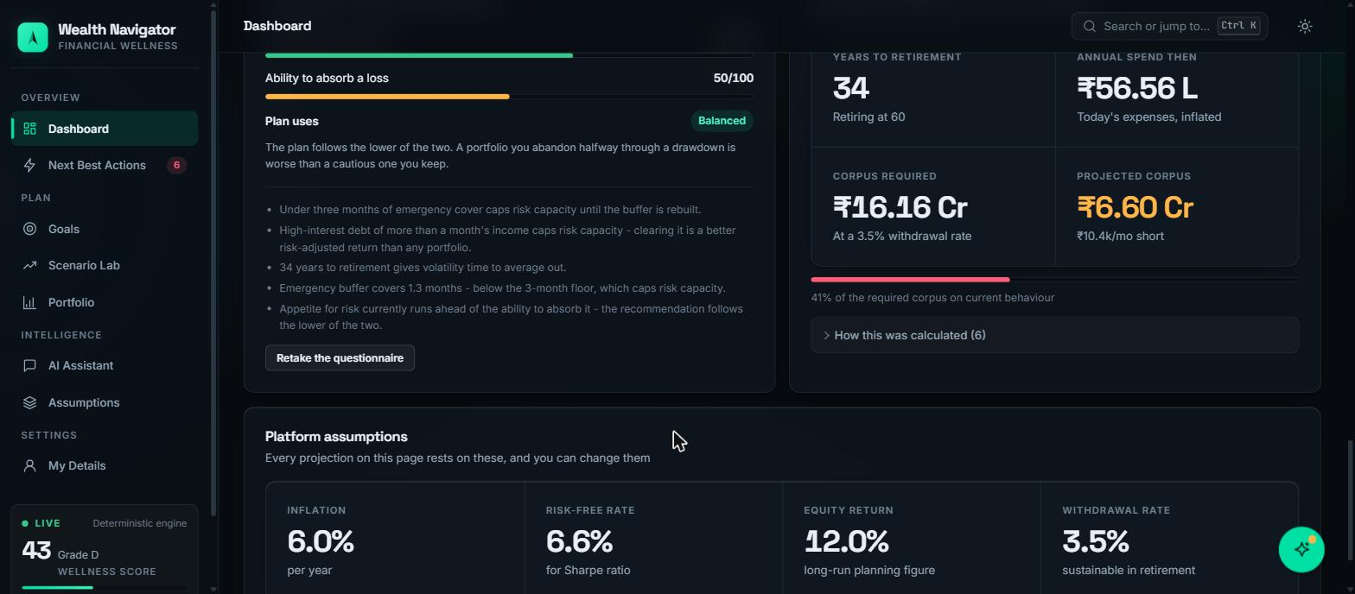
DASHBOARD — RISK
Two-axis risk: tolerance vs capacity
Tolerance
Capacity
The plan uses the lower
From the questionnaire alone. A statement about how you behave when markets fall.
From the balance sheet: horizon, buffer, dependents, income stability, debt load.
You can say you are brave while having three months of runway and a 42% card balance.
20
Notes:
This is the slide to slow down on. Read the third card almost word for word - it is the clearest example in the whole project of the engine refusing to take the user’s word for something.

Slide 22
DASHBOARD — RETIREMENT
Corpus required versus projected
YEARS TO RETIREMENT
ANNUAL SPEND THEN
CORPUS REQUIRED
PROJECTED CORPUS
34
₹56.56 L
₹16.16 Cr
₹6.60 Cr
retiring at 60
today's expenses, inflated at 6%
at a 3.5% safe withdrawal rate
on current behaviour — 41% funded
The chain is fully visible: today’s expenses, inflated for 34 years, divided by a safe withdrawal rate, gives the target. Current savings, compounded at the allocation’s expected return, gives the projection.
A "How this was calculated (6)" panel expands to list all six assumptions used. Nothing is asserted without them.
21
Notes:
Walk the arithmetic slowly: expenses today, inflate for 34 years, divide by 3.5% - that is the corpus. Then say the gap is 10 crore, which is why his advice is so blunt.

Slide 23
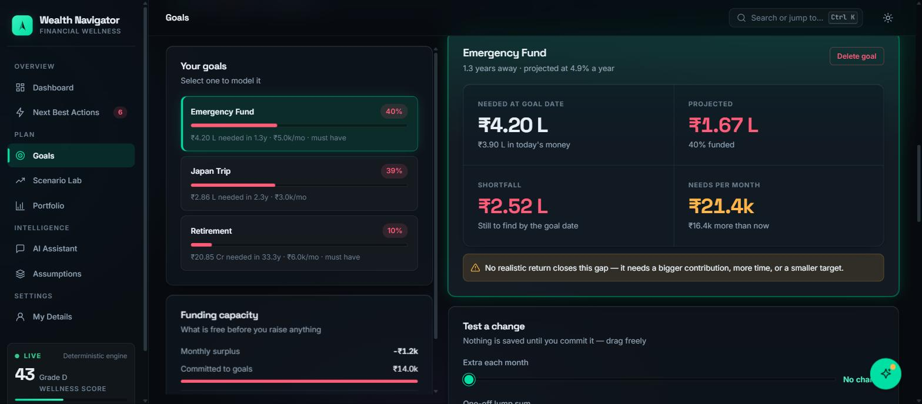
PART 4 — GOALS
Every goal projected at its own return
22
Notes:
Pick Emergency Fund. Point out "projected at 4.9% a year" - that is not the portfolio return, it is the return for a 1.3-year horizon. Money you need next year cannot sit in equity.

Slide 24
GOALS — THE ARITHMETIC
Two ideas most calculators get wrong
1. Targets are stated in today’s money
2. Each goal gets its own return
You say "I want 3.9 lakh". The engine inflates that to the year you need it — 4.20 lakh in 1.3 years — and measures you against the inflated figure.
A goal 1.3 years out is projected at 4.9%; one 33 years out at close to the full equity figure. A single blended rate across every goal is the standard shortcut, and it is wrong in both directions.
Goals can carry their own inflation override: education inflates faster than everything else.
Short goals get overstated, long goals understated.
When no realistic return closes a gap, the app says so outright rather than quietly raising the assumed return: "No realistic return closes this gap — it needs a bigger contribution, more time, or a smaller target."
23
Notes:
These two points are the ones an examiner is most likely to probe. Horizon-appropriate returns is genuinely what a real financial planner does and what a spreadsheet usually does not.

Slide 25
GOALS — THE OPTIMISER
Where your surplus should go
Goals compete for one pool of money. The optimiser allocates it by priority first, then urgency: must-have before important before aspirational, and within a tier, whatever falls inside the near-term window first.
Emergency Fund · must have, 1.3y
₹12.8k
Japan Trip · aspirational
₹0
The pool is the free surplus plus what the goals already receive — because the interesting question is rarely "where does the spare money go" (most plans have none) but "is the money already committed pointed at the right goals".
Retirement · must have, 33y
₹0
The whole surplus goes to the emergency fund: it is must-have and inside the near-term window, so it funds ahead of longer-horizon goals of the same priority.
24
Notes:
Ask the room: why does retirement get zero when it is also must-have? Answer: because the emergency fund is due in 1.3 years and retirement in 33. Urgency breaks the tie inside a priority tier.

Slide 26
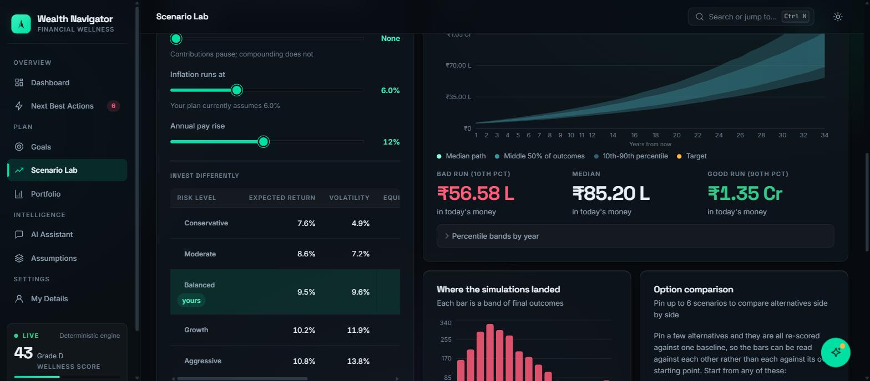
PART 5 — SCENARIO LAB
Change something, watch the consequence
25
Notes:
This is the most impressive screen for a live demo. Drag a slider and let the audience watch every number on the right move. Say: 2,500 simulated market paths, recomputed as you drag.

Slide 27
SCENARIO LAB — INPUTS
Seven levers, and what each one does
Save more each month
Change your spending
Adds to the monthly contribution from month one
Money freed by spending less is assumed invested, not respent
Retire earlier or later
Market crash
Moves the horizon, changing both the target and the compounding time
A one-off proportional shock applied at a chosen year, default year one
Career break
Inflation
Months at the start with no contribution — compounding continues
Overrides the house view for this scenario only
Annual pay rise
Steps the contribution up each year
Seven presets set the levers for you — "Survive a 35% crash", "Take a 12-month career break", "Inflation runs at 8%" — and you can then adjust them by hand. Anything you do not touch stays as it is today.
26
Notes:
Demo the crash preset. It is the most visceral: the whole fan chart shifts down and the success probability drops in front of the audience.

Slide 28
THE CORE ALGORITHM
What a Monte Carlo simulation is
A normal calculator assumes markets return exactly 9.5% every year. They never do. Monte Carlo runs the plan thousands of times, each with a different randomly drawn sequence of returns, and reports the distribution of outcomes.
Bad run (10th percentile)
₹56.58 L
Median (50th)
₹85.20 L
So instead of "you will have 85 lakh", you get "in a bad run 56 lakh, typically 85 lakh, in a good run 1.35 crore" — and a probability of clearing your target.
Good run (90th)
₹1.35 Cr
All three are quoted in today’s money — results are deflated by inflation, so the figures are comparable to what you earn now.
27
Notes:
If the audience is non-technical, this is the analogy to use: instead of predicting one future, we roll the dice 2,500 times and count how often the plan survives.

Slide 29
THE CORE ALGORITHM
Geometric Brownian Motion, done carefully
Log-returns
Variance drag
Seeded
We sample log-returns on monthly steps, so a corpus can fall but never go negative. Sampling raw percentage returns lets a bad draw produce impossible values.
We subtract half the variance from the drift so the arithmetic mean of simulated returns matches the expected return the user was shown.
Every run uses a fixed seed, so identical inputs always draw the identical fan chart. A cited probability can be reproduced.
The bug we deliberately avoided
Skipping the variance-drag correction is the single most common defect in retirement simulators. It silently inflates the median outcome by several percent a year — which compounds into a wildly optimistic answer over a 34-year horizon.
The horizon is simulated in whole months, not rounded up to years — rounding up ran a goal due in 1.3 years for two full years of growth, overstating exactly the near-term goals that matter most.
28
Notes:
This slide wins technical marks. You do not need to explain the maths fully - just say we corrected for variance drag, which most implementations forget, and name the consequence.

Slide 30
CHART EXPLAINED
The fan chart
The dark line
The x-axis is years from now; the y-axis is corpus in today’s money.
The median path — half of all simulations finish above it, half below
The fan widens with time because uncertainty compounds. That widening is the whole point of the chart: it is a picture of how little anyone can promise about year 30, and why a single-line projection is a lie told confidently.
The inner band
The middle 50% of outcomes, the 25th to 75th percentile
The outer band
The 10th to 90th percentile — the plausible range
If the target dot sits above the top of the fan, no market outcome saves the plan — the inputs have to change.
The amber dot
Your target: the corpus you actually need
29
Notes:
Trace the widening cone with your finger on screen. Then say the sentence about the single-line projection being a confident lie - it usually gets a reaction.

Slide 31
CHART EXPLAINED
The outcome histogram
What each bar is
The shape
Why it matters
A band of final corpus values; the bar’s height is how many of the 2,500 simulations ended inside that band.
Right-skewed, not a bell curve. Compounding makes large upside outcomes possible but rare, while the downside is bounded at zero.
The median tells you the middle. The histogram tells you the spread — whether the plan usually lands near the median or is a coin flip.
Success probability is simply the share of bars to the right of the target line: the fraction of simulated paths that finished at or above the inflated corpus you need. For Aarav today, that figure is close to zero — which is the honest answer.
30
Notes:
Connect it back: the fan chart shows outcomes over time, the histogram shows the same outcomes at the finish line. Two views of one simulation.

Slide 32
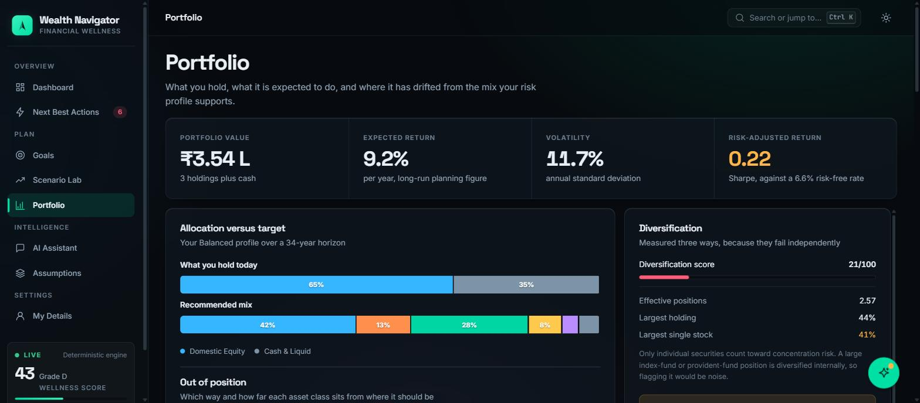
PART 6 — PORTFOLIO
What you hold, and where it has drifted
31
Notes:
Four headline numbers, then two panels. Point at the Sharpe ratio of 0.22 and say: that is the return per unit of risk, measured against the 6.6% risk-free rate.

Slide 33
CHART EXPLAINED
Allocation versus target
Two stacked bars, one above the other, on the same 100% scale: what you hold today and the mix your risk profile supports.
Target depends on horizon too
The same risk bucket gives a different mix at 34 years than at 5. A glide path pulls equity down as the goal approaches.
Aarav holds 65% domestic equity and 35% cash — two asset classes. The recommendation spreads the same money across six: 42% domestic equity, 13% international, 28% debt, 8% gold, plus REITs and cash.
Drift is halved on purpose
Every rupee overweight in one class is underweight in another, so we halve the sum of absolute deltas. The raw sum once reported "you have drifted 192%".
Stacking beats two pie charts: the eye compares segment widths along a shared axis instead of comparing angles across two circles.
It outputs trades
Not just a diagnosis — the engine computes the rupee amount to move in each class.
32
Notes:
The 192% anecdote is worth telling. It is a real bug we fixed, and it shows we thought about whether a number is meaningful to a reader, not just whether it computes.

Slide 34
CHART EXPLAINED
Diversification, measured three ways
40%
30%
30%
Spread
Breadth
Concentration
How evenly value sits across asset classes — equity, debt, gold, REITs, cash
How many distinct holdings there are at all
How large the biggest single name is
"Effective positions: 2.57" — Aarav nominally holds three things, but weighted by size he is really holding about two and a half.
Only individual securities count toward concentration. A large index-fund position is diversified internally — flagging it would be noise.
33
Notes:
Three measures because they fail independently - you can hold twenty stocks that are all banks, or one index fund that is genuinely diversified. The index-fund exception is a detail examiners like.

Slide 35
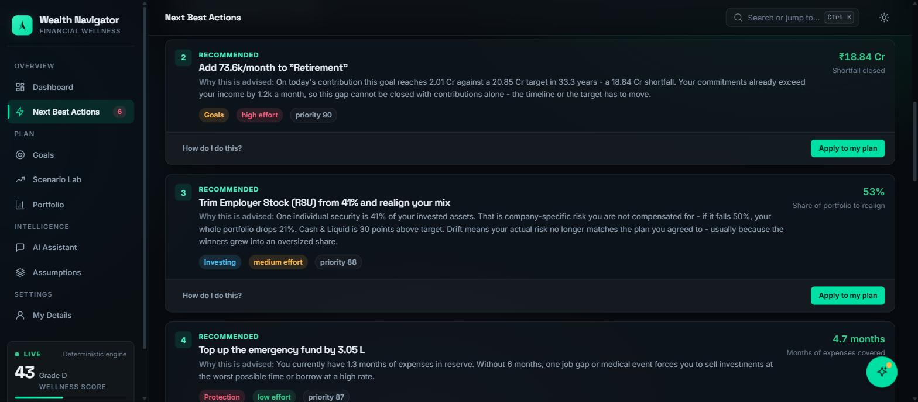
PART 7 — NEXT BEST ACTIONS
Ten recommendations from twelve rule checks
34
Notes:
Each card has a title, a "Why this is advised" paragraph with real arithmetic, a category, an effort level, a priority score, and a one-click Apply button. Read one "why" line aloud.

Slide 36
HOW ACTIONS ARE ORDERED
The planning waterfall, not raw impact
Step 1
Step 2
Step 3
Step 4
Step 5
Stop the bleeding
Protect
Clear expensive debt
Fund goals
Optimise
A debt whose payment does not cover its own interest outranks everything
Emergency fund, life cover, health cover at the age-banded target
Anything above 15% APR beats any expected investment return
Contributions, by priority then urgency
Rebalance, cut expense ratios, tax efficiency
Ordering follows the standard financial-planning waterfall rather than raw impact, because a rupee of emergency fund is worth more than a rupee of alpha when there is no buffer at all.
Aarav’s top action: "Clear Credit Card before investing anything extra — it costs 42.0% a year while your portfolio is only expected to earn 9.2%. Paying it down is a guaranteed 32.8% return, which no investment can promise."
35
Notes:
Read the Aarav quote at the bottom in full. It is the single best demonstration that the advice is reasoned rather than templated.

Slide 37
ACTIONS — STRUCTURE
What every action carries
Category
debt, protection, goals, +4
Why this is advised
a paragraph with real numbers
Effort
low, medium or high
How do I do this?
expandable concrete steps
Priority score
0–100, computed from severity
Apply to my plan
5 of the 10 work in one click
Impact figure
with its unit
Assumptions used
listed, so it can be checked
Actions the platform cannot carry out are kept in a separate notModelled list, so the headline impact figure can never quietly take credit for advice you would have to act on yourself.
36
Notes:
The filters at the top of the page - All, Debt, Goals, Investing, Protection, Saving, Tax - are these categories. Demo one filter click if you have time.

Slide 38
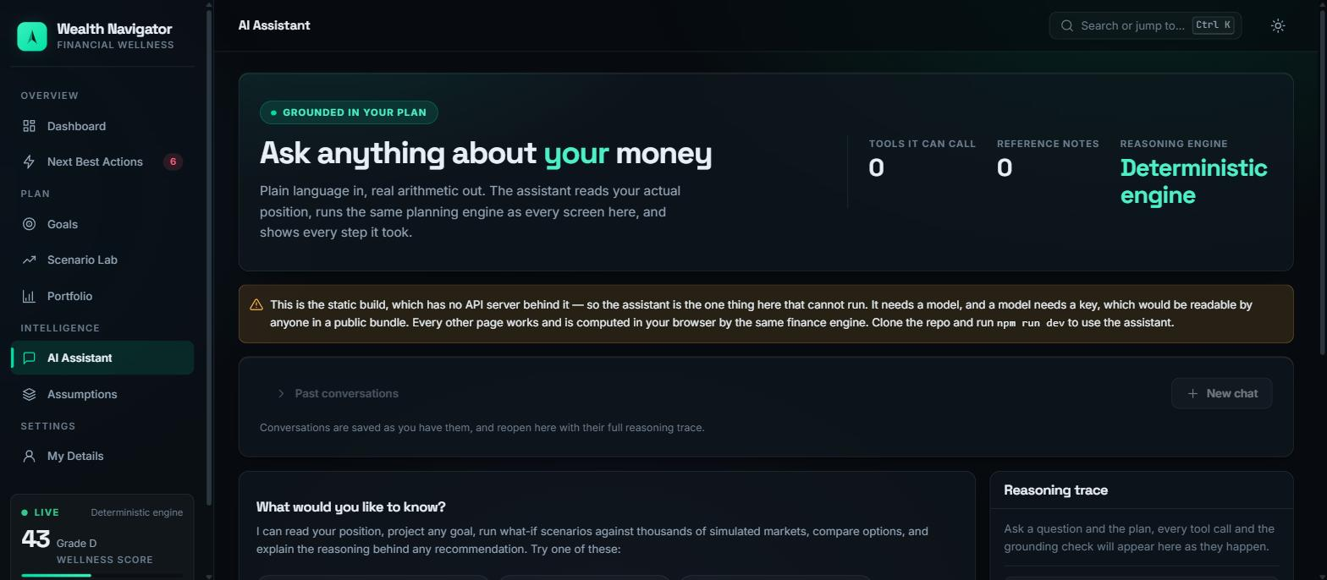
PART 8 — AI ASSISTANT
Plain language in, real arithmetic out
37
Notes:
Note the amber banner: on the public link the assistant is switched off, because it needs a model key and a public bundle cannot hold a secret. Show it running locally if you can, or describe it.

Slide 39
HOW THE AGENT WORKS
Plan, call tools, verify, answer
01
02
03
04
05
06
Classify
Plan
Call tools
Retrieve
Verify
Answer
An intent router decides what kind of question this is
It chooses a toolchain before calling anything
Up to 14 tools, each a real function from the shared engine
A small knowledge base of reference notes is searched
A grounding check tests every figure in the draft answer
Streamed token by token over Server-Sent Events
The tools are not descriptions of capabilities — they are the same functions the screens call. When the assistant says your retirement is 41% funded, it called buildSnapshot, exactly as the dashboard did.
Every step appears live in the Reasoning Trace panel: the plan, each tool call and its timing, the documents retrieved, and the grounding result. Nothing happens off-screen.
38
Notes:
The reasoning trace is the demo moment. Most AI features are a black box; here the audience watches the model choose tools and you can see the numbers arrive before the sentence is written.

Slide 40
THE SAFETY NET
The grounding verifier
Language models invent numbers. So after the model writes its answer, a verifier extracts every figure in the text and checks each one against the tool results that were actually returned.
Three providers, one interface
Claude via the Anthropic API, open-weights models on Groq, or a fully deterministic rule-based engine. The tools, the maths and the verifier are identical on all three.
A figure with no supporting tool output is flagged. The check and its evidence are shown to the user in the trace, not hidden in a log.
It works with no credentials at all
With no key configured the platform still plans, calls the same tools and grounds every figure — it just narrates from templates. The repo is clonable and demoable by anyone.
This is the architectural payoff of the design rule from the start: because the model never computes, every number it says can be mechanically checked against something that did.
39
Notes:
Close the loop with the design-rule slide. We said the model only speaks - this is the mechanism that enforces it. If a figure has no tool result behind it, the system says so.

Slide 41
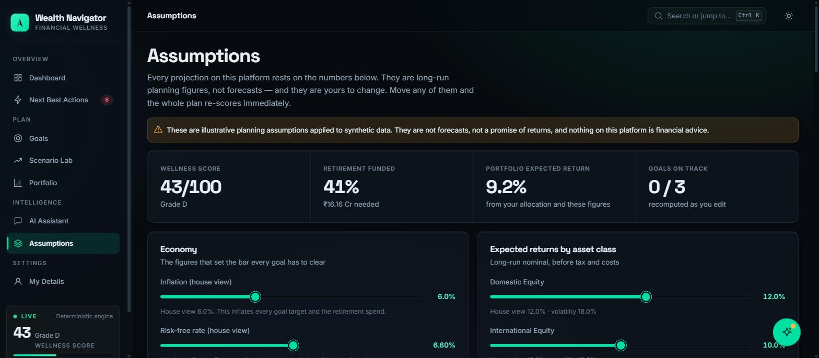
PART 8 — ASSUMPTIONS
Every figure the platform believes, in one editable place
They are yours to change
Bounded, not free-form
Stated as planning figures
Move inflation from 6% to 8% and the whole plan re-scores immediately — every goal target, every projection, every action.
Each field is range-checked. An out-of-range value cannot be stored, because one bad number used to make every later projection return null.
Not forecasts, not a promise of returns. The banner says so, and so does every projection that uses them.
40
Notes:
A good closing point for the product half: most apps hide their assumptions. Ours puts them on a page with sliders and lets you disagree.

Slide 42
PART 9 — ENGINEERING
Two ways to run it
Full stack, locally
Static, on GitHub Pages
Express API on port 4000, Vite dev server on 5173, proxied so there is one origin and no CORS. The AI assistant works here.
Pages serves files, not processes. So a second client answers the same calls in the browser, using the same engine and localStorage for the profile.
One command: npm run dev
Chosen at build time, so only one ships.
It is not a mock. Every route the client calls is either a pure function of the profile or a read of it, so the browser produces the same numbers the server would. The one exception is the agent, which needs a key — and it says so rather than pretending.
41
Notes:
Explain why the live link works at all without a backend. The finance engine was always compiled into the browser bundle for instant sliders; we just pointed the API client at it.

Slide 43
ENGINEERING
How we keep it honest
239
3
CI
Tests, all green
Test suites
On every commit
Engine arithmetic, API and agent, page renders — no credentials needed
shared, server and web, each run on every push
Typecheck, tests, build, and an end-to-end demo journey against a live API
Accessibility is tested, not assumed
Regression tests name their bug
Automated checks assert that every page has exactly one h1, that headings never skip a level, and that every form control has an accessible name.
Each one describes the defect it prevents — "the % funded axis stretches to fit an over-funded goal" — so nobody deletes it later without understanding why.
42
Notes:
Worth saying: the accessibility tests are automated, so a heading-level mistake fails the build. That is unusual in a student project and it is a genuine differentiator.

Slide 44
STATED ON EVERY SCREEN
All sample data is synthetic and fabricated for this project. Nothing here is real market data, and nothing here is financial advice.
The assumptions are illustrative long-run planning figures, not forecasts. We built a planning engine, not a prediction engine — and the difference is printed next to every number it produces.
43
Notes:
Do not skip this slide. Saying it out loud before anyone asks shows judgement, and it is genuinely true of the product - the disclaimer is on the Assumptions page and the onboarding screen.

Slide 45
Advice you can argue with.
A deterministic engine that decides, a model that only explains, and the arithmetic printed next to every figure so you never have to take it on trust.
Live app
Source
deepak17kb.github.io/BroadBridge
github.com/Deepak17kb/BroadBridge
Questions?
44
Notes:
End on the live link and invite questions. If you have time, leave the Scenario Lab open behind you - it is the screen people want to play with.

