Slide 1
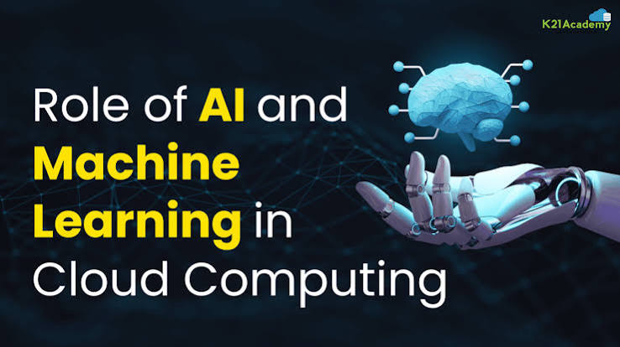
The Role of Artificial Intelligence and Machine Learning in Cloud Platforms
Cloud Computing and Big Data Analytics
Deepak R | 192511008 |

Slide 2
What Are AI, ML, and Cloud Computing?
Artificial Intelligence (AI)
Simulation of human intelligence — enabling machines to learn, reason, recognize patterns, and make decisions
Machine Learning (ML)
A subset of AI where systems learn from historical data to make predictions without explicit programming
Cloud Computing
Delivery of computing resources — servers, storage, databases, networking, and software — over the Internet
Why Combine Them?
Cloud provides the infrastructure; AI/ML provide the intelligence — together they power scalable, real-time intelligent applications

Slide 3
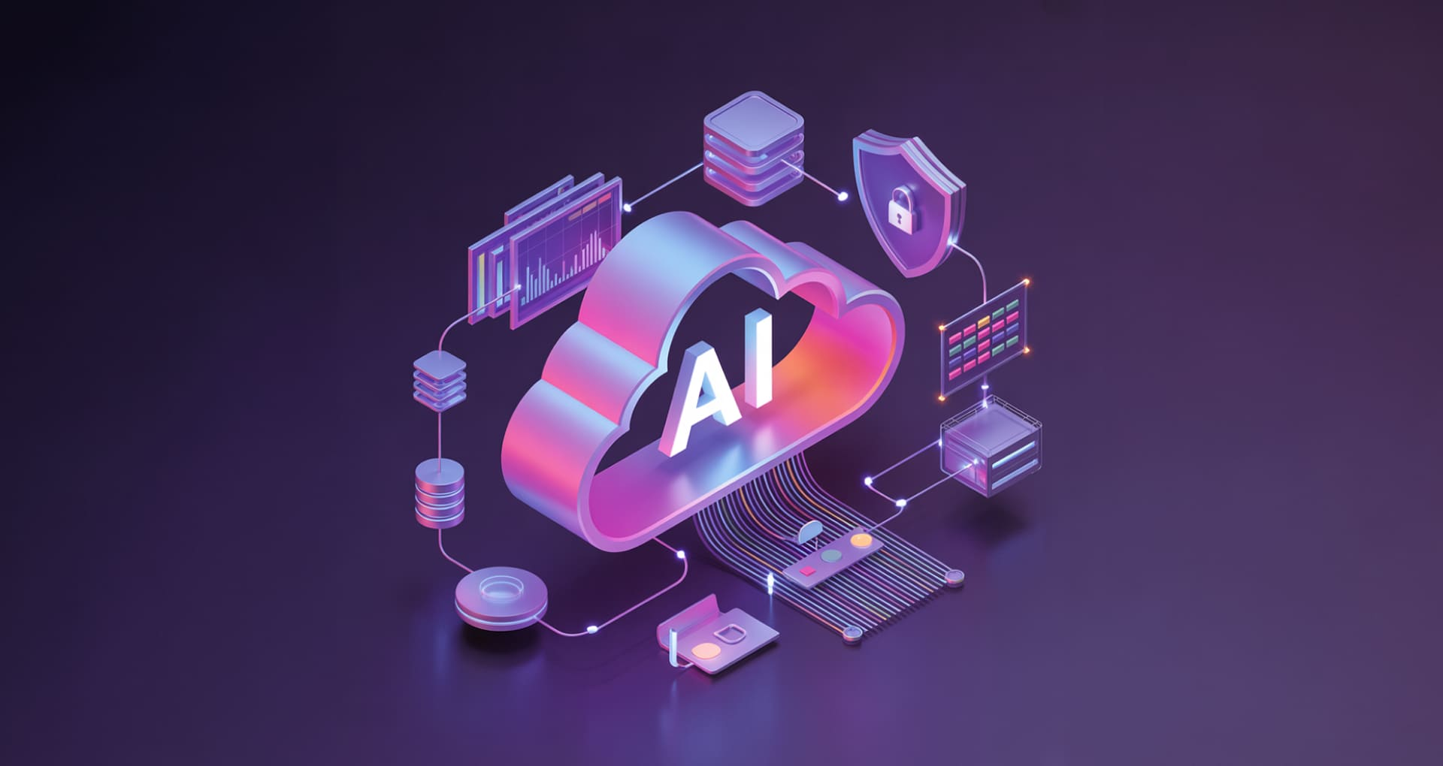

Why AI Needs the Cloud
Massive Computing Power
GPU clusters on-demand for deep learning workloads
Unlimited Storage
Petabyte-scale data lakes for training datasets
Scalability & Cost Efficiency
Pay-as-you-go model eliminates upfront hardware investment
Real-Time Processing
Stream analytics and instant inference at global scale
Global Accessibility
Deploy models anywhere; access from any device

Slide 4

Cloud AI Architecture
End-to-end pipeline: raw data flows in, intelligent predictions flow out, and feedback loops retrain the model automatically.
Data Sources
Data Processing
Continuous Improvement
Raw inputs from systems
Cleanse, transform, enrich
Feedback-driven retraining
ML Model Training
Cloud Storage
Centralized, scalable lake
Train models at scale

Slide 5
AI & ML Services by Cloud Platform
Platform
Key Features
Typical Use Cases
Industries
Google Cloud Vertex AI
AutoML, custom training, model registry, MLOps pipelines
Image recognition, NLP, recommendation engines
Retail, Healthcare, Media
Amazon SageMaker
Managed notebooks, built-in algorithms, real-time endpoints
Fraud detection, demand forecasting, chatbots
Finance, E-commerce, Logistics
Microsoft Azure ML
Drag-and-drop designer, responsible AI tools, AKS deployment
Predictive maintenance, document intelligence
Manufacturing, Banking, Government

Slide 6
AI Cloud Platforms Across Industries
Healthcare
Finance
Disease prediction & medical imaging analysis
Real-time fraud detection & risk scoring
Retail
Manufacturing
Personalized recommendation systems
Predictive maintenance to reduce downtime
Education
Agriculture
Adaptive personalized learning paths
Smart farming & crop yield prediction
Transportation
Cybersecurity
Traffic prediction & route optimization
AI-driven threat detection & response

Slide 7
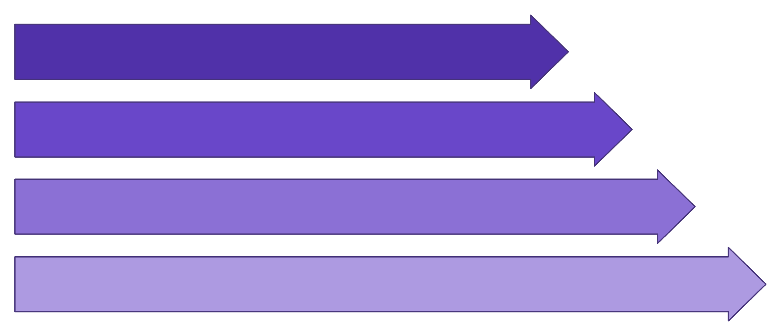
Practical Example: AI-Based Smart Water Level Monitoring
The Problem
Manual monitoring causes overflow, water wastage, and delayed response — demanding a smarter, automated solution.
Sensor
ML Role
Microcontroller
Predicts future water levels from historical sensor data; triggers alerts before overflow occurs.
Wi-Fi
Impact
Cloud
Automated, real-time water management with zero manual intervention.

Slide 8
Benefits vs. Challenges
✅ Benefits
⚠️ Challenges
Scalability on demand
Automation of repetitive tasks
Real-time analytics & insights
High availability (99.9% uptime)
Faster deployment cycles
Better data-driven decisions
Data privacy & compliance risks
Security vulnerabilities
High model training costs
Internet dependency
Bias in AI models
Ethical & regulatory concerns

Slide 9
Future Scope of AI in Cloud Platforms
Generative AI
Quantum AI
Sustainable AI
LLMs and multimodal models as cloud services — GPT, Gemini, Claude
Quantum computing accelerating model training exponentially
Green cloud infrastructure with carbon-neutral data centers
1
2
3
4
5
Edge AI
Smart Cities
ML inference on edge devices with cloud sync for ultra-low latency
Real-time AI decision-making at city scale & autonomous vehicles

Slide 10
Conclusion
AI + ML
Enables intelligent decision-making; learns continuously from data
Cloud Computing
Provides the scalable, cost-efficient infrastructure AI demands
Together
Power next-generation applications across every industry
The Big Picture
AI + Cloud is the backbone of digital transformation in the 21st century

