Slide 1
Datatrained project
Employee Attrition by Using Machine Learning

Slide 2
That article has contain the following sub-topics
1. Problem Definition 2. Data Analysis 3. EDA Concluding Remarks 4. Pre-processing Pipeline 5. Building Machine Learning Models 6. Concluding Remarks

Slide 3
Problem Definition
Employee Attrition is the gradual reduction in staff numbers that occurs as employees retire or resign and are not replaced. Employee attrition can be costly for businesses. The company loses employee productivity, and employee knowledge.
Attrition mean employee has been left the company, terminated, turnover from there position.
Employee turnover and attrition both occur when an employee leaves the company
The big difference between the two is that when turnover occurs, the company seeks someone to replace the employee. But in the case of attrition, the employer leaves that vacancy unfilled or eliminates that job role .

Slide 4
By given data analysis of this project ,our objectives to employee turnover or attrition is to try to make some specification of this given problem
Why are good employees leaving the company ?
Can we predict the employees most likely to leave ?
How to reduce employee Trunover?

Slide 5
Why and in which age employee are left the job.
We try to find out the when most of the people are leaving there job and why.
Why skilled people are leaving the company.
So, all of this is just to show how valuable an employee is regardless if that employees position will be filled or not. In this article I will show you how to predict if an employee is likely to leave the company.

Slide 6
Data Analysis
Import pandas as pd:-
We use pamdas file for read the the csv,xlsx and many other format of file from the data set
only by which we can able to read the file.
df = pd.read_excel('hr.xlsx')
Df

Slide 7
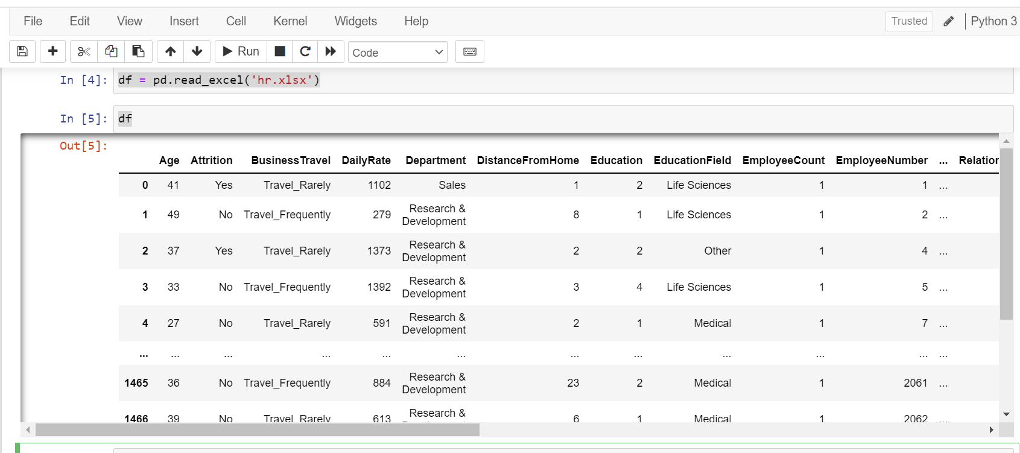
Data of HR attrition is in given below:-

Slide 8
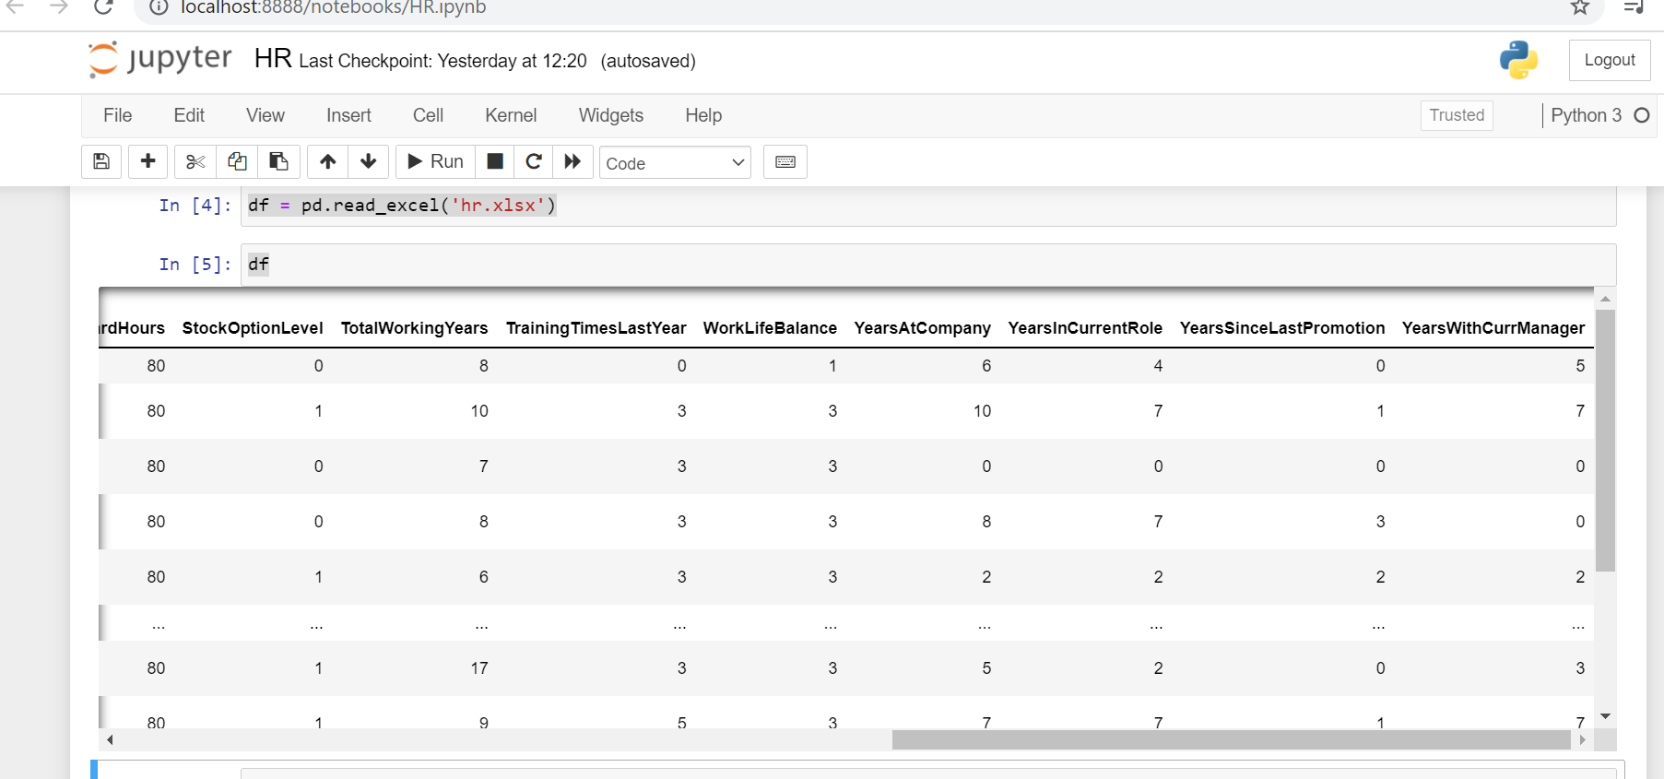

Slide 9
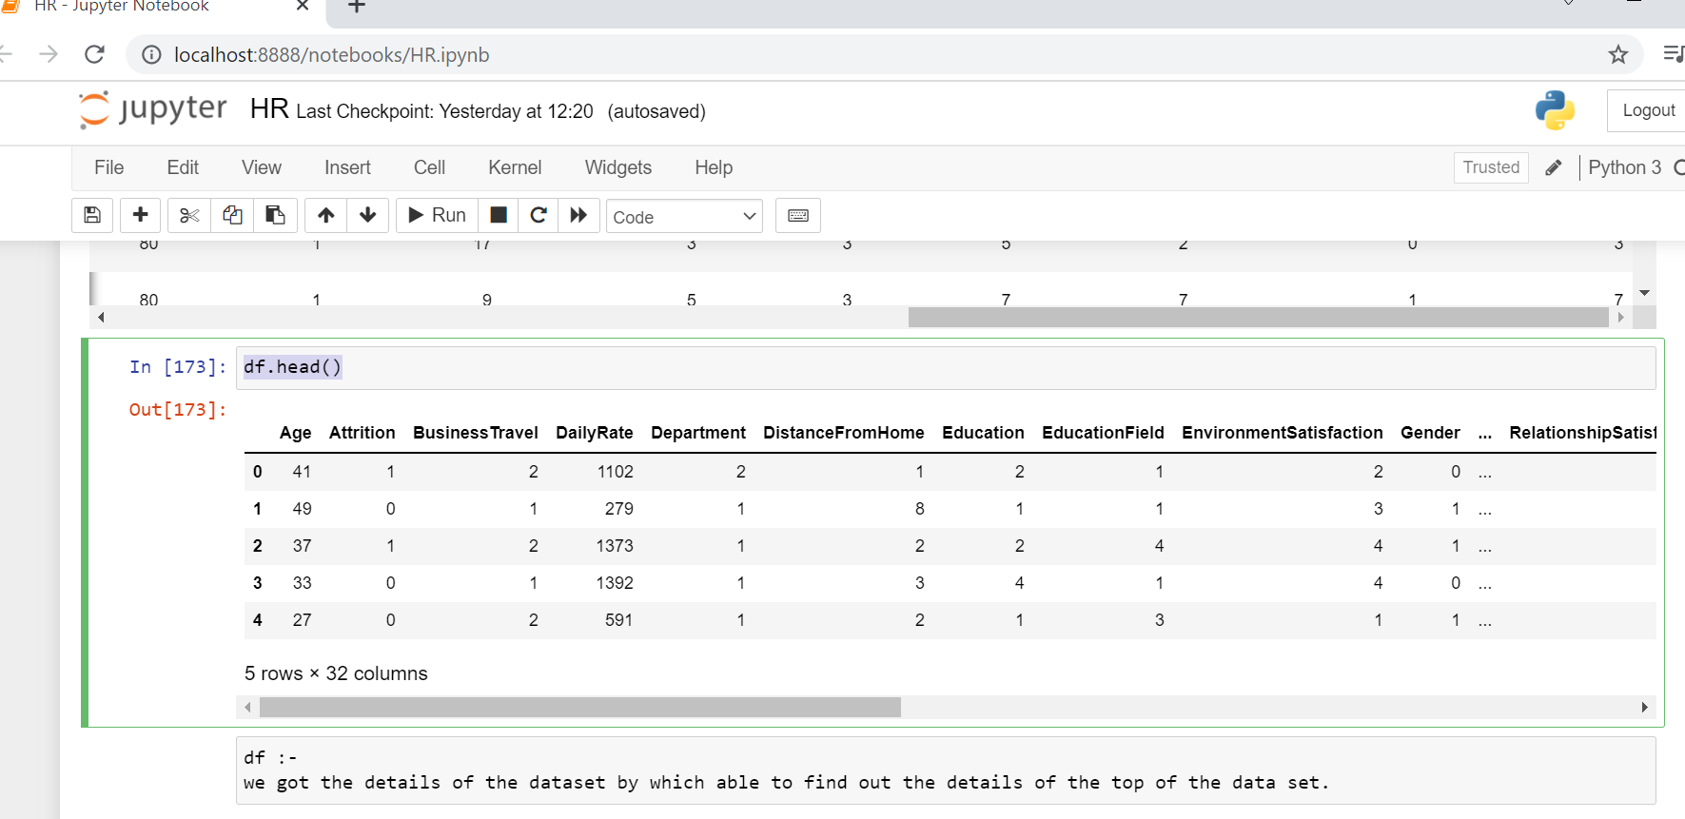
df.head() we got the details of the dataset by which able to find out the details of the top of the data set.

Slide 10
df.shape
df.shape
By calling of the shape we are able to find out the shape of the dataset.
we are able to see the number of the columns 1470 and rows 35

Slide 11
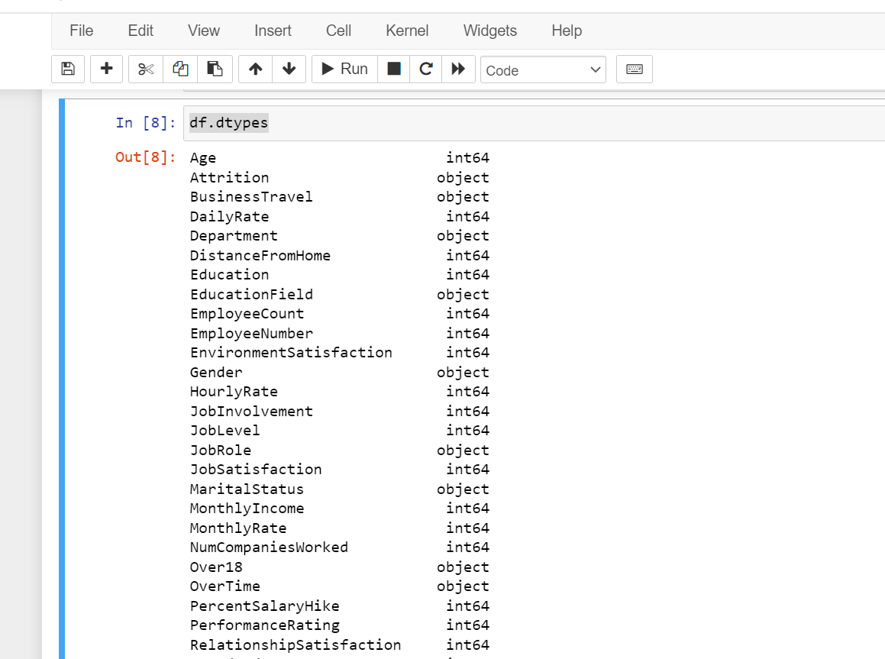
df.dtypes Datype is call the all data type is available at the dataset.

Slide 12
#To check there has any null value or missing value is there. df.isnull().values.any()
Result
False

Slide 13
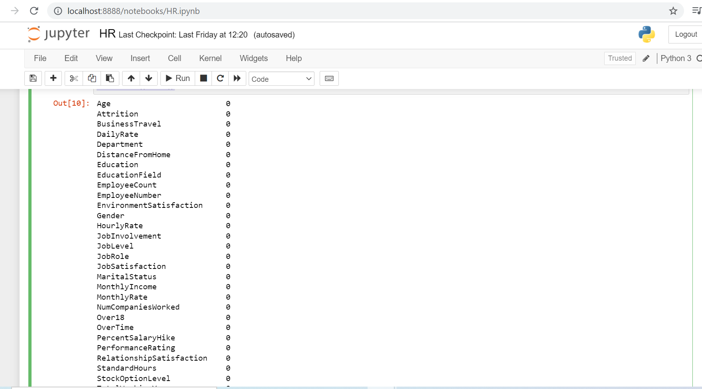
#Check for any missing / null values in the data df.isnull().sum()

Slide 14
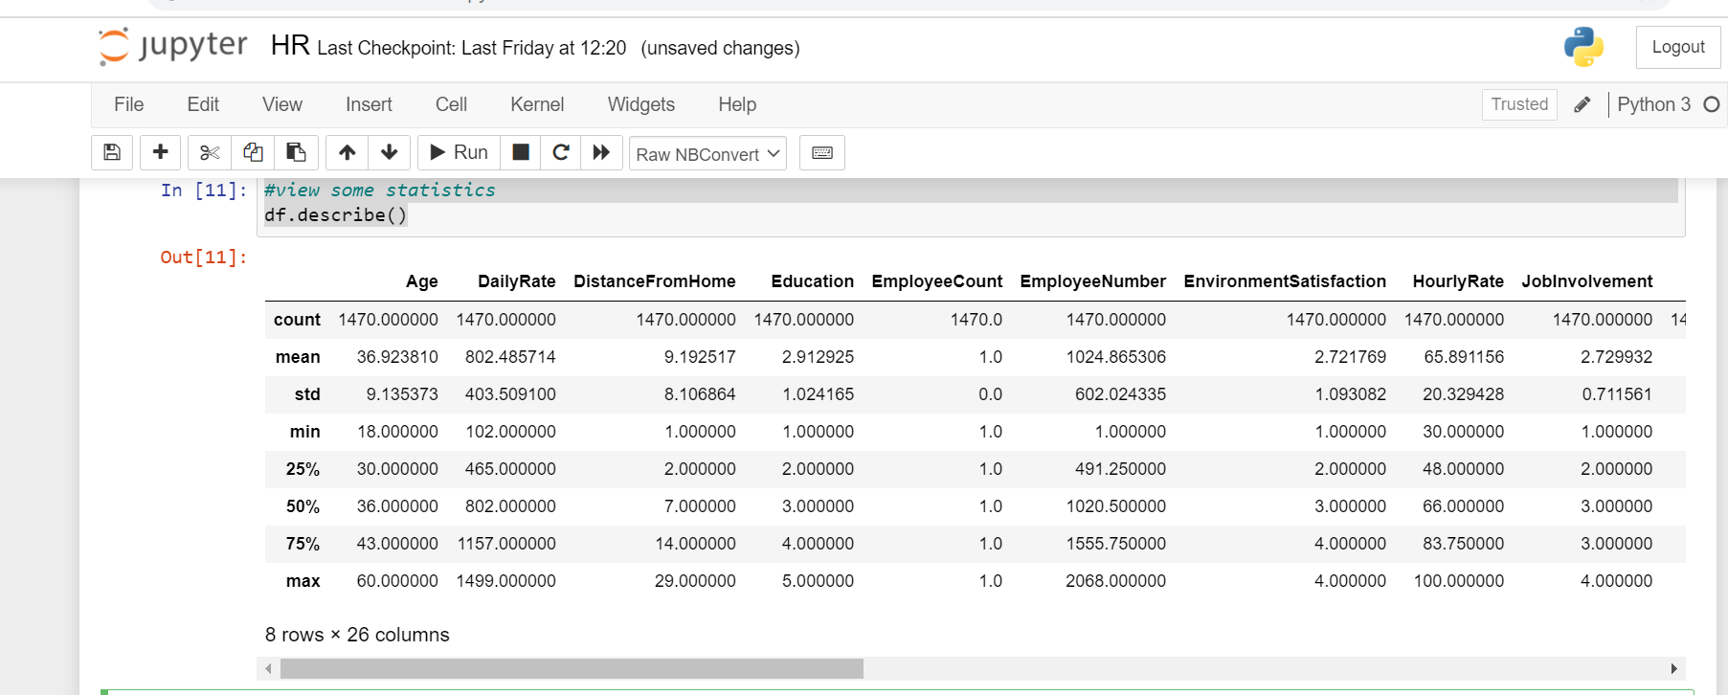
#View some basic statistical details like percentile, mean, standard deviation etc. df.describe()

Slide 15
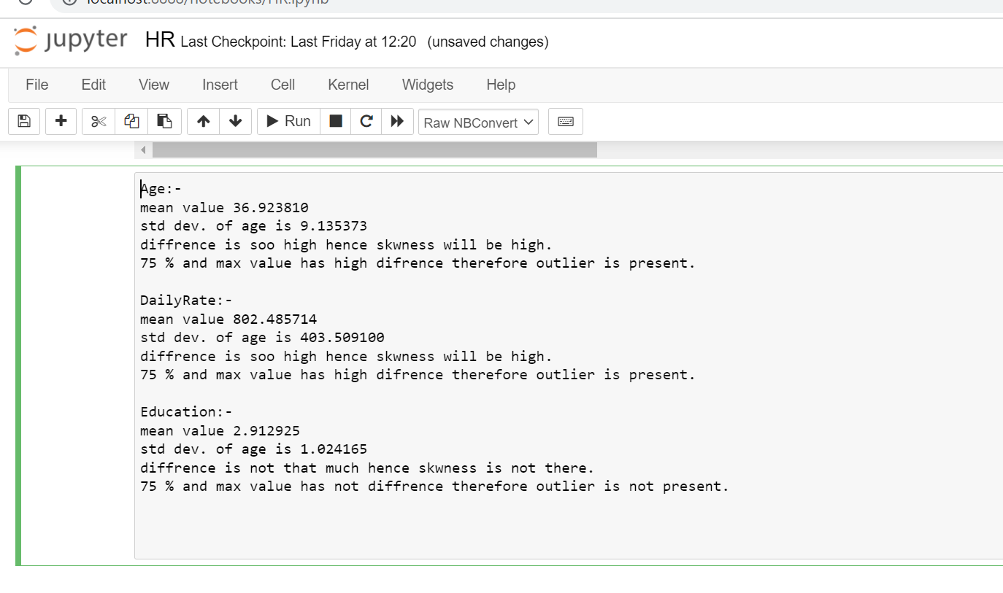
Some observation of the satastic

Slide 16
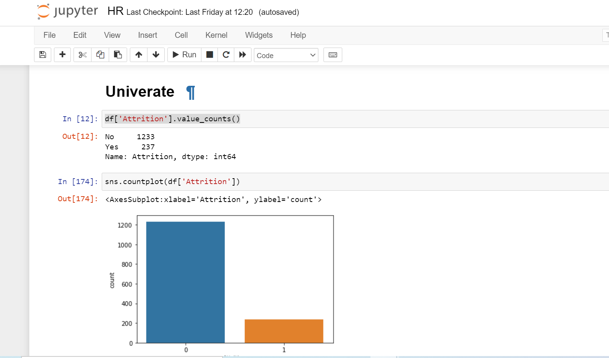
Get a count of the number of employee attrition, the number of employees that stayed (no) and the number that left (yes) the company.

Slide 17
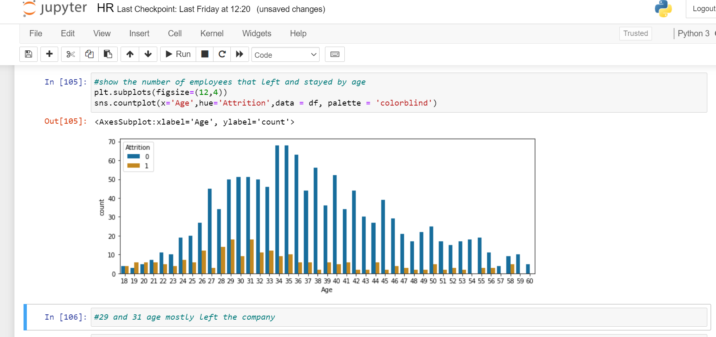
The number of employees that left and stayed at the company by age.

Slide 18
The highest count of employee attrition is age 29 & 31. The age with the highest retention is age 34 & 35.

Slide 19
Unique values
Pandas series aka columns has a unique() method that filters out only unique values from a column.
We can extend this method using pandas concat() method and concatenation all the desired columns into 1 single column and then find the unique of the resultant column.

Slide 20
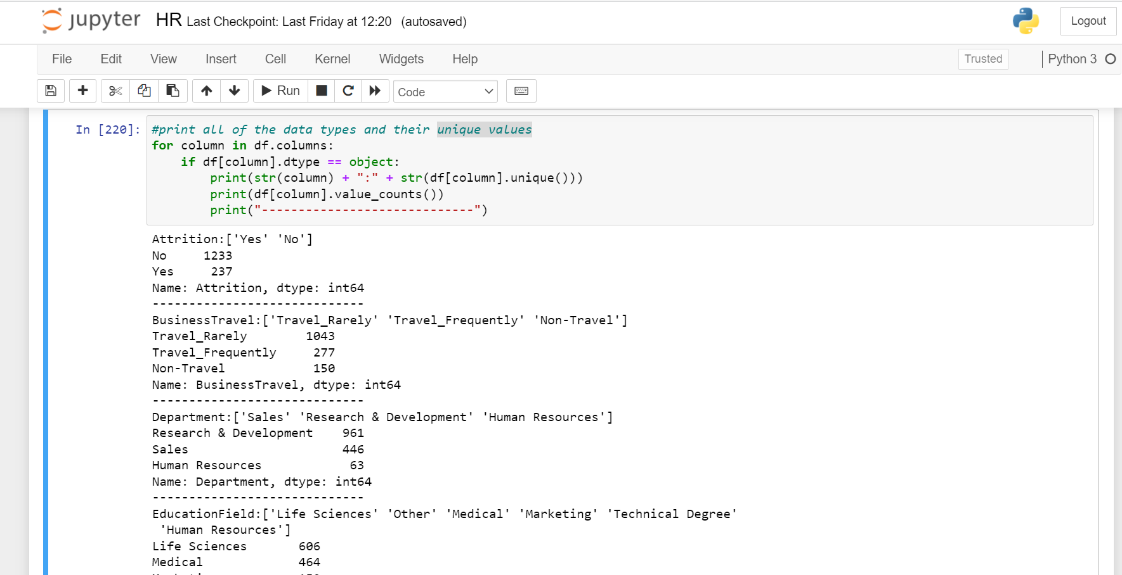
Unique

Slide 21
Drop the data form data set.
Some columns in the data set we don’t think will be needed for training the machine learning model like the number assignment to the employee (which is just some number identification).
The StandardHours , Over18 & EmployeeCount columns contain only one value in every row, so these columns would not add any additional information to the model. We will remove these columns from the data set.

Slide 22
Drop the data form data set
#Remove unneeded columns #Remove the column EmployeeNumber df = df.drop('EmployeeNumber', axis = 1) # Employee id is there no need of this columns #Remove the column StandardHours df = df.drop('StandardHours', axis = 1) #There only 80 same value in the columns so, no ned of this columns #Remove the column EmployeeCount df = df.drop('EmployeeCount', axis = 1) #
#Remove the column EmployeeCount df = df.drop('Over18', axis = 1) #Contains only the value 'Yes'

Slide 23
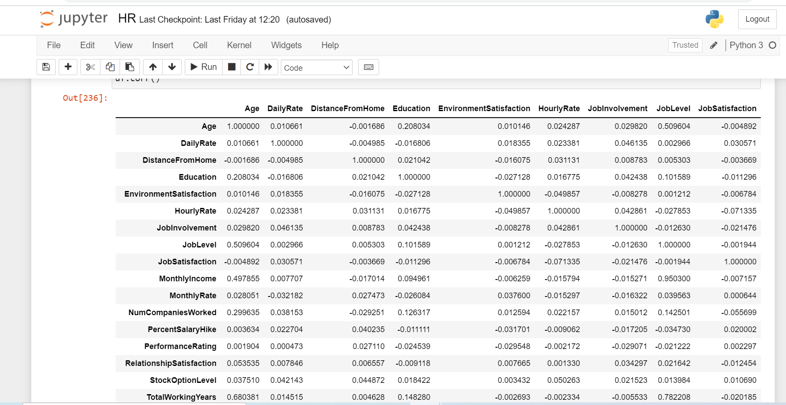
Correlation of the columns.
#Get the correlation of the columns df.corr()

Slide 24
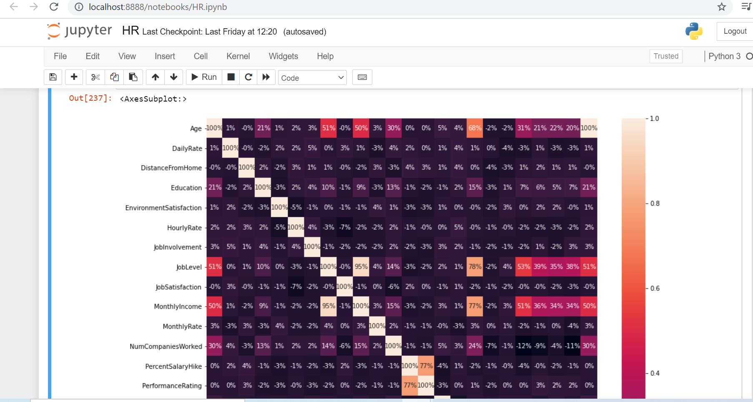
heat map
Let’s get a better visual of the correlation by using a heat map.

Slide 25
total working year 68% correlated with the age value is showing good.
total working year 77% correlated with the Monthly income is showing good
Monthly income 95% correlated with job lavel

Slide 26
Label encoder:- We are using label encoder for transform the string data into numberic data for preparing the data for machine learning model
Now let’s prepare the data for the model. We will first transform non-numeric columns to numerical columns.
#Label encoder use for convert the string value into numberi value.
#it made the data ready for m/l
from sklearn.preprocessing import LabelEncoder
le = LabelEncoder()
for column in df.columns:
if df[column].dtype == np.number:
continue
df[column] = LabelEncoder().fit_transform(df[column])

Slide 27
Label encoder we used at the that project is:-
list1=['Attrition','BusinessTravel','MaritalStatus','OverTime','JobRole','Gender','EducationField','Department' ]
for val in list1:
df[val]=le.fit_transform(df[val].astype(str))
df

Slide 28
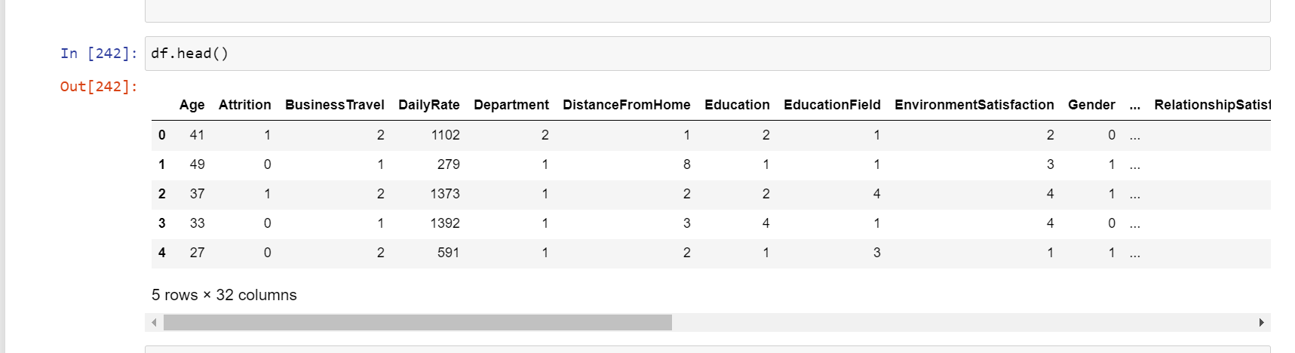
Show the data set into string value into 0,1,2,3…..

Slide 29
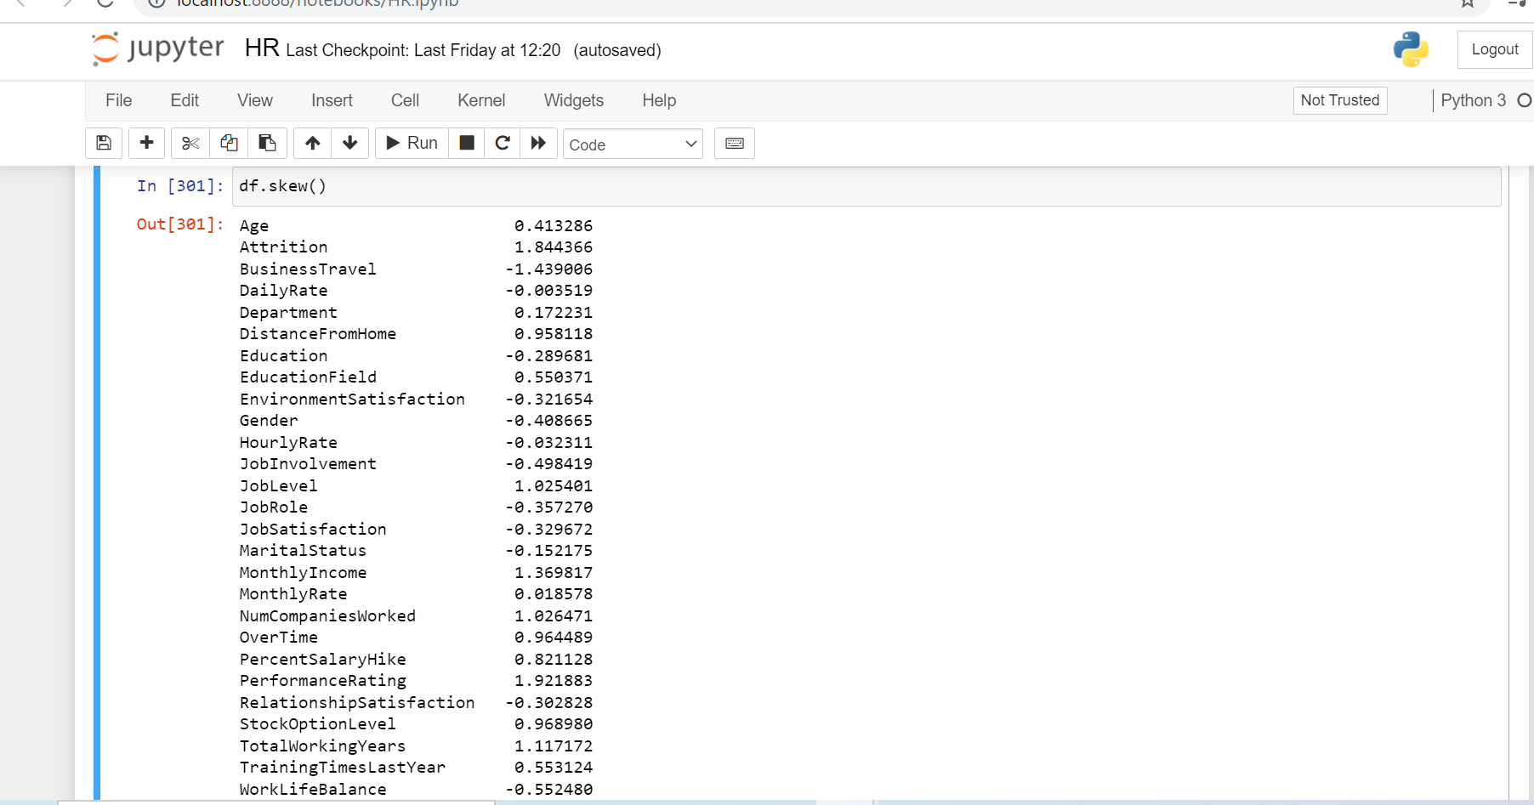
df.skew() By this, we are checking skewness

Slide 30
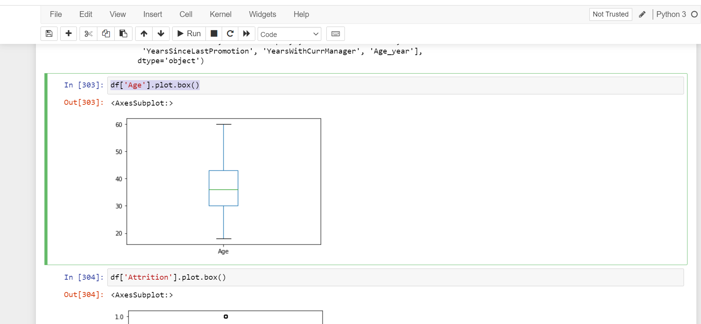
Box Plot
df['Age'].plot.box()

Slide 31
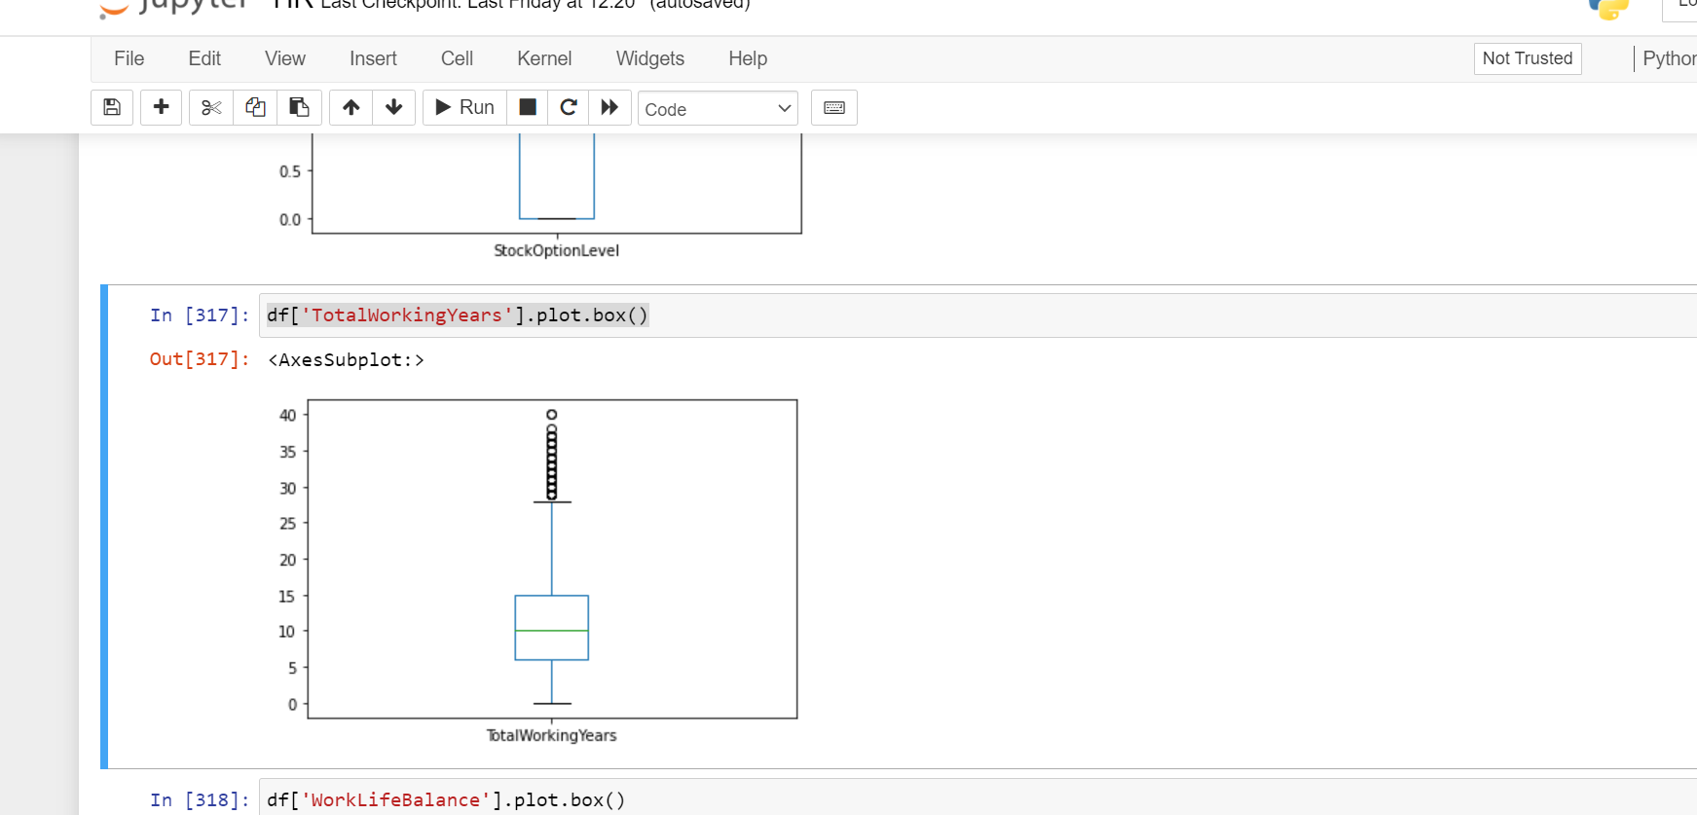
df['TotalWorkingYears'].plot.box()

Slide 32
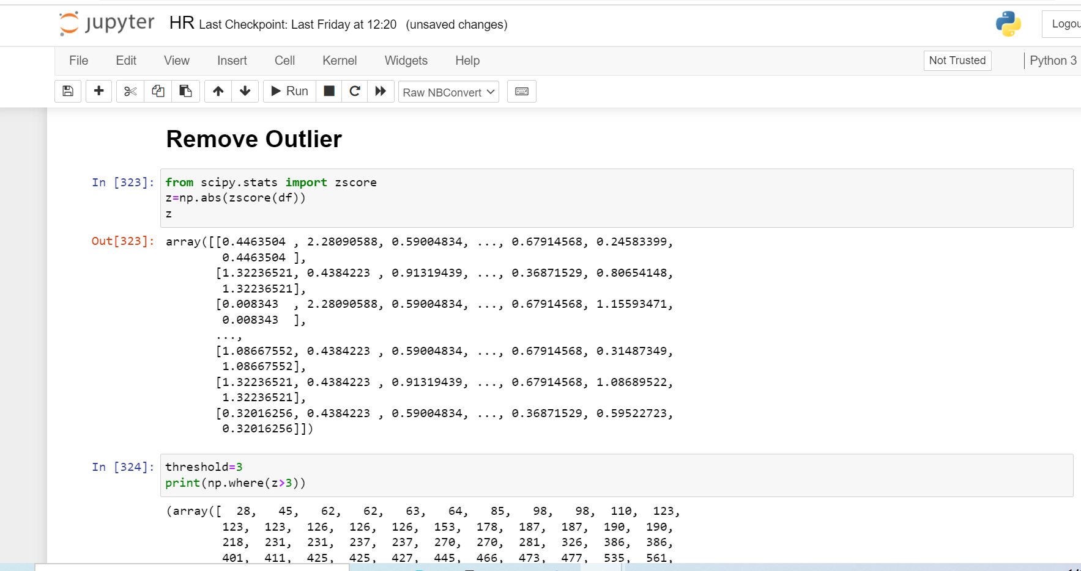
Outlier is not present in the data set. Remove Outlier

Slide 33
We checking z_score is greater then 3
from scipy.stats import zscore
z=np.abs(zscore(df))
z
df_new = df[(z<3).all(axis=1)]

Slide 34
We are checking, How much data removed from dataset.
(1387, 32)
df_new.shape
(1387,32)
df.shape
(1470,32)
For checking the percent of data how much we lost in the remove outlier
We lost the data less then 1 %
Data should be less then 10 %

Slide 35
#create a new column for spliting the data make easy for iloc:- #Create a new column
df['Age_year'] = df ['Age']

Slide 36
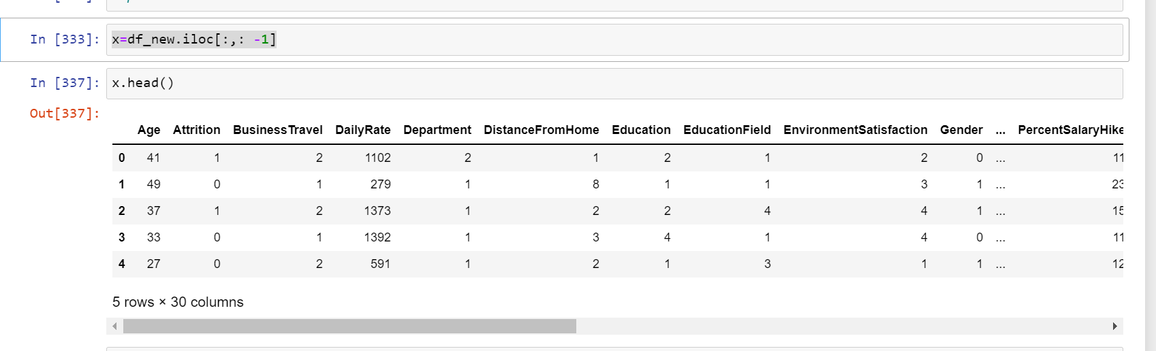
#Split the data into independent ‘x' and dependent 'y’ variables for training.
x=df_new.iloc[:,: -1]

Slide 37
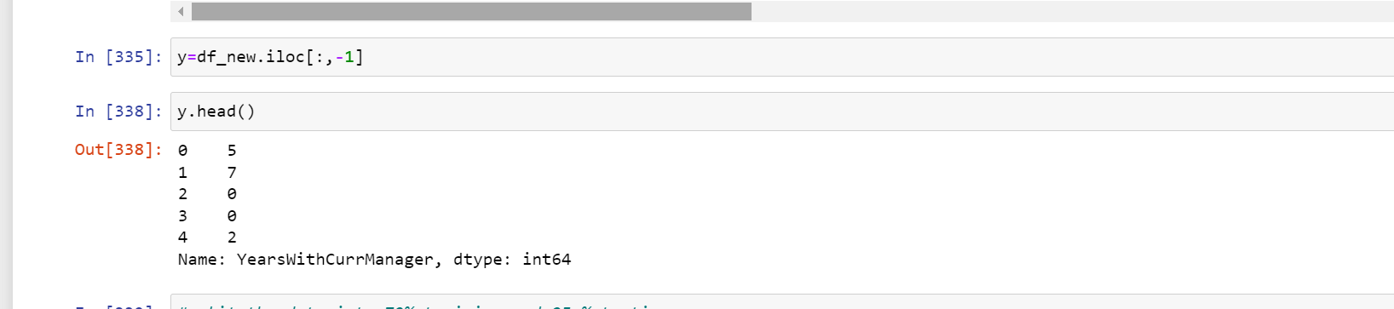
Y Variable

Slide 38
Split the dataset into 75% Training set and 25% Testing set
from sklearn.model_selection import train_test_split
x_train, x_test, y_train, y_test = train_test_split(x,y,test_size=30, random_state= 0)

Slide 39
PipeLine
from sklearn.svm import SVC
from sklearn.naive_bayes import MultinomialNB
from sklearn.tree import DecisionTreeClassifier
from sklearn.neighbors import KNeighborsClassifier
from sklearn.metrics import accuracy_score,confusion_matrix,classification_report

Slide 40
Random Forest Classifier
from sklearn.ensemble import RandomForestClassifier
forest = RandomForestClassifier(n_estimators= 10, criterion = 'entropy', random_state = 0)
forest.fit(x_train, y_train)

Slide 41
Random Forest Classifier
0.9861111111111112
0.9861111111111112
from sklearn.ensemble import RandomForestClassifier
forest = RandomForestClassifier(n_estimators= 10, criterion = 'entropy', random_state = 0)
forest.fit(x_train, y_train)
#get the accuracy score
forest.score(x_train,y_train)
Output 0.99
Best accuracy rate

Slide 42
Confusion matrices
from sklearn.metrics import confusion_matrix
cm = confusion_matrix(y_test, forest.predict(x_test))
TN = cm[0][0]
TP = cm[1][1]
FN = cm[1][0]
FP = cm[0][1]

Slide 43
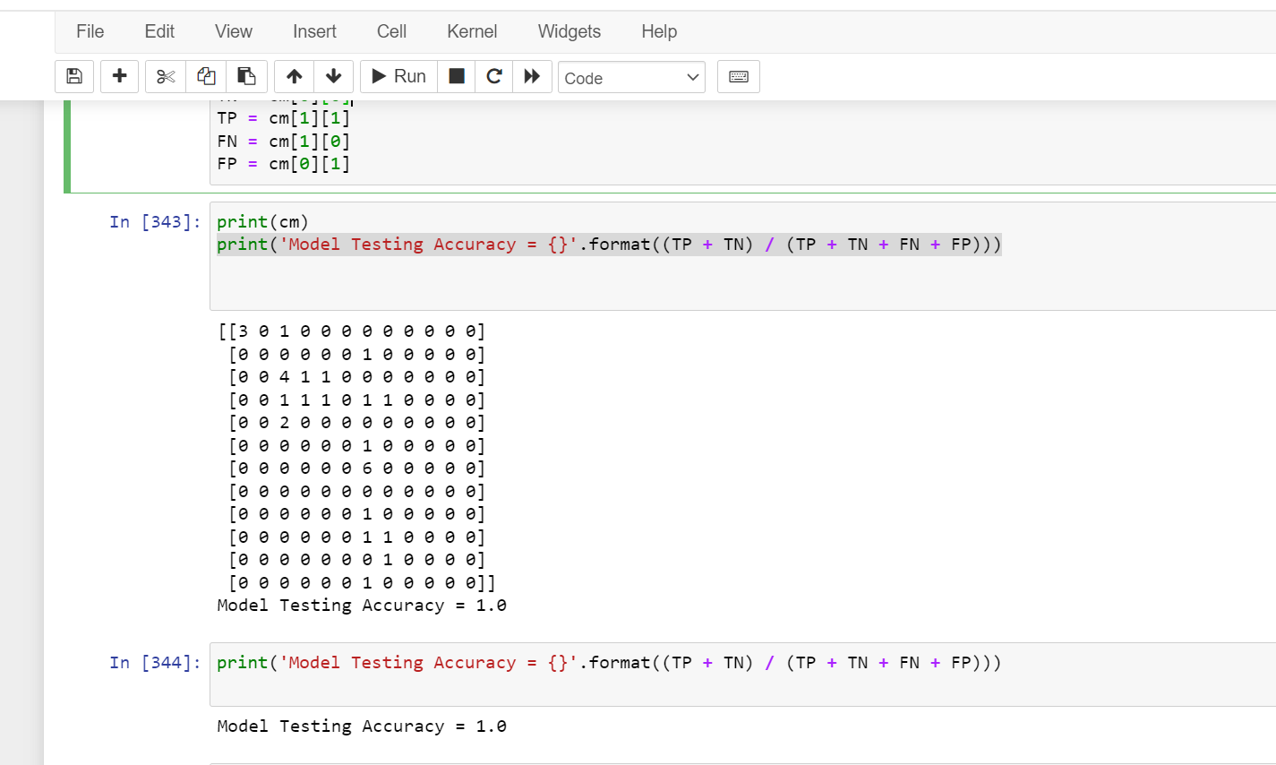
Print (cm) print('Model Testing Accuracy = {}'.format((TP + TN) / (TP + TN + FN + FP)))

Slide 44
MultinomialNB Model of machine learning
mnb = MultinomialNB()
mnb.fit(x_train,y_train)
predmnb = mnb.predict(x_test)
print(accuracy_score(y_test,predmnb))
print(confusion_matrix(y_test,predmnb))
print(classification_report(y_test,predmnb))

Slide 45
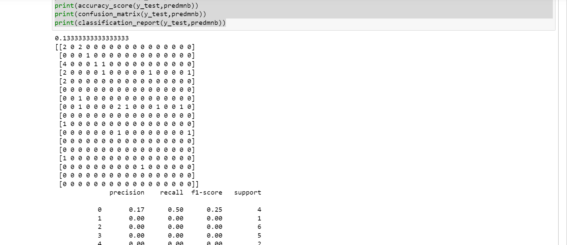
MultinomialNB

Slide 46
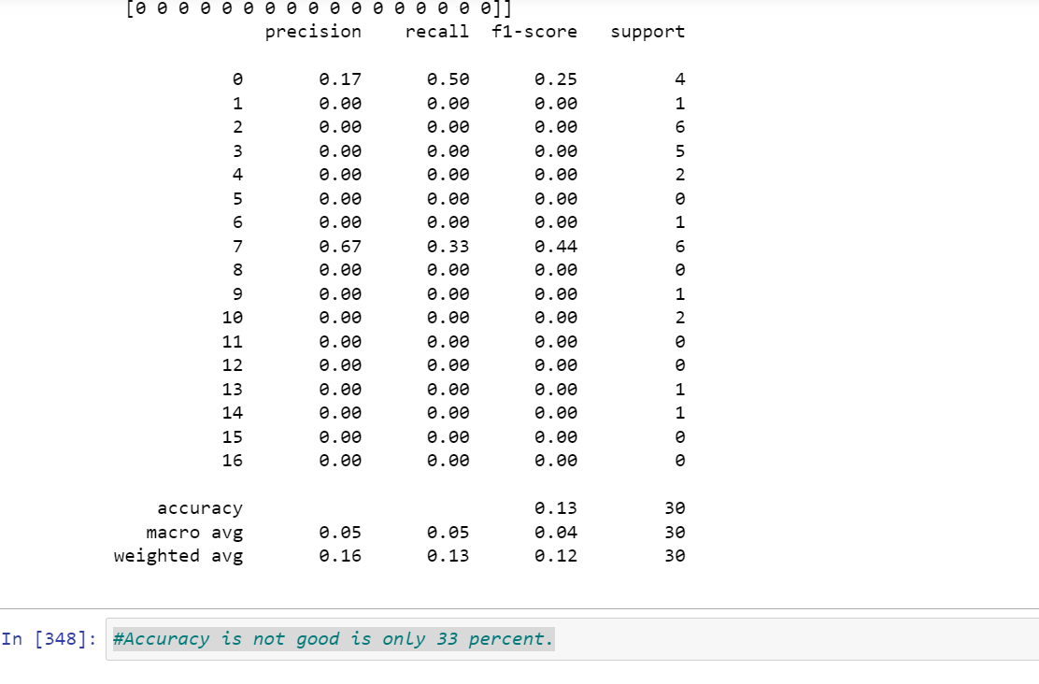
MultinomialNB

Slide 47
Support vector classifier
svc = SVC(kernel='rbf') # kernel = 'rbf is -----by defult'
svc.fit(x_train,y_train)
svc.score(x_train,y_train)
presvc = svc.predict(x_test)
print(accuracy_score(y_test,presvc))
print(confusion_matrix(y_test,presvc))
print(classification_report(y_test,presvc))

Slide 48
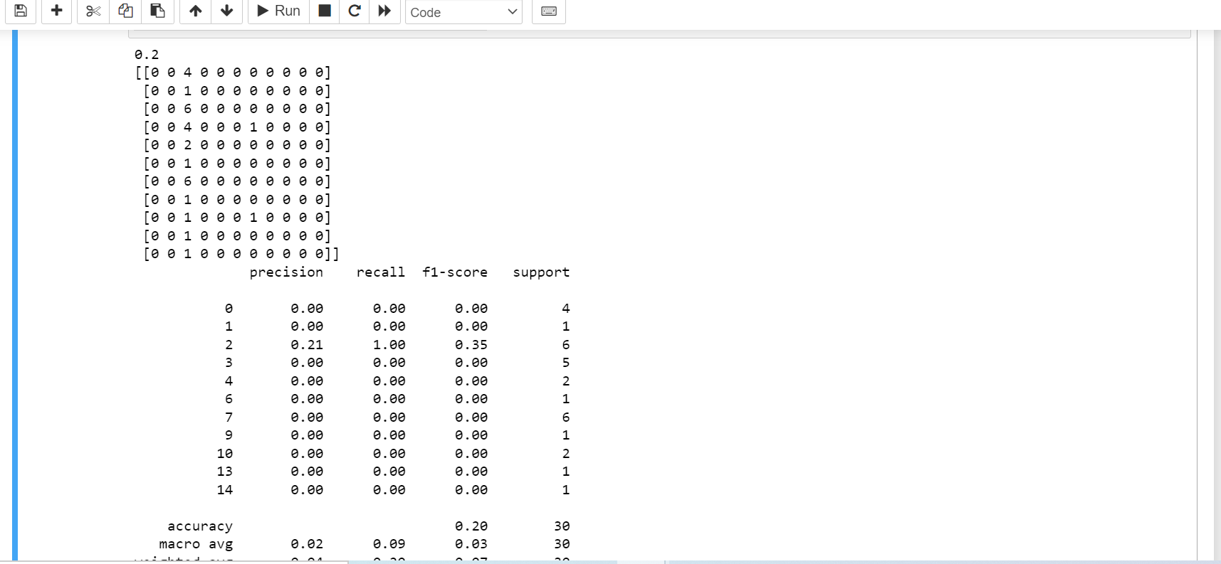
Support vector classifier

Slide 49
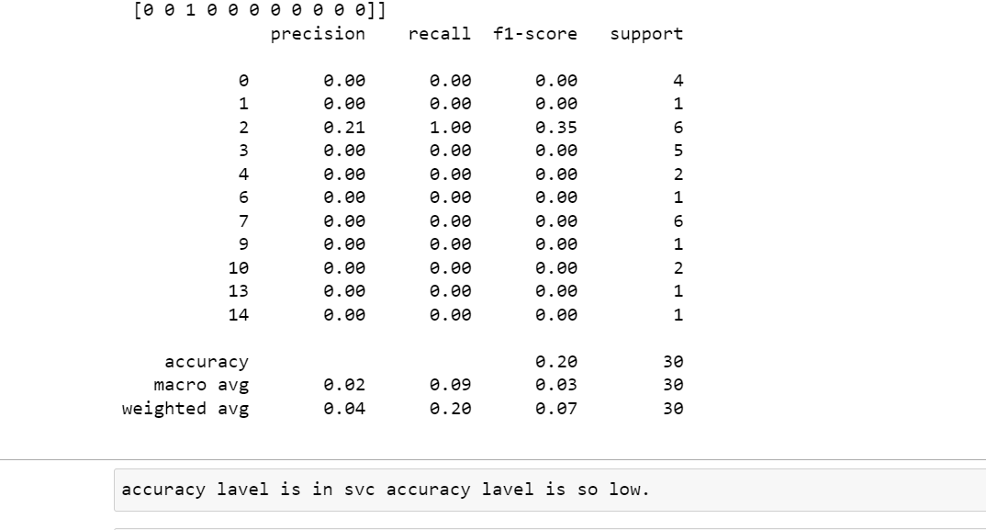
Support vector classifier

Slide 50
KNeighborsClassifier
knn = KNeighborsClassifier(n_neighbors=5)
knn.fit(x_train,y_train)
knn.score(x_train,y_train)
predknn=knn.predict(x_test)
print(accuracy_score(y_test,predknn))
print(confusion_matrix(y_test,predknn))
print(classification_report(y_test,predknn))

Slide 51
KNeighborsClassifier
knn = KNeighborsClassifier(n_neighbors=5)
knn.fit(x_train,y_train)
knn.score(x_train,y_train)
predknn=knn.predict(x_test)
print(accuracy_score(y_test,predknn))
print(confusion_matrix(y_test,predknn))
print(classification_report(y_test,predknn))

Slide 52
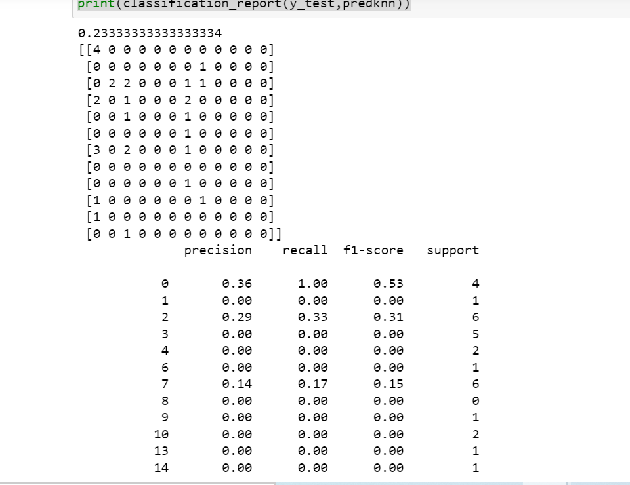
KNeighborsClassifier

Slide 53
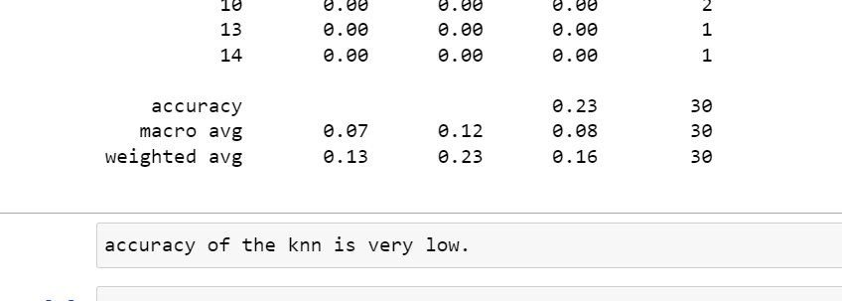
KNeighborsClassifier

Slide 54
Concluding Remarks
During this project, we has been Import necessary libraries like pandas numpy ,matapoltlib, seaborn, sklearn for eda process of the given data set.
-We did label encoding drop the unused data from the data set.
-Now, data is ready for machine learning model.
-Then we split the data into x and y variable for our training and testing purpose.
-70% training and 30% testing data ready for the machine.
-After complete this process we put the data into machine algorithm or model.
-This is the dataset is discreet data so, we are using classification technique.
Confusion matrices:- A Confusion matrix is an N x N matrix used for evaluating the performance of a classification model, where N is the number of target classes. The matrix compares the actual target values with those predicted by the machine learning model.
Confusion metric is 100 percentage accuracy in the random forest classifier in this model.
Machine learning model:-
-Random Forest Classifier
-MultinomialNB
-Support vector classifier
Random Forest Classifier is only obtaining accuracy label

