Slide 1
E-retail factors for customer activation and retention
Exploratory Data Analysis, or EDA, is an important step in any Data Analysis or Data Science project. EDA is the process of investigating the dataset to discover patterns, and anomalies (outliers), and form hypotheses based on our understanding of the dataset.

Slide 2
Importing libraries:-
We will start by importing the libraries we will require for performing EDA. These include NumPy, Pandas, Matplotlib, and Seaborn.
import pandas as pd
import pandas.plotting as pl
import numpy as np
import matplotlib as mpl
import matplotlib.pyplot as plt
import matplotlib.figure as fig
import seaborn as sns
import warnings
warnings.filterwarnings('ignore')

Slide 3
Reading data
We will now read the data from a Xsls file into a Pandas DataFrame. You can download the dataset for your reference.
df = pd.read_excel('datasheet.xlsx')

Slide 4
df.head()
To find the top data from the dataset.

Slide 5
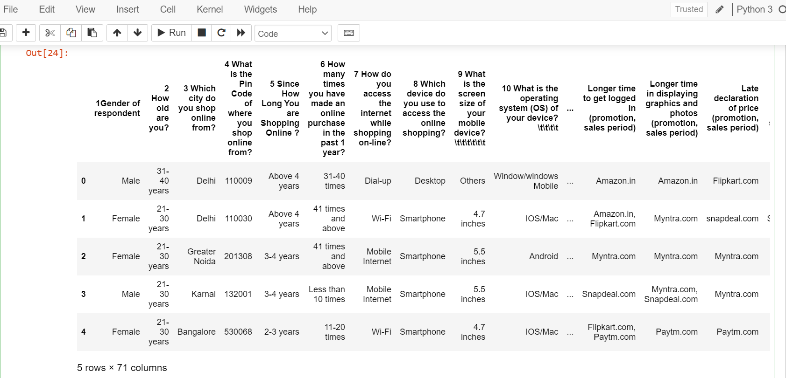
df.head() To find the top data from the dataset.

Slide 6
df.shape
(269, 71)

Slide 7
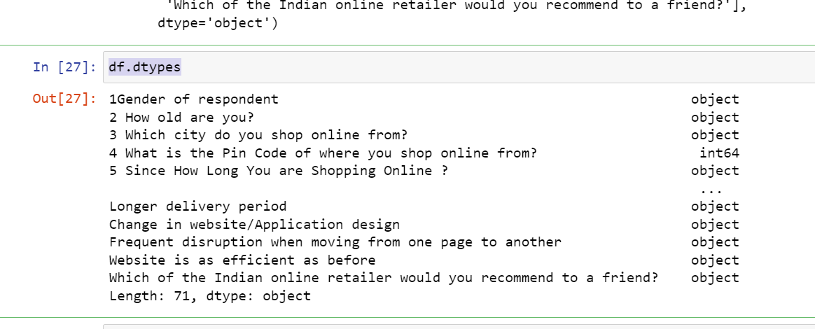
df.dtypes

Slide 8
LabelEncoder
LabelEncoder can be used to normalize labels.label encoder is used to make the data in numerical form.
Label encoder convert the data into string to numerical.
Label encoder make data fit for machine learning.
from sklearn.preprocessing import LabelEncoder
le = LabelEncoder()
for column in df.columns:
if df[column].dtype == np.number:
continue
df[column] = LabelEncoder().fit_transform(df[column])

Slide 9
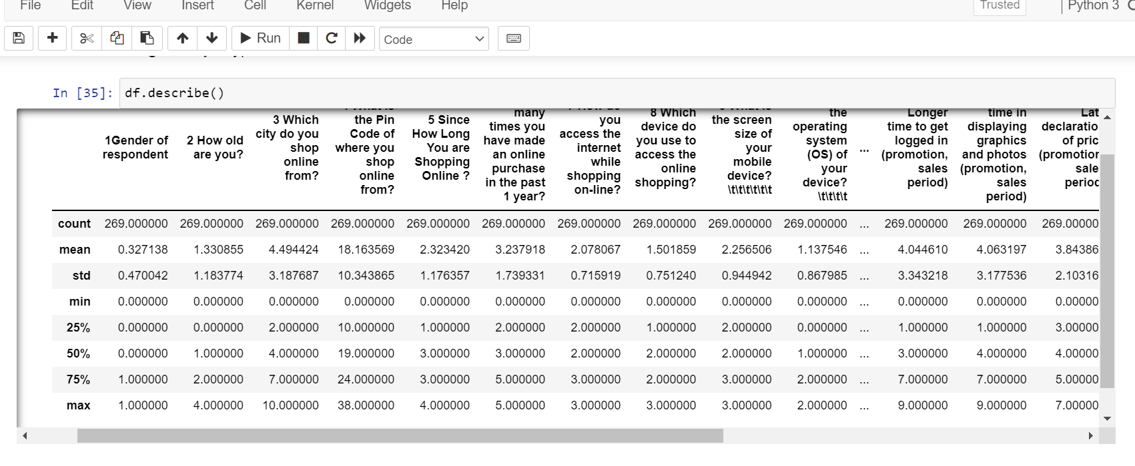
Descriptive Statistics

Slide 10
Missing value imputation
df.isnull().values.any()
False

Slide 11
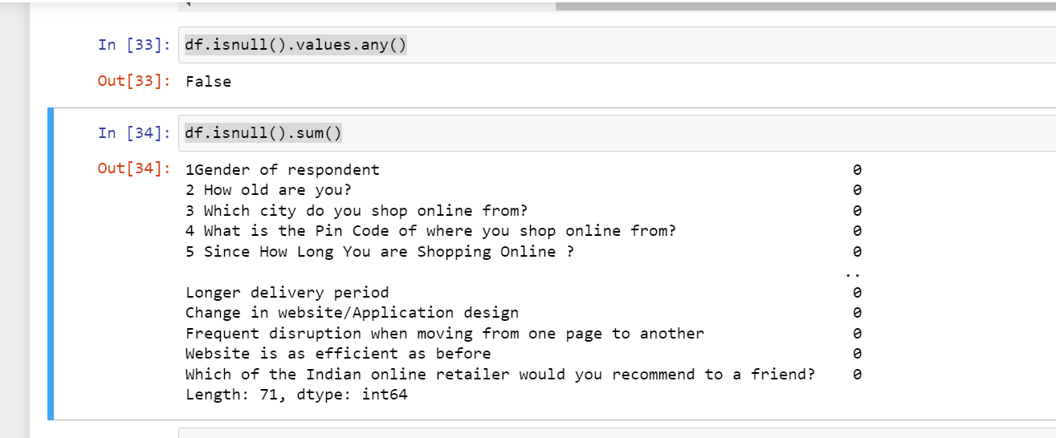
df.isnull().sum()

Slide 12
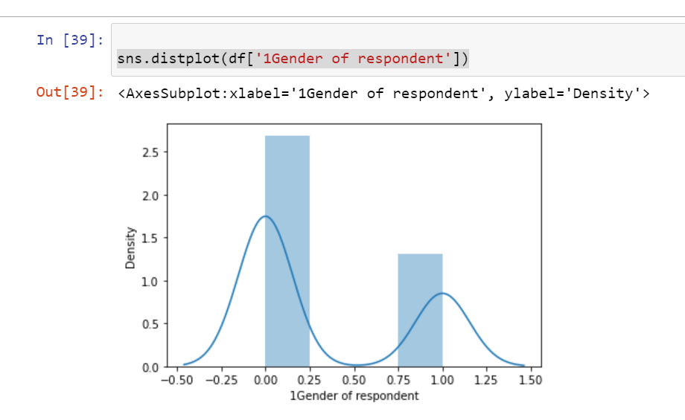
Graphical representation
Univariate Analysis.
sns.distplot(df['1Gender of respondent'])

Slide 13
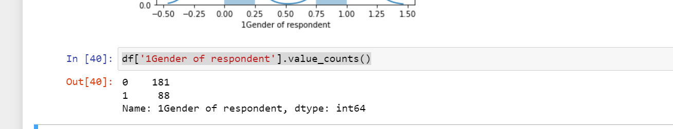
df['1Gender of respondent'].value_counts()

Slide 14
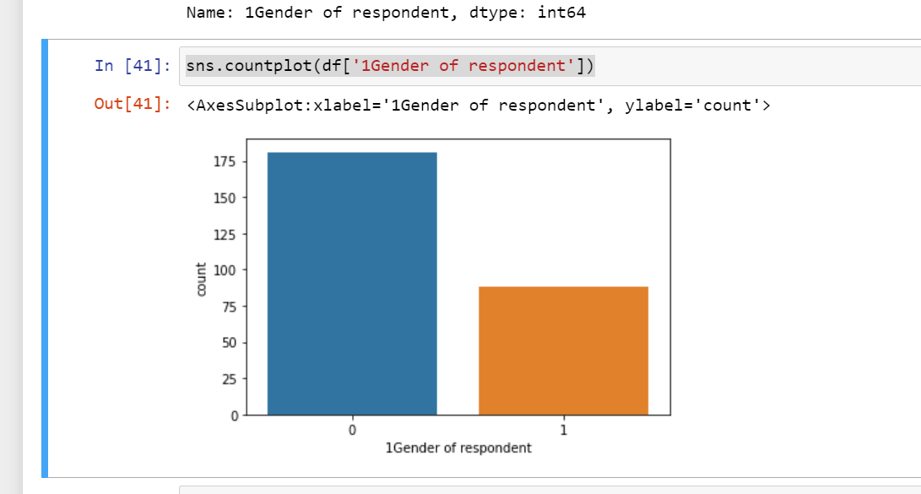
sns.countplot(df['1Gender of respondent'])

Slide 16
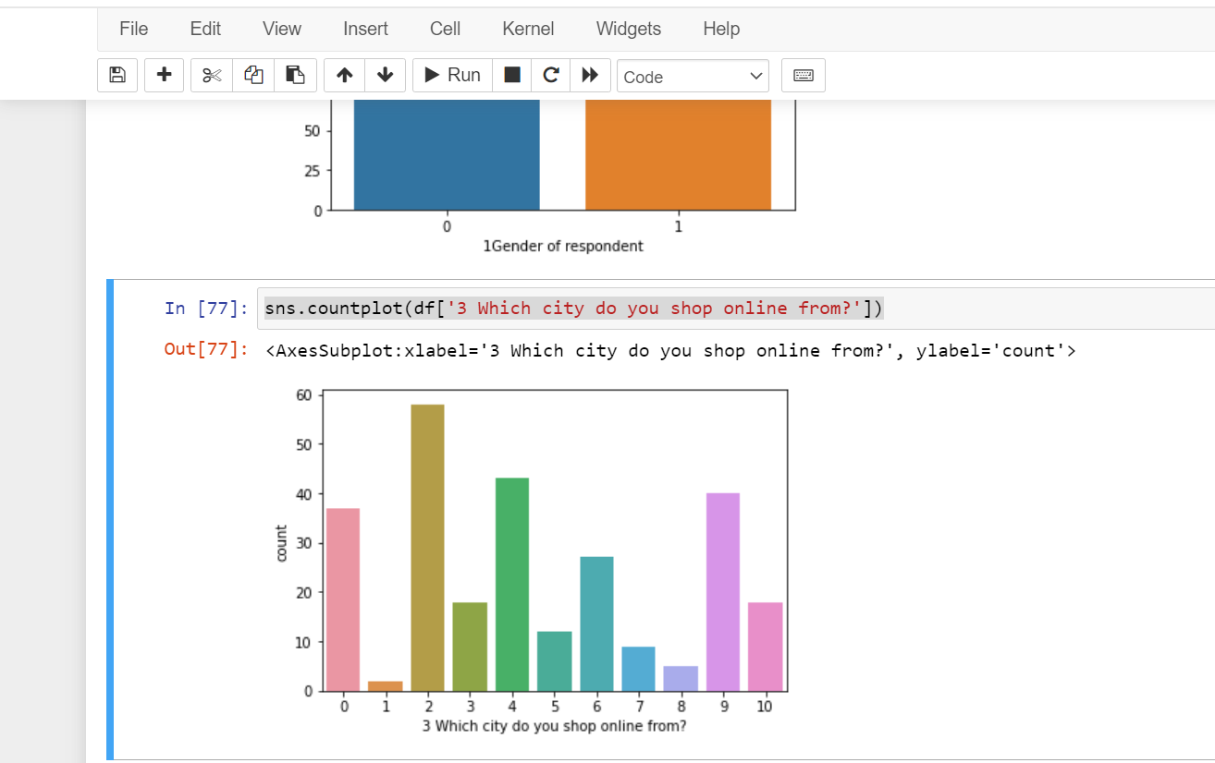
sns.countplot(df['3 Which city do you shop online from?'])

Slide 18
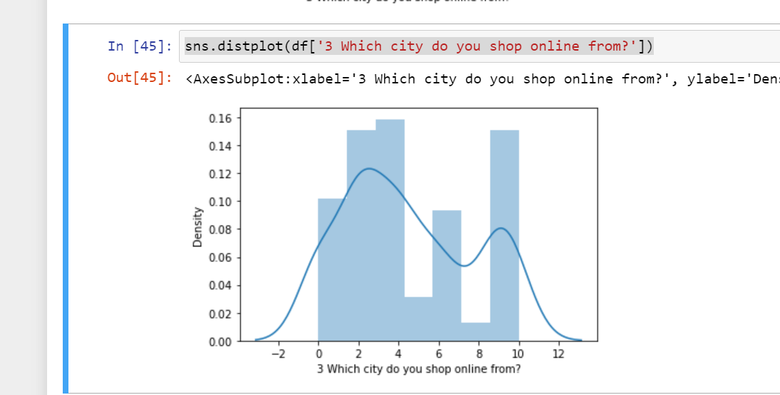

Slide 19
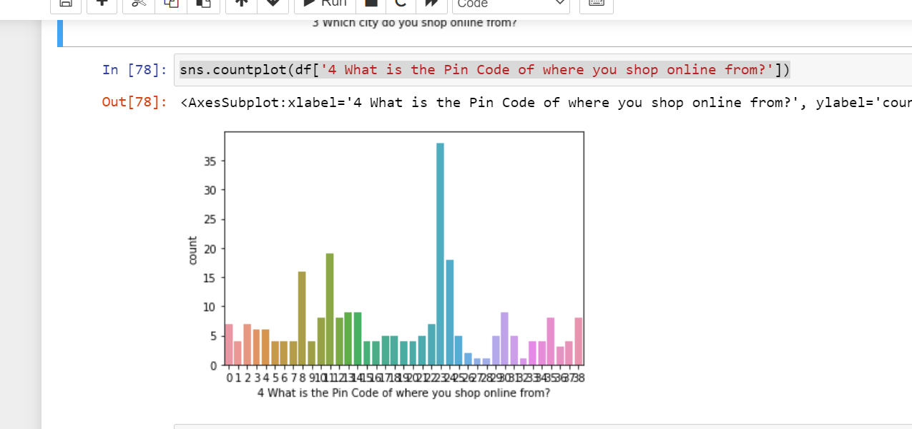

Slide 20
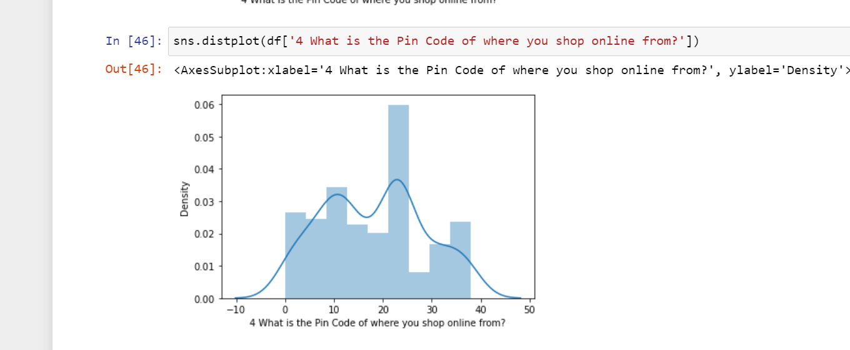

Slide 21
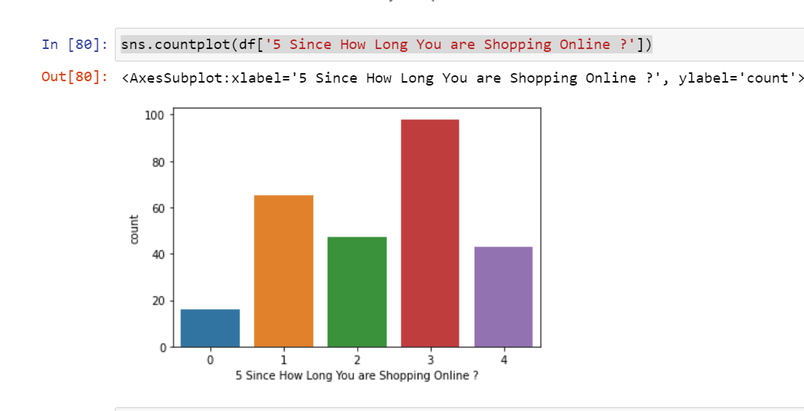

Slide 22
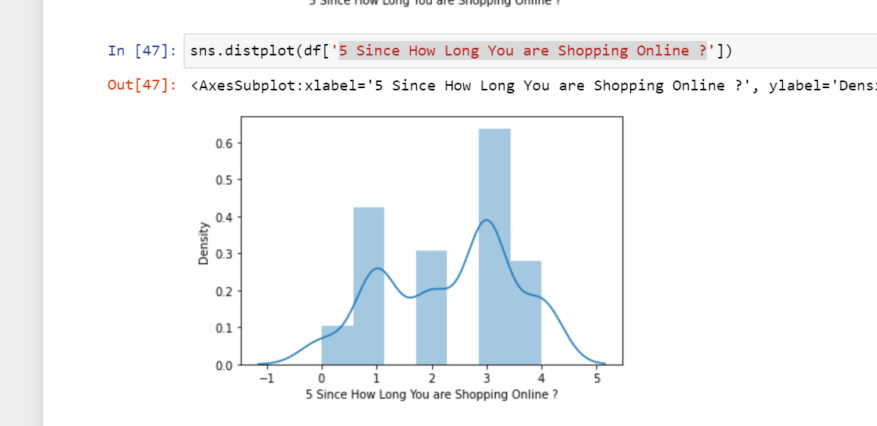

Slide 23
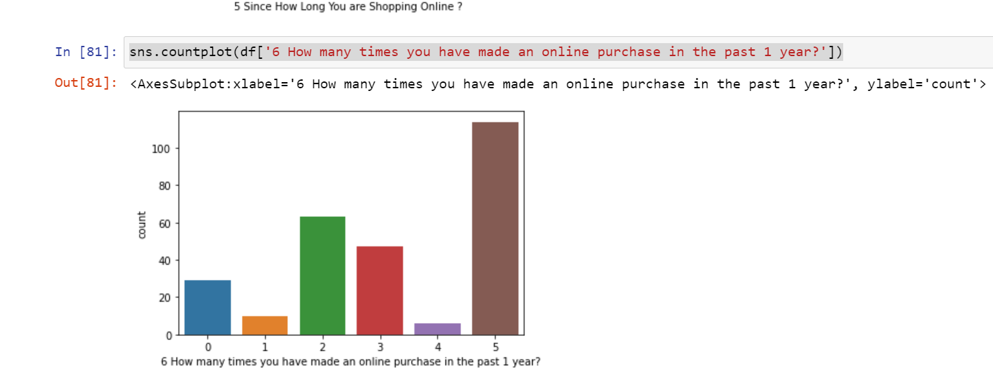

Slide 24
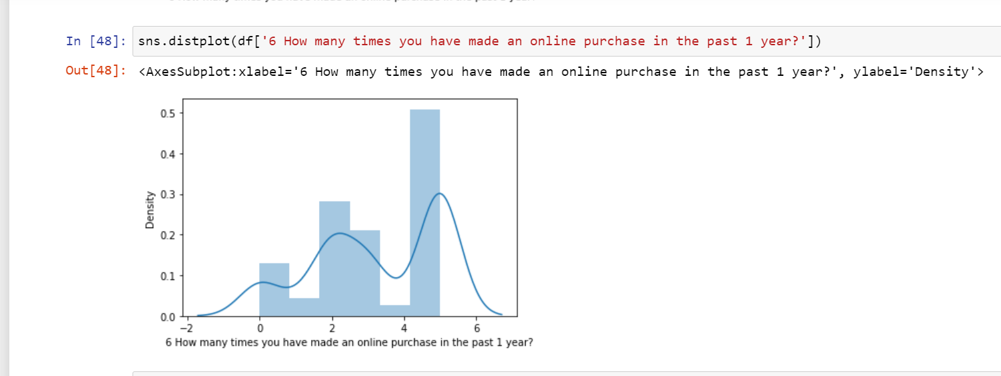

Slide 25
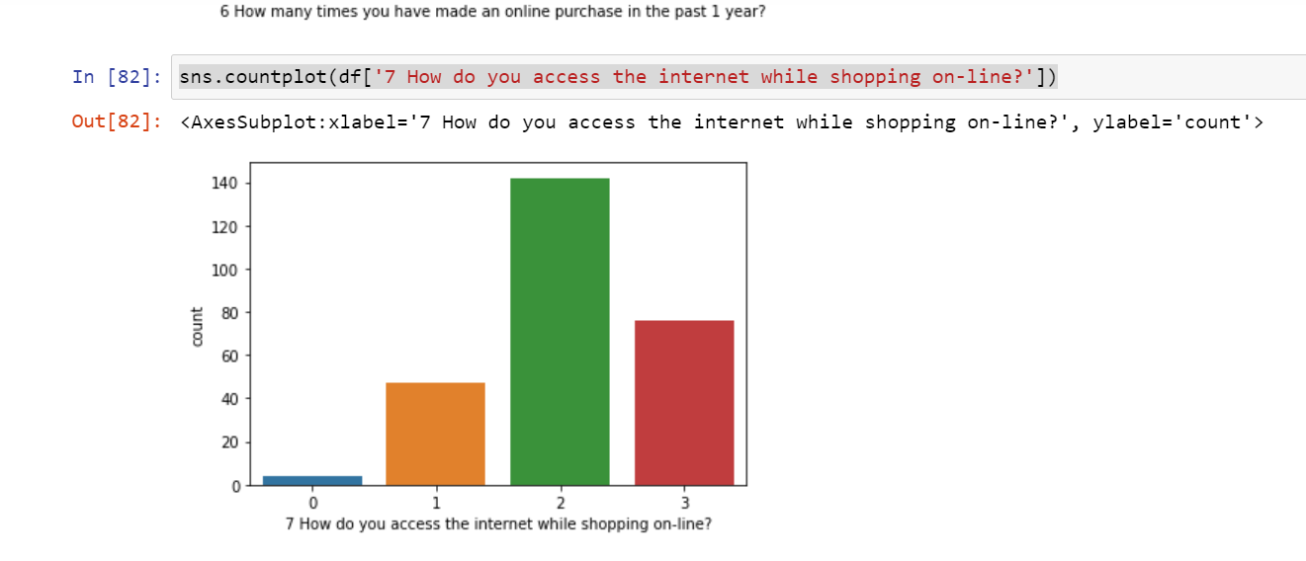

Slide 26
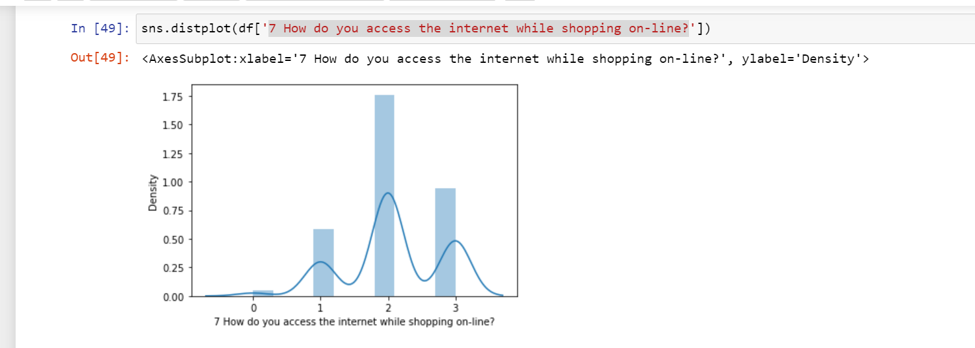

Slide 27
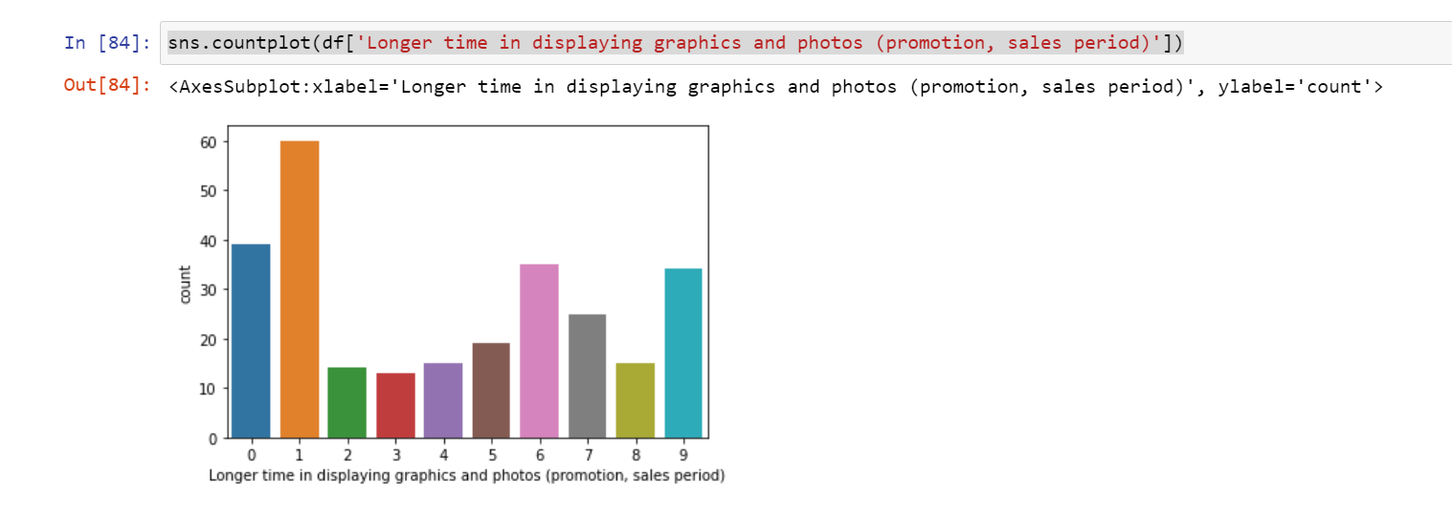

Slide 28
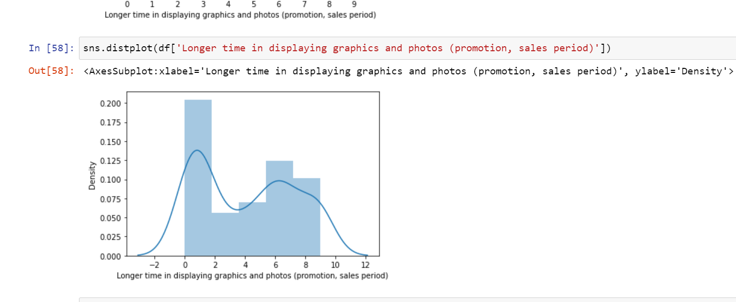

Slide 29
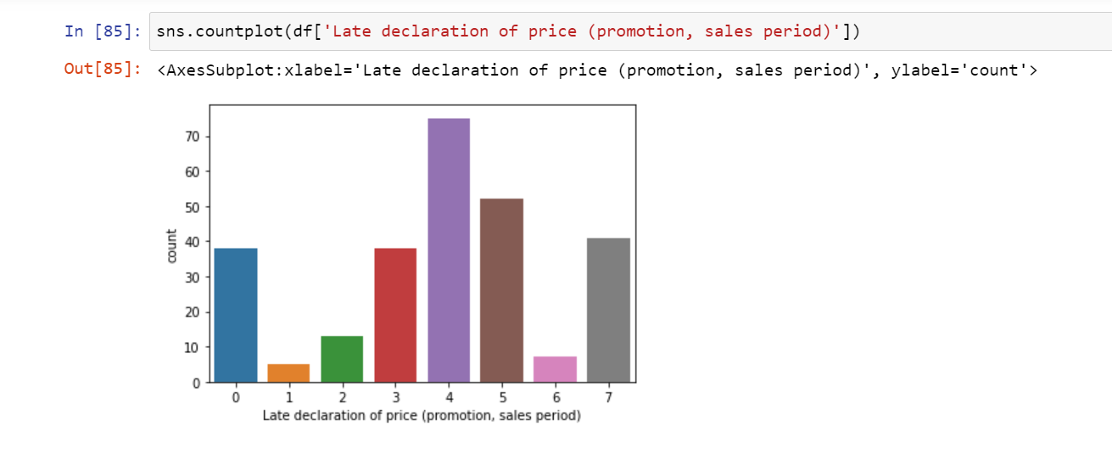

Slide 31
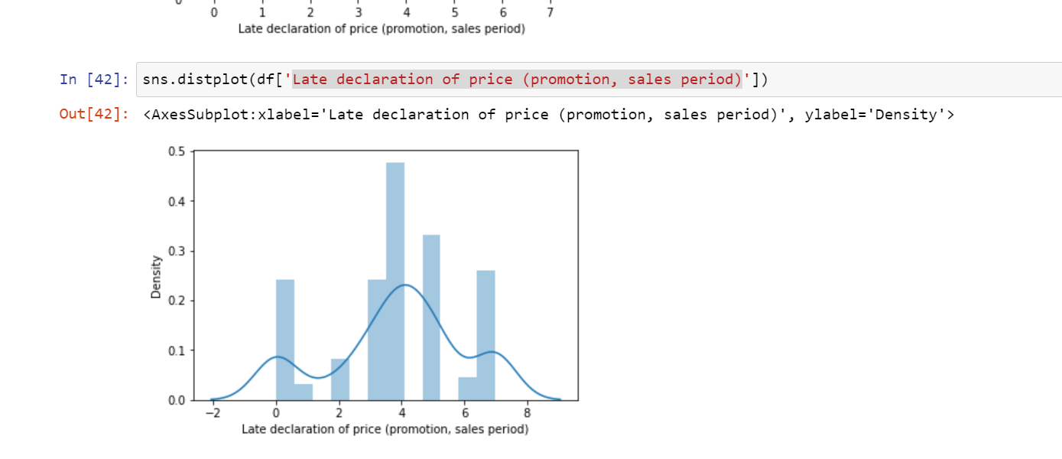

Slide 32
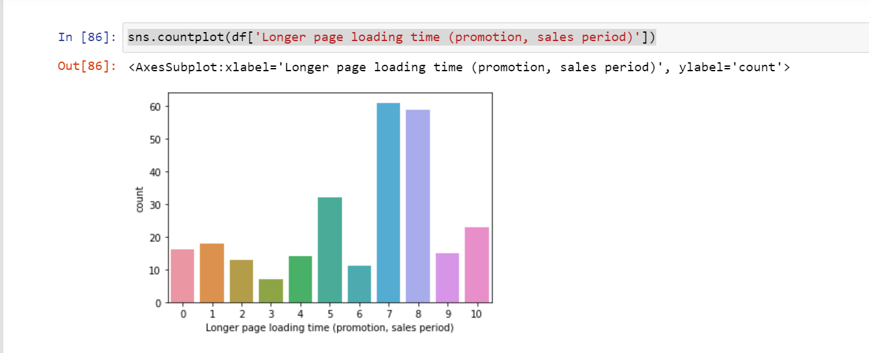

Slide 33
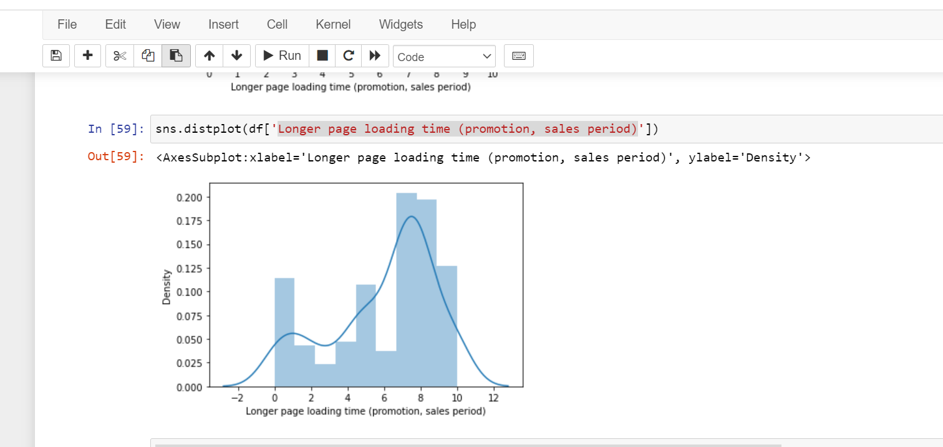

Slide 34
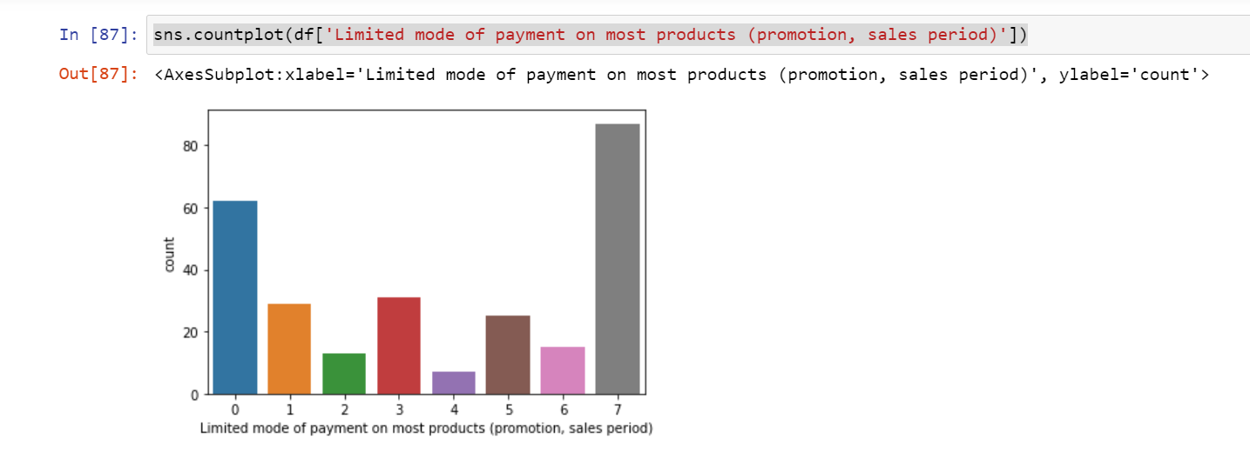

Slide 35
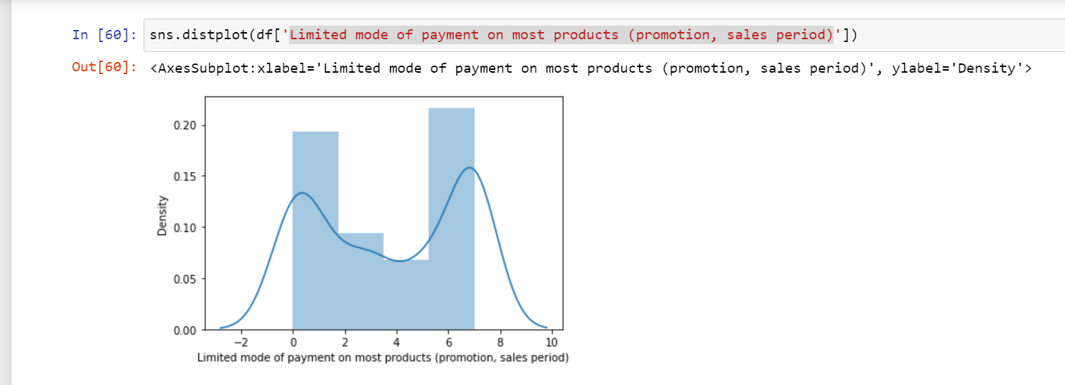

Slide 36
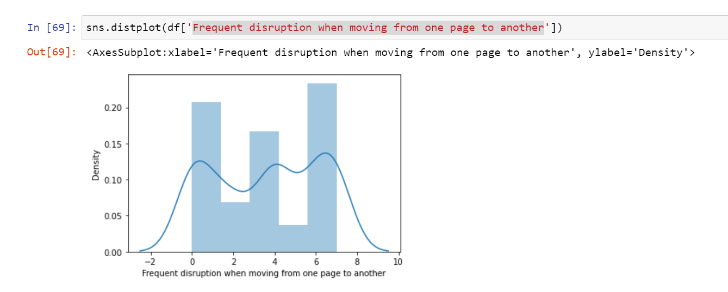

Slide 37
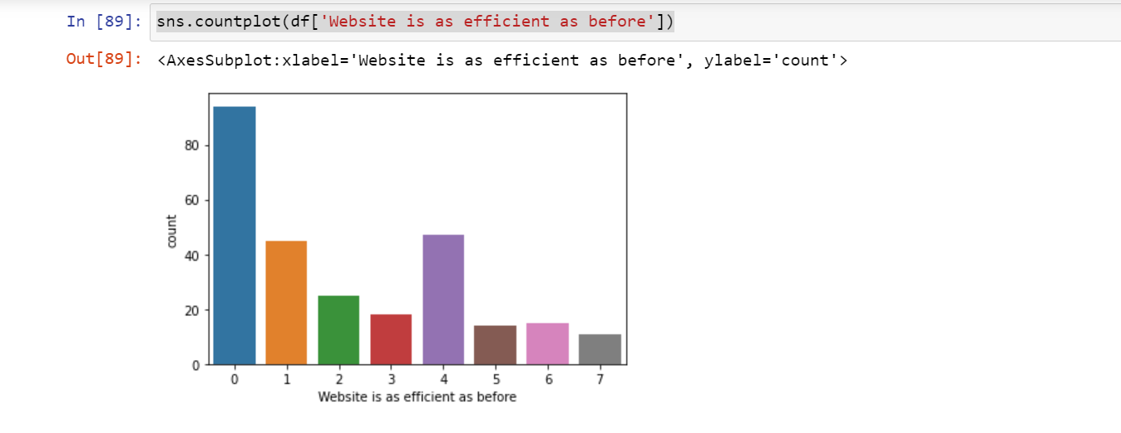

Slide 38
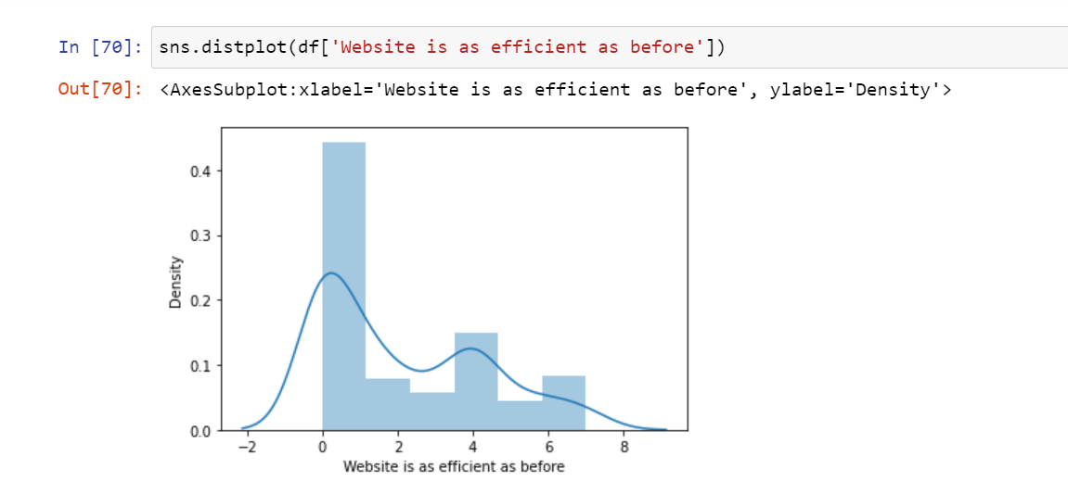

Slide 39
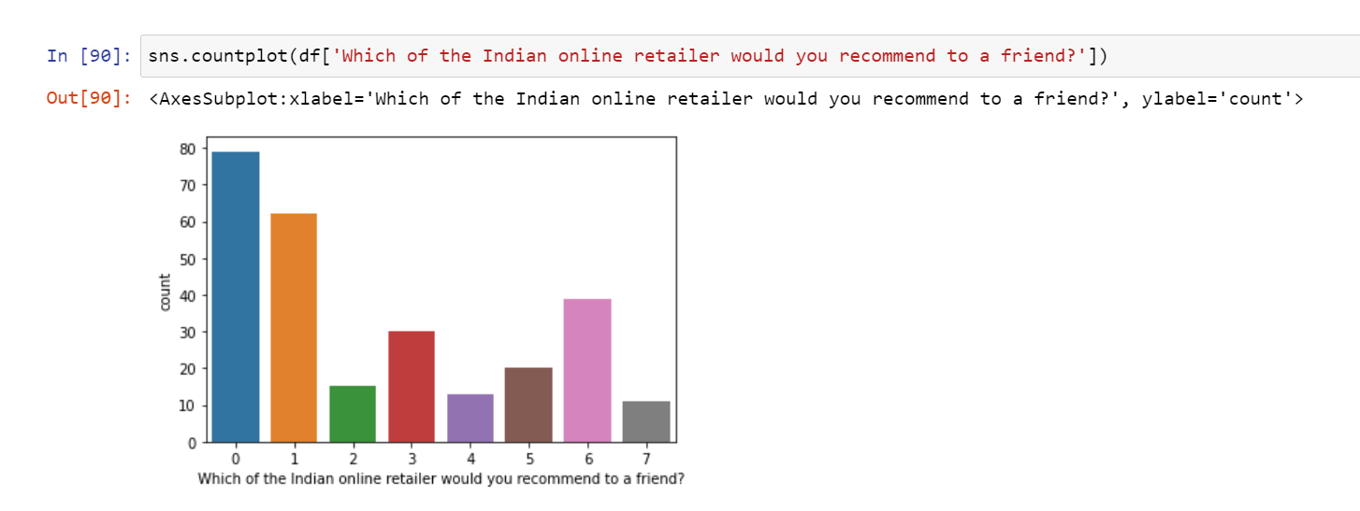

Slide 40
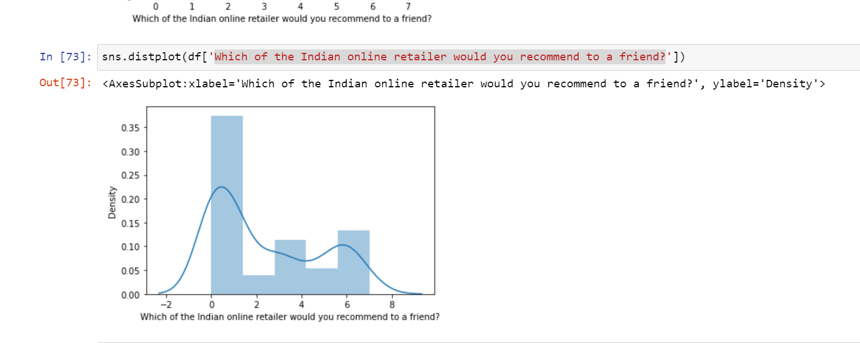

Slide 41
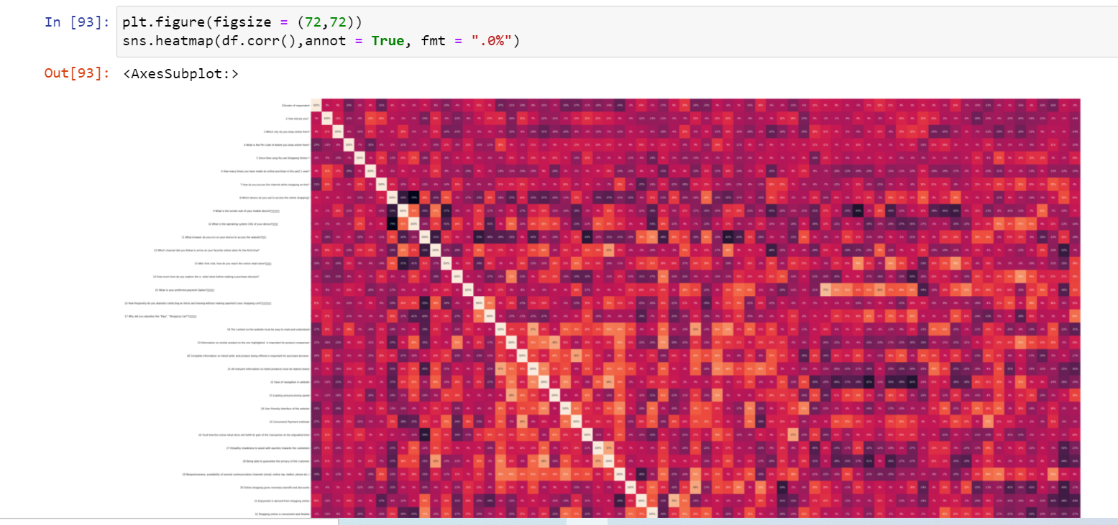
Heat Map To find the correaltion

