Slide 1
GAME DEVELOPMENT IN PYTHON

Slide 2
Team Name
Developers Hub
MEMBERS :
Dhinesh R
Deepak S
Dhanush DR

Slide 3
Mentor
Mr.rajashakaran
Industry mentor
Subashini.U

Slide 4
ABSTRACT
The title of the project is hunters. It’s a Python program developed using pygame .It’s a strategy based game, The main objective is to collect all the points without encountering the Enemies and then moving to the next level for the completion and then to continue the same as well Player is a ball like structured that is painted yellow in color ,where the enemies are red in color. This can manually contolled by the users with the help of the arrow keys present in the keyboard.

Slide 5
MODULES
It is a complex maze like path which is full of points, players must collect all the points with encountering the enemy
After collecting all the points the level one ends where the start of second level which is more complex then the previous one
If the player gets caught with the enemy he will be destroyed if by escape the player escapes both the level he will be awarded as the winner

Slide 6
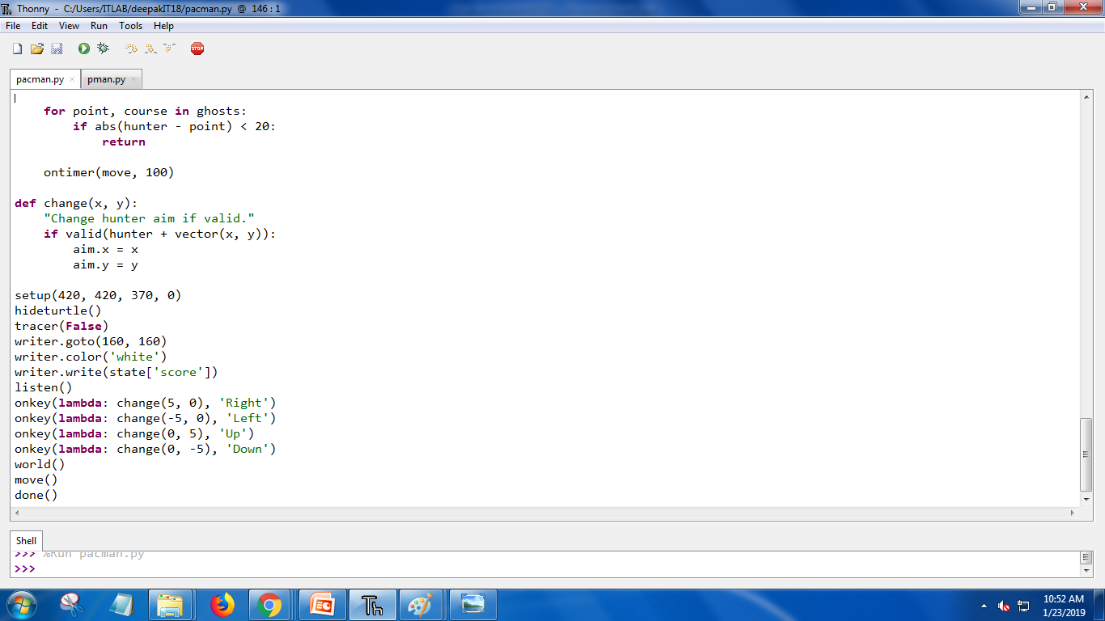
Model program

Slide 7
PYGAME
Game Programming with Python is about building games using Python.
It deals with general concepts of game development and specifics that apply when using Python for game development

Slide 8
Requriments
HARDWARE:
Processor :Intel i5-6500
System Type:64-bit os
SOFTWARE:
Thonny

Slide 9
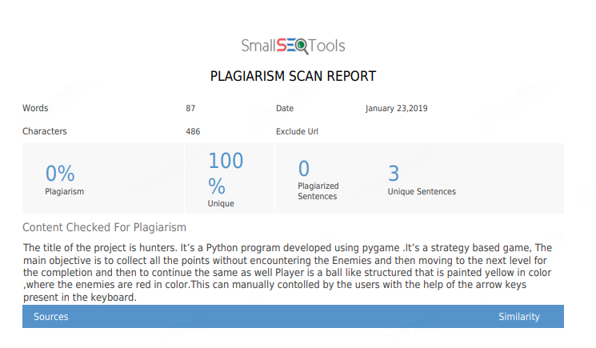
Plagiarism

Slide 10
TITLE : HUNTER
Problem Statement :
The player navigates HUNTER through a MAZE containing dots, known as Points, and four Hunters . The goal of the game is to accumulate as many points as possible by collecting the dots. When all of the dots in a stage is eaten, that stage is completed and the player will advance to the next level.

Slide 11
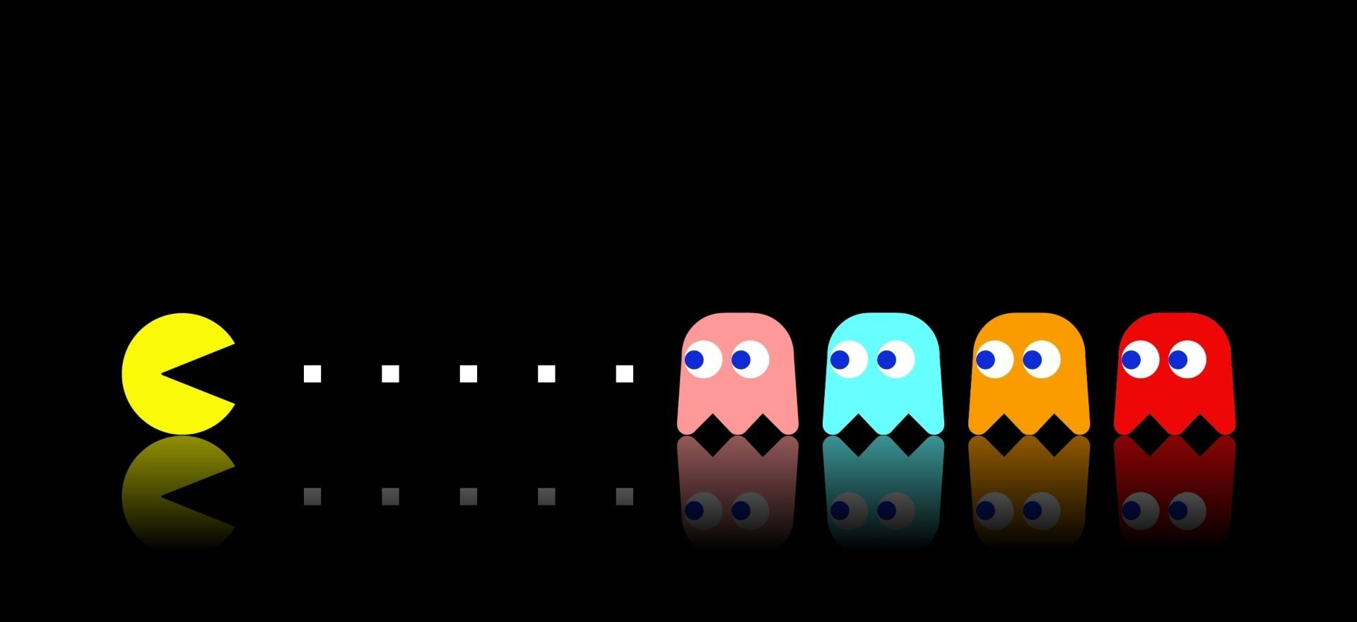
HUNTERS

Slide 12
conclusion
We are working on this HUNTER’s second level of the program
It’s all about :
- Changing Grids
- Hardening the Level
- Introducing Time Lapse
- Implementing Obstacles
- Merging the program

Slide 13
THANK YOU : )

