Slide 1

STAT 515 - FINAL PROJECT
Fifa19 GAME Analysis
By vishnu deepak
This Photo by Unknown Author is licensed under CC BY-SA

Slide 2
CONTENTS
FIFA 19 by ELECTRONIC ARTS (EA)
DATA CLEANING
DISCUSSION ON VARIABLES
RESEARCH QUESTIONS
MULTIPLE LINEAR REGRESSION
K- MEANS CLUSTERING

Slide 3
ABOUT THE GAME – FIFA 19
FIFA 19 IS THE MOST POPULAR SOCCER SIMULATION GAME DEVELOPED BY ELECTRONIC ARTS( EA) IN CANADA
CONATINS THE DATA OF 18,207 PLAYERS REGISTERED ACROSS VARIOUS CONTINENTS SUCH AS EUROPE, AFRICA , AMERICA Etc.
THE DATASET IS AT THE PLAYER-LEVEL AND CONATAINS OVER 89 VARIABLES THAT DESCRIBE VARIOUS PLAYER ATTRIBUTES
THE SOURCE OF THE DATA IS FROM KAGGLE

Slide 4
DISCUSSION ON PLAYER ATTRIBUTES/VARIBALES
PLAYER DETAILS
Height
Weight
Age
Nationality
Club
DEFENSIVE ATTRIBUTES
Strength
Jumping
Interceptions
Positioning
Marking
Tackling
ATTACKING ATTRIBUTES
Shot power
Dribbling
Sprint speed
Acceleration
Finishing
MIDFIELD ATTRIBUTES
Passing
Vision
Crossing
Long Passing
Ball Control
* All the above variables are numeric on a scale of 0 - 100

Slide 5
DATA CLEANING
THE TEXTUAL DATA THAT HAD LINKS TO IMAGES OF THE PLAYER, CLUB LOGO ETC. WERE REMOVED
THE NEXT STEP WAS TO REMOVE ROWS WHICH HAD NULL VALUES IN A CERTAIN COLUMN
(THE CLEANED DATA ACCOUNTED FOR 92% OF THE ORIGINAL DATASET)
THE CLEANED DATA SET HAD 16,643 OBSERVATIONS ACROSS 54 VARIABLES

Slide 6
RESEARCH QUESTIONS
MULTIPLE LINEAR REGRESSION
Can we build a Model to predict the variable “Overall” based on the various individual player attributes available
What are the most important variable in the prediction ?
K- MEANS CLUSTERING
Can we create a cluster with similar group of players by attributes?
This will help the managers of the football club identify/scout a player for replacement

Slide 7
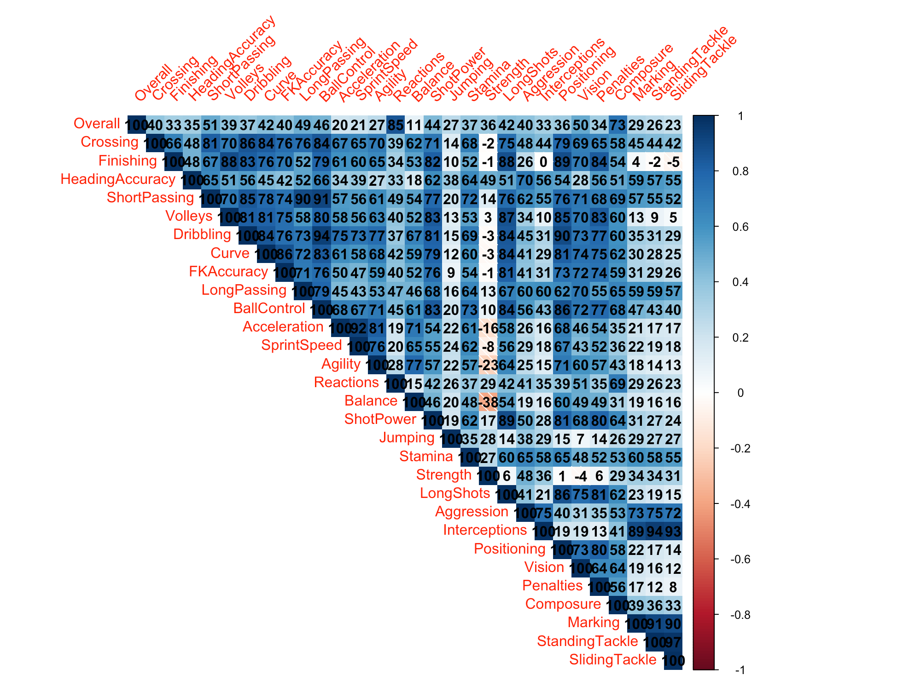

Slide 8
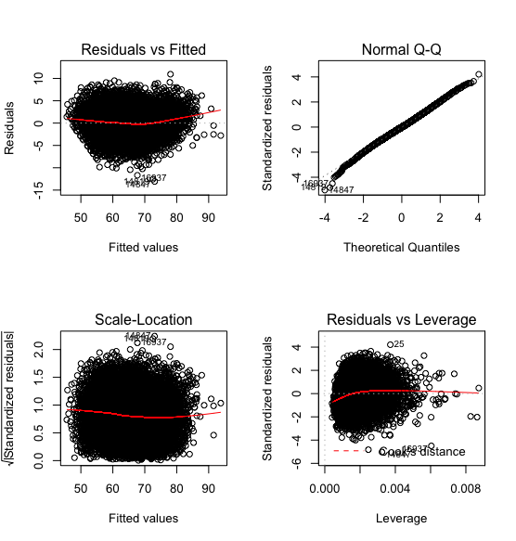
Linearity Assumption
Random fluctuations of the residual values about zero indicates linearity
Based on the QQ plot, the residuals are normally distributed. Data Points closely follow the the straight line at a 45% angle upwards

Slide 9
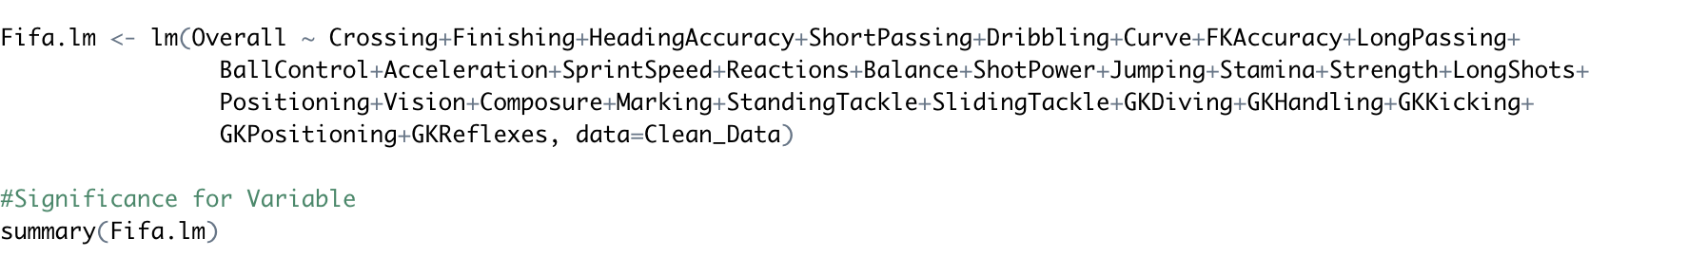
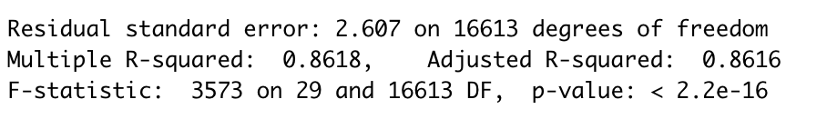
MULTIPLE LINEAR REGRESSION
RESPONSE VARIABLE – Overall ( Numeric Value between 47 to 94)
NUMBER OF VARIABLES USED FOR PREDICTION: 28
RMSE : 2.563

Slide 10
CONCLUSION
The Multiple Linear Regression Model predicts the Response Variable “Overall” with an accuracy of 86% with a root mean square error of 2.5
It is also seen that the major predictors are biased towards the attacking abilities of a player and not so much on the defensive abilities
A Forward player tends to have a higher rating than a Defender in General

Slide 11
K- MEANS CLUSTERING
The idea here is to cluster players based on similar skill set or attributes and playing position in the field
In order to simplify this exercise , it was required to group multiple 27 different playing position in the field to 4 groups
Goalkeeper
Defenders
Midfielders
Forwards

Slide 13
STEPS
Filtered out the Goalkeeper position and removed any players without a position listed
Only Numeric Player attributes were selected for this exercise - Player value, wages and overall rating have been omitted from the data so that these variables don’t sway our groupings, allowing for the clusters to contain like-for-like players based off their skillsets
Set the Number of Clusters as 8 based on trial and error method
Assign the cluster group back to the main data

Slide 14
CLUSTER TABLE
CLUSTER | DEFENDER | FORWARD | MIDFEILDER
1 | 1489 | 0 | 20
2 | 8 | 460 | 1336
3 | 1186 | 4 | 319
4 | 0 | 1433 | 116
5 | 1105 | 59 | 1480
6 | 1184 | 13 | 657
7 | 461 | 34 | 1186
8 | 5 | 1031 | 1147

Slide 15
CLUSTER TABLE
CLUSTER | DEFENDER | FORWARD | MIDFEILDER
1 | 1489 | 0 | 20
2 | 8 | 460 | 1336
3 | 1186 | 4 | 319
4 | 0 | 1433 | 116
5 | 1105 | 59 | 1480
6 | 1184 | 13 | 657
7 | 461 | 34 | 1186
8 | 5 | 1031 | 1147
Cluster 1 and 3 is primarily for Defenders

Slide 16
CLUSTER TABLE
CLUSTER | DEFENDER | FORWARD | MIDFEILDER
1 | 1489 | 0 | 20
2 | 8 | 460 | 1336
3 | 1186 | 4 | 319
4 | 0 | 1433 | 116
5 | 1105 | 59 | 1480
6 | 1184 | 13 | 657
7 | 461 | 34 | 1186
8 | 5 | 1031 | 1147
Cluster 2 and 7 is
for Midfielders
Cluster 5 and 6 is for defensive midfielders

Slide 17
CLUSTER TABLE
CLUSTER | DEFENDER | FORWARD | MIDFEILDER
1 | 1489 | 0 | 20
2 | 8 | 460 | 1336
3 | 1186 | 4 | 319
4 | 0 | 1433 | 116
5 | 1105 | 59 | 1480
6 | 1184 | 13 | 657
7 | 461 | 34 | 1186
8 | 5 | 1031 | 1147
Cluster 4 is
for Forwards
Cluster 8 is for attacking forwards

Slide 18
CONCLUSION /APLLICATION
The next step is to build a dashboard based on the cluster group with player details added
This will allow the Manager of the Club to search for like minded players for replacement in
the same field position

