Slide 1
Adult census Income prediction

Slide 2
Objective: Development of a predictive model for Adult people income to fine the who earn more or less than 50Kby this census data we can say that who is more stable in life
Benefits:
Detection of salary of the people .
Give idea about how you earn more salary.
Helps to understand that what they need to do.

Slide 3
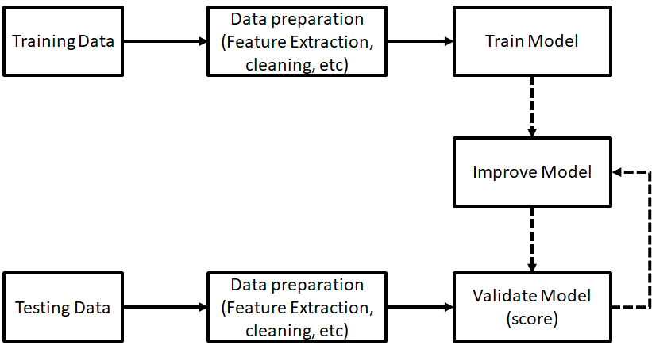
Architecture
This Photo by Unknown Author is licensed under CC BY-SA

Slide 4
Data Insertion
For data ingestion we need to make an file in raw file .
Store all the data in raw file after some cleaning
After that we need to create two more file that is train and test
Train file contain 70% of and test file contain only 30% of data
Data Tranform
In data trainform we need to some basic thing
We need to create pipeline and segregate the prediction columns
Also we need to make train and test columns in array

Slide 5
Model Training:
Data Preprocessing
Performing EDA to get insight of data like identifying distribution , outliers ,trend
among data etc.
Check for null values in the columns. If present impute the null values.
Encode the categorical values with numeric values.
Perform Standard Scalar to scale down the values

Slide 6
Model Selection –
We find the best model for each cluster. By using 2 algorithms “SVM” , “logistic regression”, Decision Tree’ KNN and 'Random Forest’. By this model we create the model after creating model we get accuracy score by that score we choose the best model which is best for our data.

Slide 7
Prediction:
The testing files are shared in the batches and we perform the same Validation operations ,data transformation and data insertion on them.
The accumulated data for prediction
We perform data pre-processing techniques on it.
SVM model created during training is preprocessed data is predicted
Based on SVM we get best model prediction because accuracy of the is good

Slide 8
How logs are managed?
We are using different logs as per the steps that we follow in validation and
modeling like File validation log , Data Insertion ,Model Training log , prediction log
etc.
What techniques were you using for data pre-processing?
Removing unwanted attributes
Visualizing relation of independent variables with each other and output variables
Checking and changing Distribution of continuous values
Removing outliers
Cleaning data and imputing if null values are present.
Converting categorical data into numeric values.
Scaling the data

Slide 9
How training was done or what models were used?
Before diving the data in training and validation set we performed clustering over fit to divide the data into clusters.
As per cluster the training and validation data were divided.
The scaling was performed over training and validation data
Algorithms like SVM , logistic regression were used based on the recall final model we saved that model .
How Prediction was done?
The testing files are shared by the client .We Perform the same life cycle till the data is clustered .Then on the basis of cluster number model is loaded and perform prediction. In the end we get the accumulated data of predictions.

