Slide 1
DeviceNet & ControlNet Mrs. Meera Ajit Khandekar Department of Instrumentation & Control College of Engineering, Pune

Slide 2
DeviceNet is widely used in various applications, like electrical energy distribution plants, the food and beverage industry, chemical plants, oil and gas production and distribution systems.
The DeviceNet refers to an application protocol that uses the controller area network protocol to access the physical medium

Slide 3
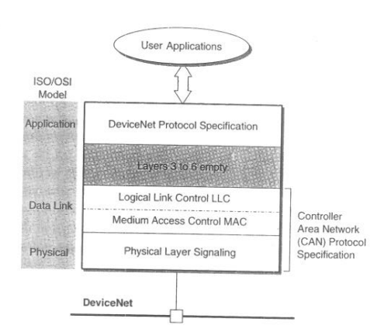
DeviceNet communication profile

Slide 4
Devicenet Physical Layer: Uses the CAN physical layer signaling. One of the advantage is great availability of chips implementing the CAN protocol from many suppliers. Maximum 64 nodes can be connected to the network. DeviceNet offers the possibility of powering the sensors directly from the network. Trunk cable comprises two twisted pairs, one is used for the data transfer, the other for the power distribution.

Slide 5
Three different data transfer speed are selectable: 125, 250 and 500kbits/s. The corresponding maximum distance coverable by the trunk line are respectively 500, 250 and 100m

Slide 6
DeviceNet data link layer: Devicenet data link layer uses the can medium access control (mac) and logical link control sublayer. To access physical medium Carrier Sense Multiple Access with Collision Detection(CSMA/CD) technique is used. Figure shows data frame transmitted on the network has an arbitration field composed of an 11-bit identifier field plus another bit called remote transmission request(RTR)

Slide 7
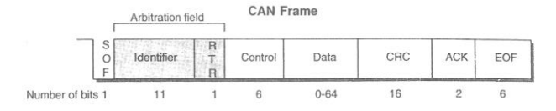

Slide 8
DeviceNet Application Layer: The protocol assigns to each station connected to the network an address is called media access control identifier(MAC ID) 11-bit CAN identifier field contains the information necessary to classify the frames: in particular, it includes a message ID and the MAC ID which, depending on the message group, can be either the source or destination MAC ID

Slide 9
The 64-bit CAN data field is used to transmit the information related to the connection between devices. With the predefined master/slave connection set the data exchange may take place using one of four different methods. The bit strobe command/response messages, intended for the exchange of small amounts of data The poll command is an I/O message, containing any amount of data sent by the master to a single slave.

Slide 10
The poll command is an I/O message, containing any amount of data sent by the master to a single slave. The latter with the poll response I/O message, may also return data. The change od state/cyclic are I/O messages that can be transmitted either by the master or by a slave. They are normally triggered by specific events such as an alarm or the expiring of a timer. The explicit response/requests are general purpose message used, to transfer the values of some attributes.

Slide 11
ControlNet ControlNet is based on a producer/consumer model, exhibit good efficiency and provides deterministic response times. ControlNet is used in complex batch control systems, the process industry and the automotive industry.

Slide 12
Physical Layer: Physical layer is split into two sublayers; the physical medium attachment (PMA) and the physical layer signaling(PLS) . The PMA is responsible for the transmission/reception of signals to/from the bus and comprises all the necessary circuitry that is not part of the ControlNet stations. The PLS implements the bit representation and timing functions required for the correct transmission of the signals on the network. The PLS realizes the interface to the data link layer.

Slide 13
The controlnet standard basically recommends two types of physical media: coaxial cable and fiber optics. A third media type, network access port(nap), allows point-to-point temporary connection between two nodes. A NAP is often used for example, to realize a link between a programming unit and a station already connected to ControlNet. The specified coaxial cable is a RG-6 quad shield, of the same type as that for the cable television industry. Several topologies may be realized with ControlNet e.g. bus, tree,star network Repeaters can be used to link segments. Each station is connected to a segment by means of a tap to which it is linked via a drop cable. The maximum segment length is related to the number of stations connected: 1000m with two stations, decreasing to 250m with 48 stations.

Slide 14
Data Link Layer: Datalink layer is split into two sublayers: medium access control(MAC) and the logical link control(LLC) A fixed period of time, the network update time(NTU) to which all the stations are strictly synchronized, is repeated indefinitely on the network. The NTU is divided into three intervals of time: scheduled, unscheduled and guardband. The scheduled interval is typically reserved for the transmission of real-time data. The MAC grants each station the possibility of transmitting one and only one frame during the scheduled interval. This is accomplished by means of an implicit token-passing procedure.

Slide 15
Token passing: 1) each station is identified by an address called the MAC ID. 2) every station connected to the network maintains an implicit token register that contains the MAC ID of the transmitting station. 3) this value is incremented by one at the end of the frame transmission. 4) Immediately after each station compares its MAC ID with that contained in the implicit token register and, if they match that station has right to transmit. 5) If a station is not present, in the fraction of scheduled interval reserved to that station there will not be activity on the network. 6) in this case, after a time-out the MAC ID is newly incremented by all the stations and the implicit token is passed on. 7) scheduled interval ends when the maximum value for the MAC ID is reached.

Slide 16
Unscheduled interval: in this period the implicit token is still circulated among stations according to a round robin scheme. The duration of such an interval is variable and a station can be granted zero, one, or more times to access the network. Unscheduled interval does not allow for a deterministic access to the network and hence is used for transmission of noncritical data. When the guardband interval is reached, the stations stop transmitting and access to the network is granted to the station with the lowest MAC ID, which is called the moderator. This station transmits a special message with which synchronizes all the stations for the beginning of a new cycle and dispatches a set of parameters necessary for correct network operation.

Slide 17
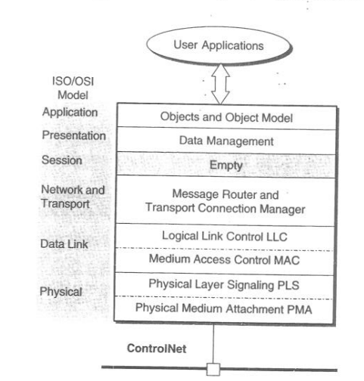

Slide 18
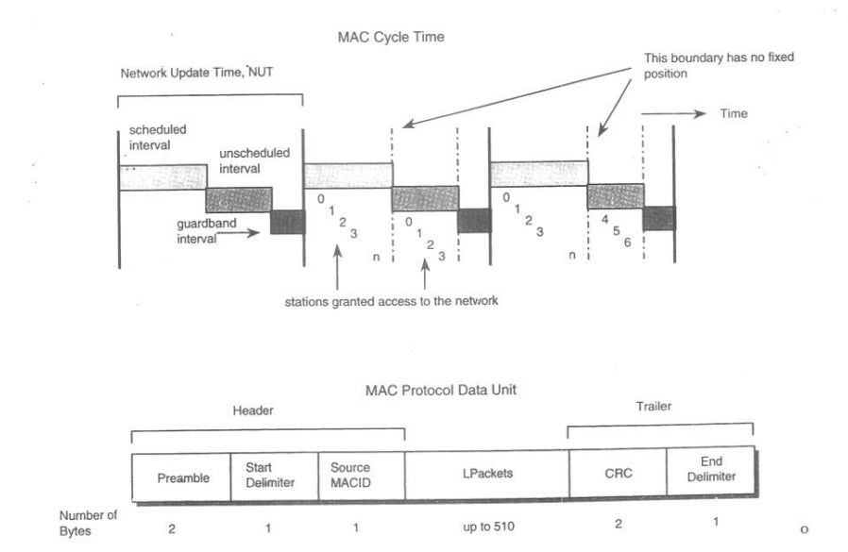

Slide 19
ControlNet Network and Transport layer: The and transport layers contain three basic modules: the unconnected message manager(UCMM), the message router, and the transport connection manager. The UMCC provides a means for the execution of unconnected services; that is, it allows for the data exchange between applications that were not previously put in communication by a connection. In this case, each data transfer is independent from the others and the messages have to carry the full details of the destination and source applications. The UCMM is mainly used for handling noncritical traffic and one of its most important applications is given by the data exchange services necessary to set up connections.

Slide 20
The message router realizes the correct dispatching of services, inside a station, to the addressed applications. The transport connection manager is actually responsible for the handling of connections. It has to make available the services necessary to create and delete connections and to exchange data over an established connections.

Slide 21
Presentation Layer: This layer is concerned with the data management. In particular, it defines a common means for specifying the format of the data handled by the application layer. The presentation layer defines elementary and derived data types. Example of elementary data types handled are Boolean, integer, floating point, character string and bit string.

Slide 22
Application Layer: is based on the object modeling. The definitions of object, class, instance, behavior and services. Objects represents an abstract description of the components of a station. A class is defined as a group of objects representing the same types of components. An instance is the real occurrence of an object and the attributes describe its characteristics. The behavior specifies how an object performs, and service identifies a function supported by an object.

Slide 23
Thank you!!!

