Slide 1
SCADA Mrs. Meera Ajit Khandekar Department of Instrumentation & Control College of Engineering, Pune

Slide 2
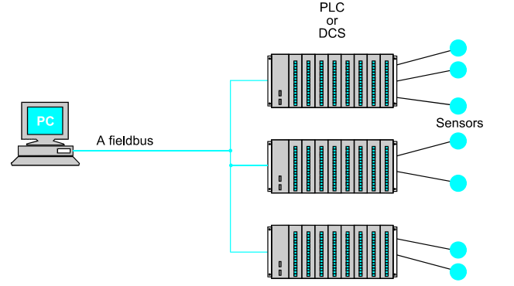

Slide 3
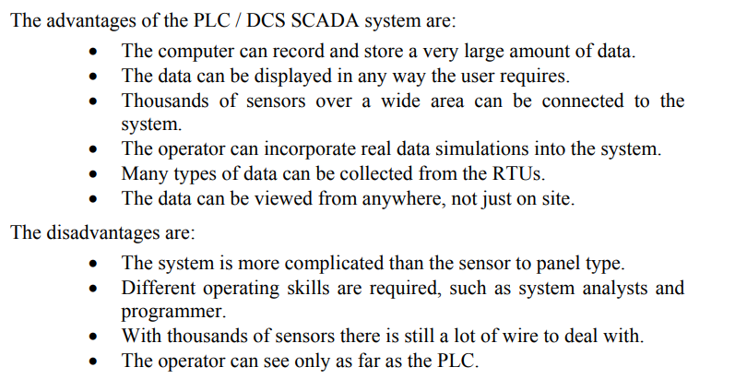

Slide 4
SCADA HARDWARE:
On a more complex SCADA system there are essentially five levels or hierarchies:
• Field level instrumentation and control devices
• Marshalling terminals and RTUs
• Communications system
• The master station(s)
• The commercial data processing department computer system

Slide 5
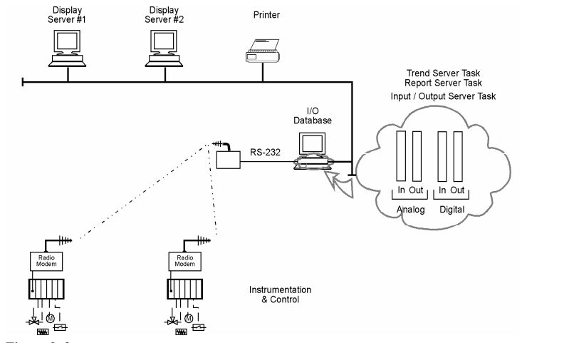
SCADA Software:

Slide 6
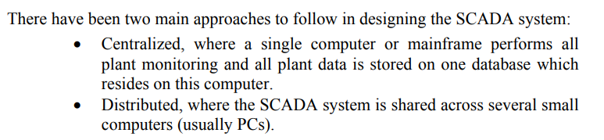

Slide 7
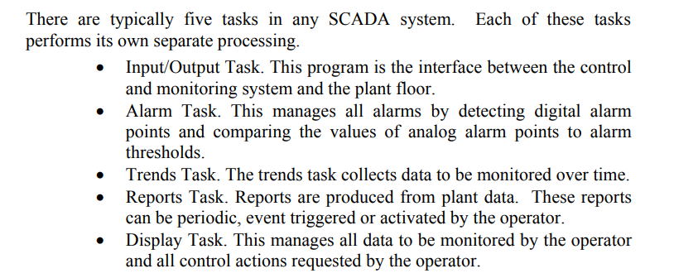

Slide 8
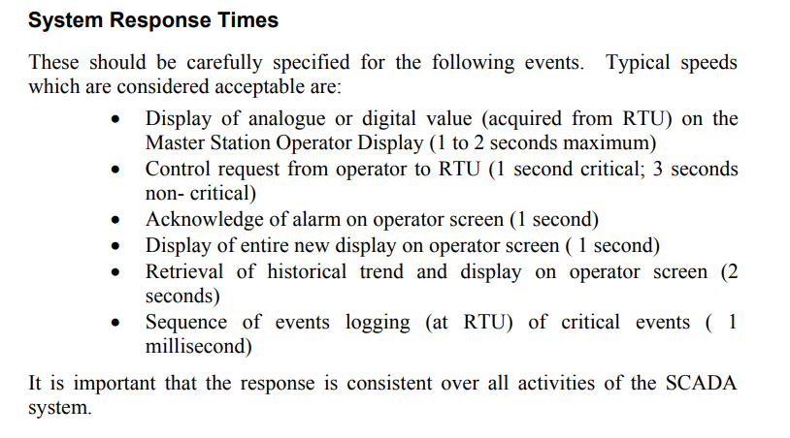

Slide 9
SCADA Key Features: User Interface : • Keyboard • Mouse • Trackball • Touch screen Graphics Displays : • Customer-configurable, object orientated and bit mapped • Unlimited number of pages, • Resolution: up to 1280 x 1024 with millions of colors Alarms: • Client server architecture • Time stamped alarms to 1 millisecond precision (or better) • Single network acknowledgment and control of alarms • Alarms shared to all clients • Alarms displayed in chronological order • Dynamic allocation of alarm pages • User-defined formats and colors

Slide 10
Trends: • Client server architecture • Export data to DBF, CSV files • X/Y plot capability • Event based trends • Trend gridlines or profiles • Background trend graphics • Real-time multi-pen trending RTU (and PLC) Interface: Interface also possible for RTUs, loop controllers, bar code readers and other equipment Driver toolkit available , Operates on a demand basis instead of the conventional predefined scan method • Optimization of block data requests to plcs • Rationalization of network user data requests • Maximization of PLC highway bandwidth

Slide 11
Scalability Additional hardware can be added without replacing or modifying existing equipment. This is limited only by the PLC architecture (typically 300 to 40,000 points) Access to Data • Direct, real-time access to data by any network user • Third-party access to real-time data, e.g. Lotus 123 and EXCEL • network DDE • DDE compatibility: read, write and exec • DDE to all IO device points • Clipboard

Slide 12
Database • ODBC driver support • Direct SQL commands or high level reporting Networking Supports all netbios compatible networks such as netware, LAN manager, windows for workgroups, windows NT (changed from existing NT) • Support protocols netbeui, IPX/SPX, TCP/IP and more • Centralized alarm, trend and report processing - data available from anywhere in the network • dual networks for full LAN redundancy

Slide 13
Fault Tolerance and Redundancy • Dual networks for full LAN redundancy • Redundancy that can be applied to specific hardware • Supports primary and secondary equipment configurations • Intelligent redundancy allows secondary equipment to contribute to processing load • Automatic changeover and recovery Client/Server Distributed Processing • Open architecture design • Real-time multitasking • Client/server fully supported with no user configuration • Distributed project updates (changes reflected across network) • Concurrent support of multiple display nodes • Access any tag from any node • Access any data (trend, alarm, report) from any node

Slide 14
Thank you!!!

