Slide 1
Software Development Process and Process Models

Slide 2
Overview
What? A software process – as a framework for the tasks that are required to build high-quality software.
Who? Managers, software engineers, and customers.
Why? Provides stability, control, and organization to an otherwise chaotic activity.
Steps? A handful of activities are common to all software processes, details vary.
Work product? Programs, documents, and data.

Slide 3
Process Framework
Software Process
Process Framework
Umbrella Activities
Process framework
Umbrella Activities
  Framework activities
  work tasks
    work products
    milestones & deliverables
    QA checkpoints
Framework activity 1
Framework activity n

Slide 4
Process framework
Why process :
A process defines who is doing what, when and how to reach a certain goal.
To build complete software process.
Identify a small number of framework activities that are applicable to all software projects, regardless of their size or complexity.
It encompasses a set of umbrella activities that are applicable across the entire software process.

Slide 5
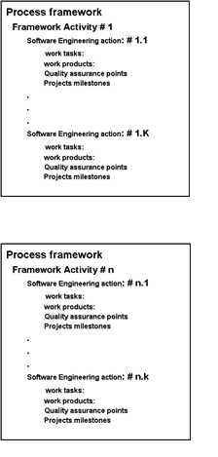
Process Framework
Each framework activity is populated by a set for software engineering actions – a collection of related tasks.
Each action has individual work task.

Slide 6
Generic Process Framework Activities
Communication:
  Heavy communication with customers, stakeholders, team
  Encompasses requirements gathering and related activities
Planning:
  Workflow that is to follow
  Describe technical task, likely risk, resources will require, work products to be produced and a work schedule.
Modeling:
  Help developer and customer to understand requirements (Analysis of requirements) & Design of software
Construction
  Code generation: either manual or automated or both
  Testing – to uncover error in the code.
Deployment:
  Delivery to the customer for evaluation
  Customer provide feedback

Slide 7
The Process Model: Adaptability
The framework activities will always be applied on every project ... BUT
The tasks for each activity will vary based on:
  The type of project (an “entry point” to the model)
  Characteristics of the project
  Common sense, judgement, concurrence of the project team

Slide 8
Umbrella Activities
Software project tracking and control
  Assessing progress against the project plan.
  Take adequate action to maintain schedule.
Formal technical reviews
  Assessing software work products in an effort to uncover and remove errors before goes into next action or activity.
Software quality assurance
  Define and conducts the activities required to ensure software quality.
Software configuration management
  Manages the effects of change.
Document preparation and production
  Help to create work products such as models, documents, logs, form and list.
Reusability management
  Define criteria for work product reuse
  Mechanisms to achieve reusable components.
Measurement
  Define and collects process, project, and product measures
  Assist the team in delivering software that meets customer’s needs.
Risk management
  Assesses risks that may effect that outcome of project or quality of product (i.e. software)

Slide 9
Capability Maturity Model Integration (CMMI)
The Software Engineering Institute (SEI) has developed process meta-model to measure organization’s different level of process capability and maturity.
CMMI – developed by SEI
The CMMI defines each process area in terms of “specific goals” and the “specific practices” required to achieve these goals.
Specific goals establish the characteristics that must exist if the activities implied by a process area are to be effective.
Specific practices refine a goal into a set of process-related activities.

Slide 10
CMMI Level
Level 1 (Initial)
processes are poorly managed or controlled.
unpredictable outcomes of processes involved.
ad hoc and chaotic approach used.
No KPAs (Key Process Areas) defined.
Lowest quality and highest risk.
Level 2 (Managed) –
requirements are managed.
processes are planned and controlled.
projects are managed and implemented according to their documented plans.
This risk involved is lower than Initial level, but still exists.
Quality is better than Initial level.

Slide 11
CMMI Level (cont.)
Level 3 (Defined) –
processes are well characterized and described using standards, proper procedures, and methods, tools, etc.
Medium quality and medium risk involved.
Focus is process standardization.
Level 4 (Quantitatively Managed) -
quantitative objectives for process performance and quality are set.
quantitative objectives are based on customer requirements, organization needs, etc.
process performance measures are analyzed quantitatively.
higher quality of processes is achieved.
lower risk
Level 5 (Optimized) –
continuous improvement in processes and their performance.
improvement has to be both incremental and innovative.
highest quality of processes.
lowest risk in processes and their performance.

Slide 12
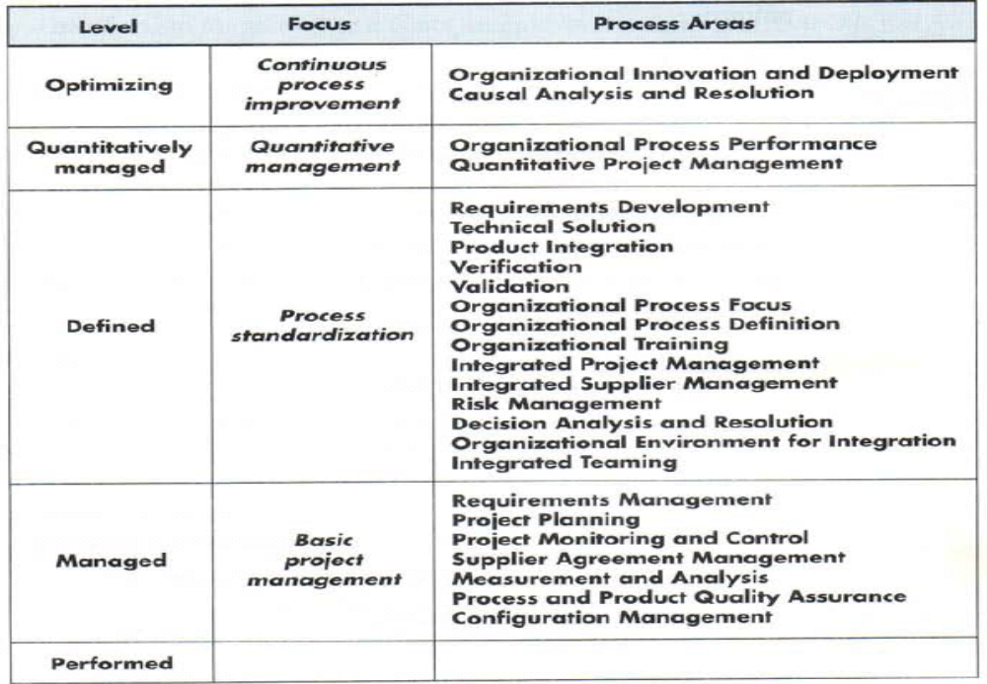

Slide 13
Software Process Models
Build and Fix Model
Why Models are needed?
  Process as a "black box“ & Problem
  Process as a “white box“ & Advantage
Prescriptive Model
Waterfall Model or Linear Sequential
Incremental Process Models
  Incremental Model
  RAD Model
Evolutionary Process Models
  Prototyping
  Spiral Model
  Concurrent Development Model
  Fourth Generation Techniques (4GT)
  Component based development (CBD)

Slide 14
Software process model
Process models prescribe a distinct set of activities, actions, tasks, milestones, and work products required to engineer high quality software.
Process models are not perfect, but provide roadmap for software engineering work.
Software models provide stability, control, and organization to a process that if not managed can easily get out of control
Software process models are adapted to meet the needs of software engineers and managers for a specific project.

Slide 15
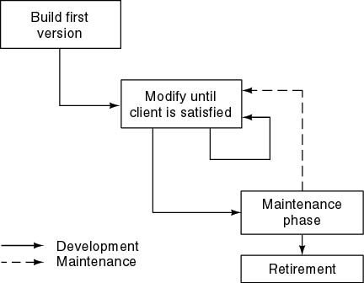
Build and Fix Model

Slide 16
Build and Fix Model
The earlier approach
Product is constructed without specification or any attempt at design.
developers simply build a product that is reworked as many times as necessary to satisfy the client.
model may work for small projects but is totally unsatisfactory for products of any reasonable size.
Maintenance is high.
Source of difficulties and deficiencies
  impossible to predict
  impossible to manage

Slide 17
Why Models are needed?
Symptoms of inadequacy: the software crisis
  scheduled time and cost exceeded
  user expectations not met
  poor quality

Slide 18
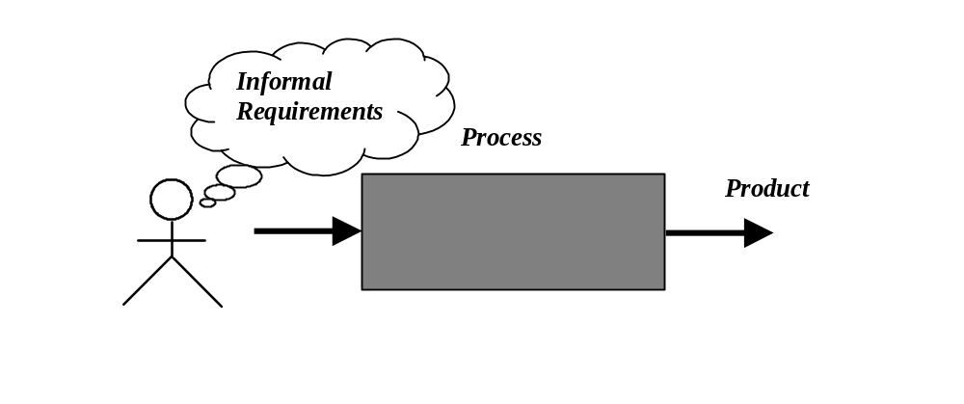
Process as a "black box"
Quality?
Uncertain /
Incomplete requirement
In the beginning

Slide 19
Problems
The assumption is that requirements can be fully understood prior to development
Interaction with the customer occurs only at the beginning (requirements) and end (after delivery)
Unfortunately the assumption almost never holds

Slide 20
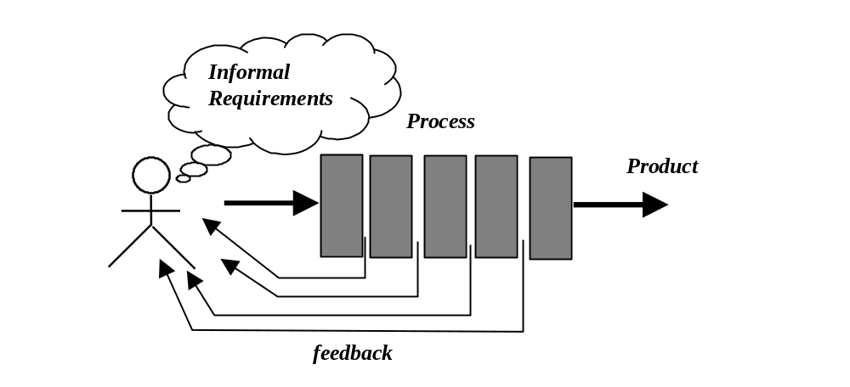
Process as a "white box"

Slide 21
Advantages
Reduce risks by improving visibility
Allow project changes as the project progresses
  based on feedback from the customer

Slide 22
Prescriptive Model
Prescriptive process models advocate an orderly approach to software engineering
  Organize framework activities in a certain order
Process framework activity with set of software engineering actions.
Each action in terms of a task set that identifies the work to be accomplished to meet the goals.
The resultant process model should be adapted to accommodate the nature of the specific project, people doing the work, and the work environment.
Software engineer choose process framework that includes activities like;
  Communication
  Planning
  Modeling
  Construction
  Deployment

Slide 23
Prescriptive Model
Calling this model as “Prescribe” because it recommend a set of process elements, activities, action task, work product & quality.
Each elements are inter related to one another (called workflow).

Slide 24
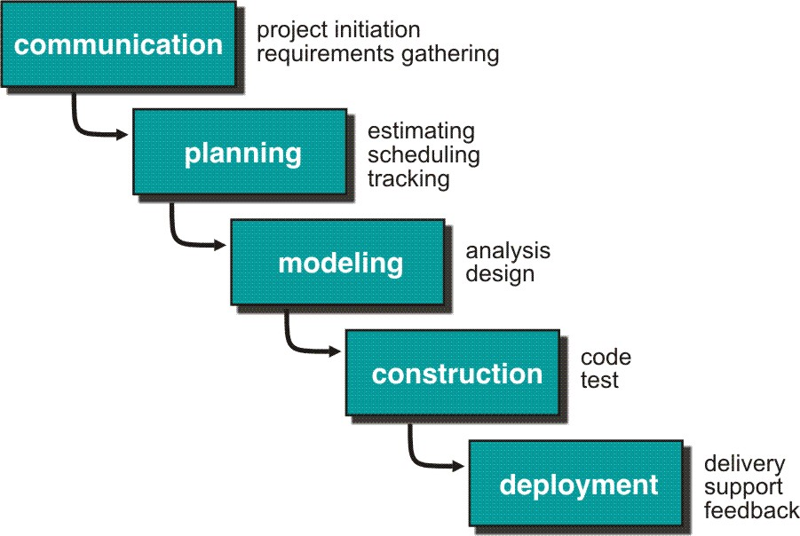
Waterfall Model or Classic Life Cycle

Slide 25
Waterfall Model or Classic Life Cycle
Requirement Analysis and Definition: What - The systems services, constraints and goals are defined by customers with system users.
Scheduling tracking -
  Assessing progress against the project plan.
  Require action to maintain schedule.
System and Software Design: How –It establishes and overall system architecture. Software design involves fundamental system abstractions and their relationships.
Integration and system testing: The individual program unit or programs are integrated and tested as a complete system to ensure that the software requirements have been met. After testing, the software system is delivered to the customer.
Operation and Maintenance: Normally this is the longest phase of the software life cycle. The system is installed and put into practical use. Maintenance involves correcting errors which were not discovered in earlier stages of the life-cycle.

Slide 26
Limitations of the waterfall model
The nature of the requirements will not change very much During development; during evolution
The model implies that you should attempt to complete a given stage before moving on to the next stage
  Does not account for the fact that requirements constantly change.
  It also means that customers can not use anything until the entire system is complete.
The model implies that once the product is finished, everything else is maintenance.
Surprises at the end are very expensive
Some teams sit ideal for other teams to finish
Therefore, this model is only appropriate when the requirements are well-understood and changes will be fairly limited during the design process.
Problems:
Real projects are rarely follow the sequential model.
Difficult for the customer to state all the requirement explicitly.
Assumes patience from customer - working version of program will not available until programs not getting change fully.

Slide 27
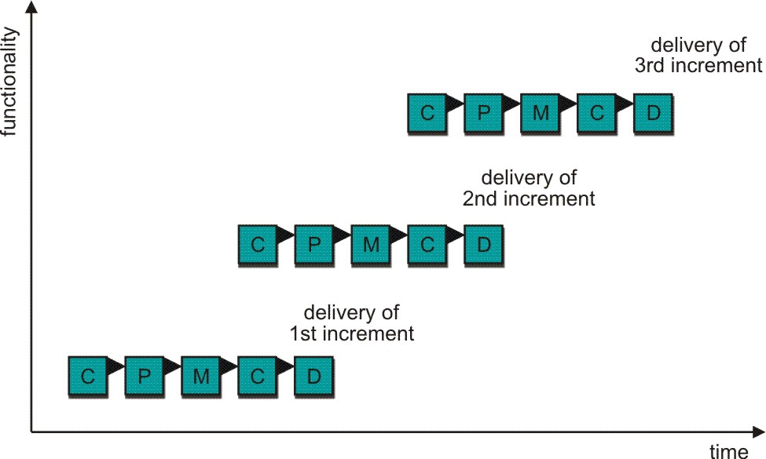
Incremental Process Model
C- Communication
P - Planning
M – Modeling
C - Construction
D - Deployment
Delivers software in small but usable pieces, each piece builds on pieces already delivered

Slide 28
The Incremental Model
Rather than deliver the system as a single delivery, the development and delivery is broken down into increments with each increment delivering part of the required functionality.
First Increment is often core product
  Includes basic requirement
  Many supplementary features (known & unknown) remain undelivered
A plan of next increment is prepared
  Modifications of the first increment
  Additional features of the first increment
It is particularly useful when enough staffing is not available for the whole project
Increment can be planned to manage technical risks.
Incremental model focus more on delivery of operation product with each increment.

Slide 29
The Incremental Model
User requirements are prioritised and the highest priority requirements are included in early increments.
Once the development of an increment is started, the requirements are frozen though requirements for later increments can continue to evolve.
Customer value can be delivered with each increment so system functionality is available earlier.
Early increments act as a prototype to help elicit requirements for later increments.
Lower risk of overall project failure.
The highest priority system services tend to receive the most testing.

Slide 30
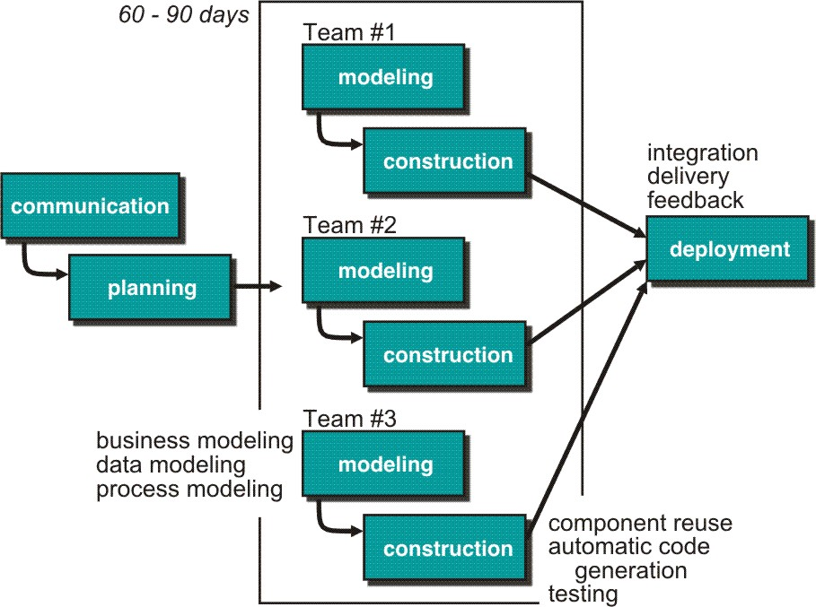
Rapid Application Development (RAD) Model
Makes heavy use of reusable software components with an extremely short development cycle

Slide 31
RAD model
Communication – to understand business problem.
Planning – multiple s/w teams work in parallel on diff. system.
Modeling –
  Business modeling – Information flow among business is working.
  Ex. What kind of information drives?
  Who is going to generate information?
  From where information comes and goes?
  Data modeling – Information refine into set of data objects that are needed to support business.
  Process modeling – Data object transforms to information flow necessary to implement business.

Slide 32
Construction – it highlighs the use of pre-existing software component.
Deployment – Deliver to customer basis for subsequent iteration.
RAD model emphasize a short development cycle.
“High speed” edition of linear sequential model.
If requirement are well understood and project scope is constrained then it enables development team to create “ fully functional system” within a very short time period.

Slide 33
RAD Model
If application is modularized (“Scalable Scope”), each major function to be completed in less than three months.
Each major function can be addressed by a separate team and then integrated to form a whole.
Drawback:
For large but scalable projects
  RAD requires sufficient human resources
Projects fail if developers and customers are not committed in a much shortened time-frame
Problematic if system can not be modularized
Not appropriate when technical risks are high ( heavy use of new technology)

Slide 34
Evolutionary Process Model
Produce an increasingly more complete version of the software with each iteration.
Evolutionary Models are iterative.
Evolutionary models are:
  Prototyping
  Spiral Model
  Concurrent Development Model
  Fourth Generation Techniques (4GT)

Slide 35
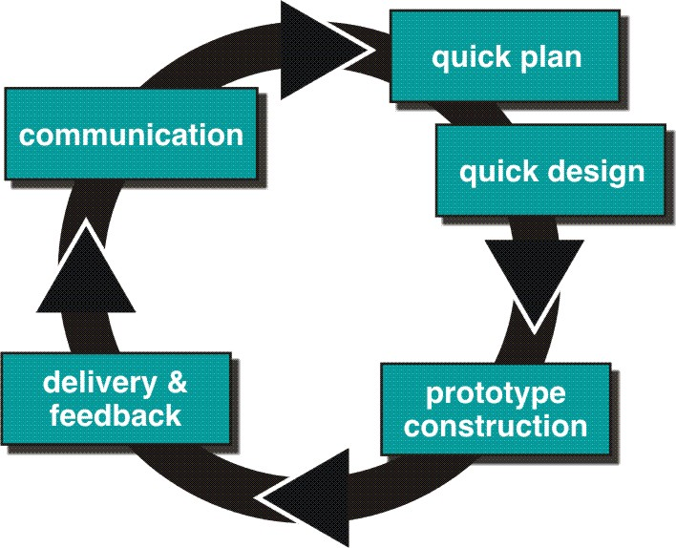
Evolutionary Process Models : Prototyping

Slide 36
Prototyping cohesive
Best approach when:
  Objectives defines by customer are general but does not have details like input, processing, or output requirement.
  Developer may be unsure of the efficiency of an algorithm, O.S., or the form that human machine interaction should take.
It can be used as standalone process model.
Model assist software engineer and customer to better understand what is to be built when requirement are fuzzy.
Prototyping start with communication, between a customer and software engineer to define overall objective, identify requirements and make a boundary.
Going ahead, planned quickly and modeling (software layout visible to the customers/end-user) occurs.
Quick design leads to prototype construction.
Prototype is deployed and evaluated by the customer/user.
Feedback from customer/end user will refine requirement and that is how iteration occurs during prototype to satisfy the needs of the customer.

Slide 37
Prototyping (cont..)
Prototype can serve as “the first system”.
Both customers and developers like the prototyping paradigm.
  Customer/End user gets a feel for the actual system
  Developer get to build something immediately.
Problem Areas:
Customer cries foul and demand that “a few fixes” be applied to make the prototype a working product, due to that software quality suffers as a result.
Developer often makes implementation in order to get a prototype working quickly without considering other factors in mind like OS, Programming language, etc.
Customer and developer both must be agree that the prototype is built to serve as a mechanism for defining requirement.

Slide 38
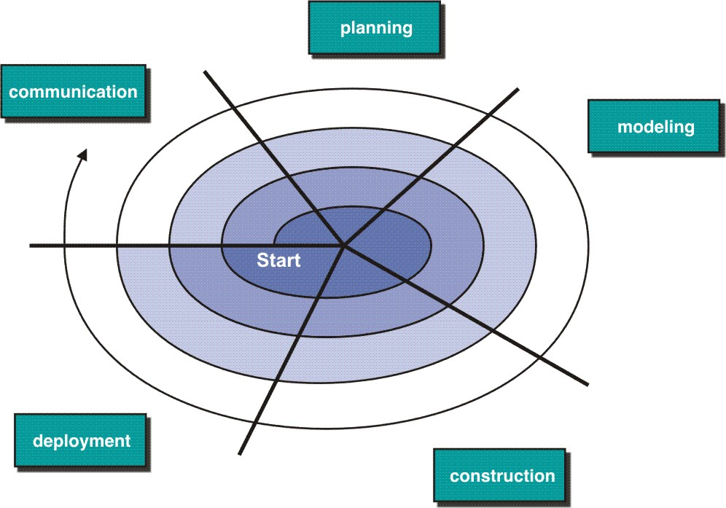
Evolutionary Model: Spiral Model

Slide 39
Spiral Model
Couples iterative nature of prototyping with the controlled and systematic aspects of the linear sequential model
It provides potential for rapid development of increasingly more complete version of the software.
Using spiral, software is developed in as series of evolutionary release.
  Early iteration, release might be on paper or prototype.
  Later iteration, more complete version of software.
Divided into framework activities (C,P,M,C,D). Each activity represent one segment.
Evolutionary process begins in a clockwise direction, beginning at the center risk.
First circuit around the spiral might result in development of a product specification. Subsequently, develop a prototype and then progressively more sophisticated version of software.
Unlike other process models that end when software is delivered it can be adapted to apply throughout the life of software.

Slide 40
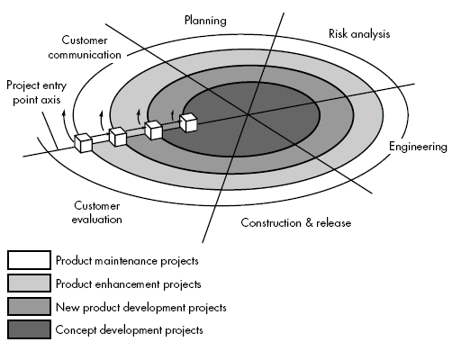
Spiral Model

Slide 41
Spiral Model (cont.)
Concept Development Project:
Start at the core and continues for multiple iterations until it is complete.
If concept is developed into an actual product, the process proceeds outward on the spiral.
New Product Development Project:
New product will evolve through a number of iterations around the spiral.
Later, a circuit around spiral might be used to represent a “Product Enhancement Project”
Product Enhancement Project:
There are times when process is dormant or software team not developing new things but change is initiated, process start at appropriate entry point.

Slide 42
Spiral models uses prototyping as a risk reduction mechanism but, more important, enables the developer to apply the prototyping approach at each stage in the evolution of the product.
It maintains the systematic stepwise approach suggested by the classic life cycle but also incorporates it into an iterative framework activity.
If risks cannot be resolved, project is immediately terminated
Problem Area:
It may be difficult to convince customers (particularly in contract situations) that the evolutionary approach is controllable.
If a major risk is not uncovered and managed, problems will undoubtedly occur.

Slide 43
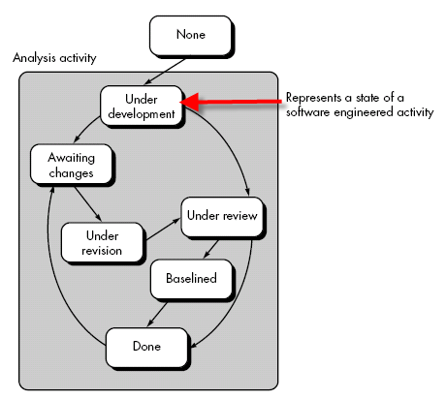
Concurrent Development Model

Slide 44
Concurrent Development Model
It is represented schematically as series of major technical activities, tasks, and their associated states.
It is often more appropriate for system engineering projects where different engineering teams are involved.
The activity-modeling may be in any one of the states for a given time.
All activities exist concurrently but reside in different states.
E.g.
The analysis activity (existed in the none state while initial customer communication was completed) now makes a transition into the under development state.
Analysis activity moves from the under development state into the awaiting changes state only if customer indicates changes in requirements.
Series of event will trigger transition from state to state.
E.g. During initial stage there was inconsistency in design which was uncovered. This will triggers the analysis action from the Done state into Awaiting Changes state.

Slide 45
Concurrent Development (Cont.)
Visibility of current state of project
It define network of activities
Each activities, actions and tasks on the network exists simultaneously with other activities ,actions and tasks.
Events generated at one point in the process network trigger transitions among the states.

Slide 46
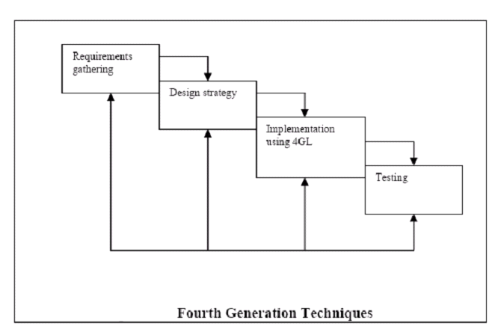
Fourth Generation Techniques(4GT)

Slide 47
4GT
Like all other models, 4GT begins with a requirements gathering phase.
Ideally, the customer would describe the requirements, which are directly translated into an operational prototype.
Practically, however, the client may be unsure of the requirements, may be ambiguous in his specs or may be unable to specify information in a manner that a 4GT tool can use.
For small applications, it may be possible to move directly from the requirements gathering phase to the implementation phase using a nonprocedural fourth generation language.
However for larger projects a design strategy is necessary. Otherwise, the same difficulties are likely to arise as with conventional approaches.

Slide 48
4GT
To transform a 4GT implementation into a product, the developer must conduct thorough testing, develop meaningful documentation.
In addition, the 4GT developed software must be built in a manner that enables maintenance to be performed quickly.
Merits:
Dramatic reduction in software development time. (For small and intermediate application)
Improved productivity for software developers.
Demerits:
Not much easier to use as compared to programming languages
The maintainability of large software systems built using 4GT is open to question.

Slide 49
4GT
4GT Software tool is used to generate the source code for a software system from a high level specification representation
Commonly used 4GT in development models are mentioned below:
  Report Generation
  Data base query language
  Data Manipulation
  Screen definition and interaction
  Code Generation
  Web engineering Tools
  high-level graphics

Slide 50
Component Based Development
component-based development (CBD) model incorporates many of the characteristics of the spiral model.
It is evolutionary by nature and iterative approach to create software.
CBD model creates applications from prepackaged software components (called classes).

Slide 51
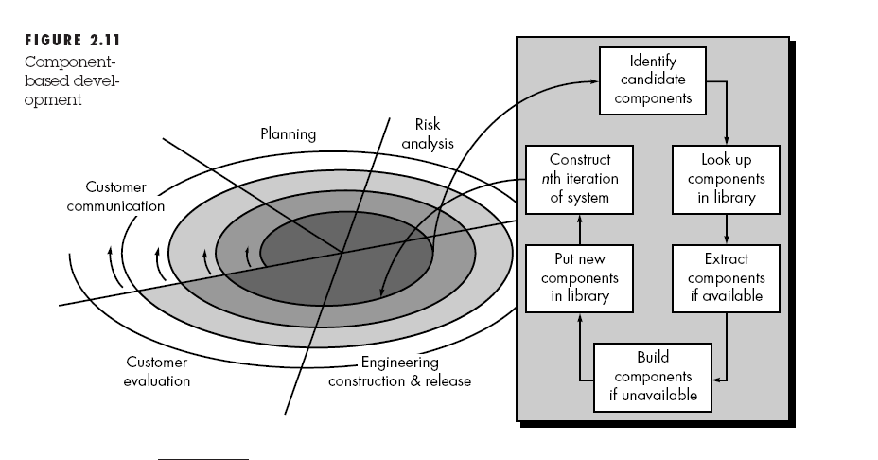
CBD Model

Slide 52
CBD model (cont.)
Modeling and construction activities begin with identification of candidate components.
Classes created in past software engineering projects are stored in a class library or repository.
Once candidate classes are identified, the class library is searched to determine if these classes already exist.
If class is already available in library extract and reuse it.
If class is not available in library, it is engineered or developed using object-oriented methods.
Any new classes built to meet the unique needs of the application.
Now process flow return to the spiral activity.

Slide 53
CBD model (cont.)
CBD model leads to software reusability.
Based on studies, CBD model leads to 70 % reduction in development cycle time.
84% reduction in project cost.
Productivity is very high.

