Slide 1
Number Theory

Slide 2
Two ancient problems
Factoring: Given a number N , express it as a product of its prime factors.
Primality: Given a number N, determine whether it is a prime.
Factoring is hard. Despite centuries of efforts the fastest methods for factoring a number N take time exponential in number of bits of N.
On the other hand, we can efficiently test whether N is prime!

Slide 3
Elementary Number Theory
Prime Numbers
building block of integers
every positive integer can be written uniquely as a product of prime numbers
difficult to write large integers as a product of primes.

Slide 4
Elementary Number Theory
Prime Factorization
Use N = {1, 2, 3, ….}
Use Z = { …., -2, -1, 0, 1, 2, …}
Defn: An integer n is prime if the only divisors are 1 and n.
We call a number composite if it is not a prime.

Slide 5
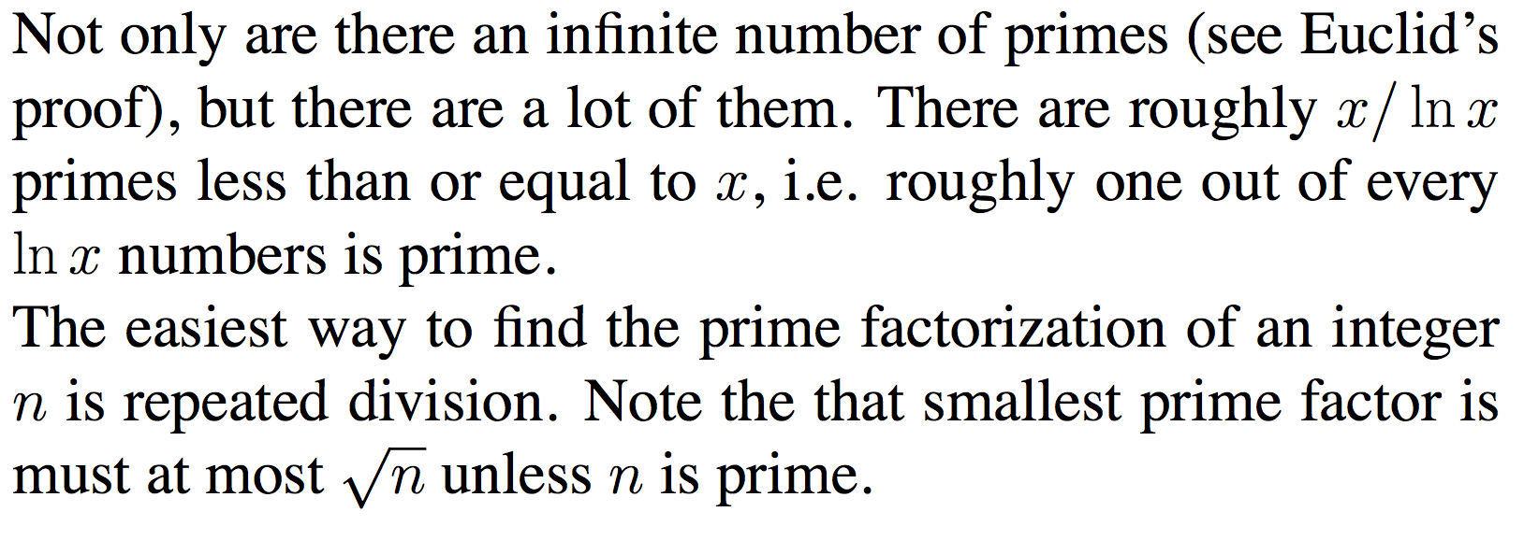
Primality Testing and Factorization

Slide 6
Finding Primes
Use repeated division
start from the smallest possible divisor and then try all divisors up to the square root of the number
once we notice that the number is not even, we try the odd numbers as the candidate divisors.
termination condition : i*i > sqrt(n).

Slide 7
Basic arithmetic
Addition
The sum of any three single-digit numbers is at most two digit long.
The cost of each addition of two integers m and n is O(log m +log n).

Slide 8
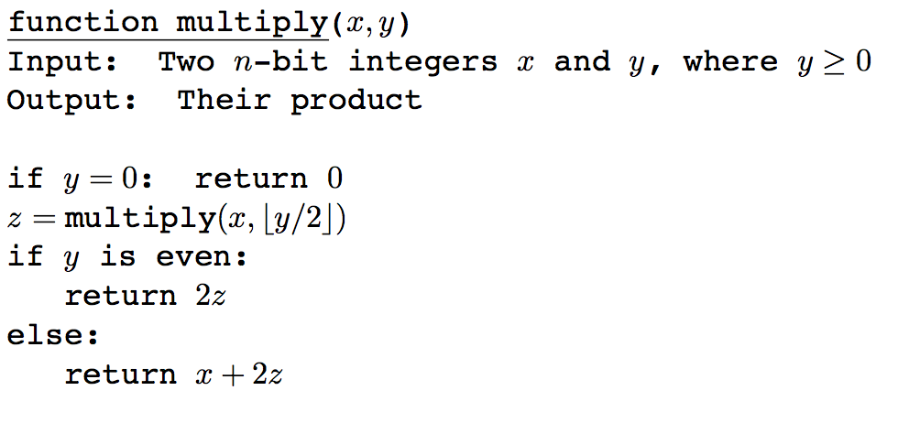
Basic arithmetic
Multiplication and Division
multiplying two integers m and n cost O(log m.log n).
Can do better with divide-and-conquer.

Slide 9
Modular arithmetic
Repeated addition and multiplication can get the result cumbersomely large.
Modular arithmetic is a system for dealing with restricted range of numbers.

Slide 10
Modular Arithmetic
We do arithmetic with the set (rings) of integers {0,1,2, …, N-1} using addition and multiplication where the sum and product of two elements of that set is again in the set.
We define x modulo N to be the remainder when x is divided by N; that is, if x=qN + r with 0 ≤ r < N, x modulo N is equal to r. We write this as x = r mod (N).
x = y (mod N) implies N divides (x-y).
253 mod 60 = 13
253 ≡ 13 (mod 60) ; 250 – 13 is divisible by 60.
15 ×21 mod 4 = 315 mod 4 = 3;
15×21 mod 4 ≡ (15 mod 4)×(21 mod 4) = 3 × 1 = 3

Slide 11
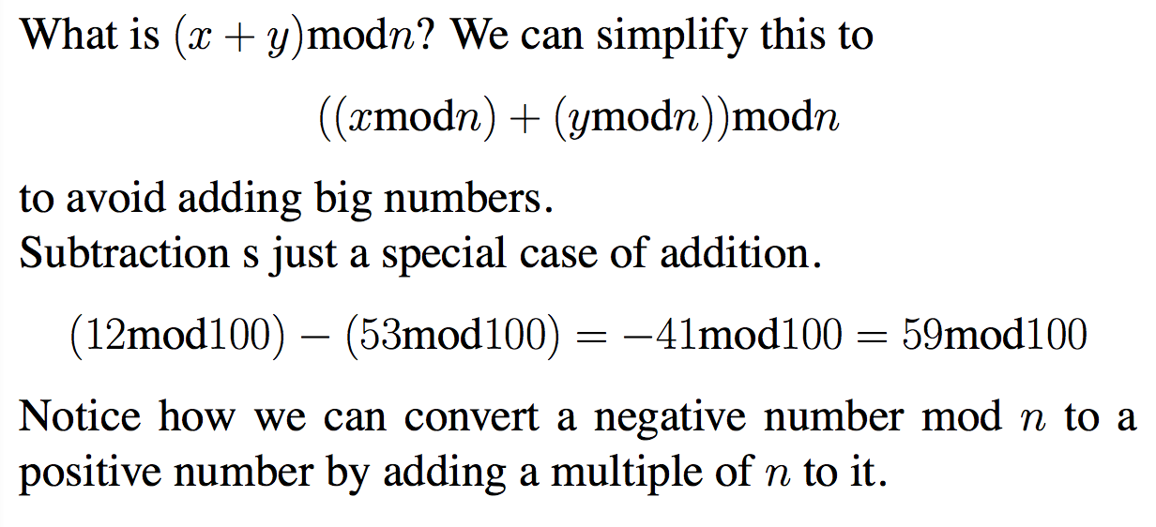
Addition and Subtraction
((x mod n) + (y mod n)) mod n
(12 mod 100) – (53 mod 100) – 41 mod 100 = 59 mod 100
ll

Slide 12
Addition and Subtraction
((x mod n) + (y mod n)) mod n
The last mod n due to the fact that (x mod n)+(y mod n)) could greater than n.
(12 mod 100) – (53 mod 100) – 41 mod 100 = 59 mod 100
ll

Slide 13
Exponentiation
In cryptosystem, it is necessary to compute x^{y} mod N for values of x, y, and N that are several hundred bits long.
Like to evaluate 2 ^{(19*(524288))} mod (N).

Slide 14
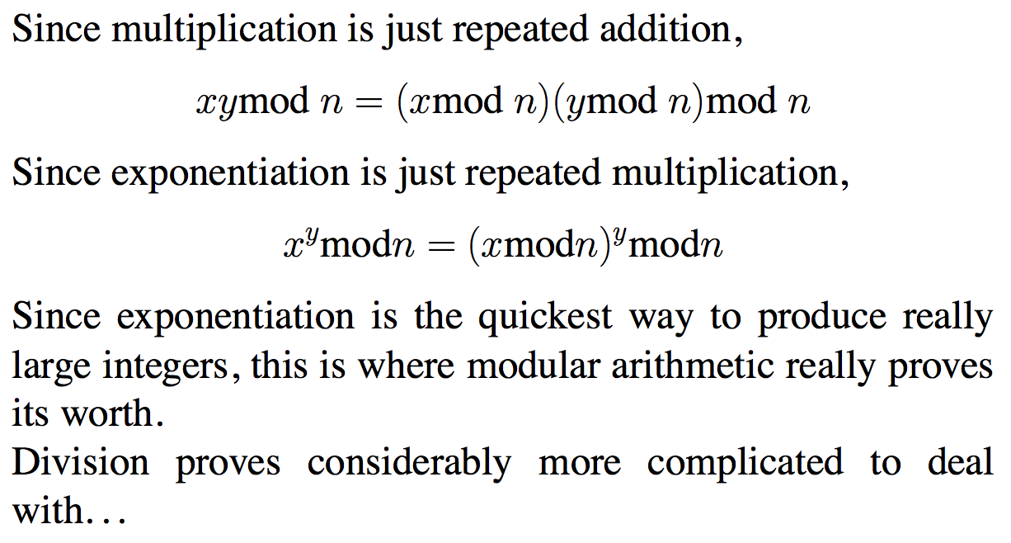
Exponentiation
xy mod n = (x mod n)(y mod n) mod n
x^{y} mod n = (x mod n)^{y} mod n

Slide 15
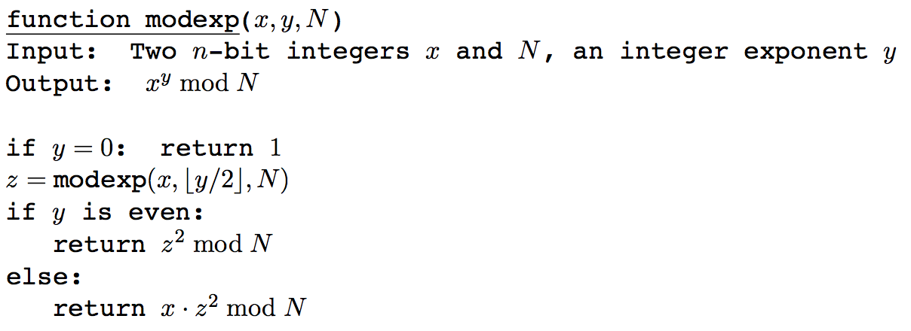
Modular exponentiation

Slide 16
Modular exponentiation
number of bits to represent x^{y} = O(ylog x)
number of bits to represent x^{y} mod N is O(log N).

Slide 17
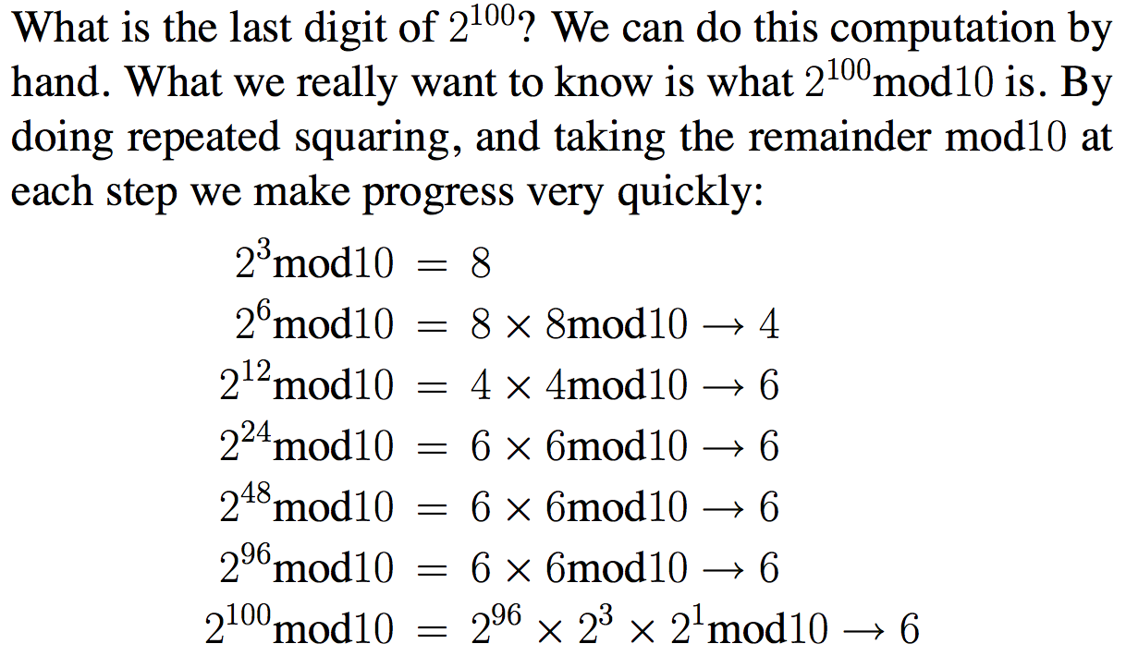
What is the last digit?

Slide 18
Greatest Common Divisor
gcd is the largest divisor shared by a given pair of integers.
If b divides a (i.e. b|a), gcd(a,b) = b
Note b|a implies a= bk.
gcd(bk,b) = b.
If a = bt + r for integers t and r, gcd(a,b) = gcd(b,r).
Lemma: for any integers a and b, we can show that
gcd(a,b)= gcd(b,a) = gcd(+/- a, +/- b) =gcd(a ,a-b) = gcd(a, a+b)

Slide 19
Euclid’s algorithm (discovered 2000 years ago)
gcd(a, b) // assume that a > b
If b=0 then return a.
Compute r = a mod b
return gcd(b, r)
This takes logarithmic time.
after every two iterations, the largest number gets reduced by a half at least.

Slide 20
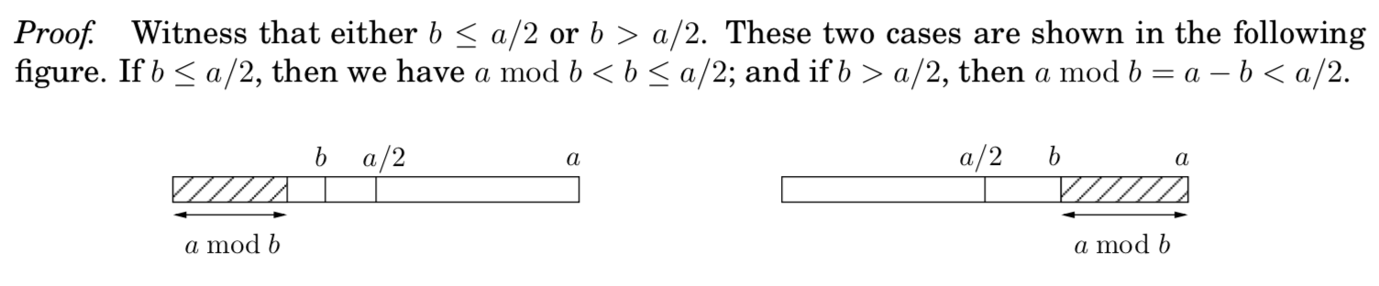
Euclid’s algorithm (discovered 2000 years ago)
gcd(a, b) // assume that a > b
If b=0 then return a.
Compute r = a mod b
return gcd(b, r)
This takes logarithmic time.
after every two iterations, the largest number gets reduced by a half at least.

Slide 21
gcd(252,198)
252 = 1 × 198 + 54
198 = 3 × 54 + 36
54 = 1 × 36 + 18
36 = 2 × 18 + 0

Slide 22
Important Property
Given any two integers a and b, there exist integers x and y, such that ax + by = gcd(a,b).
a = floor(a/b).b + r
We know that gcd(a,b) = gcd(b,r).
Assume that we know integers x’ and y’ such that b.x’ + r. y’ = gcd(b,r) = gcd(a,b)
Substituting r we get b.x’ + (a – b . floor(a/b)).y’ = gcd(a,b)
Rearranging we get ay’ + b.y = gcd(a,b). (x and y are integers)
here x = x’ – b.floor(a/b).y’
gcd(a,b) = xa +by where a and b are integers

Slide 23
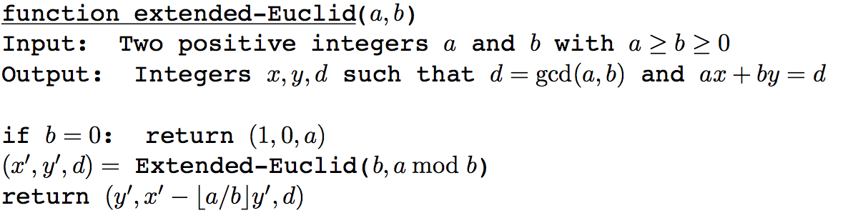
A simple extension of Euclid’s algorithm

Slide 24
gcd(252,198)
252 = 1 × 198 + 54
198 = 3 × 54 + 36
54 = 1 × 36 + 18
36 = 2 × 18 + 0
18 = 54 – 1 × 36
18 = 54 – 1 × (198 – 3 × 54) = 4 × 54 − 1× 198
18 = 4× (252 − 1 × 198) – 1 × 198 = 4 × 252 – 5 × 198
Therefore,
gcd(252,198) = 4 × 252 – 5 × 198

Slide 25
Important Property
if d divides a and b, d divides ax + by for any d. Therefore, ax + by = d. t.
When d = gcd(a,b), t=1.

Slide 26
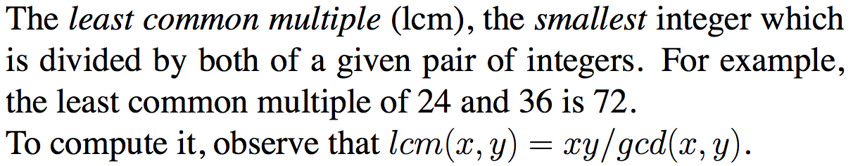
Least Common Multiple (lcm)

Slide 27
Modular division
In real arithmetic, every number a (≠ 0) has an inverse, 1/a.
Multiplying by 1/a is the same as dividing by a.
In modular arithmetic we can make a similar definition:
x is a multiplicative inverse of “a modulo N” iff ax = 1 (mod N).
Theorem: The inverse of a modulo b exists and is unique iff a is relatively prime to m, i.e. gcd(a,b) = 1.
gcd(a,b) = 1 implies ax + by = 1 for some integer x and y
ax = 1 – by implies ax ≡ 1 (mod b).

Slide 28
Modular division
In real arithmetic, every number a (≠ 0) has an inverse, 1/a.
Multiplying by 1/a is the same as dividing by a.
In modular arithmetic we can make a similar definition:
x is a multiplicative inverse of “a modulo N” if ax = 1 (mod N).
There could be at most one such x modulo N.
The inverse x is unique modulo b, since if x′ is also an inverse, then ax ≡ ax′ ≡ 1 implies xax ≡ xax′ ≡ x ≡ x′.

Slide 29
Modular division
However, inverse doesn’t always exist.
There doesn’t exist any x such that 2x = 1 (mod 6).
The necessary and sufficient condition for an x to exist in ax = 1 (mod b) is that gcd(a,b) = 1, i.e. a and b are relatively prime.

Slide 30
Congruences
Congruences are an alternate notation for representing modular arithmetic.
We say that a ≡ b(mod m) if m|(a−b).
By definition, if a mod m is b, then a ≡ b(mod m)
a and b are congruent.

Slide 31
Congruences
It gets us thinking about the set of integers with a same given remainder, and gives us equations for representing them.
What integers x satisfy the congruence x ≡ 3(mod 9)?
The set of solutions is all integers of the form 9y + 3, where y is any integer.

Slide 32
Congruences
What about 2x ≡ 3(mod 9) and 2x ≡ 3(mod 4)?
Trial and error should convince you that exactly the integers of the form 9y + 6 satisfy the first example, while the second has no solutions at all.
We need to find a way to solve them.

Slide 33
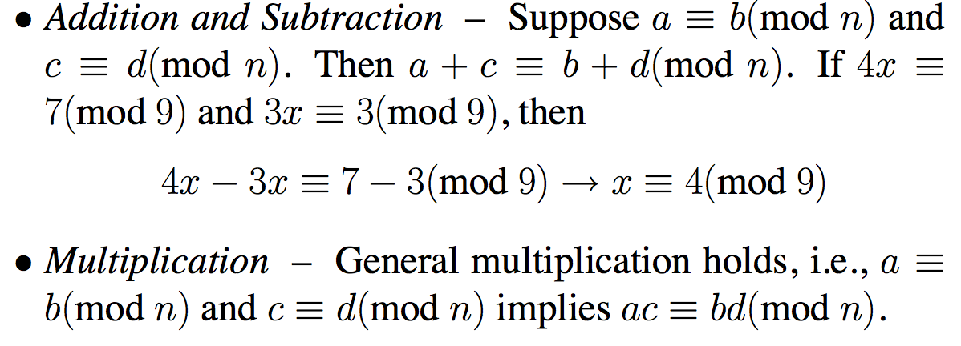
Operations on Congruences
Congruences support addition, subtraction, and multiplica- tion, as well as a limited form of division – provided they share the same modulus:

Slide 34
Operations on Congruences
Division concept is difficult.
We can simplify a congruence ad ≡ bd( mod dn) to a ≡ b(mod n), so we can divide all three terms by a mutually common factor if one exists.
Thus 170 ≡ 30(mod 140) implies that 17 ≡ 3(mod 14).
However, the congruence a ≡ b(mod n) must be false (i.e., has no solution) if gcd(a, n) does not divide b.

Slide 35
Solving Congruences
A linear congruence is an equation of the form ax ≡ b(mod n).
Solving this equation means identifying which values of x satisfy it.
Not all such equations have solutions.
ax ≡ 1(mod n) has a solution if and only if the modulus and the multiplier are relatively prime, i.e., gcd(a,n) = 1.
Euclid’s algorithm to find this inverse through the solution to a·x′ +n·y′ = gcd(a,n) = 1.
x’ is the solution

Slide 36
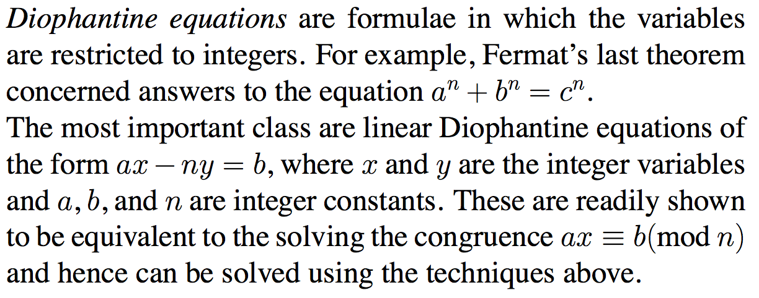
Diphantine Equations

Slide 37
Solve the equation 247x + 91y = 39
We need to find an x and y (integers)
We find that gcd(247,91) = 13.
Since 13 divides 39, we have a solution.
We can write
3 × 247 – 8 × 91 = 13
or 3 × 19 − 8 × 7 = 1
or 3 × 19 – 19 × 7 × t + 19 × 7 × t – 8 × 7 = 1
or 19 ( 3 – 7t) + 7 ( 19t -8) = 1 for any integer t
Therefore, x = 3 -7t and y = 19t – 8. (ans)

Slide 38
Primality Testing
Is your social insurance number prime?
Modern cryptography is about the following important idea: factoring is hard and primality testing is easy.
We cannot factor a large number (500 bits), we can test its primality information.

Slide 39
Fermat’s Little Theorem
If p is prime, then for every 1 ≤ a < p,
a ^{p-1} = 1 (mod p).
A proof can be found in the book Algorithm by Dasgupta, Papadimitriou and Vazirani.

Slide 40
Start by listing the first p-1 positive multiples of p.
a, 2a, 3a, …., (p-1)a
It can be shown that {a mod p, 2a mod p, …, (p-1)a mod p} = {1, 2, …,(p-1)} for prime p and 1 ≤ a < p.
Therefore
a.2a.3a. …. (p-1)a ≡ 1.2.3…..(p-1) mod (p-1)
or better
a^{p-1}(p-1)! ≡ (p-1)! mod (p-1)
or
a^{p-1} ≡ 1 mod (p-1)

Slide 41
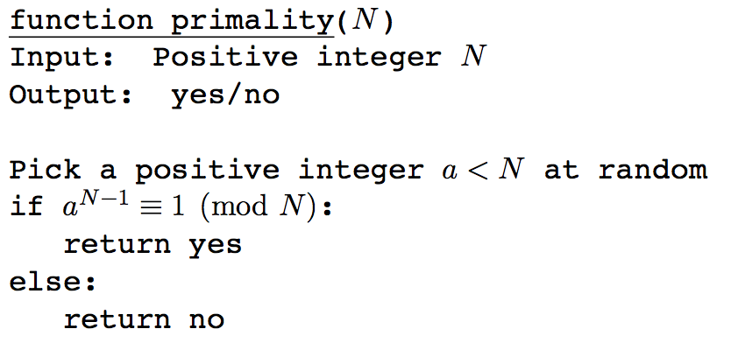
An algorithm for testing primality

Slide 42
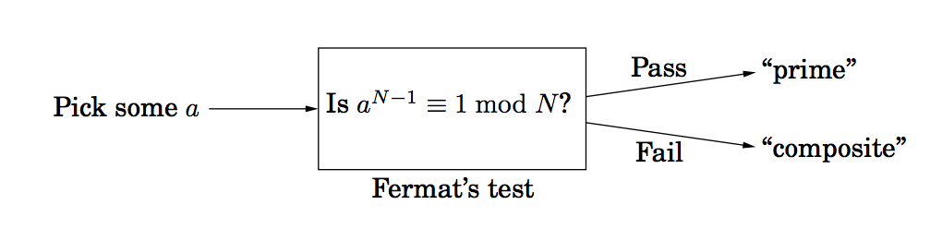
An algorithm for testing primality
Fermat’s Theorem is not an if and only if condition.
The theorem says that if N is a prime number, it will pass the test.
If it doesn’t pass the test, it is not a prime (contrapositive argument)
It is possible that, for a given N, it can pass the test but it is not a prime.

Slide 43
Carmichael number
The smallest such number is 561 = 3 . 11 . 17.
It passes Fermat’s test. Clearly it is not a prime.
There are infinitely such Carmichael numbers.
if we ignore Carmichael numbers, it can be asserted that
Pr(The algorith returns yes when N is prime) =1
Pr(the algorithm returns yes when N is not a prime) ≤ ½.

Slide 44
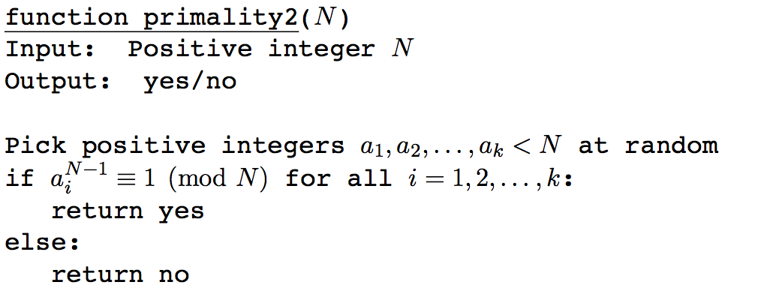
An algorithm for testing primality, with low error probability
Pr(the algorithm returns YES when N is not a prime) ≤ 1/2^{k}.

Slide 45
Generating random primes
For cryptographic applications, we need to generate large primes (like 500-bit number).
Prime numbers are quite abundant.
There are approximately (N/log_{e}N) primes with values no greater than N.
The probability of a randomly generated n-bit number to be prime is (1/(log_{e}2^{n}) (approximately, 1.44/n).

Slide 46
Generating a random n-bit prime
Pick a random n-bit number N.
Run a primality test on N.
If it passes the test, output N; else repeat the process.
Acceptance has probability 1/n.
The expected number of iterations before the program halts is n.

Slide 47
RSA Encryption Algorithm
A classic application of modular arithmetic on large integers.
The message is encrypted by coding it as an integer m, raising it to power k, where k is the so-called public-key or encryption key.
Taking the results mod n.
Since m, n, and k are all huge integers, computing m^{k} mod n efficiently requires tools we are seeing here.

Slide 48
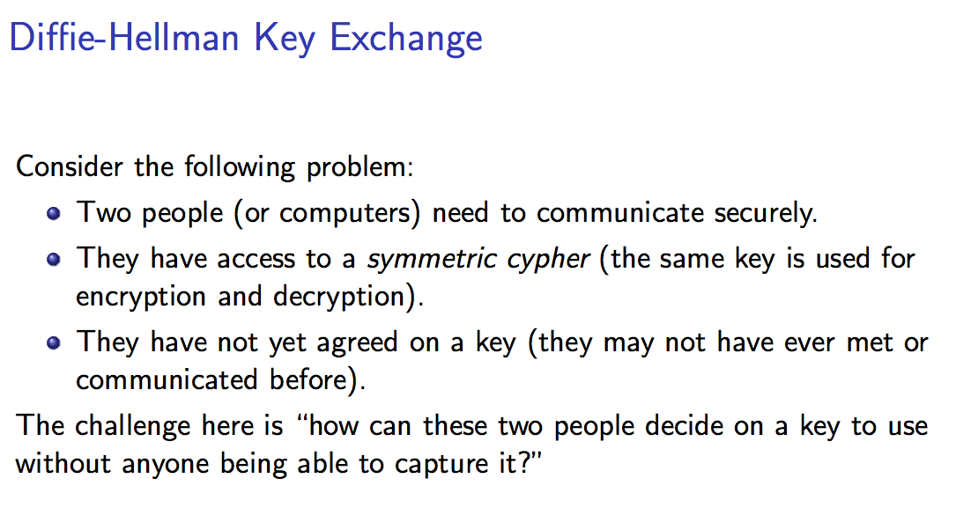

Slide 49
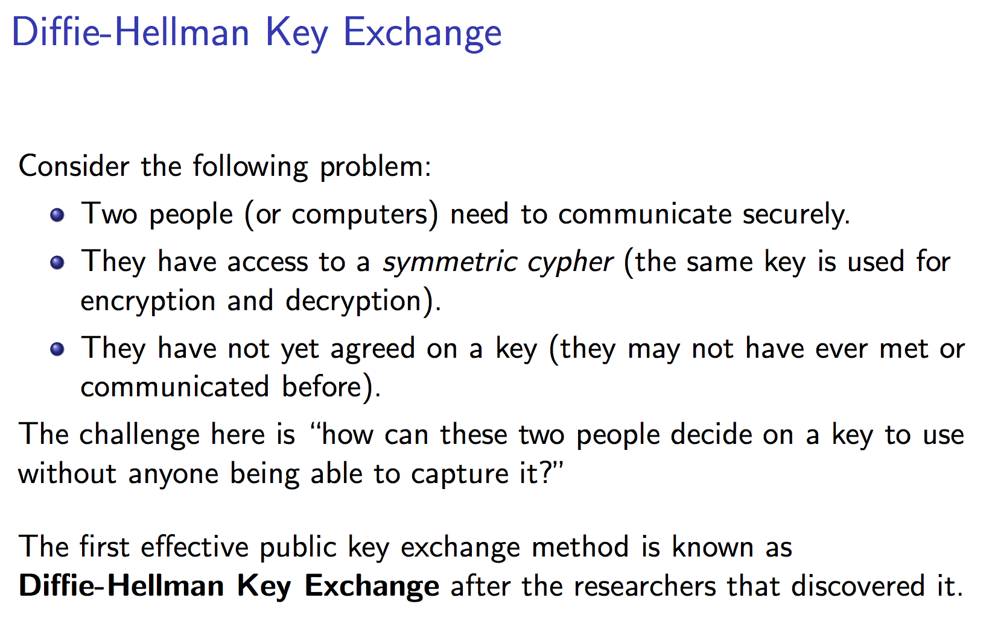

Slide 50
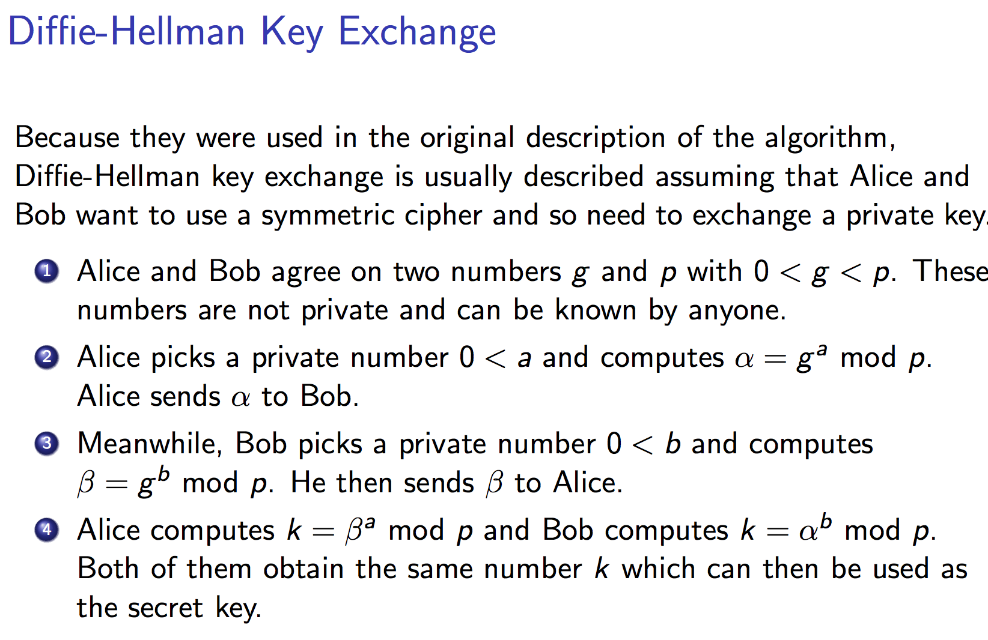

Slide 51
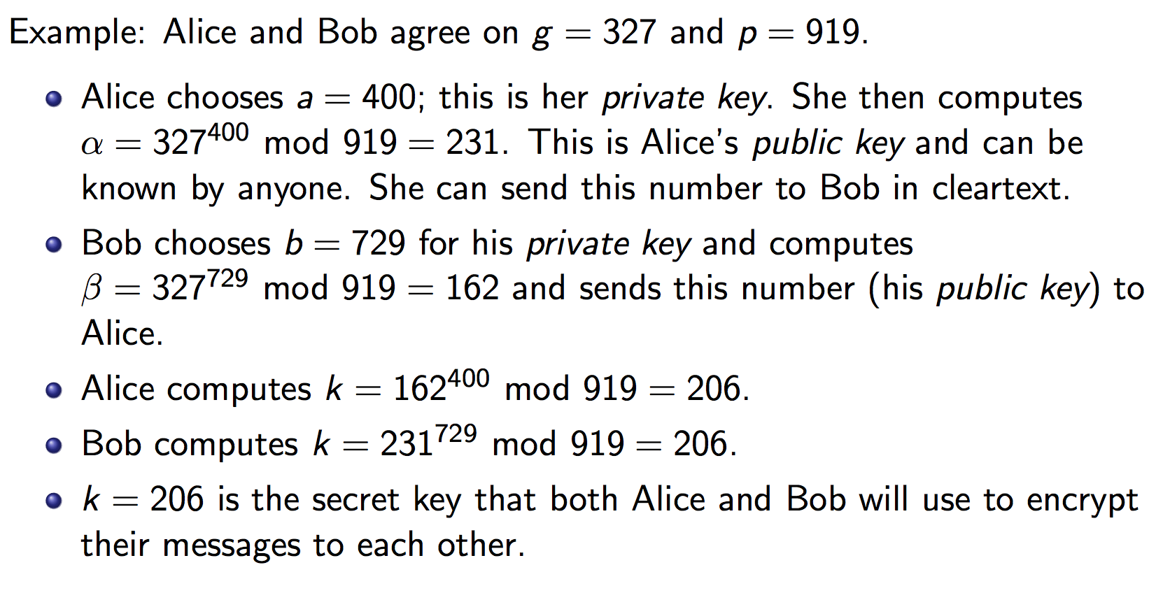

Slide 52
