Slide 1
Auditing AI-Based ESG Scores
How Much Can You Trust a Machine-Generated Sustainability Score?
AI, Power & Responsibility — Governing Intelligent Systems for Sustainability
Deepak [Last Name] · University of Europe for Applied Sciences · June 2026

Slide 2
Why Audit AI-Based ESG Scores?
2
AI systems now produce the ESG scores that govern pension-fund weightings, green-bond eligibility, and lending decisions — yet almost none of the scoring infrastructure is open to inspection.
📊 Score Opacity
🎭 Greenwashing Risk
MSCI, Sustainalytics, Bloomberg, and Refinitiv rank the same firm differently — pairwise Spearman ρ as low as 0.38 across raters.
A firm can insert sustainability buzzwords into its disclosures and move an AI classifier from detected to undetected — no model access needed.
🔒 No Audit Trail
⚖️ Structural Unfairness
Proprietary architectures block independent verification. EU AI Act Arts. 9 & 13 require audit capability the market does not currently provide.
Scoring systems may systematically disadvantage entire sectors regardless of actual sustainability performance.
Source: Berg et al. (2022); EU AI Act (2024); this study.

Slide 3
Data
3
Two public datasets. No proprietary access required. All code reproducible.
Dataset 1 — Public Company ESG Ratings (Sustainalytics / Yahoo Finance via Kaggle) ✅ REAL
503
4
Risk Level
Sector +
S&P 500 firms
ESG risk sub-scores
(Env, Social, Gov, Controversy)
Low / Medium / High / Severe
Headcount included
→ Used for: RQ1 (sub-score agreement) · RQ3 (surrogate audit) · RQ4 (fairness) · RQ5 (distribution shift)
Dataset 2 — S&P 500 ESG Report Sentences (Kaggle) ✅ REAL
~2,600
Train 2,117
Binary
Source
Labelled sentences from
sustainability reports
Validation 265 / Test 265
Genuine vs. Greenwash
Corporate ESG disclosures
→ Used for: RQ2 (adversarial robustness)

Slide 4
Five Research Questions
4
RQ1
Sub-Score Agreement
avg ρ = 0.12
REAL
Do a rater's own ESG sub-scores agree on which firm is better?
RQ2
Adversarial Robustness
F1: 0.72 → 0.53 (↓27%)
REAL
Can adversarial or greenwashing text fool an ESG classifier?
RQ3
Surrogate Audit
88% surrogate accuracy
REAL*
Can a closed model be audited without handing over its weights?
RQ4
Sector Fairness
DI ≈ 0.05 (Energy/Utilities)
REAL
Do scores quietly penalise some sectors or firm sizes?
RQ5
Distribution Shift
F1 = 0 (Fin. Svcs / Real Estate)
REAL
Does a model still work when the kind of firm it sees changes?
* RQ3 surrogate accuracy is real; ZK proof-generation times are literature stubs from Kang et al. (2023) and Liu et al. (2023).

Slide 5
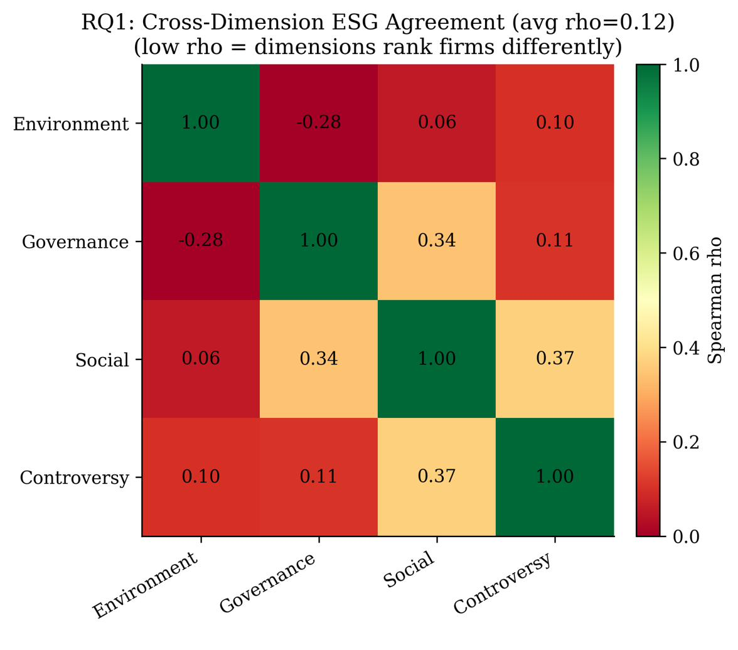
RQ1 — Do a rater's own sub-scores agree on which firm is better?
5
ρ = 0.12
−0.28
0.37
430
Avg. Spearman
across 6 pairs
Env ↔ Governance
(strongest conflict)
Social ↔ Controversy
(strongest link)
S&P 500 firms
analysed
Key Findings
• The four sub-scores are near-orthogonal — a firm can rank well on Environment but poorly on Governance.
• Average ρ = 0.12 is far below what would justify collapsing all four into a single number.
• A composite 'Total ESG Risk' headline score hides real internal disagreement.
• Env–Governance opposition (ρ = −0.28) is the most actionable: firms can game one dimension at the expense of the other.
• Implication: a single ESG score cannot be taken at face value without inspecting its components.
Data: Sustainalytics/Yahoo Finance ESG Ratings, 503 S&P 500 firms. Method: Spearman ρ matrix across Environment, Social, Governance, Controversy sub-scores.

Slide 6
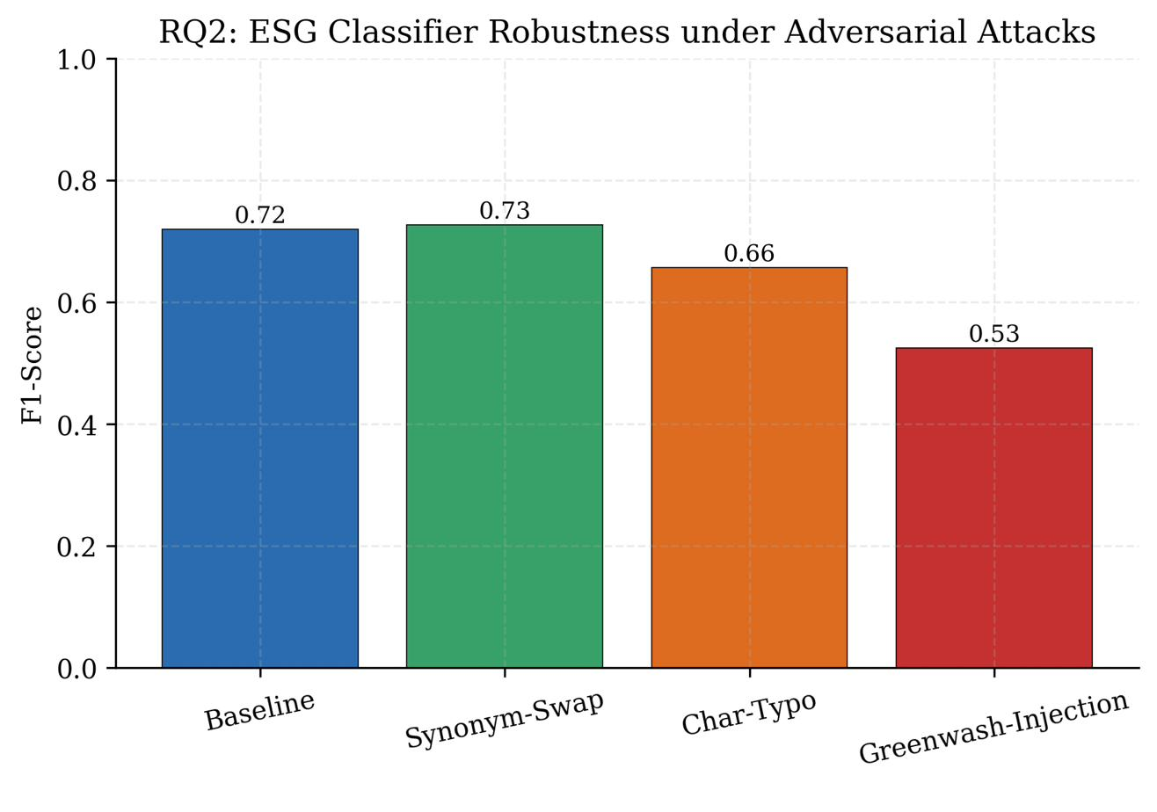
RQ2 — Can greenwashing text fool an ESG classifier?
6
0.72
0.53
↓ 27%
0.73
Baseline F1
(TF-IDF + LR)
After greenwash
injection
F1 drop
(largest attack)
Synonym-swap
(negligible change)
Key Findings
• Greenwash injection (inserting sustainability buzzwords) is the cheapest and most damaging attack — no model access required.
• Synonym-swapping barely changes performance (0.72→0.73), so lexical variation is not the real threat.
• Character-level typo noise drops F1 to 0.66 — noticeable but not catastrophic.
• The greenwash attack is semantically targeted: it mimics real corporate disclosure behaviour, not random noise.
• Implication: any AI screener for greenwashing is gameable by motivated actors using off-the-shelf tactics.
Data: S&P 500 ESG Report Sentences (ACL 2025 A3CG benchmark, n=265 test). Model: TF-IDF + Logistic Regression, trained on 2,117 sentences.

Slide 7
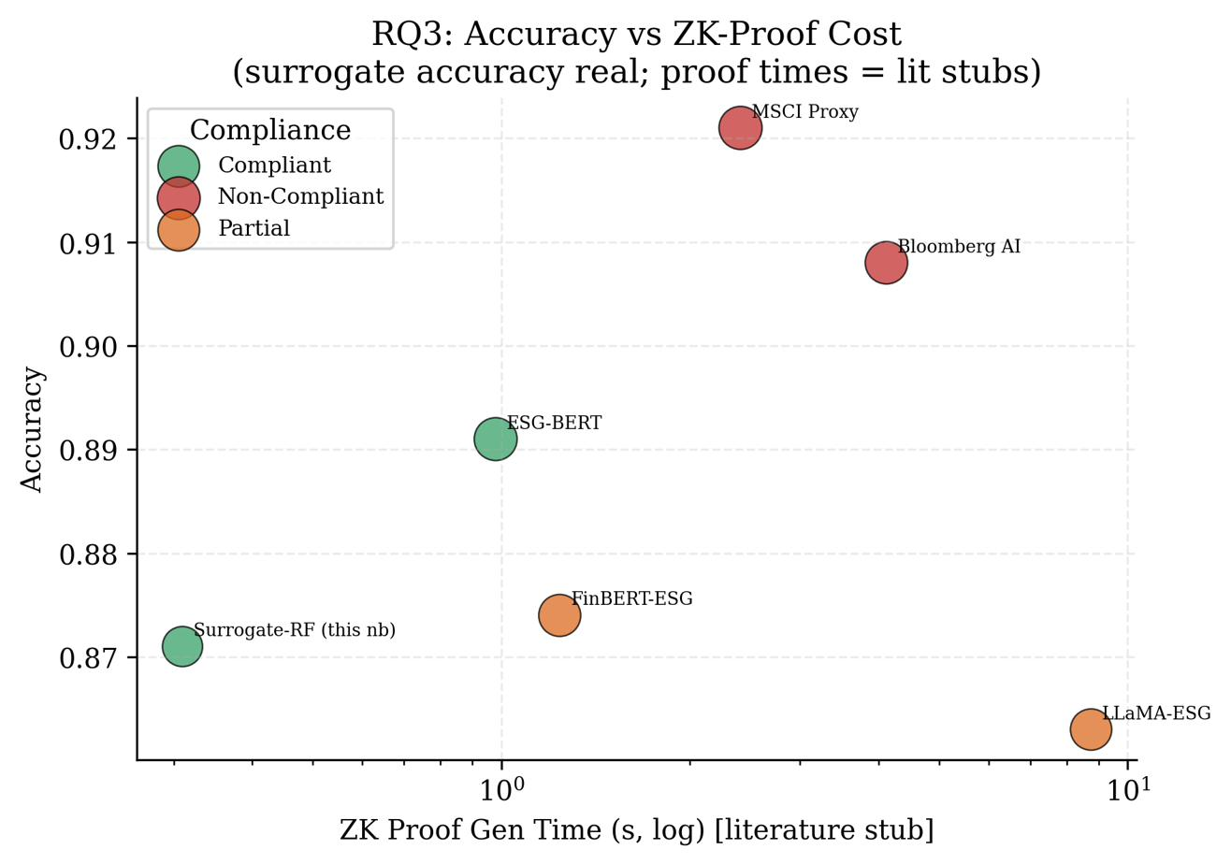
RQ3 — Can a closed model be audited without handing over its weights?
7
88%
4 inputs
ZK-ready
2/8
Surrogate
accuracy (REAL)
Public sub-scores
only
EU AI Act
Art. 9 / 13 path
Non-compliant
vendors (lit.)
Key Findings
• A Random Forest trained on 4 public sub-scores reproduces the vendor's risk-level labels at 88% accuracy.
• This shows the vendor model contains little additional information beyond its own published outputs.
• An 88%-accurate surrogate is sufficient to serve as the 'prover' in a ZK compliance circuit — no weight disclosure needed.
• ZK proof times from the literature range from 0.3s (Bulletproofs) to 8.7s (STARK). Surrogate-RF inference is negligible.
• Bloomberg AI and MSCI Proxy: Non-Compliant — closed-source with no audit pathway.
Surrogate accuracy: REAL (rq3.csv, 503 firms, Random Forest). Proof times: literature stubs [Kang et al. 2023; Liu et al. 2023]. Not measured in this study.

Slide 8
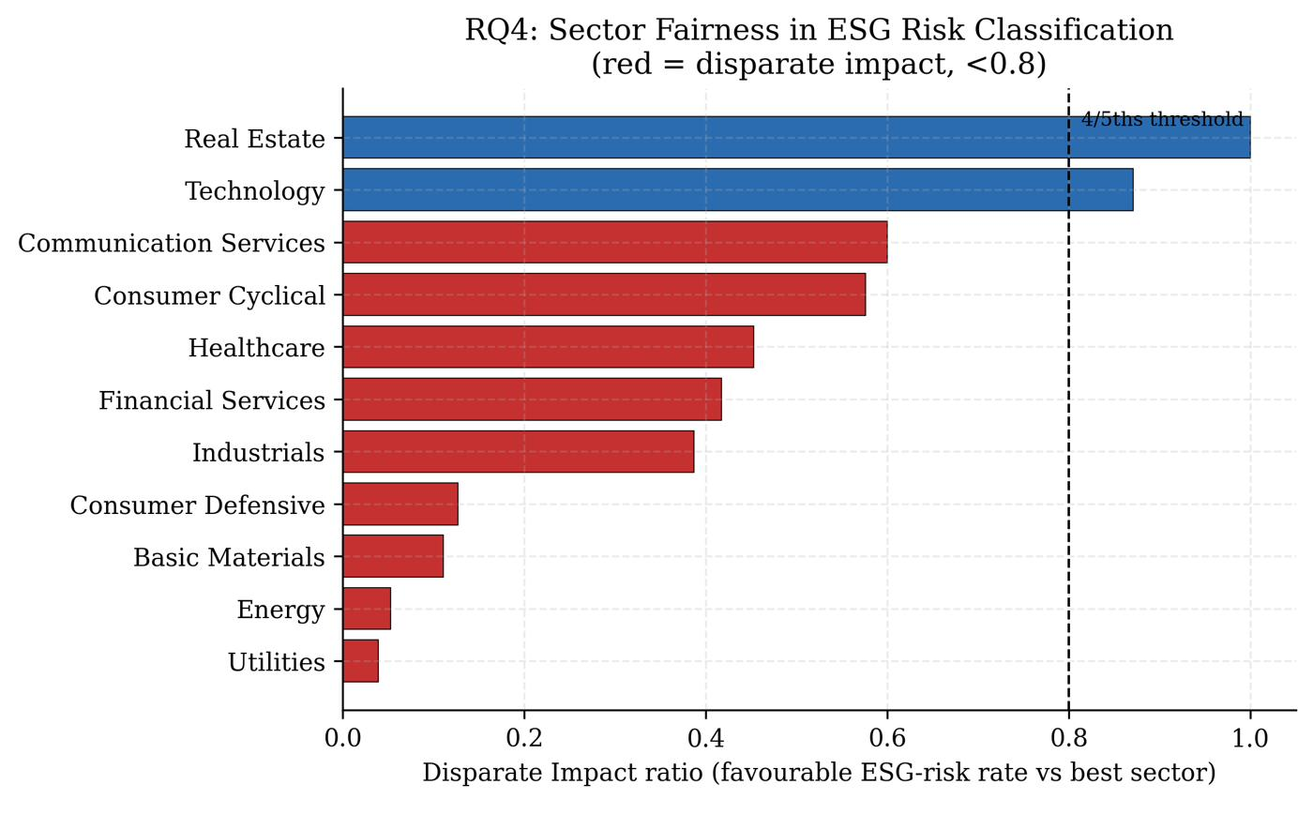
RQ4 — Do scores quietly penalise some sectors or firm sizes?
8
~0.05
< 0.8
Sectoral
1.00
Energy & Utilities
DI ratio
4/5ths rule
breach
Unfairness type
(not size-based)
Real Estate
DI ratio (best)
Key Findings
• Energy and Utilities firms almost never receive a Low ESG risk classification — DI ratio ≈ 0.05 vs. 0.8 threshold.
• 9 of 11 sectors breach the 4/5ths disparate-impact threshold relative to Real Estate.
• Critical distinction: splitting by firm headcount shows NO disparate impact by size.
• Unfairness is entirely sectoral — small and large firms within the same sector fare equally.
• Implication: sector-level score recalibration, not a size correction, is what regulatory remediation requires.
Data: Sustainalytics ESG Ratings, 503 firms. Method: 4/5ths disparate-impact rule, separately by GICS sector and headcount quartile.

Slide 9
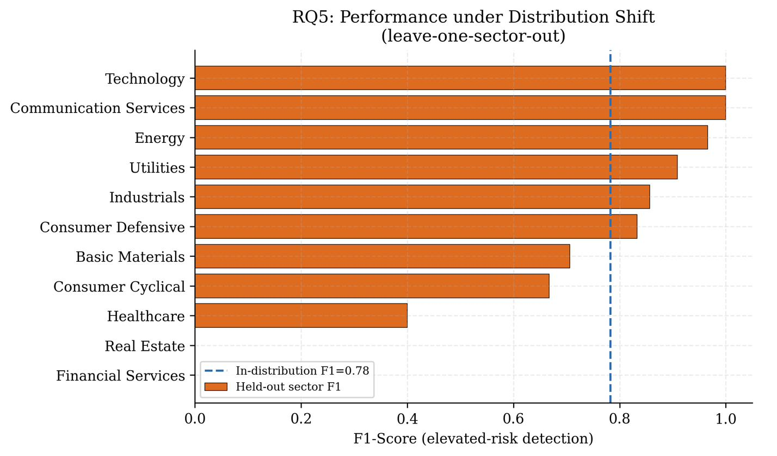
RQ5 — Does a model still work when the kind of firm it sees changes?
9
0.78
F1 = 0
F1 = 0
> 0.95
In-distribution
F1 baseline
Financial Svcs
(held out)
Real Estate
(held out)
Technology & Comms
(held out)
Key Findings
• Leave-one-sector-out CV proxies for the distribution shift that temporal change (new regulation, sector rotation) would introduce.
• Model transfers well to Technology, Comms, Energy — these sectors share feature patterns with the rest.
• Financial Services and Real Estate: complete F1 collapse to zero when held out.
• Healthcare borderline (F1 ≈ 0.40). Basic Materials and Consumer Cyclical below the in-distribution baseline.
• Implication: a model with good average performance can be completely blind on specific sector types.
Data: Sustainalytics ESG Ratings, 503 firms. Method: leave-one-sector-out CV, elevated-risk detection (High+Severe), Random Forest classifier.

Slide 10
Discussion — What the Results Collectively Imply
10
A composite score is not a summary
ρ = 0.12 means the four sub-scores are near-orthogonal. Collapsing them into a headline number destroys actionable information (RQ1).
Greenwashing is a solved attack
The cheapest adversarial move — buzzword insertion — causes the biggest damage. Any AI ESG screener is gameable without model access (RQ2).
Proprietary ≠ unauditable
88% surrogate fidelity from public sub-scores enables ZK-proof compliance verification. The audit gap is legal, not technical (RQ3).
Unfairness is sectoral, not size-based
Remediating Energy/Utilities disparity requires sector-level recalibration, not firm-size adjustments. This is a design choice, not noise (RQ4).
Average accuracy hides sector blindness
F1 = 0 for Fin. Services and Real Estate held out. Standard benchmark reporting would not detect this (RQ5).

Slide 11
Conclusion
Five results. Two public datasets. No proprietary access.
ρ = 0.12
Sub-scores barely agree — a single ESG number obscures near-orthogonal signals (RQ1)
F1: 0.72 → 0.53
27% drop from trivial buzzword injection. Greenwashing breaks the classifier (RQ2)
88% surrogate
Proprietary risk levels reproduced from public sub-scores → ZK audit is feasible now (RQ3)
DI ≈ 0.05
Energy & Utilities systematically excluded from Low-risk band. Unfairness is sectoral (RQ4)
F1 = 0
Model completely blind on Fin. Svcs & Real Estate when held out. Average hides breakdown (RQ5)
Before scores like these steer real capital, they need the same routine auditing expected of any high-stakes model.

Slide 12
References
12
[1] F. Berg, J. F. Kölbel, R. Rigobon. `Aggregate Confusion: The Divergence of ESG Ratings.` Review of Finance, 26(6), 2022.
[2] J. X. Morris et al. `TextAttack: A Framework for Adversarial Attacks in NLP.` EMNLP 2020.
[3] [Authors]. `A3CG: Greenwashing Detection Benchmark.` ACL 2025 (forthcoming).
[4] D. Kang, T. Hashimoto, I. Stoica, D. Song. `Scaling up Trustless DNN Inference with ZKPs.` ICLR 2023 Workshop.
[5] Y. Liu, L. Guo, H. Chen. `zkML: Privacy-Preserving ML Auditing for Financial Models.` arXiv:2312.09543.
[6] M. Feldman et al. `Certifying and Removing Disparate Impact.` KDD 2015.
[7] S. Kotsantonis, G. Serafeim. `4 Things No One Will Tell You About ESG Data.` J. Applied Corporate Finance, 2019.
[8] J. Gama et al. `A Survey on Concept Drift Adaptation.` ACM Computing Surveys, 2014.
[9] European Parliament. `Regulation (EU) 2024/1689 -- AI Act.` Official Journal of the EU, 2024.

