Slide 1

Steganography On Image
Problem Statement : we don’t have any top-secret sharing
data technique
Project Group Number : 09
Group Member Details : Dikshant Kumar Bhatiya (Back-End)
Deepak Kumar (Full-stack)
Daksh Raj singh (Front-End)
Guide Details : Dr. Komal Tahiliani

Slide 2

Idea/Approach Details
Abstract:
Steganography is the art of covered, or hidden, writing. The purpose of steganography is covert communication to hide the existence of a message from a third party
Describe your idea Solution/Prototype here:
⮚ Here we using Steganography
⮚
Steganography is a technique whereby we put the existence of a message to question by simply covering it up within another file image or video.
Describe your Technology stack here:
Steganography is derived from the Greek words staganos and graphein, meaning “covered, concealed, or protected” and “writing,” respectively
Steganography is ideal for concealing top-secret information in precise transporter data.

Slide 3
Project Requirements
functional requirements
non functional requirements
User can Login
New user can set the PIN
User can Encript its OTP in image
User can Decript its OTP by its Encripted Image
Compatibility: The steganographic technique should be compatible with different text formats and support multiple languages.
Capacity: The steganographic technique should have sufficient capacity to embed the entire message within the cover text without significantly altering the original text.
Security: The steganographic technique should provide a high level of security to ensure that the hidden message cannot be detected or accessed by unauthorized persons.

Slide 4
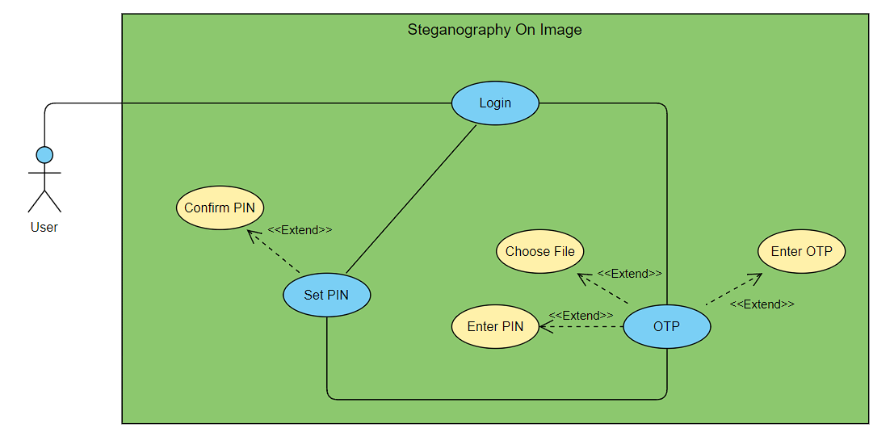
Use Case Diagram

Slide 5
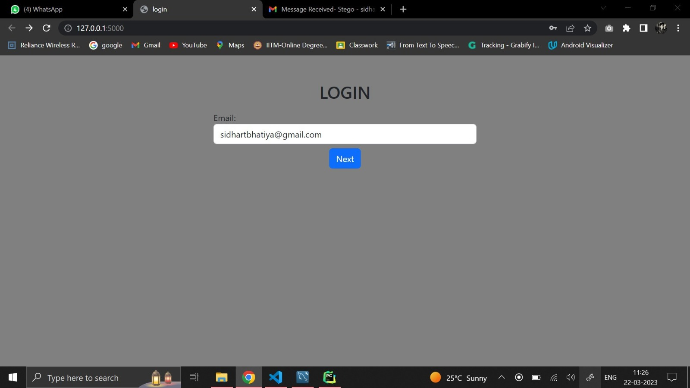
Project Screen shorts - 1

Slide 6
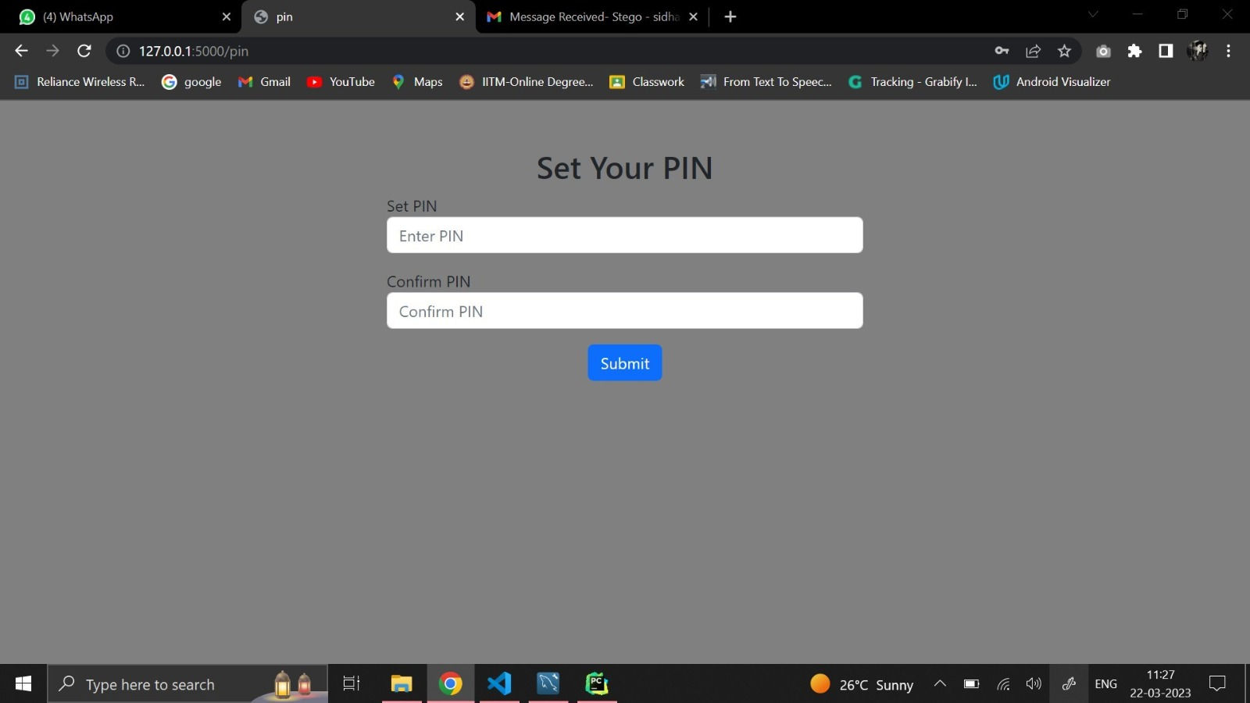
Project Screen shorts - 2

Slide 7
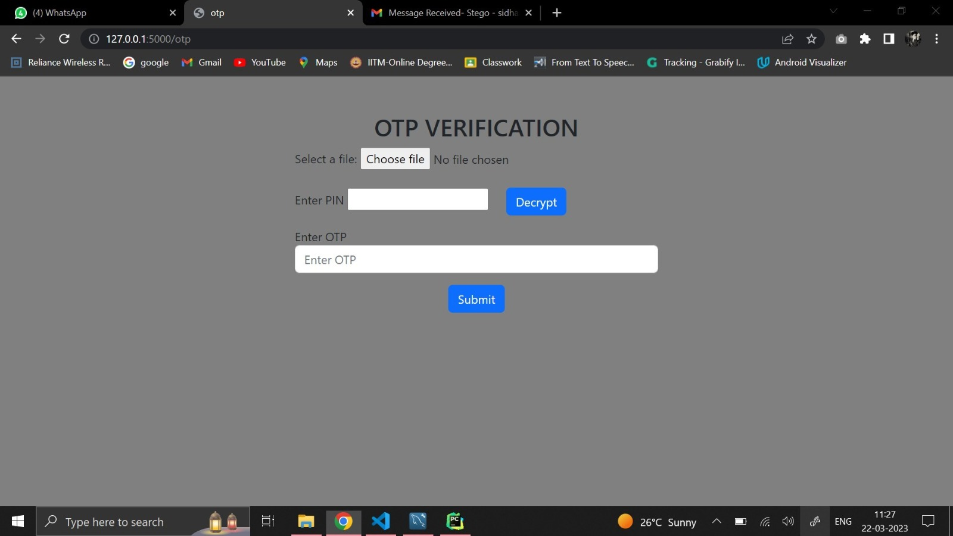
Project Screen shorts - 3

Slide 8
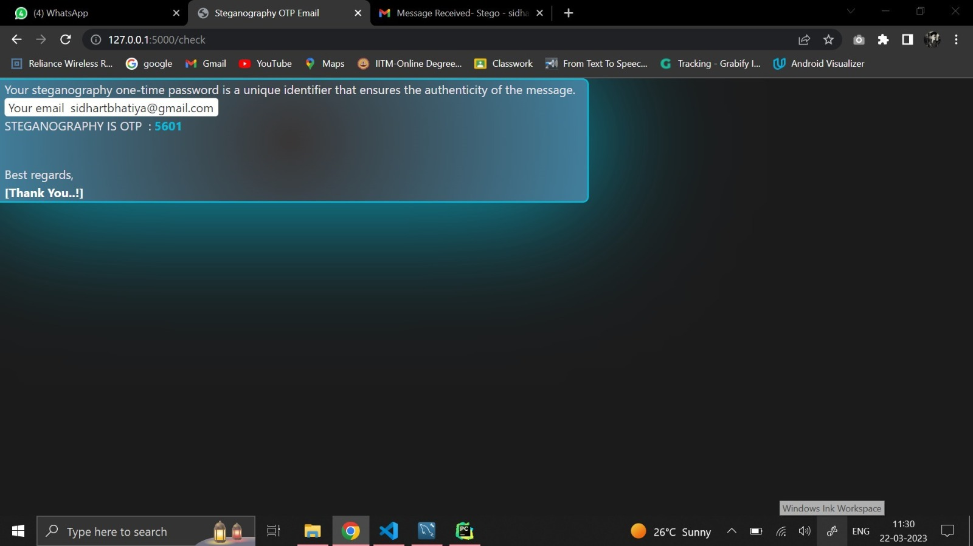
Project Screen shorts - 4

Slide 9


