Slide 1
Unknown Knowledge Mining: An Incremental Fuzzy Approach
Presented to
Dr. Ali Jaoua
By: Md. Abdullah Al Mamun (201610594)
Seeba AbdulKader (sa1606892)
Mays Alshaikhli (200753008)

Slide 2
Outline
Introduction
Database Description
Methodology Adopted
Live Demo
Results
Comparative Analysis
Conclusion

Slide 3
Introduction
Machine learning is discovering knowledge from databases in order to classify new patterns in an efficient way.
Relational database –class labels and attributes
Analyze the data, build a classifier and decides upon the class assignment.(IT-THEN)
Fuzzy set theory used for dealing with imprecise and uncertain data.
Fuzzy incremental production rule (FIPR) system is a rule that generated imprecise and uncertain IF-THEN rules from data record.
Incremental learning aims at enhancement of knowledge.
The aim of our project is to develop self adaptive algorithm, which involves improving performance over time.

Slide 4
Advantages of Fuzzy classifier
Classification behavior can be easily understood by human users (expressed in linguistic forms) by checking carefully the fuzzy if-then rules in the fuzzy classifier.
Nonlinearity in classification, which leads to high generalization ability of fuzzy rule-based classifiers while its classification behavior is linguistically understood.
Notes:
Advantages of fuzzy classifiers are mainly two-folds: First, the classification behavior can be easily understood by human users. This can be done by carefully checking the fuzzy if-then rules in the fuzzy classifier because fuzzy if-then rules are inherently expressed in linguistic forms. Another advantage is nonlinearity in clas- sification. It is well known that non-fuzzy rule-based classi- fiers are difficult to perform non-linear classification because classification boundaries are always parallel to attribute axes in most cases. The nonlinearity of fuzzy classification leads to high generalization ability of fuzzy rule-based classifiers while its classification behavior is linguistically understood.

Slide 5
Database Description
The experiments are done on the IRIS database.
It is 150 records with 3 classes (SENTOSA, VERSICOLOR, VERGINICA)
Each class contains fifty patterns
Each pattern is described by four numerical attributes
( Petal Length, Petal Width, Sepal Length, Sepal Width )
We can use 6 machine learning methods to classify the new coming flower
( PVM, IPR, FIPR, CART, ID3, SIPINA)
Our project implements FIPR .
Comparative analysis was done with new methods
CNN
RNN

Slide 6
Dataset
Train Data = 30 of each
Validate = 10 of each
Test = 10 of each
Petal Length | Petal Width | Flower Name
1.4 | 0.2 | I. Setosa
4 | 1 | I. Versicolor
6.6 | 2.1 | I. Verginica

Slide 7
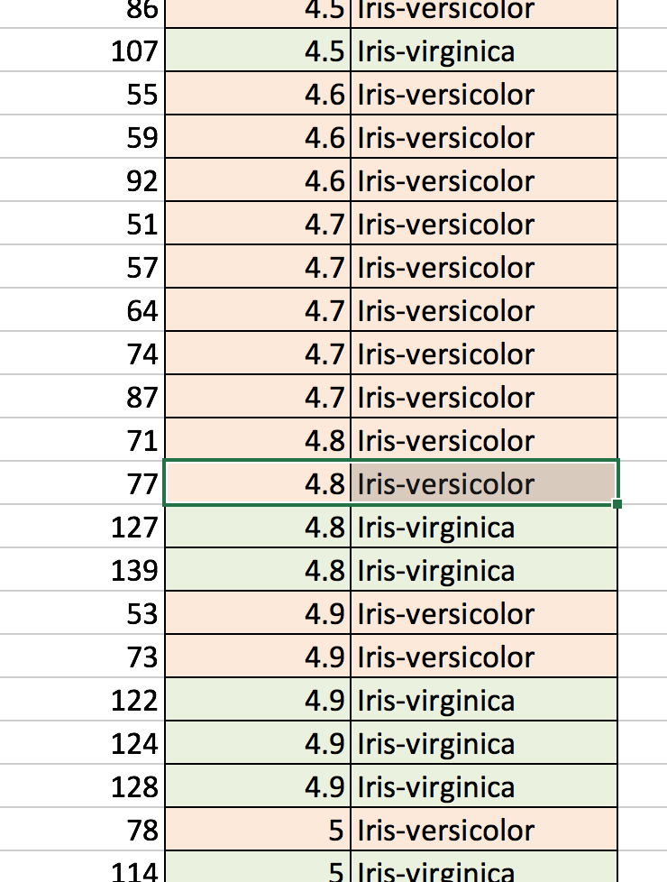
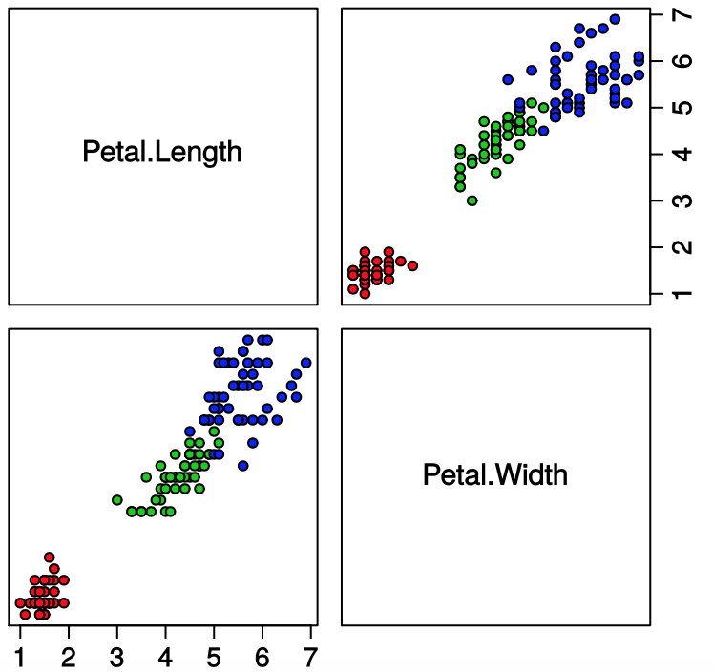
Classification

Slide 8
Methodology
Fuzzification.
Membership function: Petal Length
Alpha cut = 0.15
Variables
Input: low, medium, high
Output: C1, C2, C3

Slide 9
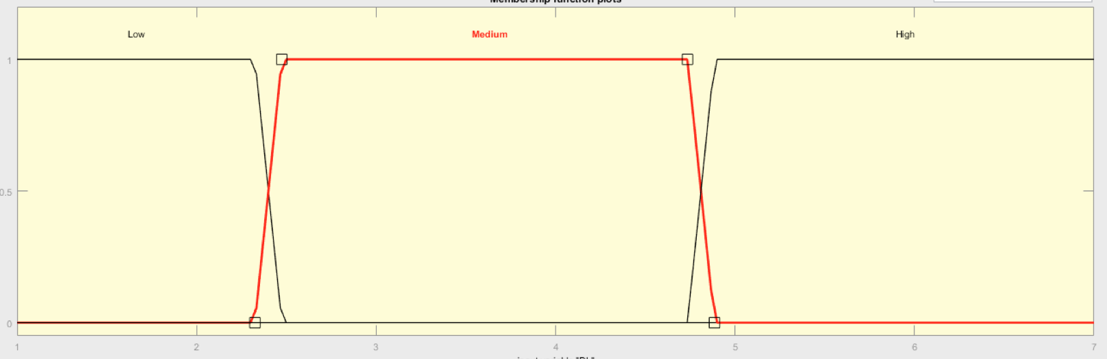
Fuzzification
Step 1: Linguistic representation
Petal Length | Class
1.5 | C1
4.4 | C2
4.8 | C2
5.7 | C3
6.1 | C3
PL | pl1 | pl2 | pl3 | C
1.5 | 1 | 0 | 0 | C1
4.4 | 0 | 1 | 0 | C2
4.8 | 0 | 0.86 | 0.14 | C2
5.7 | 0 | 0 | 1 | C3
6.1 | 0 | 0 | 1 | C3
Notes:
In the FIPR system, we allow the user to choose and define the appropriate membership functions for each variable. Then, these membership functions are used to transform the relational database into a fuzzy binary relation R. In Fig. 3, we illustrate the fuzzification of a relation containing five flowers and two variables: petal length ., the system replaces the value: "petal length of o2 equals 46 mm", by the expression "02 has a medium petal length with a degree of 0.75 and a high petal length with a degree of 0.25" (Fig. 3). The linguistic representation module is a data pre-processing step that handled by the knowledge discovery module.

Slide 10
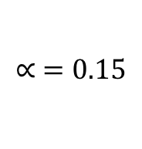
Step 2: Rectangular Decomposition of a Fuzzy Binary Relation
Fuzzyfication
Obj | pl1 | pl2 | pl3 | C
O1 | 1 | 0 | 0 | C1
O2 | 0 | 1 | 0 | C2
O3 | 0 | 0.86 | 0.14 | C2
O4 | 0 | 0 | 1 | C3
O5 | 0 | 0 | 1 | C3
Obj | pl1 | pl2 | pl3 | C
O1 | 1 | 0 | 0 | C1
O2 | 0 | 1 | 0 | C2
O3 | 0 | 1 | 0 | C2
O4 | 0 | 0 | 1 | C3
O5 | 0 | 0 | 1 | C3
$$∝ =0.15$$
RE2: {(O2,O3),(pl2)}
RE3:
{(O4,O5),(pl3)}
RE1: {(O1),(pl1)}
O2*
*pl2
O3*
O4*
*pl3
O5*
O1* *Pl1
Minimal coverage of R$∝$($∝$=0.15): C_{v} ={RE1,RE2,RE3}
Notes:
the rectangular decomposition of a fuzzy binary relation is illustrated. First, the a-cut ( = 0.13) of the fuzzy relation is generated to obtain a crisp binary one. Then, its minimal coverage is looked for. This minimal coverage is formed by three optimal rectangles.

Slide 11
Step 3: Incremental Learning
Fuzzyfication
Object | PL
6 | 5.2
Object | pl1 | pl2 | pl3 | C
6 | 0 | 0 | 1 | C3
RE3:
{(O4,O5,O6),(pl3)}
O4*
O5* *pl3
O6*
Notes:
incrementation step of the rectangular decomposition algorithm. The system generates the new coverage using the new coming object. It fuzzifies its values, looks for the rectangle that should be maintained (RE3), and updates it.

Slide 12
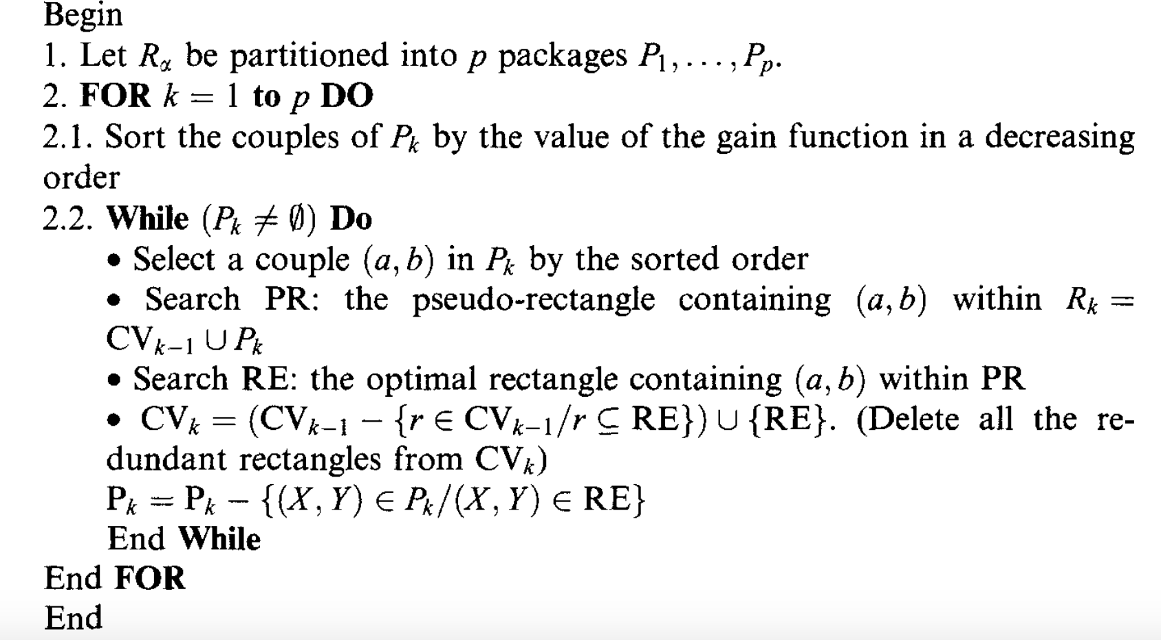
Algorithm
asdfsafd

Slide 13
Demonstration
Live Demo
Versicolor
PL | PW
53 | 78
73 | 71
78
84
Virginica
PL | PW
107 | 135
127 | 120
139 | 134
 | 130
 | 107

Slide 14
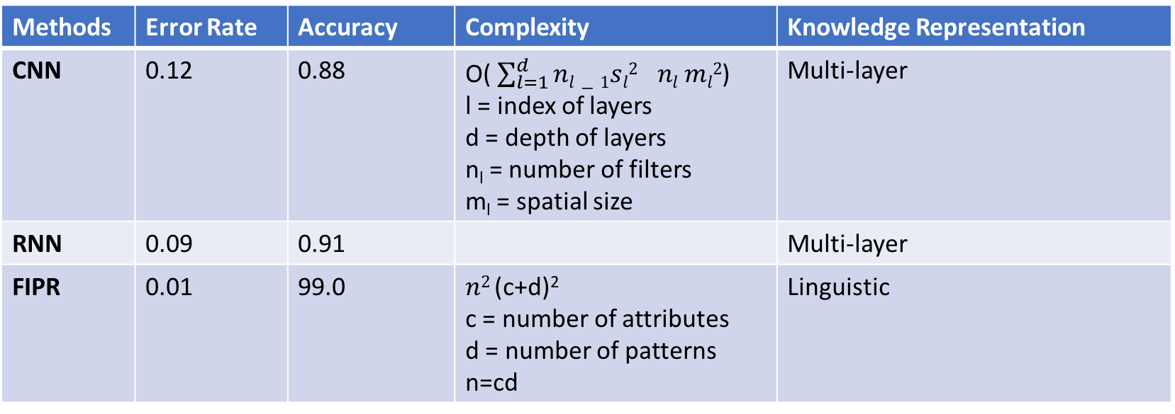
Results and Discussion
Methods | Error Rate | Accuracy | Complexity | Knowledge Representation
CNN | 0.12 | 0.88 | O( $\sum_{l=1}^{d}{nl−1{sl2}^{}nl ml2}$) l = index of layers d = depth of layers n_{l} = number of filters m_{l} = spatial size | Multi-layer
RNN | 0.09 | 0.91 |  | Multi-layer
FIPR | 0.01 | 99.0 | $n2$ (c+d)² c = number of attributes d = number of patterns n=cd | Linguistic
Notes:
e present the rules associated to the rectangles of R. The antecedent part of a rule contains fuzzy propositions related by the logical connectors "AND" and "OR". The consequent part of a rule is a single nonfuzzy proposition expressing the assignment of a class label.
So, we have dealt with fuzziness expressed by the extraction of rules invok- ing linguistic values and logical connectors. Uncertainty occurs when one is not absolutely certain about a piece of information. The degree of certainty is usu- ally represented by a numerical value, e.g. for the proposition "the petal length is medium" (CF = 0.75), the certainty factor is 0.75 [8,15,22]. The uncertainty of a rule expresses its reliability. It is calculated as the appearance frequency of the class label. Remember that the class of a rectangle is chosen as the most frequently one from those matching the patterns of the rectangle domain. In Fig. 4, the rectangle RE2, associated with the class C2, contains three flowers (o2 E C2, o4 E C2 and o6 E C1). So, the certainty factor of the second rule is 2/ 3 = 0.66.

Slide 15
Conclusion
Classifications of new objects are done using FIPR, the accuracy approved a lot when compared to other methods, the time complexity proves that it’s with acceptable in compared to existing systems.
The FIPR maintain the knowledge base with minimal overhead.
The rule that extracted from the databases with FIPR system handles imprecise and uncertain IF-THEN rules in a linguistic terms.

