Slide 1
Femtocell Cluster-based Resource Allocation Scheme for OFDMA Networks
Abdullah Al Mamun – 201403680
Feras M. Areef – 201406520
Lawani Abdolaye – 201403220

Slide 2
Introduction
Recently, operators have resorted to femtocell networks in order to enhance indoor coverage and quality of service since macro-antennas fail to reach these objectives. Nevertheless, they are confronted to many challenges to make a success of femtocells deployment.
In this paper, we address the issue of resources allocation in femtocell networks using OFDMA technology (e.g., WiMAX, LTE)

Slide 3
Objective and Solution
Our objective is to associate the best spectrum set of frequency/time resources with each FAP in order to deliver the users data, while minimizing the gap between the required and allocated tiles and at the same time minimizing interference between FAPs.
To achieve this, we formulate the resource allocation as a Min-Max optimization problem and propose a hybrid centralized/distributed scheme, namely FCRA, involving three main phases:
(i) Cluster formation
(ii) Cluster-head resource allocation

Slide 4
Literature Review
In [5], the authors proposed three resource allocation algorithms in OFDMA femtocells. The objective was to avoid interference between femtocells and macrocells in order to maximize the global network throughput.
The authors in [6] proposed a distributed resource allocation algorithm namely Distributed Random Access ( DRA), which is more appropriate for medium-wide networks.
In [4], the authors proposed a fully distributed and scalable algorithm for interference management in LTE-Advanced environments.
In [7], the authors propose a decentralized F-ALOHA spectrum allocation strategy for two-tier cellular networks.

Slide 5
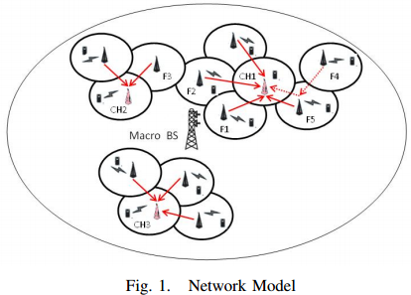
Network Model
Note:
1. Downlink Communication
2. Interference between mac/femto users.
3. Max. Th within mac/fem
4. Optimal Resource alloc for Femto.

Slide 6
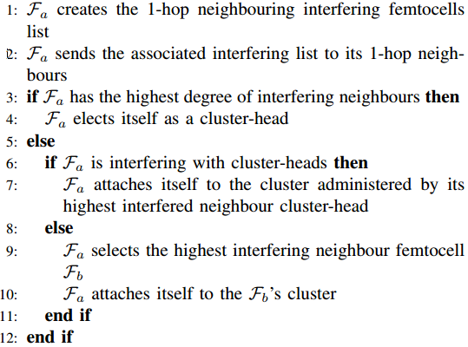
Cluster Formation

Slide 7
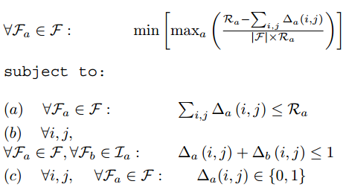
Femtocell Resource Allocation
Note:
F_{a} – Femtocell
R_{a} – Number of required resource
∆_{a}(i,j) – Location of allocated resource in allocation matrix.
F – Total number of femtocell
I_{a} – Interfarence matrix for each F_{a}
V_{a} = demand of e ach users belongs to a femtocell
n_{a} = Total number of user belongs to a femtocell

Slide 8
Experimental Setup
Sl no | Tools | Objective
1 | MatLab R2013b | Distribute FAPs, Cluster formation, Result Analysis
2 | MatLab Winner Library [4] | Path loss model
3 | IBM ILOG Cplex 12.6 | Resource Allocation Optimization
Table: Used tools and softwares

Slide 9
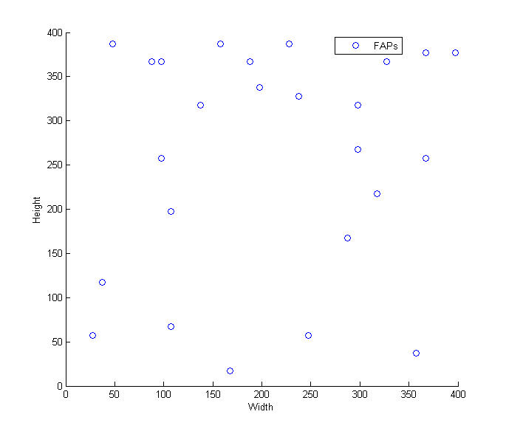
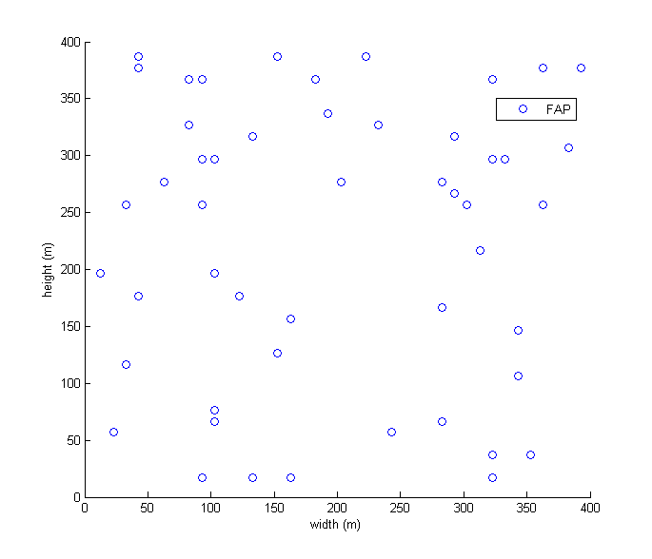
Exp. Setup - Cluster Formation
Fig: FAPs Distribution
Note:
Total Area – 400m × 400m
Each FAPs area – 10m × 10m
Number of FAPs – 25 and 50
Funtions - randperm();

Slide 10
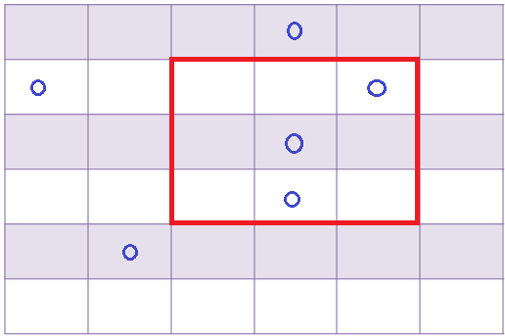
Exp. Setup - Cluster Formation(2)
Boundary Condition for calculating list of one hop neighbor –
xLower = {floor(x/10) × 10} – 10
xUpper = {Ceil(x/10) × 10} + 10
Similarly yLower and yUpper.
A FAPs is one hop neighbor, those satisfy following condition
(x>=xLower && x<=xUpper && y>=yLower && y<= yUpper)

Slide 11
Exp. Setup - Cluster Formation(3)
FAPSs Id | Number of Interfering Femtocell | Distance
8 | 1 | 10
14 | 1 | 10
17 | 1 | 10
38 | 1 | 10
42 | 1 | 10
45 | 1 | 10
All | 0 | 0
Path loss = 20 log₁₀ (d)
+ 46.4 + 20 log₁₀ (f_{c}/5.0)
d – distance
fc – frequency
Threshold SINR = 10dB
Table (2) : List of one hop neighbor

Slide 12
Exp. Setup – Resource Allocation
PC Configuration
Core i3 2.4GHz, 4GB RAM, 64bit OS(Win7)
Max. number of user per FAP = 4
Resource demand per femto V_{a}, (0<=V_{a} <= 25)
Input –
Number of femtocells = 25;
Number of Resources = 36; (6x6)
Demand[femtocell] = [10 9 3 2 16 4 5 6 7 8 9 11 13 4 5 2 3 12 14 10 9 8 7 6 5];

Slide 13
Exp. Setup – Resource Allocation (2)
Out put
Allocation[femtocell][tiles] =
[[0 0 0 0 0 0 0 0 0 0 0 0 0 1 0 0 0 0 0 0 0 0 0 0 0 1 0 0 0 0 0 0 0 0 0 0]
[0 0 0 0 1 0 0 0 0 0 0 0 0 0 0 0 0 0 0 0 1 0 0 0 0 0 0 0 0 0 0 0 0 0 0 0]
[0 0 0 0 0 0 0 0 0 0 0 0 0 0 0 0 0 0 0 0 0 0 0 1 0 0 0 0 0 0 0 0 0 0 0 0]
[0 0 0 0 0 0 0 0 0 0 0 0 0 0 0 0 0 0 0 0 0 0 0 0 0 0 0 1 0 0 0 0 0 0 0 0]
[1 0 0 0 0 0 0 0 0 0 0 0 0 0 0 0 0 0 0 0 0 0 0 0 0 0 0 0 0 0 0 0 0 0 1 0]
[0 0 0 0 0 0 0 0 0 0 0 0 1 0 0 0 0 0 0 0 0 0 0 0 0 0 0 0 0 0 0 0 0 0 0 0]
[0 0 0 0 0 0 0 0 0 1 0 0 0 0 0 0 0 0 0 0 0 0 0 0 0 0 0 0 0 0 0 0 0 0 0 0]
[0 0 0 0 0 0 0 0 0 0 0 0 0 0 0 0 0 0 0 0 0 0 0 0 0 0 0 0 0 0 0 1 0 0 0 0]
[0 0 0 0 0 0 0 0 0 0 1 0 0 0 0 0 0 0 0 0 0 0 0 0 0 0 0 0 0 0 0 0 0 0 0 0]
[0 0 0 0 0 0 0 1 0 0 0 0 0 0 0 0 0 0 0 0 0 1 0 0 0 0 0 0 0 0 0 0 0 0 0 0]
[0 0 0 1 0 0 0 0 0 0 0 0 0 0 0 0 0 0 0 0 0 0 0 0 0 0 0 0 0 1 0 0 0 0 0 0]
[0 0 0 0 0 1 0 0 0 0 0 0 0 0 0 0 0 0 0 0 0 0 0 0 0 0 0 0 0 0 0 0 0 0 0 1]
[0 0 0 0 0 0 0 0 0 0 0 0 0 0 1 0 1 0 0 0 0 0 0 0 0 0 0 0 0 0 0 0 0 0 0 0]
[0 0 0 0 0 0 0 0 0 0 0 0 0 0 0 0 0 0 0 0 0 0 0 0 0 0 1 0 0 0 0 0 0 0 0 0]
[0 0 0 0 0 0 0 0 0 0 0 0 0 0 0 0 0 1 0 0 0 0 0 0 0 0 0 0 0 0 0 0 0 0 0 0]
[0 0 0 0 0 0 0 0 0 0 0 0 0 0 0 0 0 0 0 0 0 0 0 0 0 0 0 0 1 0 0 0 0 0 0 0]
[0 0 0 0 0 0 0 0 0 0 0 0 0 0 0 0 0 0 0 0 0 0 1 0 0 0 0 0 0 0 0 0 0 0 0 0]
[0 0 1 0 0 0 1 0 0 0 0 0 0 0 0 0 0 0 0 0 0 0 0 0 0 0 0 0 0 0 0 0 0 0 0 0]
[0 0 0 0 0 0 0 0 1 0 0 0 0 0 0 0 0 0 0 1 0 0 0 0 0 0 0 0 0 0 0 0 0 0 0 0]
[0 0 0 0 0 0 0 0 0 0 0 0 0 0 0 0 0 0 0 0 0 0 0 0 0 0 0 0 0 0 1 0 0 1 0 0]
[0 1 0 0 0 0 0 0 0 0 0 1 0 0 0 0 0 0 0 0 0 0 0 0 0 0 0 0 0 0 0 0 0 0 0 0]
[0 0 0 0 0 0 0 0 0 0 0 0 0 0 0 0 0 0 0 0 0 0 0 0 0 0 0 0 0 0 0 0 1 0 0 0]
[0 0 0 0 0 0 0 0 0 0 0 0 0 0 0 0 0 0 1 0 0 0 0 0 0 0 0 0 0 0 0 0 0 0 0 0]
[0 0 0 0 0 0 0 0 0 0 0 0 0 0 0 1 0 0 0 0 0 0 0 0 0 0 0 0 0 0 0 0 0 0 0 0]
[0 0 0 0 0 0 0 0 0 0 0 0 0 0 0 0 0 0 0 0 0 0 0 0 1 0 0 0 0 0 0 0 0 0 0 0]
];

Slide 14



Result & Analysis - Formula
Throughput Satisfaction Rate (TSR)
Spectrum Spatial Reuse ( SSR)

Slide 15
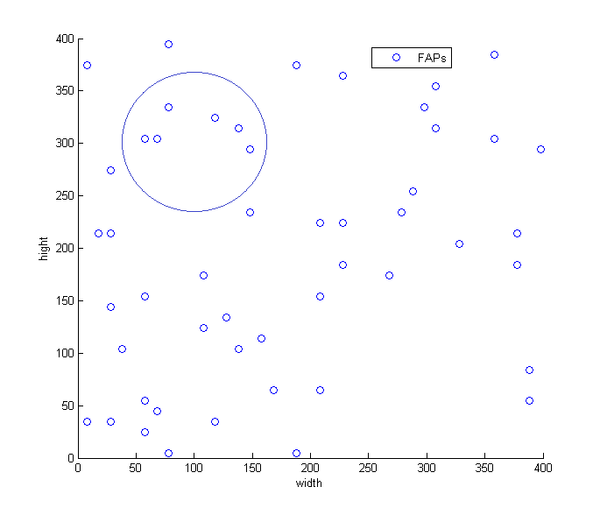
Result & Analysis – Cluster
Fig (3): FAPs Cluster

Slide 16
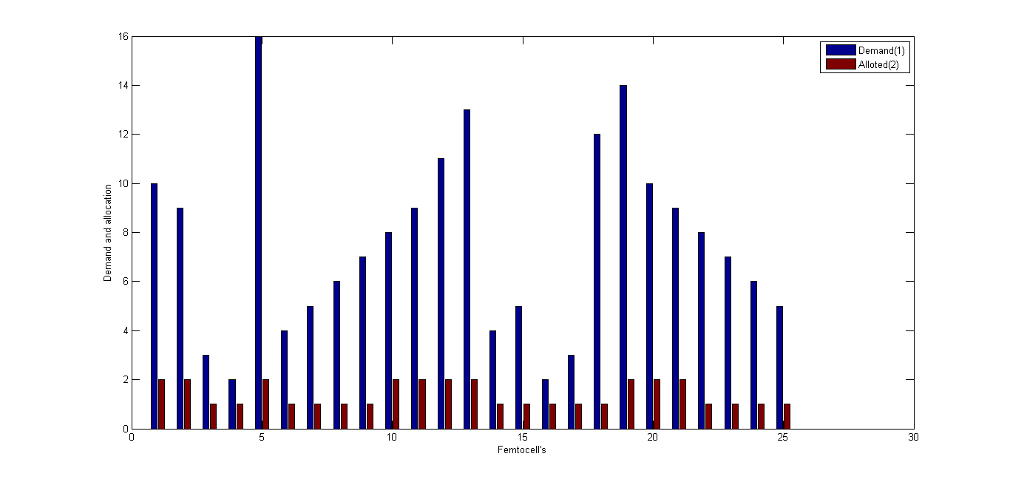
Result & Analysis – Resource Allocation
Fig(4): Demand Vs Allocation

Slide 17
Result & Analysis – Resource Allocation (2)
Title | Value
Total Demand | 188
Total Allocation (36) | 35
TSR | 22%
SSR | 3.8%
Computational Time | 280 ms
Best Bound | 0.8623
Table (3) : Result of optimized resource allocation

Slide 18
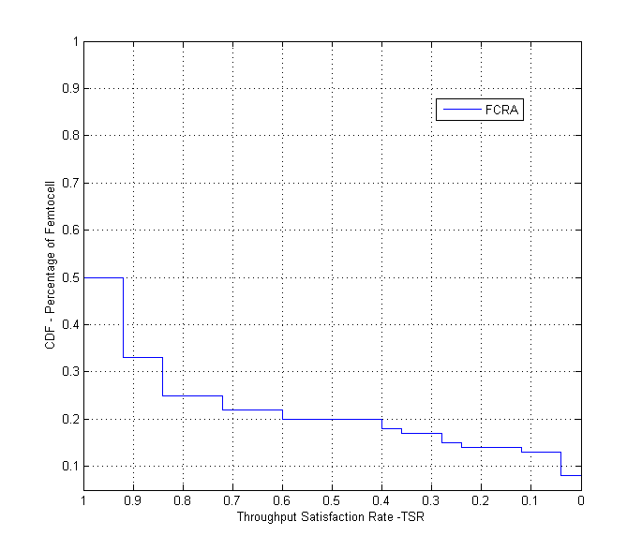
Result & Analysis – Resource Allocation (2)
Fig(4): TSR when SINR = 10dB

Slide 19
Conclusion and Future work
In this paper, we studied the resource allocation problem in OFDMA-based femtocell networks and proposed a new allocation scheme called Femtocell Cluster-based Resource Allocation (FCRA). FCRA is based on a hybrid centralized/distributed approach and involves three main phases: (i) Construction of disjoint clusters; (ii) Optimal cluster-head resource allocation by resolving a Min-Max optimization problem; The results concern the throughput satisfaction rate, the spectrum spatial reuse.
In the future, we plan to compare results with Centralized Optimal (C-DFA) and Distributed resource allocation (DRA) methods.

Slide 20
Acknowledgement & References
[1] A. Brydon and M. Heath, “Wireless network traffic 20082015: forecasts and analysis,” Analysys Mason - [Online], 2009. [2] Northstream, “Uma paves the way for convergence,” 2005. [3] V. Chandrasekhar, J. Andrews, and A. Gatherer, “Femtocell networks: a survey,” IEEE Comm. Magazine, vol. 46, 2008. [4] L. G. U. Garcia, K. l. Pedersen, and P. E. Mogensen, “Autonomous component carrier selection: Interference management in local area environments for lte-advanced,” IEEE Comm. Magazine, vol. 47, 2009. [5] D. Lopez-Perez, A. Valcarce, G. de la Roche, and J. Zhang, “Ofdma femtocells: A roadmap on interference avoidance,” IEEE Comm. Magazine, 2009. [6] K. Sundaresan and S. Rangarajan, “Efficient resource management in ofdma femto cells,” International Symposium on Mobile Ad Hoc Netw o r k i n g & C o m p u t i n g ( M o b i h o c ), 2009. [7] V. Chandrasekhar and J. Andrews, “Spectrum allocation in tiered cellular networks,” IEEE Trans. on Communications, 2009. [8] A. B. McDonald and T. F. Znati, “A mobility-based framework for adaptive clustering in wireless ad hoc networks,” IEEE J. Select. Areas C o m m u n ., vol. 17, no. 8, August 1999. [9] S. B. et al., “Localized protocols for ad hoc clustering and backbone formation: a performance comparison,” I E E E Tra n s . o n Pa ra l l e l a n d Distribu ted Systems, vol. 17, no. 4, April 2006. [10] A. Antis, R. Prakash, T. Vuong, and D. Huynh, “Max-min d-cluster formation in wireless ad-hoc networks,” IEEE INFOCOM, 2000. [11] S. Banerjee and S. Khuller, “A clustering scheme for hierarchical control in multi-hop wireless networks,” IEEE INFOCOM, 2001. [12] N. Bouabdallah, R. Langar, and R. Boutaba, “Design and analysis of mobility-aware clustering algorithms for wireless mesh networks,” IEEE/ACM Transactions on Networking, vol. 18, no. 6, pp. 1677–1690, December 2010. [13] B. Aoun, R. Boutaba, and Y. Iraqi, “Gateway placement optimization inwmnwith qos constraints,” IEEE Journal on Selected Areas in Communications (JSAC), Special Issue on Multi-hop Wireless Mesh Networks, vol. 24, pp. 2127–2136, 2006. [14] D. WINNER II, “Winner II channel models part I- channel models,” Te ch . R e p ., Sept. 2007. [15] H. Aissi, C. Bazgan, and D. Vanderpooten, “Complexity of the min-max and min-max regret assignment problems,” Operations research letters, 2005. [16] http://www.ilog.com/products/cplex/.

Slide 21
?
☺

